Slide 1
🐍 Python Drawing
Lesson slides: 9 challenges
Pythonで おえかき
Notes:
[About these slides]
Lesson slides for Python Drawing (python-draw.html). Each challenge has 3 slides: Task → Hint → Answer.
The slides use simple words for students; notes for teachers are here in the notes area.
Show the Answer slide only after students have tried.

Slide 2
What you will learn
🐍
Loops
Angles
Challenge 1, 2, 3, 4, 5, 6, 8, 9
Challenge 1, 2, 3, 5
Drawing with Python. Write numbers inside () like forward(80) and right(60), and use variables (for i in range(10, 201, 10):) and math (360 / n) to match the model.
Python syntax (colon & indent)
Nesting
Challenge 1, 2, 3, 4, 5, 6, 7, 8, 9
Challenge 4, 5, 7
Variables
Math
Challenge 6, 7, 9
Challenge 7, 9
Notes:
[Lesson aims]
Drawing with Python. Write numbers inside () like forward(80) and right(60), and use variables (for i in range(10, 201, 10):) and math (360 / n) to match the model.
[Concepts and challenges]
・Loops: Challenge 1, 2, 3, 4, 5, 6, 8, 9
・Angles: Challenge 1, 2, 3, 5
・Python syntax (colon & indent): Challenge 1, 2, 3, 4, 5, 6, 7, 8, 9
・Nesting: Challenge 4, 5, 7
・Variables: Challenge 6, 7, 9
・Math: Challenge 7, 9
・Sequence: Challenge 8
・Decomposition: Challenge 8

Slide 3
How to use
🧩
🐍
▶
🔎
1. Start with blocks
2. Write Python
3. Run it
4. Read errors
Build with “🧩 Blocks” and the same program appears below in Python.
Write it yourself in the “🐍 Python” tab. Command buttons and Tab (4 spaces) help.
Press “▶ Run”. The line that is running turns yellow.
Errors show a line number. Look at the red line and fix it.
Notes:
[Opening]
Add “python-draw.html” to the end of your published address.
You can also open it from the block app with “⚙ Settings → 🐍 Switch to Python” (it opens in Python mode).
[Teacher mode]
Add “?sensei” to the address to show the “📖 Answer” button and load answers (e.g. python-draw.html?sensei).
[Next player]
When students share a device, press “⚙ Settings → 🔄 Next player” twice to reset the records.

Slide 4
Blocks and Python
Block | Python
move forward 〇 / move back 〇 | forward(〇) ／ back(〇)
turn right 〇 / turn left 〇 | right(〇) ／ left(〇)
pen color / pen size | pen_color('red') ／ pen_width(〇)
repeat 〇 times | for i in range(〇):
count with i from 10 to 200 by 10 | for i in range(10, 201, 10):
math (+ − × ÷) | 360 / n ・ i * 4
Rules: numbers inside (), “:” at the end, indent lines inside by 4 spaces
Notes:
[Key point]
One block becomes one line of Python. An “if” alone inside “else” becomes elif in Python.
[Common errors]
- Missing “:” → SyntaxError
- Wrong indentation → IndentationError
- Missing “()” / misspelled name → SyntaxError / NameError
Errors show the line number, so look at that line together.
[Python drawing]
The “end” of range(start, end, step) is not included (range(10, 201, 10) gives 10 to 200). Use / to divide and * to multiply.

Slide 5
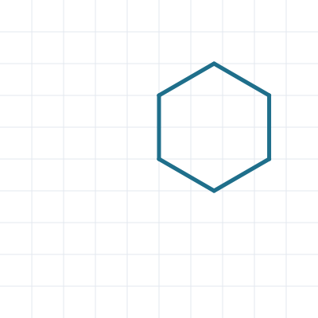
① Hexagon ★
🎯 Goal
Draw a regular polygon with for
📝 Challenge
forward(80) moves 80 steps and right(60) turns 60 degrees. Repeat them 6 times to draw a hexagon.
Notes:
[Goal] Draw a regular polygon with for
[Concepts] Loops / Angles / Python syntax (colon & indent)
[How to start]
Look at the model shape and check the number of corners and the turning angle together before starting.
[Task] forward(80) moves 80 steps and right(60) turns 60 degrees. Repeat them 6 times to draw a hexagon.

Slide 6
① Hexagon ★ Hint
💡
How to think
Put forward(80) and right(60) inside for i in range(6):. 360 ÷ 6 = 60
Notes:
[Questions to ask]
- “How many corners are there?”
- “Is there a set of moves that repeats?”
- “Run it and see where it stops.”
[Common mistake]
If right(60) is not indented, it turns only once and draws a straight line.

Slide 7
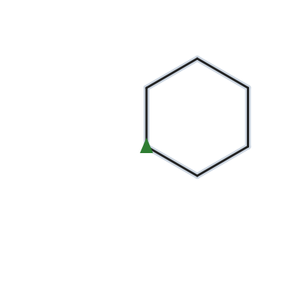
① Hexagon ★ Answer
1 for i in range(6):
2 forward(80)
3 right(60)
🎉 Clear!
✨ Key point
Write numbers inside forward() and right(). The 2 lines inside for repeat 6 times.
Notes:
[Key point] Write numbers inside forward() and right(). The 2 lines inside for repeat 6 times.
[Common mistake] If right(60) is not indented, it turns only once and draws a straight line.
[Answer code]
for i in range(6):
forward(80)
right(60)
[Video] videos/en/pydraw-01.mp4 (also on the videos page, videos.html)
[Check in the app] Open python-draw.html?sensei, choose challenge 1, then “📖 Answer” → “▶ Run”.

Slide 8
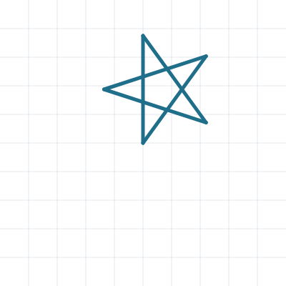
② Star ★★
🎯 Goal
Think about turning around twice
📝 Challenge
Draw a star with lines of 150 steps: repeat forward(150) and right(144) 5 times.
Notes:
[Goal] Think about turning around twice
[Concepts] Loops / Angles / Python syntax (colon & indent)
[How to start]
Look at the model shape and check the number of corners and the turning angle together before starting.
[Task] Draw a star with lines of 150 steps: repeat forward(150) and right(144) 5 times.

Slide 9
② Star ★★ Hint
💡
How to think
The turtle turns around twice (720 degrees). 720 ÷ 5 = 144
Notes:
[Questions to ask]
- “How many corners are there?”
- “Is there a set of moves that repeats?”
- “Run it and see where it stops.”
[Common mistake]
right(72) (360 ÷ 5) makes a pentagon, not a star.

Slide 10
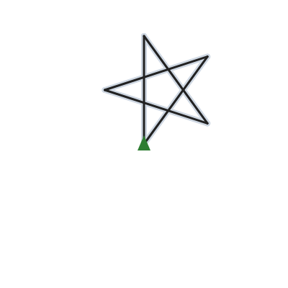
② Star ★★ Answer
1 for i in range(5):
2 forward(150)
3 right(144)
🎉 Clear!
✨ Key point
5 turns make 720 degrees (twice around), so each turn is 720 ÷ 5 = 144.
Notes:
[Key point] 5 turns make 720 degrees (twice around), so each turn is 720 ÷ 5 = 144.
[Common mistake] right(72) (360 ÷ 5) makes a pentagon, not a star.
[Answer code]
for i in range(5):
forward(150)
right(144)
[Video] videos/en/pydraw-02.mp4 (also on the videos page, videos.html)
[Check in the app] Open python-draw.html?sensei, choose challenge 2, then “📖 Answer” → “▶ Run”.

Slide 11
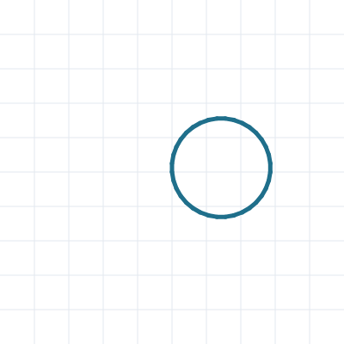
③ Circle ★★
🎯 Goal
Make a circle from short lines
📝 Challenge
Draw a circle by repeating forward(10) and right(10).
Notes:
[Goal] Make a circle from short lines
[Concepts] Loops / Angles / Python syntax (colon & indent)
[How to start]
Look at the model shape and check the number of corners and the turning angle together before starting.
[Task] Draw a circle by repeating forward(10) and right(10).

Slide 12
③ Circle ★★ Hint
💡
How to think
One full turn is 360 degrees. 360 ÷ 10 = 36, so use range(36).
Notes:
[Questions to ask]
- “How many corners are there?”
- “Is there a set of moves that repeats?”
- “Run it and see where it stops.”
[Common mistake]
range(35) leaves a small gap. Check 360 ÷ 10 = 36.

Slide 13
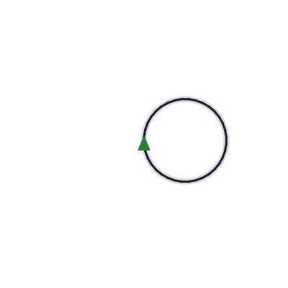
③ Circle ★★ Answer
1 for i in range(36):
2 forward(10)
3 right(10)
🎉 Clear!
✨ Key point
36 turns of 10 degrees make 360. Many short lines look like a circle.
Notes:
[Key point] 36 turns of 10 degrees make 360. Many short lines look like a circle.
[Common mistake] range(35) leaves a small gap. Check 360 ÷ 10 = 36.
[Answer code]
for i in range(36):
forward(10)
right(10)
[Video] videos/en/pydraw-03.mp4 (also on the videos page, videos.html)
[Check in the app] Open python-draw.html?sensei, choose challenge 3, then “📖 Answer” → “▶ Run”.

Slide 14
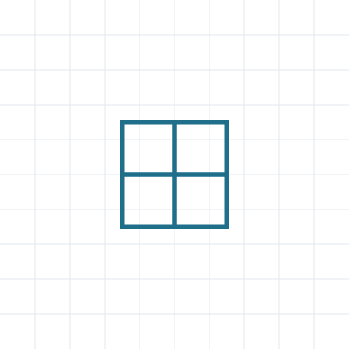
④ Window ★★★
🎯 Goal
Put a for inside a for
📝 Challenge
Draw 4 squares (sides of 60 steps) to make a window. Put a for loop inside a for loop.
Notes:
[Goal] Put a for inside a for
[Concepts] Loops / Nesting / Python syntax (colon & indent)
[How to start]
Look at the model shape and check the number of corners and the turning angle together before starting.
[Task] Draw 4 squares (sides of 60 steps) to make a window. Put a for loop inside a for loop.

Slide 15
④ Window ★★★ Hint
💡
How to think
Outer loop 4 times: the inner for k in range(4): draws a square, then right(90).
Notes:
[Questions to ask]
- “How many corners are there?”
- “Is there a set of moves that repeats?”
- “Run it and see where it stops.”
[Common mistake]
If the last right(90) is at the inner for’s depth, the squares overlap and look like one.

Slide 16

④ Window ★★★ Answer
1 for i in range(4):
2 for k in range(4):
3 forward(60)
4 right(90)
5 right(90)
🎉 Clear!
✨ Key point
The inner for is indented 8 spaces. After a square, right(90) inside the outer for.
Notes:
[Key point] The inner for is indented 8 spaces. After a square, right(90) inside the outer for.
[Common mistake] If the last right(90) is at the inner for’s depth, the squares overlap and look like one.
[Answer code]
for i in range(4):
for k in range(4):
forward(60)
right(90)
right(90)
[Video] videos/en/pydraw-04.mp4 (also on the videos page, videos.html)
[Check in the app] Open python-draw.html?sensei, choose challenge 4, then “📖 Answer” → “▶ Run”.

Slide 17
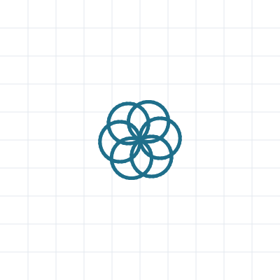
⑤ Flower ★★★
🎯 Goal
Nesting + turning around
📝 Challenge
Draw 6 circles (forward(5) and right(10), 36 times), turning 60 degrees between them, to make a flower.
Notes:
[Goal] Nesting + turning around
[Concepts] Loops / Nesting / Angles / Python syntax (colon & indent)
[How to start]
Look at the model shape and check the number of corners and the turning angle together before starting.
[Task] Draw 6 circles (forward(5) and right(10), 36 times), turning 60 degrees between them, to make a flower.

Slide 18
⑤ Flower ★★★ Hint
💡
How to think
for i in range(6): → for k in range(36): forward(5), right(10) → right(60)
Notes:
[Questions to ask]
- “How many corners are there?”
- “Is there a set of moves that repeats?”
- “Run it and see where it stops.”
[Common mistake]
If the turn is not 60, the petals are uneven.

Slide 19

⑤ Flower ★★★ Answer
1 for i in range(6):
2 for k in range(36):
3 forward(5)
4 right(10)
5 right(60)
🎉 Clear!
✨ Key point
One circle is the inner for. The outer for turns 360 ÷ 6 = 60 degrees, 6 times.
Notes:
[Key point] One circle is the inner for. The outer for turns 360 ÷ 6 = 60 degrees, 6 times.
[Common mistake] If the turn is not 60, the petals are uneven.
[Answer code]
for i in range(6):
for k in range(36):
forward(5)
right(10)
right(60)
[Video] videos/en/pydraw-05.mp4 (also on the videos page, videos.html)
[Check in the app] Open python-draw.html?sensei, choose challenge 5, then “📖 Answer” → “▶ Run”.

Slide 20

⑥ Square spiral ★★★★
🎯 Goal
Use the variable i as the length
📝 Challenge
Use for i in range(10, 201, 10): so i becomes 10, 20, 30 … 200, and draw a spiral with forward(i) and right(90).
Notes:
[Goal] Use the variable i as the length
[Concepts] Variables / Loops / Python syntax (colon & indent)
[How to start]
Look at the model shape and check the number of corners and the turning angle together before starting.
[Task] Use for i in range(10, 201, 10): so i becomes 10, 20, 30 … 200, and draw a spiral with forward(i) and right(90).

Slide 21
⑥ Square spiral ★★★★ Hint
💡
How to think
range(start, end, step). The end number is not included, so use 201.
Notes:
[Questions to ask]
- “How many corners are there?”
- “Is there a set of moves that repeats?”
- “Run it and see where it stops.”
[Common mistake]
range(10, 200, 10) stops at 190.

Slide 22
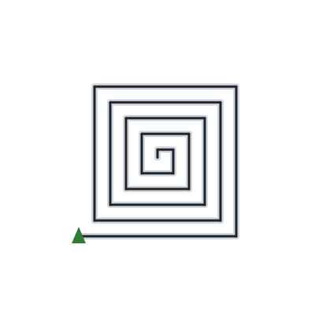
⑥ Square spiral ★★★★ Answer
1 for i in range(10, 201, 10):
2 forward(i)
3 right(90)
🎉 Clear!
✨ Key point
range(10, 201, 10) gives 10, 20, … 200. The end is not included, so use 201. forward(i) gets longer each time.
Notes:
[Key point] range(10, 201, 10) gives 10, 20, … 200. The end is not included, so use 201. forward(i) gets longer each time.
[Common mistake] range(10, 200, 10) stops at 190.
[Answer code]
for i in range(10, 201, 10):
forward(i)
right(90)
[Video] videos/en/pydraw-06.mp4 (also on the videos page, videos.html)
[Check in the app] Open python-draw.html?sensei, choose challenge 6, then “📖 Answer” → “▶ Run”.

Slide 23

⑦ Polygons in a row ★★★★
🎯 Goal
Variables and division
📝 Challenge
Use for n in range(3, 9): to change n from 3 to 8, and draw an n-sided shape (sides of 50 steps) from the same spot.
Notes:
[Goal] Variables and division
[Concepts] Variables / Math / Nesting / Python syntax (colon & indent)
[How to start]
Look at the model shape and check the number of corners and the turning angle together before starting.
[Task] Use for n in range(3, 9): to change n from 3 to 8, and draw an n-sided shape (sides of 50 steps) from the same spot.

Slide 24
⑦ Polygons in a row ★★★★ Hint
💡
How to think
Inside, for i in range(n): forward(50) and right(360 / n). / means divide.
Notes:
[Questions to ask]
- “How many corners are there?”
- “Is there a set of moves that repeats?”
- “Run it and see where it stops.”
[Common mistake]
360 // n (floor division) has no block. Use / for division.

Slide 25

⑦ Polygons in a row ★★★★ Answer
1 for n in range(3, 9):
2 for i in range(n):
3 forward(50)
4 right(360 / n)
🎉 Clear!
✨ Key point
An n-sided shape turns 360 / n. range(3, 9) gives n = 3 to 8.
Notes:
[Key point] An n-sided shape turns 360 / n. range(3, 9) gives n = 3 to 8.
[Common mistake] 360 // n (floor division) has no block. Use / for division.
[Answer code]
for n in range(3, 9):
for i in range(n):
forward(50)
right(360 / n)
[Video] videos/en/pydraw-07.mp4 (also on the videos page, videos.html)
[Check in the app] Open python-draw.html?sensei, choose challenge 7, then “📖 Answer” → “▶ Run”.

Slide 26

⑧ Snowflake ★★★★★
🎯 Goal
Break the steps into parts
📝 Challenge
Draw one branch, come back, and right(60). Repeat this 6 times to draw a snowflake.
Notes:
[Goal] Break the steps into parts
[Concepts] Sequence / Decomposition / Loops / Python syntax (colon & indent)
[How to start]
Look at the model shape and check the number of corners and the turning angle together before starting.
[Task] Draw one branch, come back, and right(60). Repeat this 6 times to draw a snowflake.

Slide 27
⑧ Snowflake ★★★★★ Hint
💡
How to think
Branch: forward(80) → back(30) → left(45) → forward(25) → back(25) → right(90) → forward(25) → back(25) → left(45) → back(50)
Notes:
[Questions to ask]
- “How many corners are there?”
- “Is there a set of moves that repeats?”
- “Run it and see where it stops.”
[Common mistake]
Forgetting the last back(50) shifts each branch.

Slide 28

⑧ Snowflake ★★★★★ Answer
1 for i in range(6):
2 forward(80)
3 back(30)
4 left(45)
5 forward(25)
6 back(25)
7 right(90)
8 forward(25)
9 back(25)
10 left(45)
11 back(50)
12 right(60)
🎉 Clear!
✨ Key point
One branch is 10 lines. It returns to the start, so right(60) moves to the next branch.
Notes:
[Key point] One branch is 10 lines. It returns to the start, so right(60) moves to the next branch.
[Common mistake] Forgetting the last back(50) shifts each branch.
[Answer code]
for i in range(6):
forward(80)
back(30)
left(45)
forward(25)
back(25)
right(90)
forward(25)
back(25)
left(45)
back(50)
right(60)
[Video] videos/en/pydraw-08.mp4 (also on the videos page, videos.html)
[Check in the app] Open python-draw.html?sensei, choose challenge 8, then “📖 Answer” → “▶ Run”.

Slide 29

⑨ Star spiral ★★★★★
🎯 Goal
Variable × math + turning
📝 Challenge
Use for i in range(1, 51): (i from 1 to 50), then forward(i * 4) and right(144). Change colors with pen_color('random').
Notes:
[Goal] Variable × math + turning
[Concepts] Variables / Math / Loops / Python syntax (colon & indent)
[How to start]
Look at the model shape and check the number of corners and the turning angle together before starting.
[Task] Use for i in range(1, 51): (i from 1 to 50), then forward(i * 4) and right(144). Change colors with pen_color('random').

Slide 30
⑨ Star spiral ★★★★★ Hint
💡
How to think
* means multiply. The line gets 4 steps longer each time.
Notes:
[Questions to ask]
- “How many corners are there?”
- “Is there a set of moves that repeats?”
- “Run it and see where it stops.”
[Common mistake]
range(1, 50) stops after 49. Use range(1, 51) for 50 times.

Slide 31

⑨ Star spiral ★★★★★ Answer
1 for i in range(1, 51):
2 pen_color('random')
3 forward(i * 4)
4 right(144)
🎉 Clear!
✨ Key point
The length i * 4 grows by 4 each time, and turning 144 makes a star spiral.
Notes:
[Key point] The length i * 4 grows by 4 each time, and turning 144 makes a star spiral.
[Common mistake] range(1, 50) stops after 49. Use range(1, 51) for 50 times.
[Answer code]
for i in range(1, 51):
pen_color('random')
forward(i * 4)
right(144)
[Video] videos/en/pydraw-09.mp4 (also on the videos page, videos.html)
[Check in the app] Open python-draw.html?sensei, choose challenge 9, then “📖 Answer” → “▶ Run”.

Slide 32
Reflection
🤔
🛠
🚀
What did you write inside forward()?
What are the three numbers of range(start, end, step)?
What could you do with the variables i and n?
📜
Clear every challenge to get a certificate! Type your name and print it.
Notes:
[Running the reflection]
Discuss one question at a time in pairs or groups, then ask 2–3 students to share with the class.
[Certificate] Clearing every stage shows a certificate (device date; issued by Yasuhito Inoue, NIT Maizuru College). Open it again from “⚙ Settings → 📜”. It prints on A4 landscape.
[Next step] Try the other Python apps too.

