Slide 1
🐍 Python Maze
Lesson slides: 5 stages
Pythonで めいろ
Notes:
[About these slides]
Lesson slides for Python Maze (python.html). Each stage has 3 slides: Task → Hint → Answer.
The slides use simple words for students; notes for teachers are here in the notes area.
Show the Answer slide only after students have tried.

Slide 2
What you will learn
🐍
Sequence
Python syntax (colon & indent)
Stage 1, 2
Stage 1, 2, 3, 4, 5
Solve the maze with Python. Blocks you build appear below as Python, and you can edit it in the “🐍 Python” tab. Go from forward() to for, while, if and elif.
Direction
Loops
Stage 2
Stage 3
Conditions
Repeat until
Stage 4, 5
Stage 4, 5
Notes:
[Lesson aims]
Solve the maze with Python. Blocks you build appear below as Python, and you can edit it in the “🐍 Python” tab. Go from forward() to for, while, if and elif.
[Concepts and stages]
・Sequence: Stage 1, 2
・Python syntax (colon & indent): Stage 1, 2, 3, 4, 5
・Direction: Stage 2
・Loops: Stage 3
・Conditions: Stage 4, 5
・Repeat until: Stage 4, 5
・Nesting: Stage 5
・Generalization: Stage 5

Slide 3
How to use
🧩
🐍
▶
🔎
1. Start with blocks
2. Write Python
3. Run it
4. Read errors
Build with “🧩 Blocks” and the same program appears below in Python.
Write it yourself in the “🐍 Python” tab. Command buttons and Tab (4 spaces) help.
Press “▶ Run”. The line that is running turns yellow.
Errors show a line number. Look at the red line and fix it.
Notes:
[Opening]
Add “python.html” to the end of your published address.
You can also open it from the block app with “⚙ Settings → 🐍 Switch to Python” (it opens in Python mode).
[Teacher mode]
Add “?sensei” to the address to show the “📖 Answer” button and load answers (e.g. python.html?sensei).
[Next player]
When students share a device, press “⚙ Settings → 🔄 Next player” twice to reset the records.

Slide 4
Blocks and Python
Block | Python
move forward | forward()
turn right / turn left | turn_right() ／ turn_left()
repeat 〇 times | for i in range(〇):
repeat until goal | while not at_goal():
if front is open | if is_open('front'):
else | else: ／ elif …:
Rules: “:” at the end, indent lines inside by 4 spaces, “()” after commands
Notes:
[Key point]
One block becomes one line of Python. An “if” alone inside “else” becomes elif in Python.
[Common errors]
- Missing “:” → SyntaxError
- Wrong indentation → IndentationError
- Missing “()” / misspelled name → SyntaxError / NameError
Errors show the line number, so look at that line together.

Slide 5
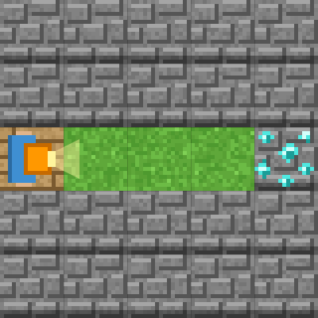
Stage 1: Go straight
🎯 Goal
Write Python commands one line at a time
📝 Task
Type forward() to move the explorer to the diamond 💎. One line moves one square.
Notes:
[Goal] Write Python commands one line at a time
[Concepts] Sequence / Python syntax (colon & indent)
[How to start]
Look at the board and trace the path to the goal with a finger. The explorer’s light shows “front”.
[Task] Type forward() to move the explorer to the diamond 💎. One line moves one square.

Slide 6
Stage 1: Go straight Hint
💡
How to think
Write forward() 4 times, one per line.
Notes:
[Questions to ask]
- “Which way is it facing at the start?”
- “Is there a set of moves that repeats?”
- “Run it and see where it stops.”
[Common mistake]
Writing forward without “()” causes an error.

Slide 7
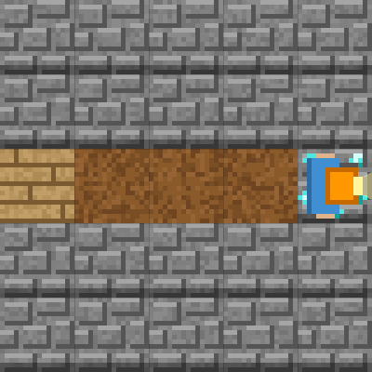
Stage 1: Go straight Answer
1 forward()
2 forward()
3 forward()
4 forward()
🎉 Clear!
✨ Key point
Python runs from the top line down. The “move forward” block = forward()
Notes:
[Key point] Python runs from the top line down. The “move forward” block = forward()
[Common mistake] Writing forward without “()” causes an error.
[Answer code]
forward()
forward()
forward()
forward()
[Video] videos/en/pymaze-01.mp4 (also on the videos page, videos.html)
[Check in the app] Open python.html?sensei, choose stage 1, then “📖 Answer” → “▶ Run”.

Slide 8
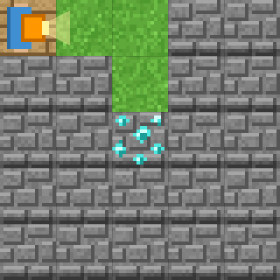
Stage 2: Let's turn
🎯 Goal
Use commands that change direction
📝 Task
turn_right() turns right, turn_left() turns left. Turning does not move you.
Notes:
[Goal] Use commands that change direction
[Concepts] Sequence / Direction / Python syntax (colon & indent)
[How to start]
Look at the board and trace the path to the goal with a finger. The explorer’s light shows “front”.
[Task] turn_right() turns right, turn_left() turns left. Turning does not move you.

Slide 9
Stage 2: Let's turn Hint
💡
How to think
forward() ×2 → turn_right() → forward() ×2
Notes:
[Questions to ask]
- “Which way is it facing at the start?”
- “Is there a set of moves that repeats?”
- “Run it and see where it stops.”
[Common mistake]
“turn right” (space) or “Turn_right” (capital) are different names.

Slide 10
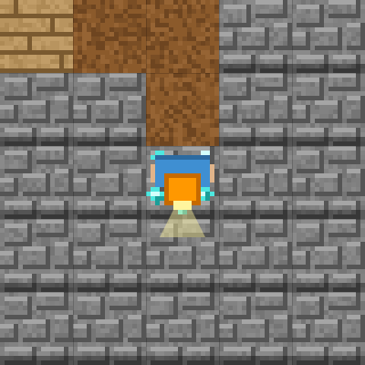
Stage 2: Let's turn Answer
1 forward()
2 forward()
3 turn_right()
4 forward()
5 forward()
🎉 Clear!
✨ Key point
Turning does not move you. Don’t forget the “_” (underscore).
Notes:
[Key point] Turning does not move you. Don’t forget the “_” (underscore).
[Common mistake] “turn right” (space) or “Turn_right” (capital) are different names.
[Answer code]
forward()
forward()
turn_right()
forward()
forward()
[Video] videos/en/pymaze-02.mp4 (also on the videos page, videos.html)
[Check in the app] Open python.html?sensei, choose stage 2, then “📖 Answer” → “▶ Run”.

Slide 11
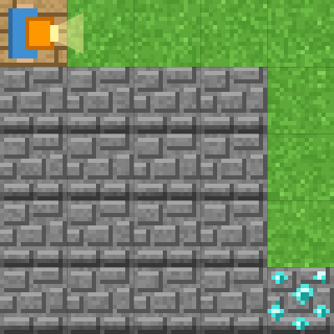
Stage 3: Repeat with for
🎯 Goal
Write a loop with for and indentation
📝 Task
“for i in range(4):” repeats the lines under it 4 times. Indent those lines with 4 spaces!
Notes:
[Goal] Write a loop with for and indentation
[Concepts] Loops / Python syntax (colon & indent)
[How to start]
Look at the board and trace the path to the goal with a finger. The explorer’s light shows “front”.
[Task] “for i in range(4):” repeats the lines under it 4 times. Indent those lines with 4 spaces!

Slide 12
Stage 3: Repeat with for Hint
💡
How to think
for i in range(4): → forward() (indented) → turn_right() → the same loop again
Notes:
[Questions to ask]
- “Which way is it facing at the start?”
- “Is there a set of moves that repeats?”
- “Run it and see where it stops.”
[Common mistake]
Forgetting the final “:”. Indenting turn_right() too makes it turn 4 times.

Slide 13
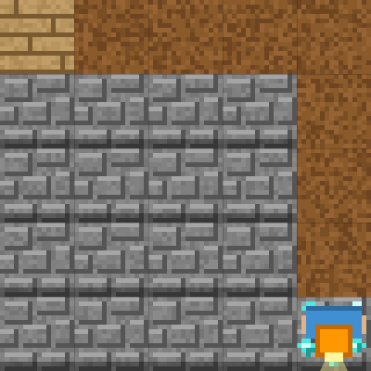
Stage 3: Repeat with for Answer
1 for i in range(4):
2 forward()
3 turn_right()
4 for i in range(4):
5 forward()
🎉 Clear!
✨ Key point
Lines indented after “:” are inside the loop. Un-indent to leave the loop.
Notes:
[Key point] Lines indented after “:” are inside the loop. Un-indent to leave the loop.
[Common mistake] Forgetting the final “:”. Indenting turn_right() too makes it turn 4 times.
[Answer code]
for i in range(4):
forward()
turn_right()
for i in range(4):
forward()
[Video] videos/en/pymaze-03.mp4 (also on the videos page, videos.html)
[Check in the app] Open python.html?sensei, choose stage 3, then “📖 Answer” → “▶ Run”.

Slide 14
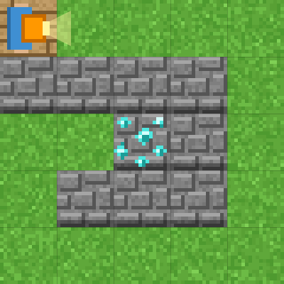
Stage 4: while and if
🎯 Goal
Combine while with if / else
📝 Task
Repeat with “while not at_goal():” and decide with “if is_open('front'):”. else runs when the front is blocked.
Notes:
[Goal] Combine while with if / else
[Concepts] Conditions / Repeat until / Python syntax (colon & indent)
[How to start]
Look at the board and trace the path to the goal with a finger. The explorer’s light shows “front”.
[Task] Repeat with “while not at_goal():” and decide with “if is_open('front'):”. else runs when the front is blocked.

Slide 15
Stage 4: while and if Hint
💡
How to think
while not at_goal(): → if is_open('front'): forward() → else: turn_right()
Notes:
[Questions to ask]
- “Which way is it facing at the start?”
- “Is there a set of moves that repeats?”
- “Run it and see where it stops.”
[Common mistake]
Misaligned if/else causes an error. Write else: at the same depth as if.

Slide 16
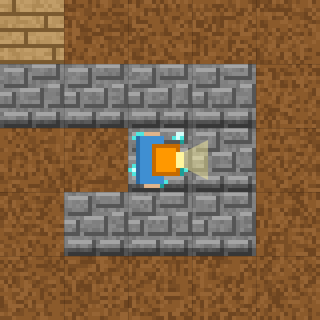
Stage 4: while and if Answer
1 while not at_goal():
2 if is_open('front'):
3 forward()
4 else:
5 turn_right()
🎉 Clear!
✨ Key point
not means “is not”. while not at_goal() = “repeat while you are not at the goal”.
Notes:
[Key point] not means “is not”. while not at_goal() = “repeat while you are not at the goal”.
[Common mistake] Misaligned if/else causes an error. Write else: at the same depth as if.
[Answer code]
while not at_goal():
if is_open('front'):
forward()
else:
turn_right()
[Video] videos/en/pymaze-04.mp4 (also on the videos page, videos.html)
[Check in the app] Open python.html?sensei, choose stage 4, then “📖 Answer” → “▶ Run”.

Slide 17
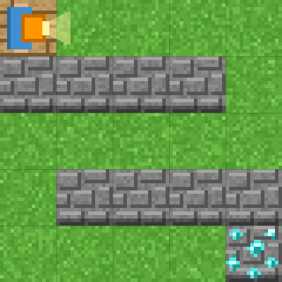
Stage 5: Three choices with elif
🎯 Goal
Split into three cases with elif
📝 Task
Python has elif (“else if”). Check the front, then the right, and otherwise turn left.
Notes:
[Goal] Split into three cases with elif
[Concepts] Conditions / Repeat until / Nesting / Generalization / Python syntax (colon & indent)
[How to start]
Look at the board and trace the path to the goal with a finger. The explorer’s light shows “front”.
[Task] Python has elif (“else if”). Check the front, then the right, and otherwise turn left.

Slide 18
Stage 5: Three choices with elif Hint
💡
How to think
if is_open('front'): … elif is_open('right'): … else: …
Notes:
[Questions to ask]
- “Which way is it facing at the start?”
- “Is there a set of moves that repeats?”
- “Run it and see where it stops.”
[Common mistake]
Writing “else if” is an error in Python. Changing the order takes a different path.

Slide 19
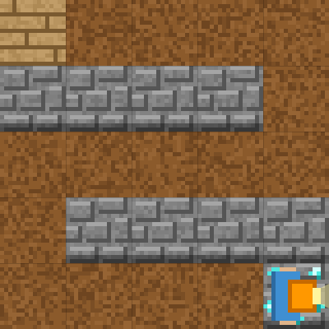
Stage 5: Three choices with elif Answer
1 while not at_goal():
2 if is_open('front'):
3 forward()
4 elif is_open('right'):
5 turn_right()
6 else:
7 turn_left()
🎉 Clear!
✨ Key point
elif means “else if”. Putting an “if” block inside “else” becomes elif in Python.
Notes:
[Key point] elif means “else if”. Putting an “if” block inside “else” becomes elif in Python.
[Common mistake] Writing “else if” is an error in Python. Changing the order takes a different path.
[Answer code]
while not at_goal():
if is_open('front'):
forward()
elif is_open('right'):
turn_right()
else:
turn_left()
[Video] videos/en/pymaze-05.mp4 (also on the videos page, videos.html)
[Check in the app] Open python.html?sensei, choose stage 5, then “📖 Answer” → “▶ Run”.

Slide 20
Reflection
🤔
🛠
🚀
How are blocks and Python similar?
How did you fix errors?
What is the indent (4 spaces) for?
📜
Clear every stage to get a certificate! Type your name and print it.
Notes:
[Running the reflection]
Discuss one question at a time in pairs or groups, then ask 2–3 students to share with the class.
[Certificate] Clearing every stage shows a certificate (device date; issued by Yasuhito Inoue, NIT Maizuru College). Open it again from “⚙ Settings → 📜”. It prints on A4 landscape.
[Next step] Try the other Python apps too.

