Slide 1
🐍 Python Space
Lesson slides: 6 stages
Pythonで うちゅう
Notes:
[About these slides]
Lesson slides for Python Space (python-space.html). Each stage has 3 slides: Task → Hint → Answer.
The slides use simple words for students; notes for teachers are here in the notes area.
Show the Answer slide only after students have tried.

Slide 2
What you will learn
🐍
Sequence
Python syntax (colon & indent)
Stage 1, 2
Stage 1, 2, 3, 4, 5, 6
Star hunting with Python. Use pick_up(), has_star() and mission_done() to collect every star and reach the rocket.
Direction
Loops
Stage 2
Stage 3, 4, 5
Patterns
Conditions
Stage 4
Stage 5, 6
Notes:
[Lesson aims]
Star hunting with Python. Use pick_up(), has_star() and mission_done() to collect every star and reach the rocket.
[Concepts and stages]
・Sequence: Stage 1, 2
・Python syntax (colon & indent): Stage 1, 2, 3, 4, 5, 6
・Direction: Stage 2
・Loops: Stage 3, 4, 5
・Patterns: Stage 4
・Conditions: Stage 5, 6
・Nesting: Stage 5, 6
・Repeat until: Stage 6

Slide 3
How to use
🧩
🐍
▶
🔎
1. Start with blocks
2. Write Python
3. Run it
4. Read errors
Build with “🧩 Blocks” and the same program appears below in Python.
Write it yourself in the “🐍 Python” tab. Command buttons and Tab (4 spaces) help.
Press “▶ Run”. The line that is running turns yellow.
Errors show a line number. Look at the red line and fix it.
Notes:
[Opening]
Add “python-space.html” to the end of your published address.
You can also open it from the block app with “⚙ Settings → 🐍 Switch to Python” (it opens in Python mode).
[Teacher mode]
Add “?sensei” to the address to show the “📖 Answer” button and load answers (e.g. python-space.html?sensei).
[Next player]
When students share a device, press “⚙ Settings → 🔄 Next player” twice to reset the records.

Slide 4
Blocks and Python
Block | Python
move forward / turn right, left | forward() ／ turn_right() ／ turn_left()
⭐ pick up star | pick_up()
repeat 〇 times | for i in range(〇):
🚀 repeat until mission complete | while not mission_done():
if there is a ⭐ star here | if has_star():
if front is open | if is_open('front'):
Rules: “:” at the end, indent lines inside by 4 spaces, “()” after commands
Notes:
[Key point]
One block becomes one line of Python. An “if” alone inside “else” becomes elif in Python.
[Common errors]
- Missing “:” → SyntaxError
- Wrong indentation → IndentationError
- Missing “()” / misspelled name → SyntaxError / NameError
Errors show the line number, so look at that line together.

Slide 5
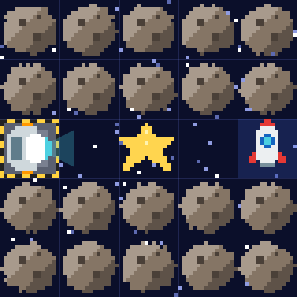
Stage 1: Pick up a star
🎯 Goal
Use pick_up()
📝 Task
Pick up the star ⭐ with pick_up(), then go to the rocket 🚀. pick_up() works only on a star square.
Notes:
[Goal] Use pick_up()
[Concepts] Sequence / Python syntax (colon & indent)
[How to start]
Look at the board and trace the path to the goal with a finger. The explorer’s light shows “front”.
[Task] Pick up the star ⭐ with pick_up(), then go to the rocket 🚀. pick_up() works only on a star square.

Slide 6
Stage 1: Pick up a star Hint
💡
How to think
forward() ×2 → pick_up() → forward() ×2
Notes:
[Questions to ask]
- “Which way is it facing at the start?”
- “Is there a set of moves that repeats?”
- “Run it and see where it stops.”
[Common mistake]
Writing pickup() or pick up() causes a NameError. Don’t forget the “_”.

Slide 7
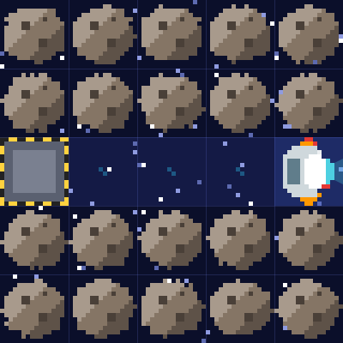
Stage 1: Pick up a star Answer
1 forward()
2 forward()
3 pick_up()
4 forward()
5 forward()
🎉 Clear!
✨ Key point
pick_up() picks up the star on your square. Collect them all, then go to the rocket!
Notes:
[Key point] pick_up() picks up the star on your square. Collect them all, then go to the rocket!
[Common mistake] Writing pickup() or pick up() causes a NameError. Don’t forget the “_”.
[Answer code]
forward()
forward()
pick_up()
forward()
forward()
[Video] videos/en/pyspace-01.mp4 (also on the videos page, videos.html)
[Check in the app] Open python-space.html?sensei, choose stage 1, then “📖 Answer” → “▶ Run”.

Slide 8
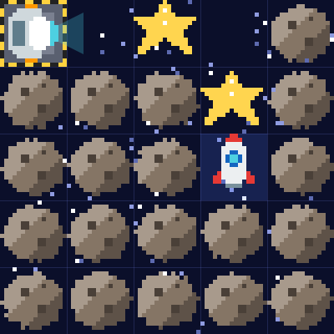
Stage 2: Turn and collect
🎯 Goal
Turn and collect in order
📝 Task
There are 2 stars. Use turn_right() where the path turns.
Notes:
[Goal] Turn and collect in order
[Concepts] Sequence / Direction / Python syntax (colon & indent)
[How to start]
Look at the board and trace the path to the goal with a finger. The explorer’s light shows “front”.
[Task] There are 2 stars. Use turn_right() where the path turns.

Slide 9
Stage 2: Turn and collect Hint
💡
How to think
forward() ×2, pick_up() → forward() → turn_right() → forward(), pick_up() → forward()
Notes:
[Questions to ask]
- “Which way is it facing at the start?”
- “Is there a set of moves that repeats?”
- “Run it and see where it stops.”
[Common mistake]
pick_up() on an empty square fails. Check which square has the star.

Slide 10
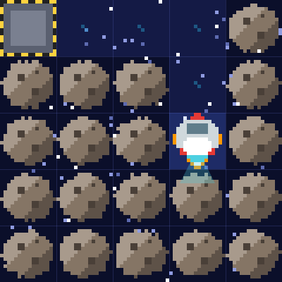
Stage 2: Turn and collect Answer
1 forward()
2 forward()
3 pick_up()
4 forward()
5 turn_right()
6 forward()
7 pick_up()
8 forward()
🎉 Clear!
✨ Key point
turn_right() only changes direction. The order of turning and picking up matters.
Notes:
[Key point] turn_right() only changes direction. The order of turning and picking up matters.
[Common mistake] pick_up() on an empty square fails. Check which square has the star.
[Answer code]
forward()
forward()
pick_up()
forward()
turn_right()
forward()
pick_up()
forward()
[Video] videos/en/pyspace-02.mp4 (also on the videos page, videos.html)
[Check in the app] Open python-space.html?sensei, choose stage 2, then “📖 Answer” → “▶ Run”.

Slide 11
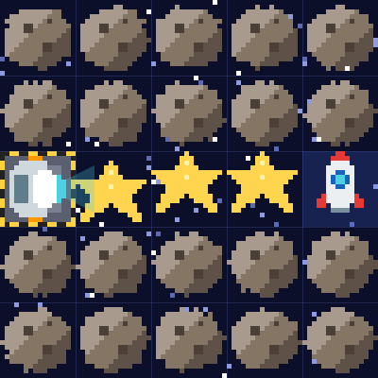
Stage 3: Collect with for
🎯 Goal
Repeat with for
📝 Task
The stars are in a row. Repeat “forward() → pick_up()” with for. Indent the lines inside the loop by 4 spaces.
Notes:
[Goal] Repeat with for
[Concepts] Loops / Python syntax (colon & indent)
[How to start]
Look at the board and trace the path to the goal with a finger. The explorer’s light shows “front”.
[Task] The stars are in a row. Repeat “forward() → pick_up()” with for. Indent the lines inside the loop by 4 spaces.

Slide 12
Stage 3: Collect with for Hint
💡
How to think
for i in range(3): → (indented) forward() and pick_up() → forward()
Notes:
[Questions to ask]
- “Which way is it facing at the start?”
- “Is there a set of moves that repeats?”
- “Run it and see where it stops.”
[Common mistake]
If you forget to indent pick_up(), it runs only once.

Slide 13
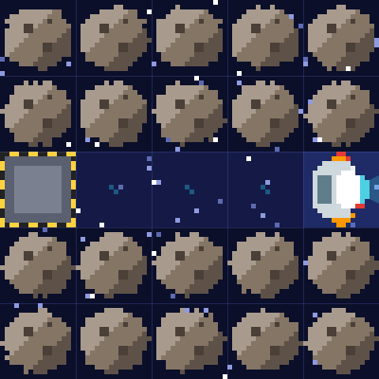
Stage 3: Collect with for Answer
1 for i in range(3):
2 forward()
3 pick_up()
4 forward()
🎉 Clear!
✨ Key point
To put 2 lines inside for, indent both by 4 spaces. The last forward() is not indented.
Notes:
[Key point] To put 2 lines inside for, indent both by 4 spaces. The last forward() is not indented.
[Common mistake] If you forget to indent pick_up(), it runs only once.
[Answer code]
for i in range(3):
forward()
pick_up()
forward()
[Video] videos/en/pyspace-03.mp4 (also on the videos page, videos.html)
[Check in the app] Open python-space.html?sensei, choose stage 3, then “📖 Answer” → “▶ Run”.

Slide 14
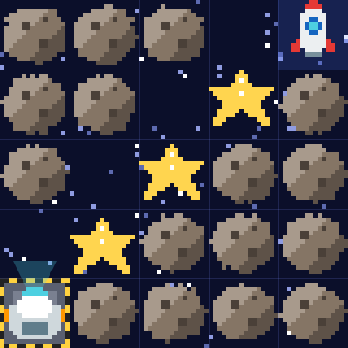
Stage 4: Star stairs
🎯 Goal
Find the set that repeats
📝 Task
Find the set of moves that repeats on the stairs and put all of it inside the for loop.
Notes:
[Goal] Find the set that repeats
[Concepts] Loops / Patterns / Python syntax (colon & indent)
[How to start]
Look at the board and trace the path to the goal with a finger. The explorer’s light shows “front”.
[Task] Find the set of moves that repeats on the stairs and put all of it inside the for loop.

Slide 15
Stage 4: Star stairs Hint
💡
How to think
for i in range(4): forward(), turn_right(), forward(), pick_up(), turn_left()
Notes:
[Questions to ask]
- “Which way is it facing at the start?”
- “Is there a set of moves that repeats?”
- “Run it and see where it stops.”
[Common mistake]
Forgetting turn_left() keeps changing your direction and you hit an asteroid.

Slide 16
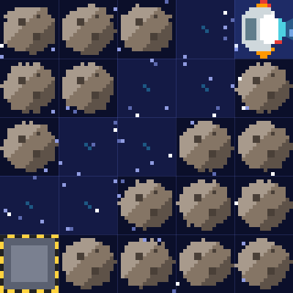
Stage 4: Star stairs Answer
1 for i in range(4):
2 forward()
3 turn_right()
4 forward()
5 pick_up()
6 turn_left()
🎉 Clear!
✨ Key point
Put the whole 5-line set inside for. You reach the rocket during the 4th repeat, and it ends there.
Notes:
[Key point] Put the whole 5-line set inside for. You reach the rocket during the 4th repeat, and it ends there.
[Common mistake] Forgetting turn_left() keeps changing your direction and you hit an asteroid.
[Answer code]
for i in range(4):
forward()
turn_right()
forward()
pick_up()
turn_left()
[Video] videos/en/pyspace-04.mp4 (also on the videos page, videos.html)
[Check in the app] Open python-space.html?sensei, choose stage 4, then “📖 Answer” → “▶ Run”.

Slide 17
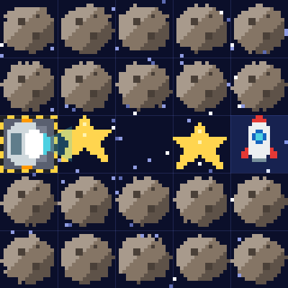
Stage 5: if has_star():
🎯 Goal
Check with if before you act
📝 Task
Some squares have stars and some don’t. has_star() checks the square you are on. Use if so you only pick up where there is a star.
Notes:
[Goal] Check with if before you act
[Concepts] Conditions / Loops / Nesting / Python syntax (colon & indent)
[How to start]
Look at the board and trace the path to the goal with a finger. The explorer’s light shows “front”.
[Task] Some squares have stars and some don’t. has_star() checks the square you are on. Use if so you only pick up where there is a star.

Slide 18
Stage 5: if has_star(): Hint
💡
How to think
for i in range(4): forward() → if has_star(): → (indent more) pick_up()
Notes:
[Questions to ask]
- “Which way is it facing at the start?”
- “Is there a set of moves that repeats?”
- “Run it and see where it stops.”
[Common mistake]
Forgetting the “:” after if has_star() causes a SyntaxError.

Slide 19
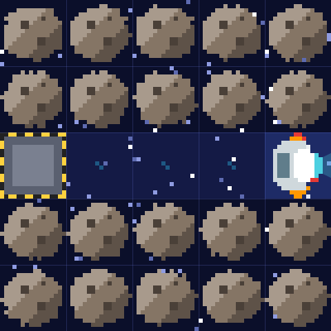
Stage 5: if has_star(): Answer
1 for i in range(4):
2 forward()
3 if has_star():
4 pick_up()
🎉 Clear!
✨ Key point
Lines inside if are indented one more level (8 spaces in total).
Notes:
[Key point] Lines inside if are indented one more level (8 spaces in total).
[Common mistake] Forgetting the “:” after if has_star() causes a SyntaxError.
[Answer code]
for i in range(4):
forward()
if has_star():
pick_up()
[Video] videos/en/pyspace-05.mp4 (also on the videos page, videos.html)
[Check in the app] Open python-space.html?sensei, choose stage 5, then “📖 Answer” → “▶ Run”.

Slide 20
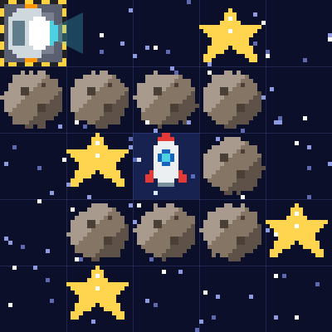
Stage 6: while not mission_done():
🎯 Goal
Repeat with while not mission_done():
📝 Task
Stars are scattered around a spiral. Repeat with “while not mission_done():” and check as you go.
Notes:
[Goal] Repeat with while not mission_done():
[Concepts] Conditions / Repeat until / Nesting / Python syntax (colon & indent)
[How to start]
Look at the board and trace the path to the goal with a finger. The explorer’s light shows “front”.
[Task] Stars are scattered around a spiral. Repeat with “while not mission_done():” and check as you go.

Slide 21
Stage 6: while not mission_done(): Hint
💡
How to think
Inside while: if has_star(): pick_up() → if is_open('front'): forward() else: turn_right()
Notes:
[Questions to ask]
- “Which way is it facing at the start?”
- “Is there a set of moves that repeats?”
- “Run it and see where it stops.”
[Common mistake]
If you join the two ifs with elif, you will not move on the turn you pick up a star (it can still clear).

Slide 22
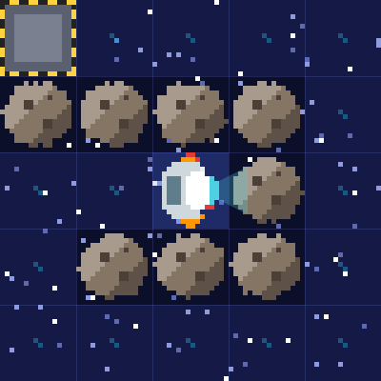
Stage 6: while not mission_done(): Answer
1 while not mission_done():
2 if has_star():
3 pick_up()
4 if is_open('front'):
5 forward()
6 else:
7 turn_right()
🎉 Clear!
✨ Key point
mission_done() becomes True when you have every star and are at the rocket. not repeats “while it is not done yet”.
Notes:
[Key point] mission_done() becomes True when you have every star and are at the rocket. not repeats “while it is not done yet”.
[Common mistake] If you join the two ifs with elif, you will not move on the turn you pick up a star (it can still clear).
[Answer code]
while not mission_done():
if has_star():
pick_up()
if is_open('front'):
forward()
else:
turn_right()
[Video] videos/en/pyspace-06.mp4 (also on the videos page, videos.html)
[Check in the app] Open python-space.html?sensei, choose stage 6, then “📖 Answer” → “▶ Run”.

Slide 23
Reflection
🤔
🛠
🚀
When did you use has_star()?
How many spaces of indent were inside if?
What does not mean in not mission_done()?
📜
Clear every stage to get a certificate! Type your name and print it.
Notes:
[Running the reflection]
Discuss one question at a time in pairs or groups, then ask 2–3 students to share with the class.
[Certificate] Clearing every stage shows a certificate (device date; issued by Yasuhito Inoue, NIT Maizuru College). Open it again from “⚙ Settings → 📜”. It prints on A4 landscape.
[Next step] Try the other Python apps too.

