Slide 1
🐍 Python Break & Build
Lesson slides: 7 stages
Pythonで こわす・おく
Notes:
[About these slides]
Lesson slides for Python Break & Build (python-craft.html). Each stage has 3 slides: Task → Hint → Answer.
The slides use simple words for students; notes for teachers are here in the notes area.
Show the Answer slide only after students have tried.

Slide 2
What you will learn
🐍
Sequence
Python syntax (colon & indent)
Stage 1, 2
Stage 1, 2, 3, 4, 5, 6, 7
Break & Build with Python. Use mine(), place() and front_is('stone') to break stone and bridge water. Split into 3 or more cases with elif.
Loops
Counting
Stage 3, 4, 5, 6
Stage 4, 6
Conditions
Nesting
Stage 5, 6, 7
Stage 5, 6, 7
Notes:
[Lesson aims]
Break & Build with Python. Use mine(), place() and front_is('stone') to break stone and bridge water. Split into 3 or more cases with elif.
[Concepts and stages]
・Sequence: Stage 1, 2
・Python syntax (colon & indent): Stage 1, 2, 3, 4, 5, 6, 7
・Loops: Stage 3, 4, 5, 6
・Counting: Stage 4, 6
・Conditions: Stage 5, 6, 7
・Nesting: Stage 5, 6, 7
・Repeat until: Stage 7
・Generalization: Stage 7

Slide 3
How to use
🧩
🐍
▶
🔎
1. Start with blocks
2. Write Python
3. Run it
4. Read errors
Build with “🧩 Blocks” and the same program appears below in Python.
Write it yourself in the “🐍 Python” tab. Command buttons and Tab (4 spaces) help.
Press “▶ Run”. The line that is running turns yellow.
Errors show a line number. Look at the red line and fix it.
Notes:
[Opening]
Add “python-craft.html” to the end of your published address.
You can also open it from the block app with “⚙ Settings → 🐍 Switch to Python” (it opens in Python mode).
[Teacher mode]
Add “?sensei” to the address to show the “📖 Answer” button and load answers (e.g. python-craft.html?sensei).
[Next player]
When students share a device, press “⚙ Settings → 🔄 Next player” twice to reset the records.

Slide 4
Blocks and Python
Block | Python
move forward / turn right, left | forward() ／ turn_right() ／ turn_left()
⛏ break / 🧱 place | mine() ／ place()
repeat 〇 times | for i in range(〇):
repeat until goal | while not at_goal():
if the front is a stone block | if front_is('stone'):
(water / open path) | front_is('water') ／ front_is('path')
Rules: “:” at the end, indent lines inside by 4 spaces, “()” after commands
Notes:
[Key point]
One block becomes one line of Python. An “if” alone inside “else” becomes elif in Python.
[Common errors]
- Missing “:” → SyntaxError
- Wrong indentation → IndentationError
- Missing “()” / misspelled name → SyntaxError / NameError
Errors show the line number, so look at that line together.

Slide 5
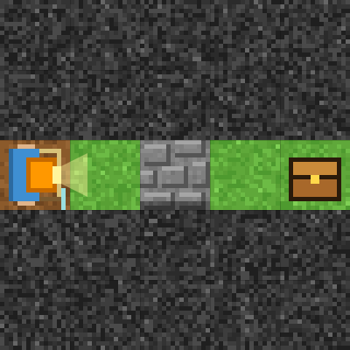
Stage 1: Break and go
🎯 Goal
Use mine()
📝 Task
A stone block is in the way. mine() breaks the block in front of you. Break it and go to the treasure chest!
Notes:
[Goal] Use mine()
[Concepts] Sequence / Python syntax (colon & indent)
[How to start]
Look at the board and trace the path to the goal with a finger. The explorer’s light shows “front”.
[Task] A stone block is in the way. mine() breaks the block in front of you. Break it and go to the treasure chest!

Slide 6
Stage 1: Break and go Hint
💡
How to think
forward() → mine() → forward() ×3
Notes:
[Questions to ask]
- “Which way is it facing at the start?”
- “Is there a set of moves that repeats?”
- “Run it and see where it stops.”
[Common mistake]
mine() where there is no stone fails. Move forward once before breaking.

Slide 7
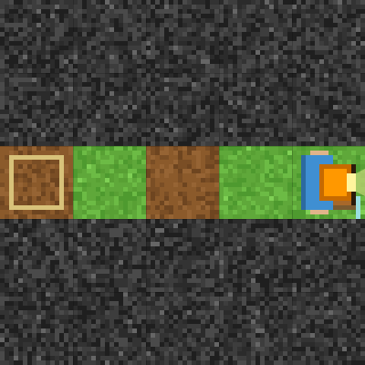
Stage 1: Break and go Answer
1 forward()
2 mine()
3 forward()
4 forward()
5 forward()
🎉 Clear!
✨ Key point
mine() breaks the stone in front, and it becomes a path.
Notes:
[Key point] mine() breaks the stone in front, and it becomes a path.
[Common mistake] mine() where there is no stone fails. Move forward once before breaking.
[Answer code]
forward()
mine()
forward()
forward()
forward()
[Video] videos/en/pycraft-01.mp4 (also on the videos page, videos.html)
[Check in the app] Open python-craft.html?sensei, choose stage 1, then “📖 Answer” → “▶ Run”.

Slide 8
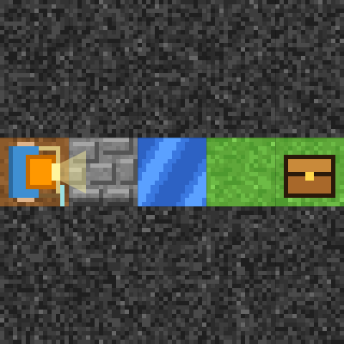
Stage 2: Build a bridge
🎯 Goal
The order: mine() → place()
📝 Task
place() puts a block in front of you. On water it becomes a bridge. Break the stone first to get a block!
Notes:
[Goal] The order: mine() → place()
[Concepts] Sequence / Python syntax (colon & indent)
[How to start]
Look at the board and trace the path to the goal with a finger. The explorer’s light shows “front”.
[Task] place() puts a block in front of you. On water it becomes a bridge. Break the stone first to get a block!

Slide 9
Stage 2: Build a bridge Hint
💡
How to think
mine() → forward() → place() → forward() ×3
Notes:
[Questions to ask]
- “Which way is it facing at the start?”
- “Is there a set of moves that repeats?”
- “Run it and see where it stops.”
[Common mistake]
forward() first bumps into the stone. Move to just before the water before place().

Slide 10
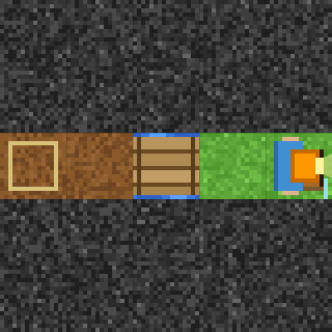
Stage 2: Build a bridge Answer
1 mine()
2 forward()
3 place()
4 forward()
5 forward()
6 forward()
🎉 Clear!
✨ Key point
You start with no blocks. mine() to get one, then place() to build a bridge.
Notes:
[Key point] You start with no blocks. mine() to get one, then place() to build a bridge.
[Common mistake] forward() first bumps into the stone. Move to just before the water before place().
[Answer code]
mine()
forward()
place()
forward()
forward()
forward()
[Video] videos/en/pycraft-02.mp4 (also on the videos page, videos.html)
[Check in the app] Open python-craft.html?sensei, choose stage 2, then “📖 Answer” → “▶ Run”.

Slide 11
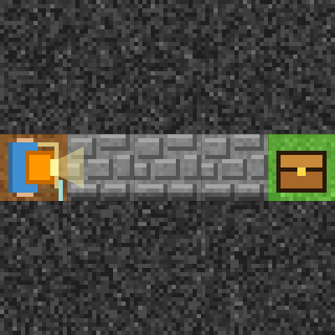
Stage 3: Break with for
🎯 Goal
Break with for
📝 Task
Stone blocks in a row! Repeat “mine() → forward()” with for.
Notes:
[Goal] Break with for
[Concepts] Loops / Python syntax (colon & indent)
[How to start]
Look at the board and trace the path to the goal with a finger. The explorer’s light shows “front”.
[Task] Stone blocks in a row! Repeat “mine() → forward()” with for.

Slide 12
Stage 3: Break with for Hint
💡
How to think
for i in range(3): mine(), forward() → forward()
Notes:
[Questions to ask]
- “Which way is it facing at the start?”
- “Is there a set of moves that repeats?”
- “Run it and see where it stops.”
[Common mistake]
If forward() is not indented, mine() runs 3 times in a row and fails.

Slide 13
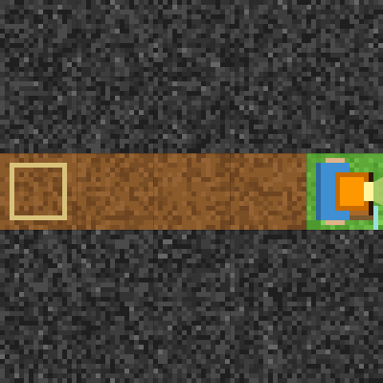
Stage 3: Break with for Answer
1 for i in range(3):
2 mine()
3 forward()
4 forward()
🎉 Clear!
✨ Key point
“mine() → forward()” 3 times. The last forward() is outside the for (not indented).
Notes:
[Key point] “mine() → forward()” 3 times. The last forward() is outside the for (not indented).
[Common mistake] If forward() is not indented, mine() runs 3 times in a row and fails.
[Answer code]
for i in range(3):
mine()
forward()
forward()
[Video] videos/en/pycraft-03.mp4 (also on the videos page, videos.html)
[Check in the app] Open python-craft.html?sensei, choose stage 3, then “📖 Answer” → “▶ Run”.

Slide 14
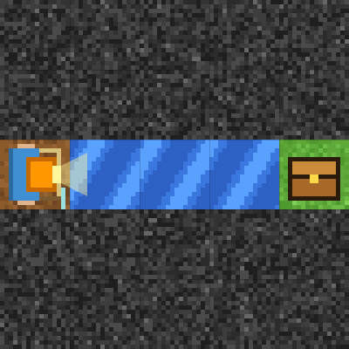
Stage 4: A long bridge
🎯 Goal
Use up the blocks you have
📝 Task
You have 3 blocks. Repeat “place() → forward()” to make a long bridge.
Notes:
[Goal] Use up the blocks you have
[Concepts] Loops / Counting / Python syntax (colon & indent)
[How to start]
Look at the board and trace the path to the goal with a finger. The explorer’s light shows “front”.
[Task] You have 3 blocks. Repeat “place() → forward()” to make a long bridge.

Slide 15
Stage 4: A long bridge Hint
💡
How to think
for i in range(3): place(), forward() → forward()
Notes:
[Questions to ask]
- “Which way is it facing at the start?”
- “Is there a set of moves that repeats?”
- “Run it and see where it stops.”
[Common mistake]
With range(4), the 4th place() runs out of blocks.

Slide 16
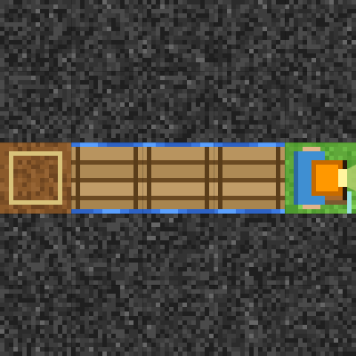
Stage 4: A long bridge Answer
1 for i in range(3):
2 place()
3 forward()
4 forward()
🎉 Clear!
✨ Key point
You have 3 blocks, so after 3 place() calls you have exactly 0.
Notes:
[Key point] You have 3 blocks, so after 3 place() calls you have exactly 0.
[Common mistake] With range(4), the 4th place() runs out of blocks.
[Answer code]
for i in range(3):
place()
forward()
forward()
[Video] videos/en/pycraft-04.mp4 (also on the videos page, videos.html)
[Check in the app] Open python-craft.html?sensei, choose stage 4, then “📖 Answer” → “▶ Run”.

Slide 17
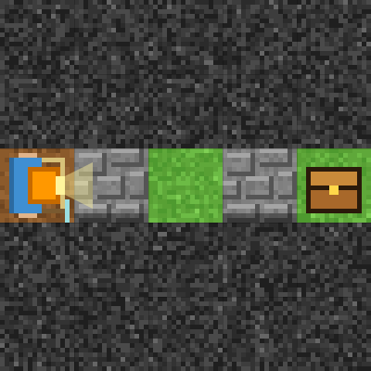
Stage 5: if front_is('stone'):
🎯 Goal
Check with if front_is('stone'):
📝 Task
front_is('stone') checks if the front is a stone block. Use if so you only break where there is stone.
Notes:
[Goal] Check with if front_is('stone'):
[Concepts] Conditions / Loops / Nesting / Python syntax (colon & indent)
[How to start]
Look at the board and trace the path to the goal with a finger. The explorer’s light shows “front”.
[Task] front_is('stone') checks if the front is a stone block. Use if so you only break where there is stone.

Slide 18
Stage 5: if front_is('stone'): Hint
💡
How to think
for i in range(4): if front_is('stone'): mine() → forward()
Notes:
[Questions to ask]
- “Which way is it facing at the start?”
- “Is there a set of moves that repeats?”
- “Run it and see where it stops.”
[Common mistake]
"stone" with double quotes is OK, but other words like 'rock' cause a ValueError.

Slide 19
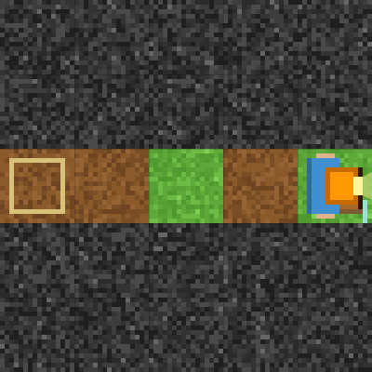
Stage 5: if front_is('stone'): Answer
1 for i in range(4):
2 if front_is('stone'):
3 mine()
4 forward()
🎉 Clear!
✨ Key point
front_is('stone') is True if the front is stone. Indent one more level inside if.
Notes:
[Key point] front_is('stone') is True if the front is stone. Indent one more level inside if.
[Common mistake] "stone" with double quotes is OK, but other words like 'rock' cause a ValueError.
[Answer code]
for i in range(4):
if front_is('stone'):
mine()
forward()
[Video] videos/en/pycraft-05.mp4 (also on the videos page, videos.html)
[Check in the app] Open python-craft.html?sensei, choose stage 5, then “📖 Answer” → “▶ Run”.

Slide 20
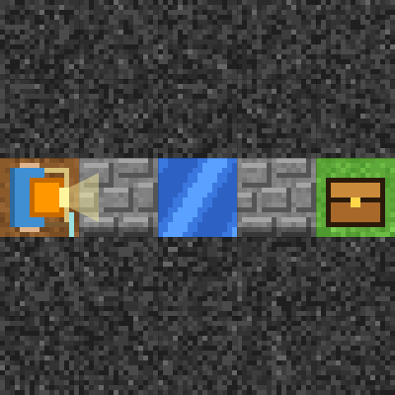
Stage 6: Stone and water with elif
🎯 Goal
Split into two cases with elif
📝 Task
Stone and water are mixed. If it is stone, mine(); elif it is water, place(). Breaking gives you a block, and placing uses one.
Notes:
[Goal] Split into two cases with elif
[Concepts] Conditions / Loops / Nesting / Counting / Python syntax (colon & indent)
[How to start]
Look at the board and trace the path to the goal with a finger. The explorer’s light shows “front”.
[Task] Stone and water are mixed. If it is stone, mine(); elif it is water, place(). Breaking gives you a block, and placing uses one.

Slide 21
Stage 6: Stone and water with elif Hint
💡
How to think
for i in range(4): if front_is('stone'): mine() / elif front_is('water'): place() / forward()
Notes:
[Questions to ask]
- “Which way is it facing at the start?”
- “Is there a set of moves that repeats?”
- “Run it and see where it stops.”
[Common mistake]
Writing “else if” causes a SyntaxError. Write elif at the same depth as if.

Slide 22
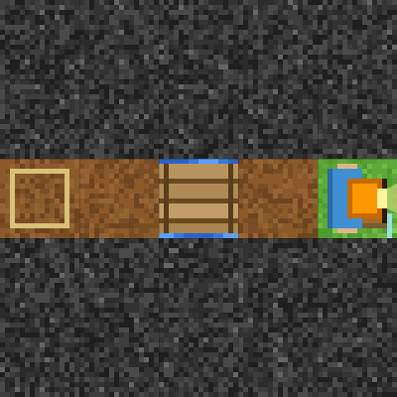
Stage 6: Stone and water with elif Answer
1 for i in range(4):
2 if front_is('stone'):
3 mine()
4 elif front_is('water'):
5 place()
6 forward()
🎉 Clear!
✨ Key point
Stone → mine(), else if water → place(). Breaking adds one and placing uses one (0 → 1 → 0 → 1).
Notes:
[Key point] Stone → mine(), else if water → place(). Breaking adds one and placing uses one (0 → 1 → 0 → 1).
[Common mistake] Writing “else if” causes a SyntaxError. Write elif at the same depth as if.
[Answer code]
for i in range(4):
if front_is('stone'):
mine()
elif front_is('water'):
place()
forward()
[Video] videos/en/pycraft-06.mp4 (also on the videos page, videos.html)
[Check in the app] Open python-craft.html?sensei, choose stage 6, then “📖 Answer” → “▶ Run”.

Slide 23
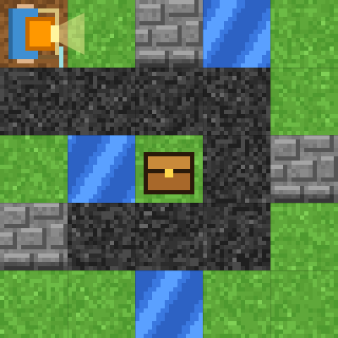
Stage 7: Spiral cave
🎯 Goal
Check the front as you go
📝 Task
Use “while not at_goal():” and decide by checking the front: stone → mine(), water → place(), path → forward(), otherwise turn_right().
Notes:
[Goal] Check the front as you go
[Concepts] Conditions / Repeat until / Nesting / Generalization / Python syntax (colon & indent)
[How to start]
Look at the board and trace the path to the goal with a finger. The explorer’s light shows “front”.
[Task] Use “while not at_goal():” and decide by checking the front: stone → mine(), water → place(), path → forward(), otherwise turn_right().

Slide 24
Stage 7: Spiral cave Hint
💡
How to think
while not at_goal(): if front_is('stone') … elif front_is('water') … elif front_is('path') … else: turn_right()
Notes:
[Questions to ask]
- “Which way is it facing at the start?”
- “Is there a set of moves that repeats?”
- “Run it and see where it stops.”
[Common mistake]
Hard dark rock is not 'stone' for front_is. When you cannot move, else turns right.

Slide 25
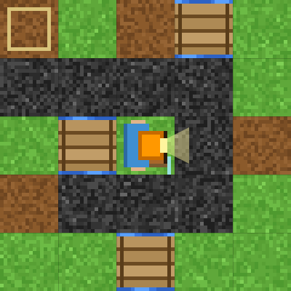
Stage 7: Spiral cave Answer
1 while not at_goal():
2 if front_is('stone'):
3 mine()
4 elif front_is('water'):
5 place()
6 elif front_is('path'):
7 forward()
8 else:
9 turn_right()
🎉 Clear!
✨ Key point
if, elif, elif and else split it into 4 cases. You check the front again on every loop.
Notes:
[Key point] if, elif, elif and else split it into 4 cases. You check the front again on every loop.
[Common mistake] Hard dark rock is not 'stone' for front_is. When you cannot move, else turns right.
[Answer code]
while not at_goal():
if front_is('stone'):
mine()
elif front_is('water'):
place()
elif front_is('path'):
forward()
else:
turn_right()
[Video] videos/en/pycraft-07.mp4 (also on the videos page, videos.html)
[Check in the app] Open python-craft.html?sensei, choose stage 7, then “📖 Answer” → “▶ Run”.

Slide 26
Reflection
🤔
🛠
🚀
How are if and elif different?
What did you write inside front_is('stone')?
Where did you add a new case?
📜
Clear every stage to get a certificate! Type your name and print it.
Notes:
[Running the reflection]
Discuss one question at a time in pairs or groups, then ask 2–3 students to share with the class.
[Certificate] Clearing every stage shows a certificate (device date; issued by Yasuhito Inoue, NIT Maizuru College). Open it again from “⚙ Settings → 📜”. It prints on A4 landscape.
[Next step] Try the other Python apps too.

