Slide 1
🧭 Arrow Maze
Lesson slides: 6 stages
やじるしの めいろ
Notes:
[About these slides]
Lesson slides for Arrow Maze (maze-junior.html). Each stage has 3 slides: Task → Hint → Answer.
The slides use simple words for students; notes for teachers are here in the notes area.
Show the Answer slide only after students have tried.

Slide 2
What you will learn
🧭
Sequence
Direction
Stage 1, 2, 3, 4, 5
Stage 2, 4, 5
For younger kids. Move the explorer to the diamond with up, down, left and right arrows. Learn about order without thinking about directions.
Patterns
Loops
Stage 3, 6
Stage 6
Notes:
[Lesson aims]
For younger kids. Move the explorer to the diamond with up, down, left and right arrows. Learn about order without thinking about directions.
[Concepts and stages]
・Sequence: Stage 1, 2, 3, 4, 5
・Direction: Stage 2, 4, 5
・Patterns: Stage 3, 6
・Loops: Stage 6

Slide 3
How to use
🗂
🧩
▶
🔁
1. Choose a stage
2. Connect blocks
3. Run it
4. Fix and try again
Pick a stage from the list at the top right and read the task.
Drag blocks from the left and stack them in order.
Press “▶ Run”. The block that is running lights up.
If it fails, press “↺ Restart”. Stuck? Press “💡 Hint”.
Notes:
[Opening]
Add “maze-junior.html” to the end of your published address.
[Teacher mode]
Add “?sensei” to the address to show the “📖 Answer” button and load answers (e.g. maze-junior.html?sensei).
[Next player]
When students share a device, press “⚙ Settings → 🔄 Next player” twice to reset the records.

Slide 4
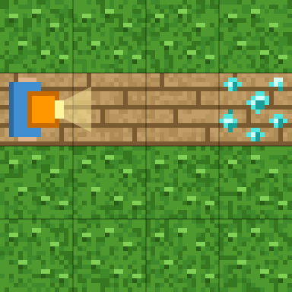
Stage 1: Go right
🎯 Goal
Line up arrows to move
📝 Task
Stack three "right ➡" arrows and go to the diamond 💎.
Notes:
[Goal] Line up arrows to move
[Concepts] Sequence
[How to start]
Look at the board and trace the path to the goal with a finger. The explorer’s light shows “front”.
[Task] Stack three "right ➡" arrows and go to the diamond 💎.

Slide 5
Stage 1: Go right Hint
💡
How to think
The diamond is 3 squares away.
Notes:
[Questions to ask]
- “Which way is it facing at the start?”
- “Is there a set of moves that repeats?”
- “Run it and see where it stops.”
[Common mistake]
With 2 arrows you fall short; with 4 you bump into the bushes.

Slide 6
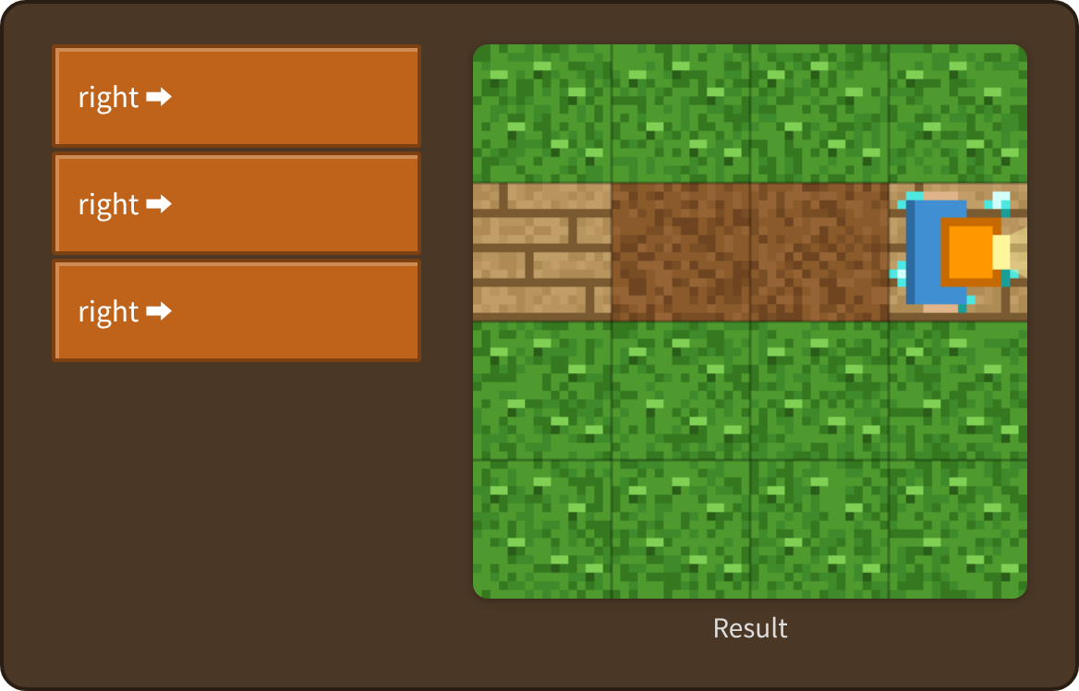
Stage 1: Go right Answer
✨ Key point
One arrow moves one square. Count the squares to the diamond and stack that many.
⚠ Watch out
With 2 arrows you fall short; with 4 you bump into the bushes.
Notes:
[Key point] One arrow moves one square. Count the squares to the diamond and stack that many.
[Common mistake] With 2 arrows you fall short; with 4 you bump into the bushes.
[Video] videos/en/mazejr-01.mp4 (also on the videos page, videos.html)
[Check in the app] Open maze-junior.html?sensei, choose stage 1, then “📖 Answer” → “▶ Run”.

Slide 7
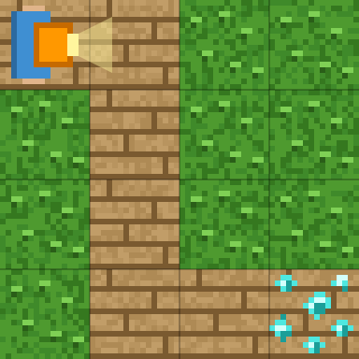
Stage 2: Go down
🎯 Goal
Use two kinds of arrows
📝 Task
Use "right ➡" and "down ⬇".
Notes:
[Goal] Use two kinds of arrows
[Concepts] Sequence / Direction
[How to start]
Look at the board and trace the path to the goal with a finger. The explorer’s light shows “front”.
[Task] Use "right ➡" and "down ⬇".

Slide 8
Stage 2: Go down Hint
💡
How to think
right, then down 3 times, then right 2 times.
Notes:
[Questions to ask]
- “Which way is it facing at the start?”
- “Is there a set of moves that repeats?”
- “Run it and see where it stops.”
[Common mistake]
If you use the wrong number of “down” arrows, you bump into the bushes.

Slide 9
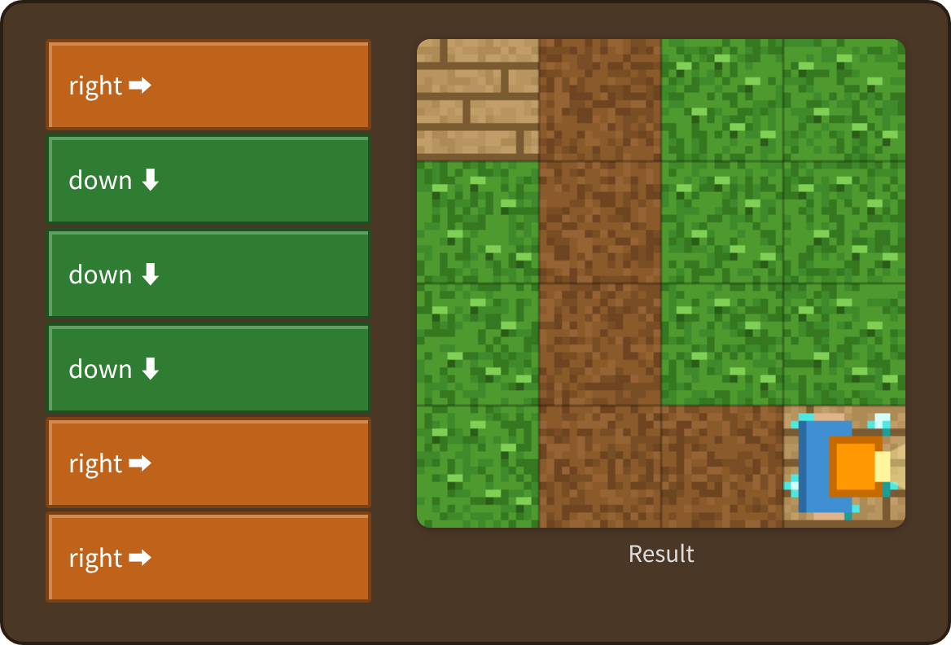
Stage 2: Go down Answer
✨ Key point
Right → down → right. Put the arrows in the order you go.
⚠ Watch out
If you use the wrong number of “down” arrows, you bump into the bushes.
Notes:
[Key point] Right → down → right. Put the arrows in the order you go.
[Common mistake] If you use the wrong number of “down” arrows, you bump into the bushes.
[Video] videos/en/mazejr-02.mp4 (also on the videos page, videos.html)
[Check in the app] Open maze-junior.html?sensei, choose stage 2, then “📖 Answer” → “▶ Run”.

Slide 10
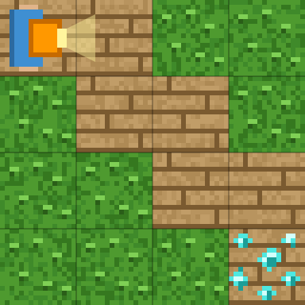
Stage 3: Stairs
🎯 Goal
Find the alternating pattern
📝 Task
Right and down, one after the other.
Notes:
[Goal] Find the alternating pattern
[Concepts] Sequence / Patterns
[How to start]
Look at the board and trace the path to the goal with a finger. The explorer’s light shows “front”.
[Task] Right and down, one after the other.

Slide 11
Stage 3: Stairs Hint
💡
How to think
right, down, right, down, right, down
Notes:
[Questions to ask]
- “Which way is it facing at the start?”
- “Is there a set of moves that repeats?”
- “Run it and see where it stops.”
[Common mistake]
Two “right” arrows in a row bump into the bushes.

Slide 12
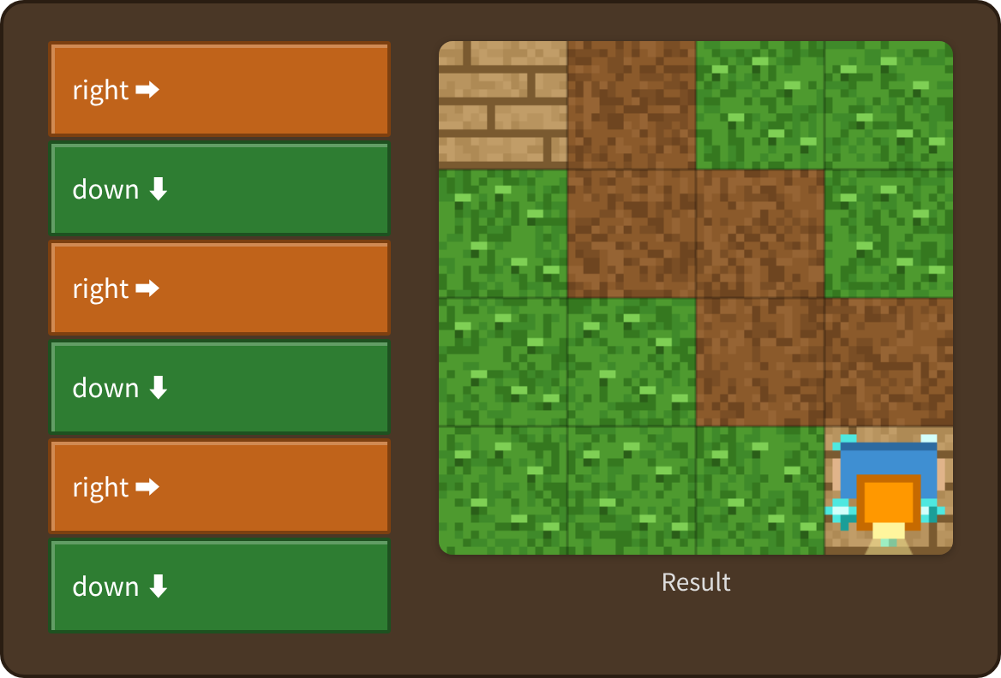
Stage 3: Stairs Answer
✨ Key point
Right, down, right, down… the same pair keeps going.
⚠ Watch out
Two “right” arrows in a row bump into the bushes.
Notes:
[Key point] Right, down, right, down… the same pair keeps going.
[Common mistake] Two “right” arrows in a row bump into the bushes.
[Video] videos/en/mazejr-03.mp4 (also on the videos page, videos.html)
[Check in the app] Open maze-junior.html?sensei, choose stage 3, then “📖 Answer” → “▶ Run”.

Slide 13
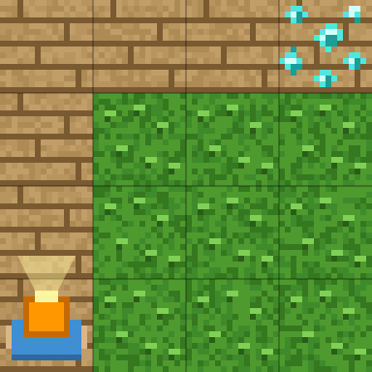
Stage 4: Go up
🎯 Goal
Use “up” too
📝 Task
Now use "up ⬆" too.
Notes:
[Goal] Use “up” too
[Concepts] Sequence / Direction
[How to start]
Look at the board and trace the path to the goal with a finger. The explorer’s light shows “front”.
[Task] Now use "up ⬆" too.

Slide 14
Stage 4: Go up Hint
💡
How to think
up 3 times, then right 3 times.
Notes:
[Questions to ask]
- “Which way is it facing at the start?”
- “Is there a set of moves that repeats?”
- “Run it and see where it stops.”
[Common mistake]
If you start with “right”, you bump into the bushes right away.

Slide 15
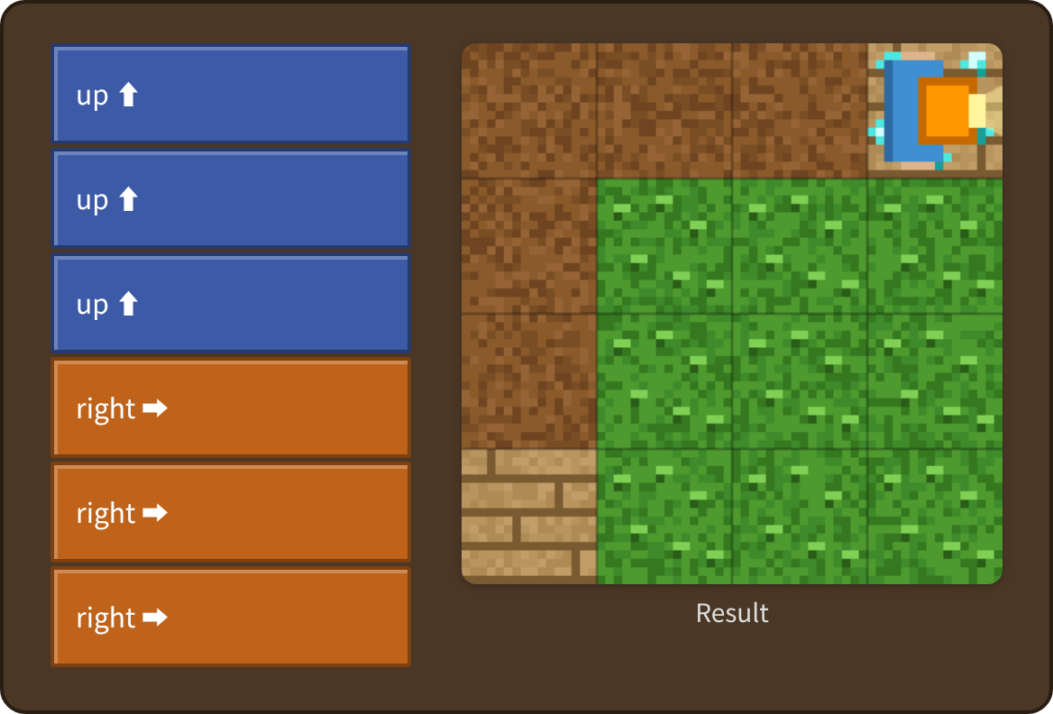
Stage 4: Go up Answer
✨ Key point
You start at the bottom left. First up 3, then right 3.
⚠ Watch out
If you start with “right”, you bump into the bushes right away.
Notes:
[Key point] You start at the bottom left. First up 3, then right 3.
[Common mistake] If you start with “right”, you bump into the bushes right away.
[Video] videos/en/mazejr-04.mp4 (also on the videos page, videos.html)
[Check in the app] Open maze-junior.html?sensei, choose stage 4, then “📖 Answer” → “▶ Run”.

Slide 16
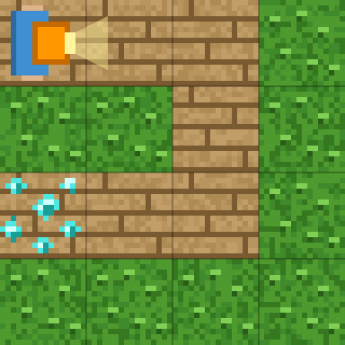
Stage 5: Go around
🎯 Goal
Use all four arrows
📝 Task
Use all four arrows.
Notes:
[Goal] Use all four arrows
[Concepts] Sequence / Direction
[How to start]
Look at the board and trace the path to the goal with a finger. The explorer’s light shows “front”.
[Task] Use all four arrows.

Slide 17
Stage 5: Go around Hint
💡
How to think
right 2, down 2, left 2.
Notes:
[Questions to ask]
- “Which way is it facing at the start?”
- “Is there a set of moves that repeats?”
- “Run it and see where it stops.”
[Common mistake]
“Left” and “right” are easy to mix up. They mean left and right on the screen.

Slide 18
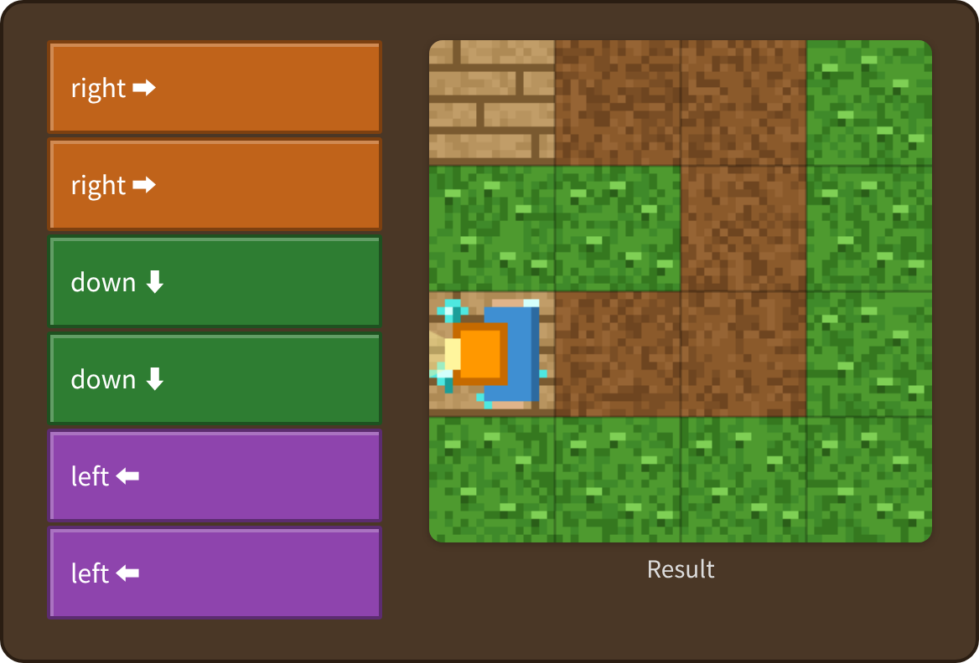
Stage 5: Go around Answer
✨ Key point
Right → down → left. Go around to the diamond.
⚠ Watch out
“Left” and “right” are easy to mix up. They mean left and right on the screen.
Notes:
[Key point] Right → down → left. Go around to the diamond.
[Common mistake] “Left” and “right” are easy to mix up. They mean left and right on the screen.
[Video] videos/en/mazejr-05.mp4 (also on the videos page, videos.html)
[Check in the app] Open maze-junior.html?sensei, choose stage 5, then “📖 Answer” → “▶ Run”.

Slide 19
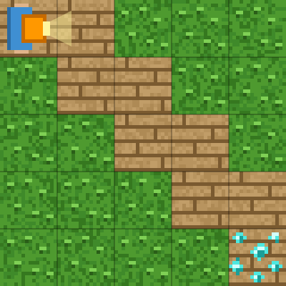
Stage 6: Use repeat
🎯 Goal
Make it shorter with repeat
📝 Task
A long staircase! Put "right ➡ down ⬇" inside "repeat".
Target: 3 blocks or fewer
Notes:
[Goal] Make it shorter with repeat
[Concepts] Loops / Patterns
[How to start]
Look at the board and trace the path to the goal with a finger. The explorer’s light shows “front”.
The target is 3 blocks or fewer.
[Task] A long staircase! Put "right ➡ down ⬇" inside "repeat".

Slide 20
Stage 6: Use repeat Hint
💡
How to think
repeat 4 times: right, down
Notes:
[Questions to ask]
- “Which way is it facing at the start?”
- “Is there a set of moves that repeats?”
- “Run it and see where it stops.”
[Common mistake]
With 3 repeats you stop just before the diamond.

Slide 21
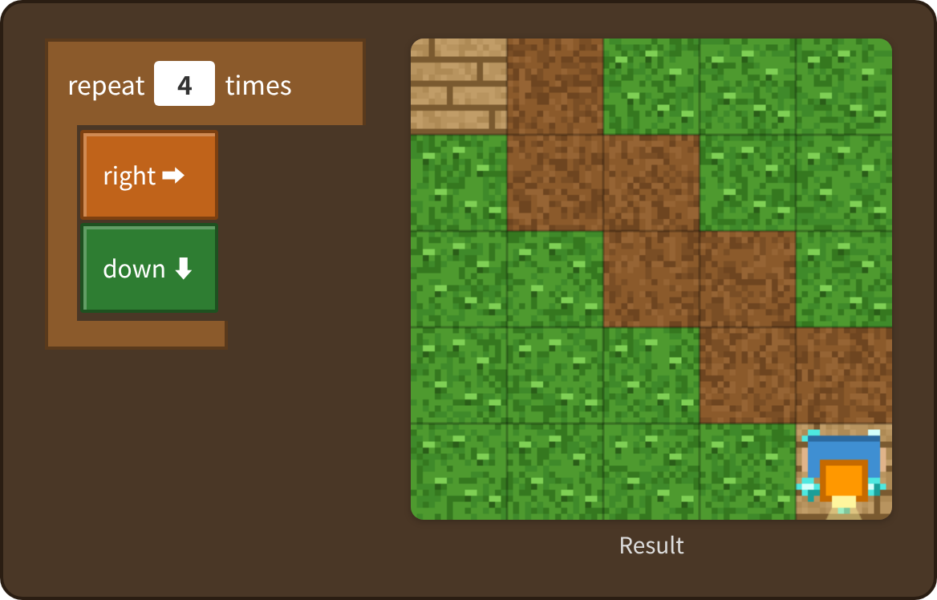
Stage 6: Use repeat Answer
✨ Key point
Repeat the “right, down” set 4 times. Just 3 blocks!
⚠ Watch out
With 3 repeats you stop just before the diamond.
Notes:
[Key point] Repeat the “right, down” set 4 times. Just 3 blocks!
[Common mistake] With 3 repeats you stop just before the diamond.
[Video] videos/en/mazejr-06.mp4 (also on the videos page, videos.html)
[Check in the app] Open maze-junior.html?sensei, choose stage 6, then “📖 Answer” → “▶ Run”.

Slide 22
Reflection
🤔
🛠
🚀
How many arrows did you use?
What happened when the order was wrong?
Where could you make it shorter with repeat?
📜
Clear every stage to get a certificate! Type your name and print it.
Notes:
[Running the reflection]
Discuss one question at a time in pairs or groups, then ask 2–3 students to share with the class.
[Certificate] Clearing every stage shows a certificate (device date; issued by Yasuhito Inoue, NIT Maizuru College). Open it again from “⚙ Settings → 📜”. It prints on A4 landscape.
[Next step] Use “⚙ Settings → 🐍 Switch to Python” to solve the same world with Python.

