Slide 1
🗝 Keys & Doors Maze
Lesson slides: 4 stages
かぎと とびらの めいろ
Notes:
[About these slides]
Lesson slides for Keys & Doors Maze (maze-key.html). Each stage has 3 slides: Task → Hint → Answer.
The slides use simple words for students; notes for teachers are here in the notes area.
Show the Answer slide only after students have tried.

Slide 2
What you will learn
🗝
Sequence
State
Stage 1, 2
Stage 1, 2, 3, 4
Pick up keys and open doors as you go. Practice remembering what you are carrying (state).
Decomposition
Loops
Stage 2
Stage 3
Patterns
Conditions
Stage 3
Stage 4
Notes:
[Lesson aims]
Pick up keys and open doors as you go. Practice remembering what you are carrying (state).
[Concepts and stages]
・Sequence: Stage 1, 2
・State: Stage 1, 2, 3, 4
・Decomposition: Stage 2
・Loops: Stage 3
・Patterns: Stage 3
・Conditions: Stage 4
・Repeat until: Stage 4
・Generalization: Stage 4

Slide 3
How to use
🗂
🧩
▶
🔁
1. Choose a stage
2. Connect blocks
3. Run it
4. Fix and try again
Pick a stage from the list at the top right and read the task.
Drag blocks from the left and stack them in order.
Press “▶ Run”. The block that is running lights up.
If it fails, press “↺ Restart”. Stuck? Press “💡 Hint”.
Notes:
[Opening]
Add “maze-key.html” to the end of your published address.
[Teacher mode]
Add “?sensei” to the address to show the “📖 Answer” button and load answers (e.g. maze-key.html?sensei).
[Next player]
When students share a device, press “⚙ Settings → 🔄 Next player” twice to reset the records.

Slide 4
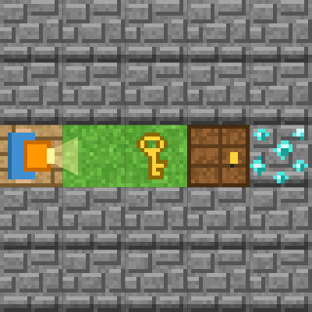
Stage 1: Pick up the key, open the door
🎯 Goal
Pick up the key and open the door
📝 Task
Move onto the key 🔑 and use "pick up key". In front of the door 🚪, use "open door" and you can go through.
Notes:
[Goal] Pick up the key and open the door
[Concepts] Sequence / State
[How to start]
Look at the board and trace the path to the goal with a finger. The explorer’s light shows “front”.
[Task] Move onto the key 🔑 and use "pick up key". In front of the door 🚪, use "open door" and you can go through.

Slide 5
Stage 1: Pick up the key, open the door Hint
💡
How to think
forward → forward → pick up key → open door → forward → forward
Notes:
[Questions to ask]
- “Which way is it facing at the start?”
- “Is there a set of moves that repeats?”
- “Run it and see where it stops.”
[Common mistake]
Picking up when you are not on the key gives “There is no key here.” Check how far you move.

Slide 6
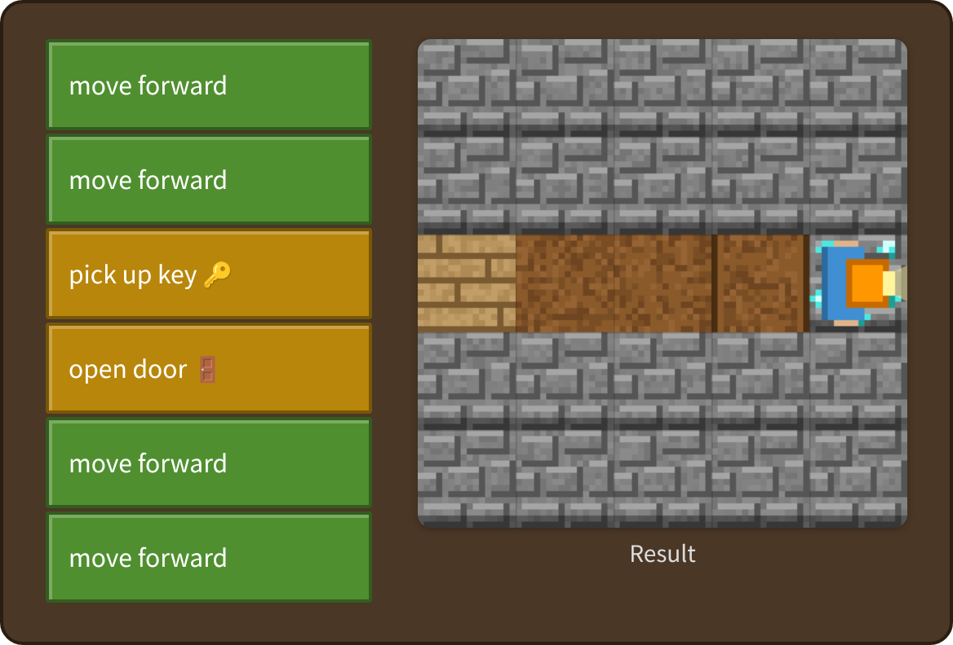
Stage 1: Pick up the key, open the door Answer
✨ Key point
“Pick up key” makes your key count 1, and “open door” brings it back to 0.
⚠ Watch out
Picking up when you are not on the key gives “There is no key here.” Check how far you move.
Notes:
[Key point] “Pick up key” makes your key count 1, and “open door” brings it back to 0.
[Common mistake] Picking up when you are not on the key gives “There is no key here.” Check how far you move.
[Video] videos/en/mazekey-01.mp4 (also on the videos page, videos.html)
[Check in the app] Open maze-key.html?sensei, choose stage 1, then “📖 Answer” → “▶ Run”.

Slide 7
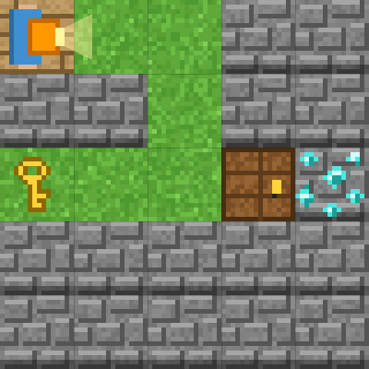
Stage 2: Where is the key?
🎯 Goal
Get the key first
📝 Task
The diamond is behind the door. Go and get the key first. Without a key, the door will not open.
Notes:
[Goal] Get the key first
[Concepts] Sequence / State / Decomposition
[How to start]
Look at the board and trace the path to the goal with a finger. The explorer’s light shows “front”.
[Task] The diamond is behind the door. Go and get the key first. Without a key, the door will not open.

Slide 8
Stage 2: Where is the key? Hint
💡
How to think
Walk to the key and pick it up. Then turn right twice and go back.
Notes:
[Questions to ask]
- “Which way is it facing at the start?”
- “Is there a set of moves that repeats?”
- “Run it and see where it stops.”
[Common mistake]
Going to the door without a key gives “The door is locked. Where is the key?”

Slide 9
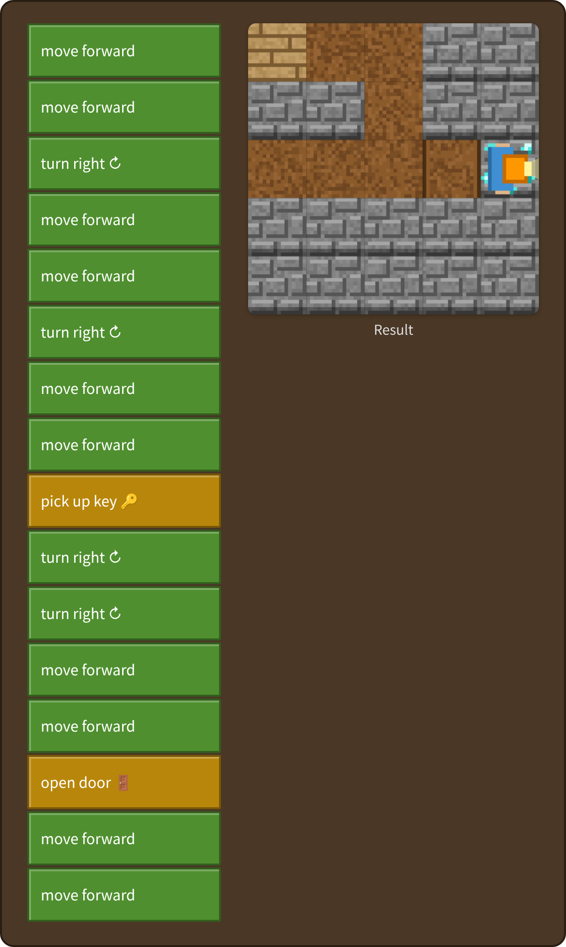
Stage 2: Where is the key? Answer
✨ Key point
Take a side trip before the goal. Think of it as “get the key” and “go back to the door”.
⚠ Watch out
Going to the door without a key gives “The door is locked. Where is the key?”
Notes:
[Key point] Take a side trip before the goal. Think of it as “get the key” and “go back to the door”.
[Common mistake] Going to the door without a key gives “The door is locked. Where is the key?”
[Video] videos/en/mazekey-02.mp4 (also on the videos page, videos.html)
[Check in the app] Open maze-key.html?sensei, choose stage 2, then “📖 Answer” → “▶ Run”.

Slide 10
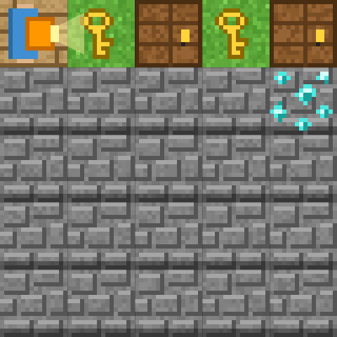
Stage 3: Two doors
🎯 Goal
Repeat the same set
📝 Task
Keys and doors are in a row. Find the set of moves that repeats and use "repeat".
Target: 7 blocks or fewer
Notes:
[Goal] Repeat the same set
[Concepts] Loops / Patterns / State
[How to start]
Look at the board and trace the path to the goal with a finger. The explorer’s light shows “front”.
The target is 7 blocks or fewer.
[Task] Keys and doors are in a row. Find the set of moves that repeats and use "repeat".

Slide 11
Stage 3: Two doors Hint
💡
How to think
Repeat 2 times: forward → pick up key → open door → forward. Then turn right and move forward.
Notes:
[Questions to ask]
- “Which way is it facing at the start?”
- “Is there a set of moves that repeats?”
- “Run it and see where it stops.”
[Common mistake]
If you forget “move forward” after “open door”, you never reach the next key.

Slide 12
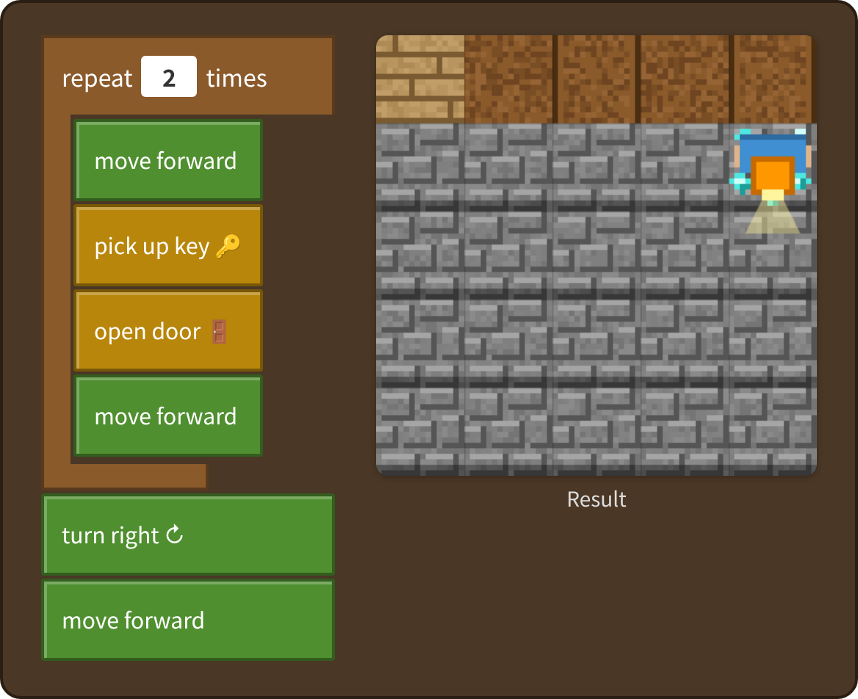
Stage 3: Two doors Answer
✨ Key point
Key → door appears twice. Repeat the 4 blocks 2 times.
⚠ Watch out
If you forget “move forward” after “open door”, you never reach the next key.
Notes:
[Key point] Key → door appears twice. Repeat the 4 blocks 2 times.
[Common mistake] If you forget “move forward” after “open door”, you never reach the next key.
[Video] videos/en/mazekey-03.mp4 (also on the videos page, videos.html)
[Check in the app] Open maze-key.html?sensei, choose stage 3, then “📖 Answer” → “▶ Run”.

Slide 13
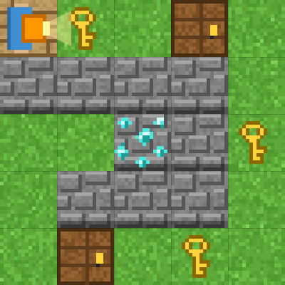
Stage 4: A thinking explorer
🎯 Goal
Check and decide by yourself
📝 Task
Use "repeat until goal" and "if". Make a program that picks up a key when it finds one and opens a door when there is one.
Target: 8 blocks or fewer
Notes:
[Goal] Check and decide by yourself
[Concepts] Conditions / Repeat until / State / Generalization
[How to start]
Look at the board and trace the path to the goal with a finger. The explorer’s light shows “front”.
The target is 8 blocks or fewer.
[Task] Use "repeat until goal" and "if". Make a program that picks up a key when it finds one and opens a door when there is one.

Slide 14
Stage 4: A thinking explorer Hint
💡
How to think
Inside the loop: if key here → pick up key; if door in front → open door; if front is open → forward, else → turn right.
Notes:
[Questions to ask]
- “Which way is it facing at the start?”
- “Is there a set of moves that repeats?”
- “Run it and see where it stops.”
[Common mistake]
If “if front is open” comes before “if door in front”, you turn around at the door.

Slide 15
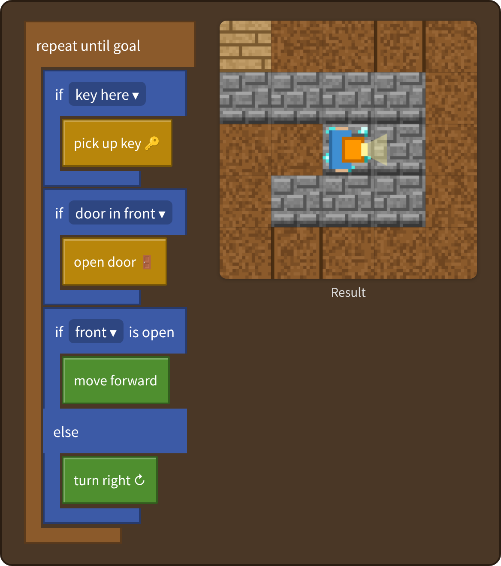
Stage 4: A thinking explorer Answer
✨ Key point
Pick up a key when you find one, open a door when there is one, and then go forward or turn right. Check all three every time.
⚠ Watch out
If “if front is open” comes before “if door in front”, you turn around at the door.
Notes:
[Key point] Pick up a key when you find one, open a door when there is one, and then go forward or turn right. Check all three every time.
[Common mistake] If “if front is open” comes before “if door in front”, you turn around at the door.
[Video] videos/en/mazekey-04.mp4 (also on the videos page, videos.html)
[Check in the app] Open maze-key.html?sensei, choose stage 4, then “📖 Answer” → “▶ Run”.

Slide 16
Reflection
🤔
🛠
🚀
How did the number of keys change?
How did you decide the order for getting keys?
Why was checking with “if” useful?
📜
Clear every stage to get a certificate! Type your name and print it.
Notes:
[Running the reflection]
Discuss one question at a time in pairs or groups, then ask 2–3 students to share with the class.
[Certificate] Clearing every stage shows a certificate (device date; issued by Yasuhito Inoue, NIT Maizuru College). Open it again from “⚙ Settings → 📜”. It prints on A4 landscape.
[Next step] Use “⚙ Settings → 🐍 Switch to Python” to solve the same world with Python.

