Slide 1
👾 Dodge the Slime Maze
Lesson slides: 4 stages
てきを よける めいろ
Notes:
[About these slides]
Lesson slides for Dodge the Slime Maze (maze-enemy.html). Each stage has 3 slides: Task → Hint → Answer.
The slides use simple words for students; notes for teachers are here in the notes area.
Show the Answer slide only after students have tried.

Slide 2
What you will learn
👾
Sequence
Timing
Stage 1
Stage 1, 2, 3, 4
Dodge slimes that move back and forth by waiting. Learn about timing and “if”.
Conditions
Repeat until
Stage 2, 3
Stage 2, 3, 4
Nesting
Generalization
Stage 3
Stage 4
Notes:
[Lesson aims]
Dodge slimes that move back and forth by waiting. Learn about timing and “if”.
[Concepts and stages]
・Sequence: Stage 1
・Timing: Stage 1, 2, 3, 4
・Conditions: Stage 2, 3
・Repeat until: Stage 2, 3, 4
・Nesting: Stage 3
・Generalization: Stage 4

Slide 3
How to use
🗂
🧩
▶
🔁
1. Choose a stage
2. Connect blocks
3. Run it
4. Fix and try again
Pick a stage from the list at the top right and read the task.
Drag blocks from the left and stack them in order.
Press “▶ Run”. The block that is running lights up.
If it fails, press “↺ Restart”. Stuck? Press “💡 Hint”.
Notes:
[Opening]
Add “maze-enemy.html” to the end of your published address.
[Teacher mode]
Add “?sensei” to the address to show the “📖 Answer” button and load answers (e.g. maze-enemy.html?sensei).
[Next player]
When students share a device, press “⚙ Settings → 🔄 Next player” twice to reset the records.

Slide 4
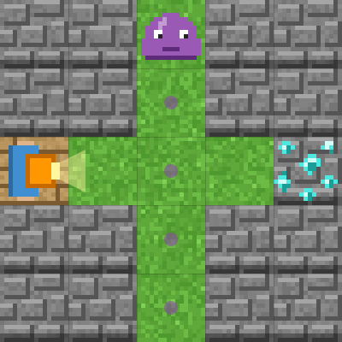
Stage 1: Wait and dodge
🎯 Goal
Wait to time your move
📝 Task
The slime goes up and down. Use "wait" to time your move so you do not bump into it.
Notes:
[Goal] Wait to time your move
[Concepts] Sequence / Timing
[How to start]
Look at the board and trace the path to the goal with a finger. The explorer’s light shows “front”.
[Task] The slime goes up and down. Use "wait" to time your move so you do not bump into it.

Slide 5
Stage 1: Wait and dodge Hint
💡
How to think
Move 1 square, then wait 2 times until the slime passes. Then move 3 squares.
Notes:
[Questions to ask]
- “Which way is it facing at the start?”
- “Is there a set of moves that repeats?”
- “Run it and see where it stops.”
[Common mistake]
With only one “wait”, you walk right into the slime.

Slide 6
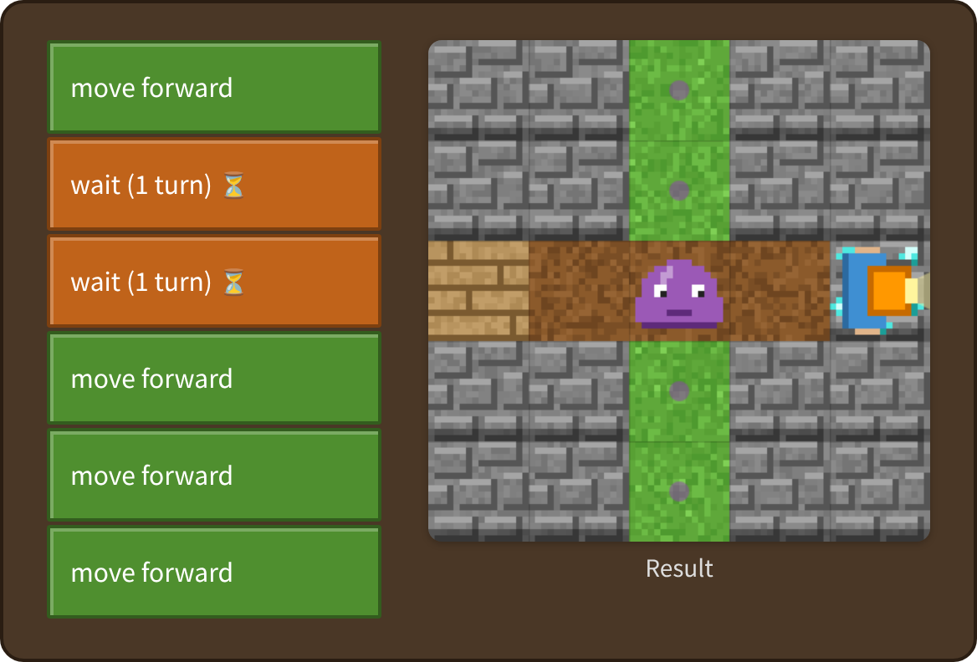
Stage 1: Wait and dodge Answer
✨ Key point
The slime moves one square each turn. Wait 2 times until it passes.
⚠ Watch out
With only one “wait”, you walk right into the slime.
Notes:
[Key point] The slime moves one square each turn. Wait 2 times until it passes.
[Common mistake] With only one “wait”, you walk right into the slime.
[Video] videos/en/mazeenemy-01.mp4 (also on the videos page, videos.html)
[Check in the app] Open maze-enemy.html?sensei, choose stage 1, then “📖 Answer” → “▶ Run”.

Slide 7
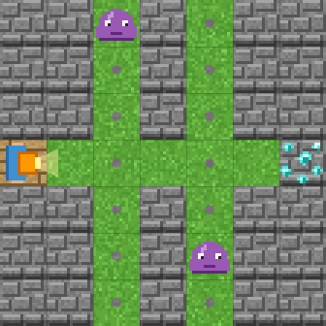
Stage 2: Wait if it is dangerous
🎯 Goal
Wait when it is dangerous
📝 Task
Use "if danger ahead". It is dangerous when a slime is in front of you, or will move in front of you next.
Target: 4 blocks or fewer
Notes:
[Goal] Wait when it is dangerous
[Concepts] Conditions / Repeat until / Timing
[How to start]
Look at the board and trace the path to the goal with a finger. The explorer’s light shows “front”.
The target is 4 blocks or fewer.
[Task] Use "if danger ahead". It is dangerous when a slime is in front of you, or will move in front of you next.

Slide 8
Stage 2: Wait if it is dangerous Hint
💡
How to think
Repeat until goal: if danger ahead → wait, else → move forward.
Notes:
[Questions to ask]
- “Which way is it facing at the start?”
- “Is there a set of moves that repeats?”
- “Run it and see where it stops.”
[Common mistake]
If the “if” is outside the loop, it checks only once.

Slide 9
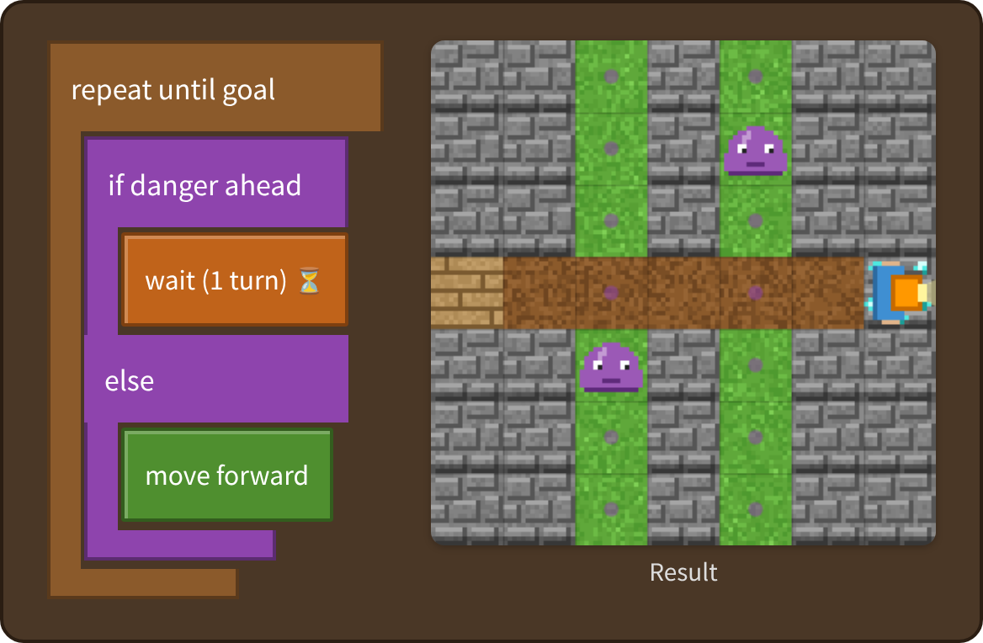
Stage 2: Wait if it is dangerous Answer
✨ Key point
“Danger” means a slime is in front or will come there next. If so, wait; if not, move.
⚠ Watch out
If the “if” is outside the loop, it checks only once.
Notes:
[Key point] “Danger” means a slime is in front or will come there next. If so, wait; if not, move.
[Common mistake] If the “if” is outside the loop, it checks only once.
[Video] videos/en/mazeenemy-02.mp4 (also on the videos page, videos.html)
[Check in the app] Open maze-enemy.html?sensei, choose stage 2, then “📖 Answer” → “▶ Run”.

Slide 10
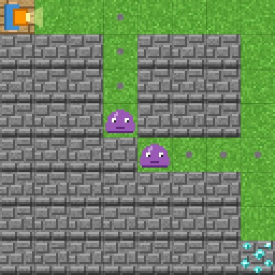
Stage 3: A bigger maze
🎯 Goal
An if inside an if
📝 Task
The maze is bigger. If it is dangerous, wait. If not: move forward when the front is open, turn right when it is blocked.
Target: 6 blocks or fewer
Notes:
[Goal] An if inside an if
[Concepts] Conditions / Nesting / Repeat until / Timing
[How to start]
Look at the board and trace the path to the goal with a finger. The explorer’s light shows “front”.
The target is 6 blocks or fewer.
[Task] The maze is bigger. If it is dangerous, wait. If not: move forward when the front is open, turn right when it is blocked.

Slide 11
Stage 3: A bigger maze Hint
💡
How to think
Repeat until goal: if danger ahead → wait, else → (if front is open → forward, else → turn right).
Notes:
[Questions to ask]
- “Which way is it facing at the start?”
- “Is there a set of moves that repeats?”
- “Run it and see where it stops.”
[Common mistake]
If you move without checking for danger, a slime catches you on the way.

Slide 12
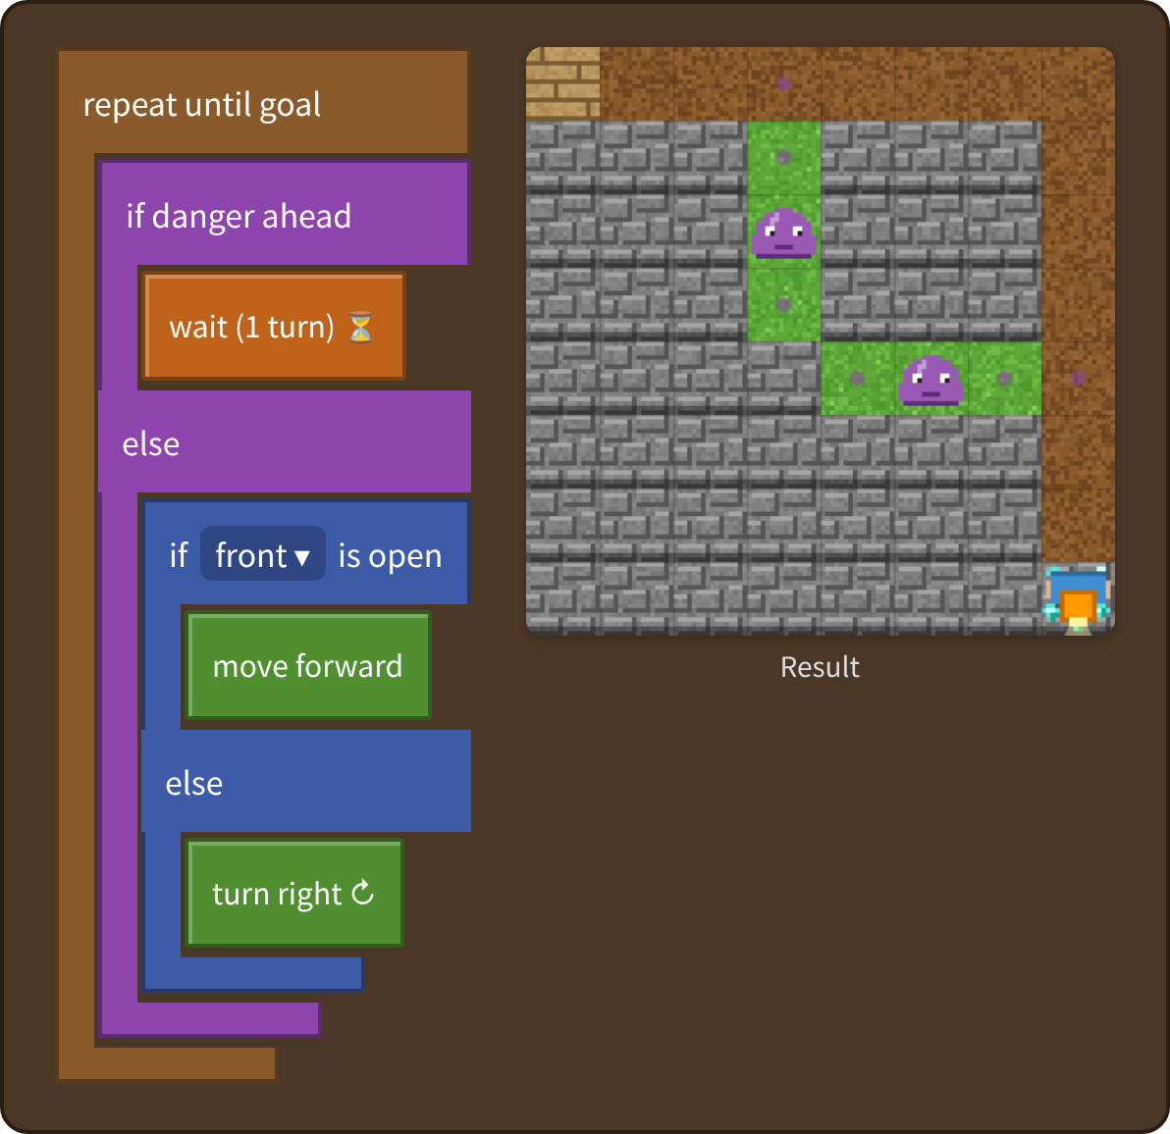
Stage 3: A bigger maze Answer
✨ Key point
First check for danger. If it is safe, check if the front is open. The order matters.
⚠ Watch out
If you move without checking for danger, a slime catches you on the way.
Notes:
[Key point] First check for danger. If it is safe, check if the front is open. The order matters.
[Common mistake] If you move without checking for danger, a slime catches you on the way.
[Video] videos/en/mazeenemy-03.mp4 (also on the videos page, videos.html)
[Check in the app] Open maze-enemy.html?sensei, choose stage 3, then “📖 Answer” → “▶ Run”.

Slide 13
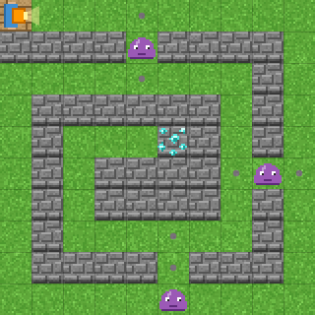
Stage 4: The spiral maze
🎯 Goal
The same program, a bigger maze
📝 Task
Last one: a 10×10 spiral with three slimes. Can the program from Stage 3 reach the goal?
Target: 6 blocks or fewer
Notes:
[Goal] The same program, a bigger maze
[Concepts] Generalization / Repeat until / Timing
[How to start]
Look at the board and trace the path to the goal with a finger. The explorer’s light shows “front”.
The target is 6 blocks or fewer.
[Task] Last one: a 10×10 spiral with three slimes. Can the program from Stage 3 reach the goal?

Slide 14
Stage 4: The spiral maze Hint
💡
How to think
Use the same program as Stage 3. The slimes cross the path, so check for danger every time.
Notes:
[Questions to ask]
- “Which way is it facing at the start?”
- “Is there a set of moves that repeats?”
- “Run it and see where it stops.”
[Common mistake]
Without “wait”, one of the three slimes catches you.

Slide 15
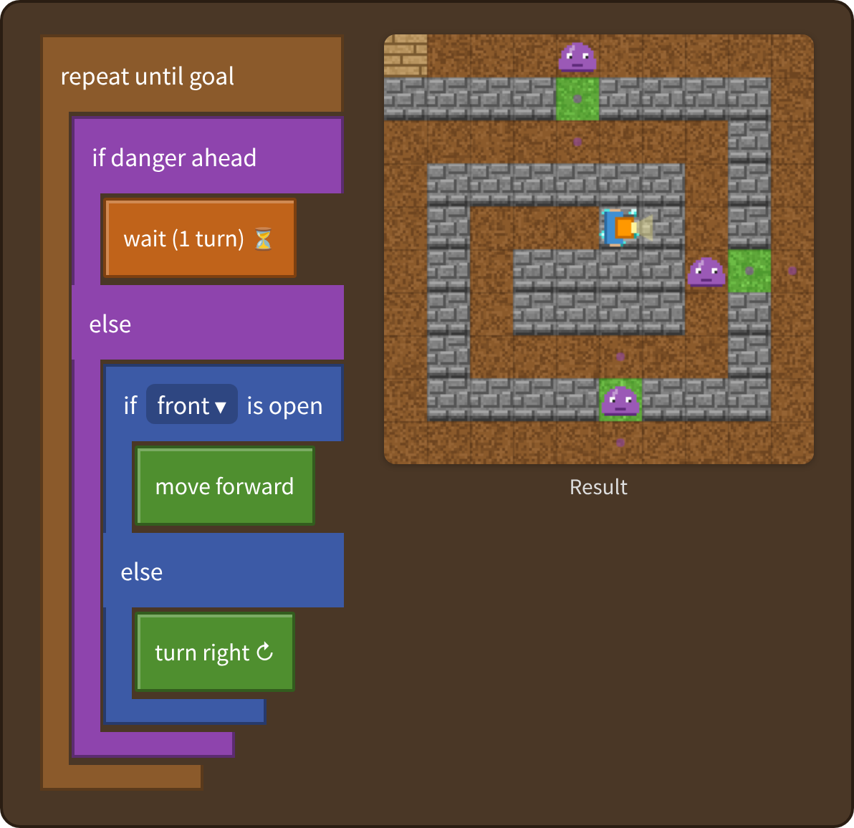
Stage 4: The spiral maze Answer
✨ Key point
The Stage 3 program works as it is. That is a method that works anywhere (generalization).
⚠ Watch out
Without “wait”, one of the three slimes catches you.
Notes:
[Key point] The Stage 3 program works as it is. That is a method that works anywhere (generalization).
[Common mistake] Without “wait”, one of the three slimes catches you.
[Video] videos/en/mazeenemy-04.mp4 (also on the videos page, videos.html)
[Check in the app] Open maze-enemy.html?sensei, choose stage 4, then “📖 Answer” → “▶ Run”.

Slide 16
Reflection
🤔
🛠
🚀
When did you use “wait”?
When is it “dangerous”?
Why did the same program work in a bigger maze?
📜
Clear every stage to get a certificate! Type your name and print it.
Notes:
[Running the reflection]
Discuss one question at a time in pairs or groups, then ask 2–3 students to share with the class.
[Certificate] Clearing every stage shows a certificate (device date; issued by Yasuhito Inoue, NIT Maizuru College). Open it again from “⚙ Settings → 📜”. It prints on A4 landscape.
[Next step] Use “⚙ Settings → 🐍 Switch to Python” to solve the same world with Python.

