Slide 1
🐍 Python Arrow Maze
Lesson slides: 6 stages
Pythonで やじるし めいろ
Notes:
[About these slides]
Lesson slides for Python Arrow Maze (python-maze-junior.html). Each stage has 3 slides: Task → Hint → Answer.
The slides use simple words for students; notes for teachers are here in the notes area.
Show the Answer slide only after students have tried.

Slide 2
What you will learn
🐍
Sequence
Python syntax (colon & indent)
Stage 1, 2, 3, 4, 5
Stage 1, 2, 3, 4, 5, 6
The Arrow Maze in Python. Use the four commands up(), down(), left(), right() and for.
Direction
Patterns
Stage 2, 4, 5
Stage 3
Loops
Stage 6
Notes:
[Lesson aims]
The Arrow Maze in Python. Use the four commands up(), down(), left(), right() and for.
[Concepts and stages]
・Sequence: Stage 1, 2, 3, 4, 5
・Python syntax (colon & indent): Stage 1, 2, 3, 4, 5, 6
・Direction: Stage 2, 4, 5
・Patterns: Stage 3
・Loops: Stage 6

Slide 3
How to use
🧩
🐍
▶
🔎
1. Start with blocks
2. Write Python
3. Run it
4. Read errors
Build with “🧩 Blocks” and the same program appears below in Python.
Write it yourself in the “🐍 Python” tab. Command buttons and Tab (4 spaces) help.
Press “▶ Run”. The line that is running turns yellow.
Errors show a line number. Look at the red line and fix it.
Notes:
[Opening]
Add “python-maze-junior.html” to the end of your published address.
You can also open it from the block app with “⚙ Settings → 🐍 Switch to Python” (it opens in Python mode).
[Teacher mode]
Add “?sensei” to the address to show the “📖 Answer” button and load answers (e.g. python-maze-junior.html?sensei).
[Next player]
When students share a device, press “⚙ Settings → 🔄 Next player” twice to reset the records.

Slide 4
Blocks and Python
Block | Python
up ⬆ | up()
down ⬇ | down()
left ⬅ | left()
right ➡ | right()
repeat 〇 times | for i in range(〇):
Rules: “:” at the end, indent lines inside by 4 spaces, “()” after commands
Notes:
[Key point]
One block becomes one line of Python. An “if” alone inside “else” becomes elif in Python.
[Common errors]
- Missing “:” → SyntaxError
- Wrong indentation → IndentationError
- Missing “()” / misspelled name → SyntaxError / NameError
Errors show the line number, so look at that line together.

Slide 5
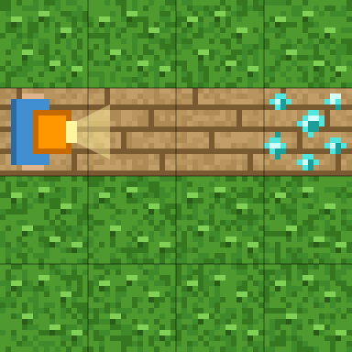
Stage 1: Go with right()
🎯 Goal
Write right()
📝 Task
right() moves one square to the right. Write it 3 times, one per line, to reach the diamond 💎.
Notes:
[Goal] Write right()
[Concepts] Sequence / Python syntax (colon & indent)
[How to start]
Look at the board and trace the path to the goal with a finger. The explorer’s light shows “front”.
[Task] right() moves one square to the right. Write it 3 times, one per line, to reach the diamond 💎.

Slide 6
Stage 1: Go with right() Hint
💡
How to think
right() on 3 lines.
Notes:
[Questions to ask]
- “Which way is it facing at the start?”
- “Is there a set of moves that repeats?”
- “Run it and see where it stops.”
[Common mistake]
Writing just right without “()” causes a SyntaxError.

Slide 7
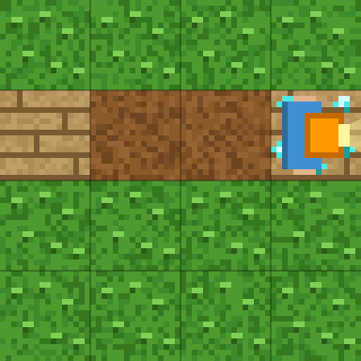
Stage 1: Go with right() Answer
1 right()
2 right()
3 right()
🎉 Clear!
✨ Key point
Python has one command per line. Three lines of right() move 3 squares.
Notes:
[Key point] Python has one command per line. Three lines of right() move 3 squares.
[Common mistake] Writing just right without “()” causes a SyntaxError.
[Answer code]
right()
right()
right()
[Video] videos/en/pymazejr-01.mp4 (also on the videos page, videos.html)
[Check in the app] Open python-maze-junior.html?sensei, choose stage 1, then “📖 Answer” → “▶ Run”.

Slide 8
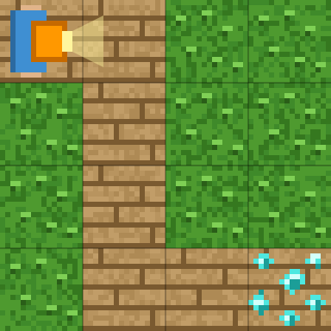
Stage 2: Go down with down()
🎯 Goal
Use down() too
📝 Task
down() moves one square down.
Notes:
[Goal] Use down() too
[Concepts] Sequence / Direction / Python syntax (colon & indent)
[How to start]
Look at the board and trace the path to the goal with a finger. The explorer’s light shows “front”.
[Task] down() moves one square down.

Slide 9
Stage 2: Go down with down() Hint
💡
How to think
right() → down() ×3 → right() ×2
Notes:
[Questions to ask]
- “Which way is it facing at the start?”
- “Is there a set of moves that repeats?”
- “Run it and see where it stops.”
[Common mistake]
Down() with a capital letter causes a NameError. Python cares about capital letters.

Slide 10
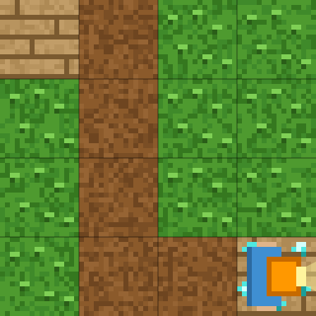
Stage 2: Go down with down() Answer
1 right()
2 down()
3 down()
4 down()
5 right()
6 right()
🎉 Clear!
✨ Key point
Write right() and down() in the order you go.
Notes:
[Key point] Write right() and down() in the order you go.
[Common mistake] Down() with a capital letter causes a NameError. Python cares about capital letters.
[Answer code]
right()
down()
down()
down()
right()
right()
[Video] videos/en/pymazejr-02.mp4 (also on the videos page, videos.html)
[Check in the app] Open python-maze-junior.html?sensei, choose stage 2, then “📖 Answer” → “▶ Run”.

Slide 11
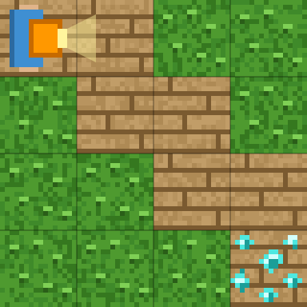
Stage 3: Stairs
🎯 Goal
Write them alternately
📝 Task
right() and down(), one after the other.
Notes:
[Goal] Write them alternately
[Concepts] Sequence / Patterns / Python syntax (colon & indent)
[How to start]
Look at the board and trace the path to the goal with a finger. The explorer’s light shows “front”.
[Task] right() and down(), one after the other.

Slide 12
Stage 3: Stairs Hint
💡
How to think
right() down() right() down() right() down()
Notes:
[Questions to ask]
- “Which way is it facing at the start?”
- “Is there a set of moves that repeats?”
- “Run it and see where it stops.”
[Common mistake]
If the order is swapped, you bump into the bushes.

Slide 13
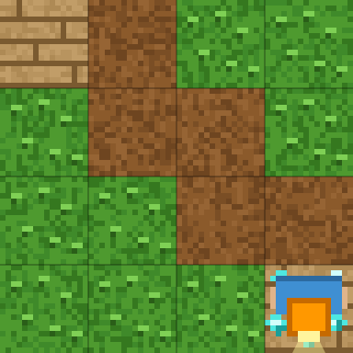
Stage 3: Stairs Answer
1 right()
2 down()
3 right()
4 down()
5 right()
6 down()
🎉 Clear!
✨ Key point
right() and down(), 3 times each, one after the other.
Notes:
[Key point] right() and down(), 3 times each, one after the other.
[Common mistake] If the order is swapped, you bump into the bushes.
[Answer code]
right()
down()
right()
down()
right()
down()
[Video] videos/en/pymazejr-03.mp4 (also on the videos page, videos.html)
[Check in the app] Open python-maze-junior.html?sensei, choose stage 3, then “📖 Answer” → “▶ Run”.

Slide 14
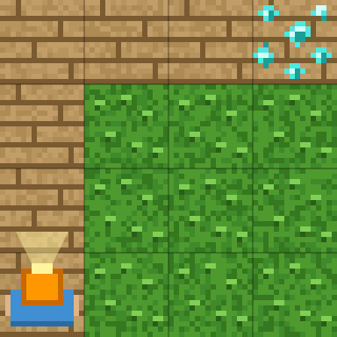
Stage 4: Go up with up()
🎯 Goal
Go up with up()
📝 Task
up() moves one square up.
Notes:
[Goal] Go up with up()
[Concepts] Sequence / Direction / Python syntax (colon & indent)
[How to start]
Look at the board and trace the path to the goal with a finger. The explorer’s light shows “front”.
[Task] up() moves one square up.

Slide 15
Stage 4: Go up with up() Hint
💡
How to think
up() ×3 → right() ×3
Notes:
[Questions to ask]
- “Which way is it facing at the start?”
- “Is there a set of moves that repeats?”
- “Run it and see where it stops.”
[Common mistake]
A space at the start of a line causes an IndentationError. Only lines inside for are indented.

Slide 16
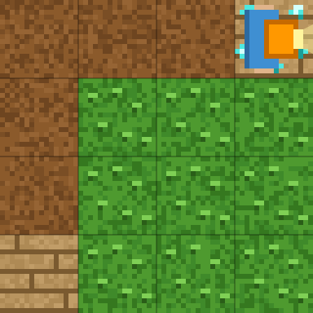
Stage 4: Go up with up() Answer
1 up()
2 up()
3 up()
4 right()
5 right()
6 right()
🎉 Clear!
✨ Key point
Three lines of up(), then three lines of right().
Notes:
[Key point] Three lines of up(), then three lines of right().
[Common mistake] A space at the start of a line causes an IndentationError. Only lines inside for are indented.
[Answer code]
up()
up()
up()
right()
right()
right()
[Video] videos/en/pymazejr-04.mp4 (also on the videos page, videos.html)
[Check in the app] Open python-maze-junior.html?sensei, choose stage 4, then “📖 Answer” → “▶ Run”.

Slide 17
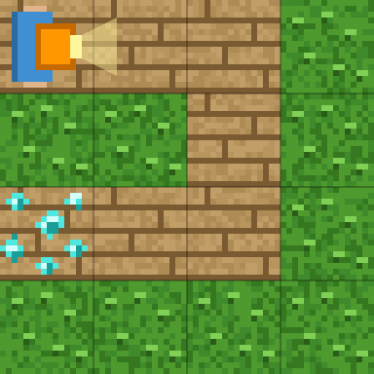
Stage 5: Use left() too
🎯 Goal
Use left() too
📝 Task
left() moves one square to the left. Use all four.
Notes:
[Goal] Use left() too
[Concepts] Sequence / Direction / Python syntax (colon & indent)
[How to start]
Look at the board and trace the path to the goal with a finger. The explorer’s light shows “front”.
[Task] left() moves one square to the left. Use all four.

Slide 18
Stage 5: Use left() too Hint
💡
How to think
right() ×2 → down() ×2 → left() ×2
Notes:
[Questions to ask]
- “Which way is it facing at the start?”
- “Is there a set of moves that repeats?”
- “Run it and see where it stops.”
[Common mistake]
left and right are easy to mix up. Think of the left and right of the screen.

Slide 19
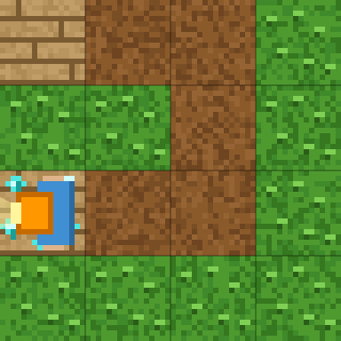
Stage 5: Use left() too Answer
1 right()
2 right()
3 down()
4 down()
5 left()
6 left()
🎉 Clear!
✨ Key point
right() → down() → left(). Now you have used all four commands.
Notes:
[Key point] right() → down() → left(). Now you have used all four commands.
[Common mistake] left and right are easy to mix up. Think of the left and right of the screen.
[Answer code]
right()
right()
down()
down()
left()
left()
[Video] videos/en/pymazejr-05.mp4 (also on the videos page, videos.html)
[Check in the app] Open python-maze-junior.html?sensei, choose stage 5, then “📖 Answer” → “▶ Run”.

Slide 20
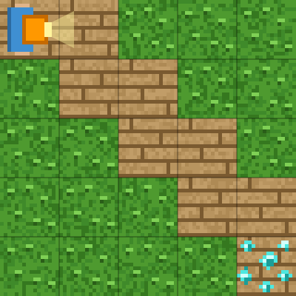
Stage 6: Repeat with for
🎯 Goal
Repeat with for
📝 Task
“for i in range(4):” repeats the lines under it 4 times. Indent those lines with 4 spaces.
Notes:
[Goal] Repeat with for
[Concepts] Loops / Python syntax (colon & indent)
[How to start]
Look at the board and trace the path to the goal with a finger. The explorer’s light shows “front”.
[Task] “for i in range(4):” repeats the lines under it 4 times. Indent those lines with 4 spaces.

Slide 21
Stage 6: Repeat with for Hint
💡
How to think
for i in range(4): → (indented) right() and down()
Notes:
[Questions to ask]
- “Which way is it facing at the start?”
- “Is there a set of moves that repeats?”
- “Run it and see where it stops.”
[Common mistake]
If down() is not indented, only right() repeats.

Slide 22
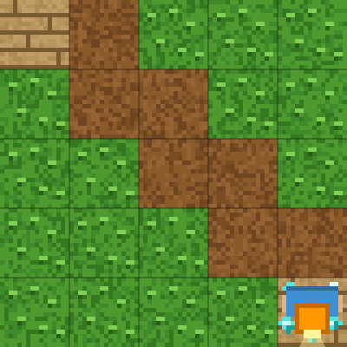
Stage 6: Repeat with for Answer
1 for i in range(4):
2 right()
3 down()
🎉 Clear!
✨ Key point
Indent the 2 lines under for i in range(4): by 4 spaces. Both lines repeat.
Notes:
[Key point] Indent the 2 lines under for i in range(4): by 4 spaces. Both lines repeat.
[Common mistake] If down() is not indented, only right() repeats.
[Answer code]
for i in range(4):
right()
down()
[Video] videos/en/pymazejr-06.mp4 (also on the videos page, videos.html)
[Check in the app] Open python-maze-junior.html?sensei, choose stage 6, then “📖 Answer” → “▶ Run”.

Slide 23
Reflection
🤔
🛠
🚀
How are up() and right() different?
How many spaces did you indent inside for?
Which was easier, blocks or Python?
📜
Clear every stage to get a certificate! Type your name and print it.
Notes:
[Running the reflection]
Discuss one question at a time in pairs or groups, then ask 2–3 students to share with the class.
[Certificate] Clearing every stage shows a certificate (device date; issued by Yasuhito Inoue, NIT Maizuru College). Open it again from “⚙ Settings → 📜”. It prints on A4 landscape.
[Next step] Try the other Python apps too.

