Slide 1
🐍 Python Keys & Doors
Lesson slides: 4 stages
Pythonで かぎと とびら
Notes:
[About these slides]
Lesson slides for Python Keys & Doors (python-maze-key.html). Each stage has 3 slides: Task → Hint → Answer.
The slides use simple words for students; notes for teachers are here in the notes area.
Show the Answer slide only after students have tried.

Slide 2
What you will learn
🐍
Sequence
State
Stage 1, 2
Stage 1, 2, 4
Keys & Doors in Python. Use pick_up(), open_door() and if with key_here() and door_ahead().
Python syntax (colon & indent)
Decomposition
Stage 1, 2, 3, 4
Stage 2
Loops
Patterns
Stage 3
Stage 3
Notes:
[Lesson aims]
Keys & Doors in Python. Use pick_up(), open_door() and if with key_here() and door_ahead().
[Concepts and stages]
・Sequence: Stage 1, 2
・State: Stage 1, 2, 4
・Python syntax (colon & indent): Stage 1, 2, 3, 4
・Decomposition: Stage 2
・Loops: Stage 3
・Patterns: Stage 3
・Conditions: Stage 4
・Repeat until: Stage 4
・Generalization: Stage 4

Slide 3
How to use
🧩
🐍
▶
🔎
1. Start with blocks
2. Write Python
3. Run it
4. Read errors
Build with “🧩 Blocks” and the same program appears below in Python.
Write it yourself in the “🐍 Python” tab. Command buttons and Tab (4 spaces) help.
Press “▶ Run”. The line that is running turns yellow.
Errors show a line number. Look at the red line and fix it.
Notes:
[Opening]
Add “python-maze-key.html” to the end of your published address.
You can also open it from the block app with “⚙ Settings → 🐍 Switch to Python” (it opens in Python mode).
[Teacher mode]
Add “?sensei” to the address to show the “📖 Answer” button and load answers (e.g. python-maze-key.html?sensei).
[Next player]
When students share a device, press “⚙ Settings → 🔄 Next player” twice to reset the records.

Slide 4
Blocks and Python
Block | Python
move forward / turn right, left | forward() ／ turn_right() ／ turn_left()
pick up key / open door | pick_up() ／ open_door()
repeat 〇 times | for i in range(〇):
repeat until goal | while not at_goal():
if key here / if door in front | if key_here(): ／ if door_ahead():
if front is open | if is_open('front'):
Rules: “:” at the end, indent lines inside by 4 spaces, “()” after commands
Notes:
[Key point]
One block becomes one line of Python. An “if” alone inside “else” becomes elif in Python.
[Common errors]
- Missing “:” → SyntaxError
- Wrong indentation → IndentationError
- Missing “()” / misspelled name → SyntaxError / NameError
Errors show the line number, so look at that line together.

Slide 5
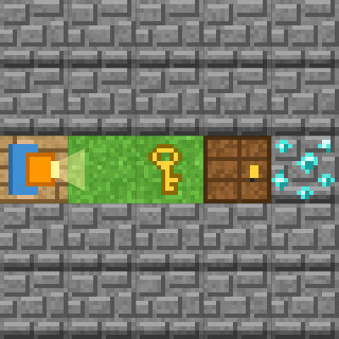
Stage 1: pick_up() and open_door()
🎯 Goal
pick_up() and open_door()
📝 Task
On the key 🔑, pick_up(). In front of the door 🚪, open_door(). Then you can go through.
Notes:
[Goal] pick_up() and open_door()
[Concepts] Sequence / State / Python syntax (colon & indent)
[How to start]
Look at the board and trace the path to the goal with a finger. The explorer’s light shows “front”.
[Task] On the key 🔑, pick_up(). In front of the door 🚪, open_door(). Then you can go through.

Slide 6
Stage 1: pick_up() and open_door() Hint
💡
How to think
forward() ×2 → pick_up() → open_door() → forward() ×2
Notes:
[Questions to ask]
- “Which way is it facing at the start?”
- “Is there a set of moves that repeats?”
- “Run it and see where it stops.”
[Common mistake]
pickup() or open door() causes an error. Don’t forget the “_”.

Slide 7
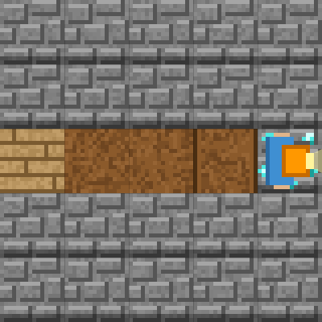
Stage 1: pick_up() and open_door() Answer
1 forward()
2 forward()
3 pick_up()
4 open_door()
5 forward()
6 forward()
🎉 Clear!
✨ Key point
pick_up() makes 1 key and open_door() makes 0. Your item count changes.
Notes:
[Key point] pick_up() makes 1 key and open_door() makes 0. Your item count changes.
[Common mistake] pickup() or open door() causes an error. Don’t forget the “_”.
[Answer code]
forward()
forward()
pick_up()
open_door()
forward()
forward()
[Video] videos/en/pymazekey-01.mp4 (also on the videos page, videos.html)
[Check in the app] Open python-maze-key.html?sensei, choose stage 1, then “📖 Answer” → “▶ Run”.

Slide 8
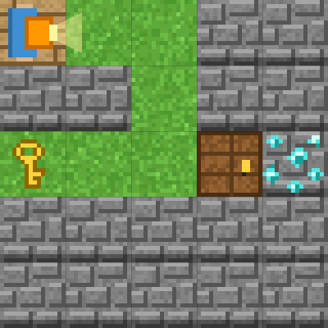
Stage 2: Where is the key?
🎯 Goal
Write the side trip in order
📝 Task
Get the key first. Without a key, open_door() does not work.
Notes:
[Goal] Write the side trip in order
[Concepts] Sequence / State / Decomposition / Python syntax (colon & indent)
[How to start]
Look at the board and trace the path to the goal with a finger. The explorer’s light shows “front”.
[Task] Get the key first. Without a key, open_door() does not work.

Slide 9
Stage 2: Where is the key? Hint
💡
How to think
Walk to the key, pick_up(), turn_right() twice and go back.
Notes:
[Questions to ask]
- “Which way is it facing at the start?”
- “Is there a set of moves that repeats?”
- “Run it and see where it stops.”
[Common mistake]
open_door() before pick_up() gives “You have no key.”

Slide 10
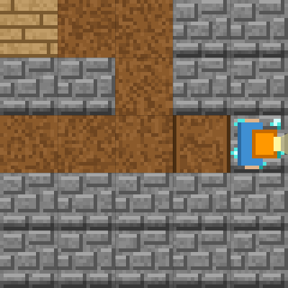
Stage 2: Where is the key? Answer
1 forward()
2 forward()
3 turn_right()
4 forward()
5 forward()
6 turn_right()
7 forward()
8 forward()
9 pick_up()
10 turn_right()
11 turn_right()
12 forward()
13 forward()
14 open_door()
15 forward()
16 forward()
🎉 Clear!
✨ Key point
Go to the key → pick_up() → turn_right() twice → to the door. Write a long plan one line at a time.
Notes:
[Key point] Go to the key → pick_up() → turn_right() twice → to the door. Write a long plan one line at a time.
[Common mistake] open_door() before pick_up() gives “You have no key.”
[Answer code]
forward()
forward()
turn_right()
forward()
forward()
turn_right()
forward()
forward()
pick_up()
turn_right()
turn_right()
forward()
forward()
open_door()
forward()
forward()
[Video] videos/en/pymazekey-02.mp4 (also on the videos page, videos.html)
[Check in the app] Open python-maze-key.html?sensei, choose stage 2, then “📖 Answer” → “▶ Run”.

Slide 11
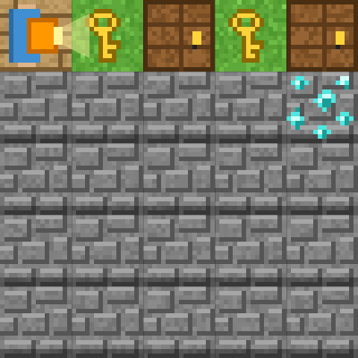
Stage 3: Two doors with for
🎯 Goal
Four lines inside for
📝 Task
Repeat “forward() → pick_up() → open_door() → forward()” with for.
Notes:
[Goal] Four lines inside for
[Concepts] Loops / Patterns / Python syntax (colon & indent)
[How to start]
Look at the board and trace the path to the goal with a finger. The explorer’s light shows “front”.
[Task] Repeat “forward() → pick_up() → open_door() → forward()” with for.

Slide 12
Stage 3: Two doors with for Hint
💡
How to think
for i in range(2): (4 lines, indented) → turn_right() → forward()
Notes:
[Questions to ask]
- “Which way is it facing at the start?”
- “Is there a set of moves that repeats?”
- “Run it and see where it stops.”
[Common mistake]
If turn_right() is indented too, you turn twice and go back.

Slide 13
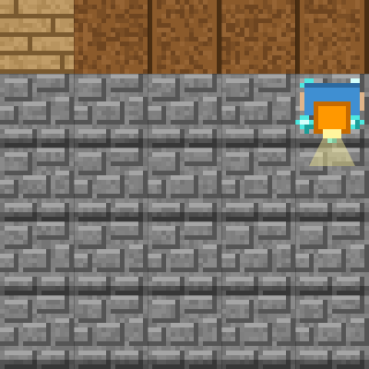
Stage 3: Two doors with for Answer
1 for i in range(2):
2 forward()
3 pick_up()
4 open_door()
5 forward()
6 turn_right()
7 forward()
🎉 Clear!
✨ Key point
All 4 lines inside for are indented by 4 spaces. The last 2 lines are not.
Notes:
[Key point] All 4 lines inside for are indented by 4 spaces. The last 2 lines are not.
[Common mistake] If turn_right() is indented too, you turn twice and go back.
[Answer code]
for i in range(2):
forward()
pick_up()
open_door()
forward()
turn_right()
forward()
[Video] videos/en/pymazekey-03.mp4 (also on the videos page, videos.html)
[Check in the app] Open python-maze-key.html?sensei, choose stage 3, then “📖 Answer” → “▶ Run”.

Slide 14
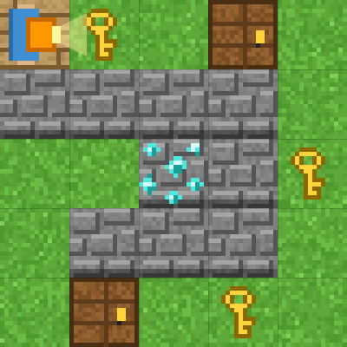
Stage 4: key_here() and door_ahead()
🎯 Goal
Check with key_here() and door_ahead()
📝 Task
key_here() checks for a key where you stand. door_ahead() checks for a door in front. Use them inside “while not at_goal():”.
Notes:
[Goal] Check with key_here() and door_ahead()
[Concepts] Conditions / Repeat until / State / Generalization / Python syntax (colon & indent)
[How to start]
Look at the board and trace the path to the goal with a finger. The explorer’s light shows “front”.
[Task] key_here() checks for a key where you stand. door_ahead() checks for a door in front. Use them inside “while not at_goal():”.

Slide 15
Stage 4: key_here() and door_ahead() Hint
💡
How to think
while not at_goal(): if key_here(): pick_up() / if door_ahead(): open_door() / if is_open('front'): forward() else: turn_right()
Notes:
[Questions to ask]
- “Which way is it facing at the start?”
- “Is there a set of moves that repeats?”
- “Run it and see where it stops.”
[Common mistake]
Forgetting “()” after key_here causes a SyntaxError. Checks also need ().

Slide 16
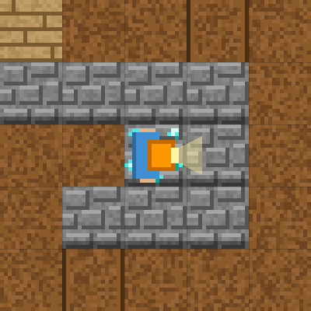
Stage 4: key_here() and door_ahead() Answer
1 while not at_goal():
2 if key_here():
3 pick_up()
4 if door_ahead():
5 open_door()
6 if is_open('front'):
7 forward()
8 else:
9 turn_right()
🎉 Clear!
✨ Key point
Two ifs in a row, then if … else. Inside while, everything is checked again each time.
Notes:
[Key point] Two ifs in a row, then if … else. Inside while, everything is checked again each time.
[Common mistake] Forgetting “()” after key_here causes a SyntaxError. Checks also need ().
[Answer code]
while not at_goal():
if key_here():
pick_up()
if door_ahead():
open_door()
if is_open('front'):
forward()
else:
turn_right()
[Video] videos/en/pymazekey-04.mp4 (also on the videos page, videos.html)
[Check in the app] Open python-maze-key.html?sensei, choose stage 4, then “📖 Answer” → “▶ Run”.

Slide 17
Reflection
🤔
🛠
🚀
What order did pick_up() and open_door() go in?
When are key_here() and door_ahead() True?
Why did you put the three ifs in that order?
📜
Clear every stage to get a certificate! Type your name and print it.
Notes:
[Running the reflection]
Discuss one question at a time in pairs or groups, then ask 2–3 students to share with the class.
[Certificate] Clearing every stage shows a certificate (device date; issued by Yasuhito Inoue, NIT Maizuru College). Open it again from “⚙ Settings → 📜”. It prints on A4 landscape.
[Next step] Try the other Python apps too.

