Slide 1
🐍 Python Slime Maze
Lesson slides: 4 stages
Pythonで てきを よける
Notes:
[About these slides]
Lesson slides for Python Slime Maze (python-maze-enemy.html). Each stage has 3 slides: Task → Hint → Answer.
The slides use simple words for students; notes for teachers are here in the notes area.
Show the Answer slide only after students have tried.

Slide 2
What you will learn
🐍
Sequence
Timing
Stage 1
Stage 1, 2, 3, 4
Dodge the Slime Maze in Python. Use wait(), danger_ahead() and if, elif, else.
Python syntax (colon & indent)
Conditions
Stage 1, 2, 3, 4
Stage 2, 3
Repeat until
Nesting
Stage 2, 3, 4
Stage 3
Notes:
[Lesson aims]
Dodge the Slime Maze in Python. Use wait(), danger_ahead() and if, elif, else.
[Concepts and stages]
・Sequence: Stage 1
・Timing: Stage 1, 2, 3, 4
・Python syntax (colon & indent): Stage 1, 2, 3, 4
・Conditions: Stage 2, 3
・Repeat until: Stage 2, 3, 4
・Nesting: Stage 3
・Generalization: Stage 4

Slide 3
How to use
🧩
🐍
▶
🔎
1. Start with blocks
2. Write Python
3. Run it
4. Read errors
Build with “🧩 Blocks” and the same program appears below in Python.
Write it yourself in the “🐍 Python” tab. Command buttons and Tab (4 spaces) help.
Press “▶ Run”. The line that is running turns yellow.
Errors show a line number. Look at the red line and fix it.
Notes:
[Opening]
Add “python-maze-enemy.html” to the end of your published address.
You can also open it from the block app with “⚙ Settings → 🐍 Switch to Python” (it opens in Python mode).
[Teacher mode]
Add “?sensei” to the address to show the “📖 Answer” button and load answers (e.g. python-maze-enemy.html?sensei).
[Next player]
When students share a device, press “⚙ Settings → 🔄 Next player” twice to reset the records.

Slide 4
Blocks and Python
Block | Python
move forward / turn right, left | forward() ／ turn_right() ／ turn_left()
wait (1 turn) | wait()
repeat until goal | while not at_goal():
if danger ahead | if danger_ahead():
if front is open | if is_open('front'):
else | elif …: ／ else:
Rules: “:” at the end, indent lines inside by 4 spaces, “()” after commands
Notes:
[Key point]
One block becomes one line of Python. An “if” alone inside “else” becomes elif in Python.
[Common errors]
- Missing “:” → SyntaxError
- Wrong indentation → IndentationError
- Missing “()” / misspelled name → SyntaxError / NameError
Errors show the line number, so look at that line together.

Slide 5
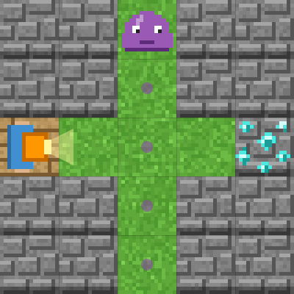
Stage 1: wait()
🎯 Goal
Wait with wait()
📝 Task
wait() makes the explorer wait for 1 turn. The slime moves 1 square every turn. Time your move!
Notes:
[Goal] Wait with wait()
[Concepts] Sequence / Timing / Python syntax (colon & indent)
[How to start]
Look at the board and trace the path to the goal with a finger. The explorer’s light shows “front”.
[Task] wait() makes the explorer wait for 1 turn. The slime moves 1 square every turn. Time your move!

Slide 6
Stage 1: wait() Hint
💡
How to think
forward() → wait() ×2 → forward() ×3
Notes:
[Questions to ask]
- “Which way is it facing at the start?”
- “Is there a set of moves that repeats?”
- “Run it and see where it stops.”
[Common mistake]
wait(2) causes a TypeError. To wait twice, write wait() on 2 lines.

Slide 7
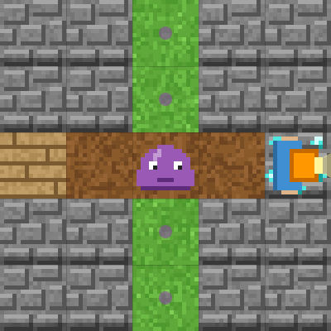
Stage 1: wait() Answer
1 forward()
2 wait()
3 wait()
4 forward()
5 forward()
6 forward()
🎉 Clear!
✨ Key point
wait() waits one turn. The slime moves one square meanwhile.
Notes:
[Key point] wait() waits one turn. The slime moves one square meanwhile.
[Common mistake] wait(2) causes a TypeError. To wait twice, write wait() on 2 lines.
[Answer code]
forward()
wait()
wait()
forward()
forward()
forward()
[Video] videos/en/pymazeenemy-01.mp4 (also on the videos page, videos.html)
[Check in the app] Open python-maze-enemy.html?sensei, choose stage 1, then “📖 Answer” → “▶ Run”.

Slide 8
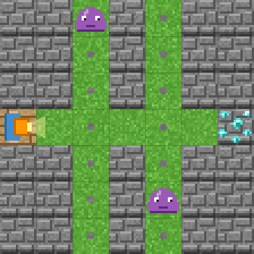
Stage 2: if danger_ahead():
🎯 Goal
Check with if danger_ahead():
📝 Task
danger_ahead() is True when a slime is in front of you or will come there next. If so, wait(); else, forward().
Notes:
[Goal] Check with if danger_ahead():
[Concepts] Conditions / Repeat until / Timing / Python syntax (colon & indent)
[How to start]
Look at the board and trace the path to the goal with a finger. The explorer’s light shows “front”.
[Task] danger_ahead() is True when a slime is in front of you or will come there next. If so, wait(); else, forward().

Slide 9
Stage 2: if danger_ahead(): Hint
💡
How to think
while not at_goal(): if danger_ahead(): wait() else: forward()
Notes:
[Questions to ask]
- “Which way is it facing at the start?”
- “Is there a set of moves that repeats?”
- “Run it and see where it stops.”
[Common mistake]
Forgetting the “:” after else causes a SyntaxError.

Slide 10
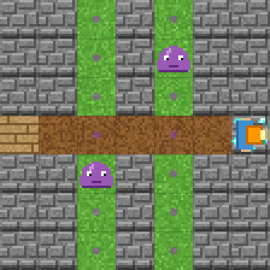
Stage 2: if danger_ahead(): Answer
1 while not at_goal():
2 if danger_ahead():
3 wait()
4 else:
5 forward()
🎉 Clear!
✨ Key point
danger_ahead() is True when it is dangerous. if … else decides between waiting and moving.
Notes:
[Key point] danger_ahead() is True when it is dangerous. if … else decides between waiting and moving.
[Common mistake] Forgetting the “:” after else causes a SyntaxError.
[Answer code]
while not at_goal():
if danger_ahead():
wait()
else:
forward()
[Video] videos/en/pymazeenemy-02.mp4 (also on the videos page, videos.html)
[Check in the app] Open python-maze-enemy.html?sensei, choose stage 2, then “📖 Answer” → “▶ Run”.

Slide 11
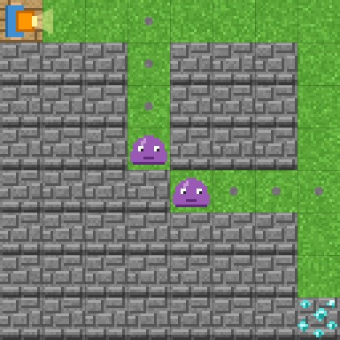
Stage 3: A bigger maze with elif
🎯 Goal
Split into three with elif
📝 Task
If danger, wait(). elif the front is open, forward(). else turn_right().
Notes:
[Goal] Split into three with elif
[Concepts] Conditions / Nesting / Repeat until / Timing / Python syntax (colon & indent)
[How to start]
Look at the board and trace the path to the goal with a finger. The explorer’s light shows “front”.
[Task] If danger, wait(). elif the front is open, forward(). else turn_right().

Slide 12
Stage 3: A bigger maze with elif Hint
💡
How to think
while not at_goal(): if danger_ahead(): wait() / elif is_open('front'): forward() / else: turn_right()
Notes:
[Questions to ask]
- “Which way is it facing at the start?”
- “Is there a set of moves that repeats?”
- “Run it and see where it stops.”
[Common mistake]
If you change elif to if, you may move right after waiting and get caught.

Slide 13
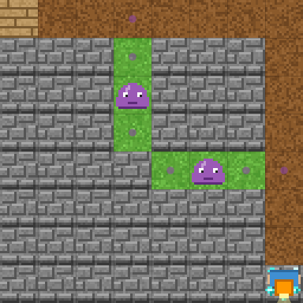
Stage 3: A bigger maze with elif Answer
1 while not at_goal():
2 if danger_ahead():
3 wait()
4 elif is_open('front'):
5 forward()
6 else:
7 turn_right()
🎉 Clear!
✨ Key point
if (danger) → elif (front is open) → else (turn right). They are checked from the top.
Notes:
[Key point] if (danger) → elif (front is open) → else (turn right). They are checked from the top.
[Common mistake] If you change elif to if, you may move right after waiting and get caught.
[Answer code]
while not at_goal():
if danger_ahead():
wait()
elif is_open('front'):
forward()
else:
turn_right()
[Video] videos/en/pymazeenemy-03.mp4 (also on the videos page, videos.html)
[Check in the app] Open python-maze-enemy.html?sensei, choose stage 3, then “📖 Answer” → “▶ Run”.

Slide 14
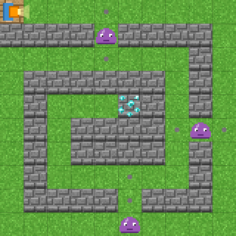
Stage 4: The spiral maze
🎯 Goal
The same code, a bigger maze
📝 Task
A 10×10 spiral with three slimes. Does your program from Stage 3 work here too?
Notes:
[Goal] The same code, a bigger maze
[Concepts] Generalization / Repeat until / Timing / Python syntax (colon & indent)
[How to start]
Look at the board and trace the path to the goal with a finger. The explorer’s light shows “front”.
[Task] A 10×10 spiral with three slimes. Does your program from Stage 3 work here too?

Slide 15
Stage 4: The spiral maze Hint
💡
How to think
The Stage 3 program works as it is.
Notes:
[Questions to ask]
- “Which way is it facing at the start?”
- “Is there a set of moves that repeats?”
- “Run it and see where it stops.”
[Common mistake]
Forgetting the quotes in is_open('front') causes an error.

Slide 16
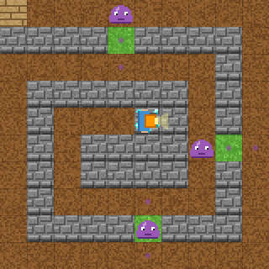
Stage 4: The spiral maze Answer
1 while not at_goal():
2 if danger_ahead():
3 wait()
4 elif is_open('front'):
5 forward()
6 else:
7 turn_right()
🎉 Clear!
✨ Key point
Use the Stage 3 code as it is. It works in any maze.
Notes:
[Key point] Use the Stage 3 code as it is. It works in any maze.
[Common mistake] Forgetting the quotes in is_open('front') causes an error.
[Answer code]
while not at_goal():
if danger_ahead():
wait()
elif is_open('front'):
forward()
else:
turn_right()
[Video] videos/en/pymazeenemy-04.mp4 (also on the videos page, videos.html)
[Check in the app] Open python-maze-enemy.html?sensei, choose stage 4, then “📖 Answer” → “▶ Run”.

Slide 17
Reflection
🤔
🛠
🚀
When did you use wait()?
Why does the order of if, elif and else matter?
When does danger_ahead() become True?
📜
Clear every stage to get a certificate! Type your name and print it.
Notes:
[Running the reflection]
Discuss one question at a time in pairs or groups, then ask 2–3 students to share with the class.
[Certificate] Clearing every stage shows a certificate (device date; issued by Yasuhito Inoue, NIT Maizuru College). Open it again from “⚙ Settings → 📜”. It prints on A4 landscape.
[Next step] Try the other Python apps too.

