Slide 1


LearnStack Final Product Presentation
DevBallers
Atilla Dogan, Oguzhan Kaluk

Slide 2

Project Idea
Anki
Deck management
Flash card management
Learning features
StudyDrive
Easy sharing
Discussion platform

Slide 3
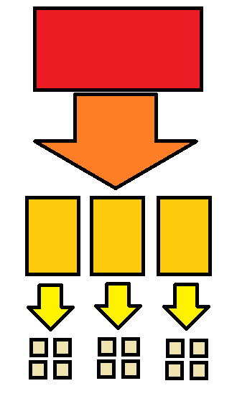
Conceptual solution
Identifying features
Feature walkthrough mentally
Task management

Slide 4

Implementation
MongoDB
Express.js
Angular
Node.js
Material Design

Slide 5
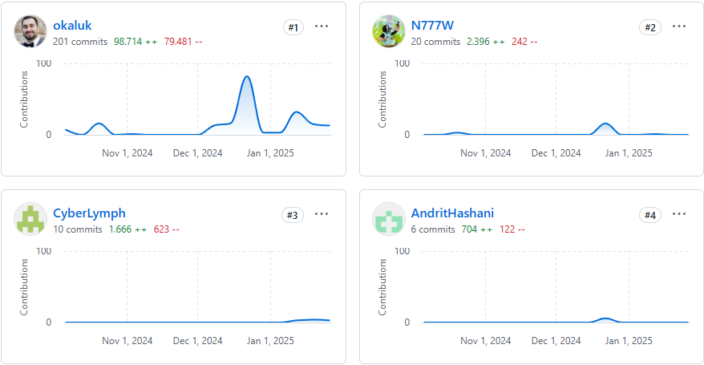
Contribution
Andrit Hashani
Authentication
Oguzhan Kaluk
Stacks and Cards
Training-Session
preliminary work by Nick Waldschmidt
Dashboard
Project Initialization
Atilla Dogan
Forum

Slide 6
Live Demo
LIVE DEMO

