Slide 1


Intermediate Project Presentation
DevBallers
Atilla Dogan, Andrit Hashani, Oguzhan Kaluk, Dursun Berat Saral, Nick Waldschmidt

Slide 2
Table of Contents
Conceptual solution
Status of the project
Group management
Demo

Slide 3
Conceptual solution
Establish development cycle
Issue generation
Implementation
Review
Repeat every week

Slide 4
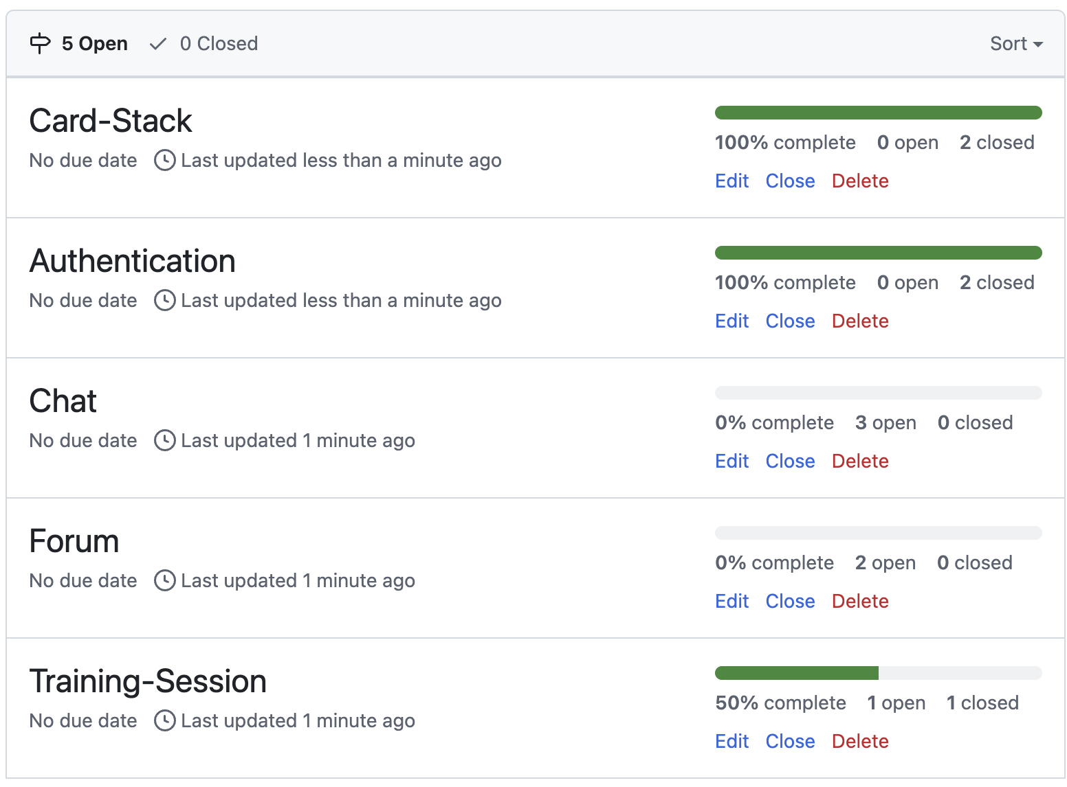
Status of the project
Finished:
Card-Stack
Authentication
In Progress:
Training-Session
Forum
To-dos:
Message-Handling
Design & Clean up
Chat(dropped)

Slide 5
Group management
Tools
GitHub
Discord
Whatsapp
WebStorm/VSCode
Group contributors
Authentication – Andrit Hashani
Card-Stack – Oguzhan Kaluk
Training-Session – Nick Waldschmidt(dropped)
Forum – Atilla Dogan
Chat – Dursun Berat Saral(dropped)

Slide 6
Demo
LIVE DEMO

