Slide 2
Guidelines for Good Presentation Slides
Footer should consist of the topic and group name separated by a hyphen
From the top menu, click Insert menu → under Text category click Header & Footer → check Slide number and Footer
E.g., Assignment 2 – Big Data Tools Presentation – MongoDB – Group 1
Provide slide numbers
Use different layouts
Right slide on a slide of your left panel
Open the “Layout” menu
Select the appropriate layouts
Avoid empty slides. Add provide appropriate diagrams/illustrations at the right side
Avoid long sentences (max. 7-10 words per bullet point)
Avoid a period after each sentence
Maintain consistency, e.g., same bulleting styles, Capital letters, positioning, etc.
Maintain the aspect ratio of the images
Provide readable code snippets, e.g., use CodeSnap plugin from VSCode
Use blue color text to highlight important keywords
Use bold style for enumerating steps
Remove this slide before submitting!

Slide 3

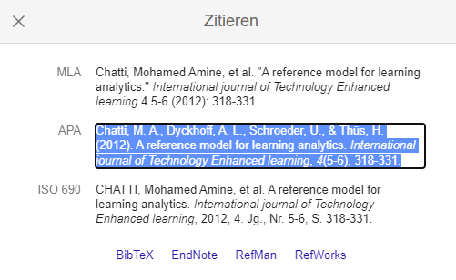


How To Cite Paper
Step 1: Search for a paper in Google Scholar
Remove this slide before submitting!
Step 3: Copy APA
Step 2: Click on cite
Step 4: Use it presentation
Chatti, M. A., Dyckhoff, A. L., Schroeder, U., & Thüs, H. (2012). A reference model for learning analytics. International journal of Technology Enhanced learning, 4(5-6), 318-331.
Example →

Slide 4
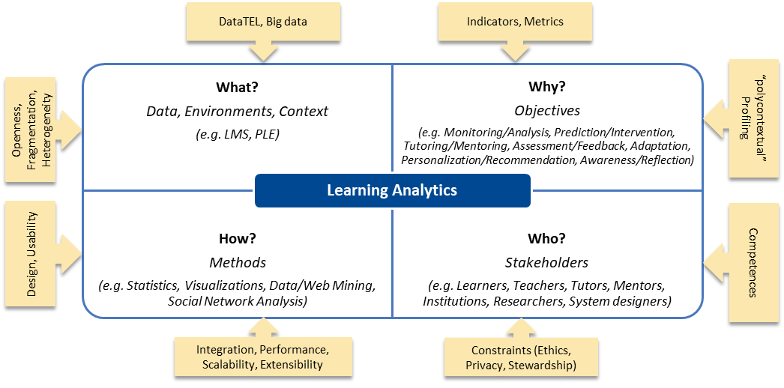
How To Cite Paper – Example – Presentations
Remove this slide before submitting!
Learning Analytics Reference Model [1]
Openness in LA Reference Model
Provide open learning, open dataset, open methods, open standards, etc.
Open Learning Analytics Platform
Implementation of the LA Reference Model
Human-centered learning analytics platform
Support end users in exploring and defining custom indicators that meet their needs
Citation number in square brackets
Citation number in square brackets
Learning Analytics Reference Model [1]
Bottom corner with font size 10. Use number bullet point
Chatti, M. A., Dyckhoff, A. L., Schroeder, U., & Thüs, H. (2012). A reference model for learning analytics. International journal of Technology Enhanced learning, 4(5-6), 318-331.

