Slide 1


LearnStack Final Product Presentation
DevBallers
Atilla Dogan, Oguzhan Kaluk

Slide 2

Project Idea
Anki
Deck management
Flash card management
Learning features
StudyDrive
Easy sharing
Discussion platform

Slide 3
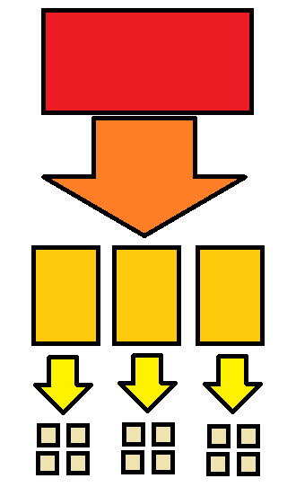
Conceptual solution
Identifying features
Feature walkthrough mentally
Task management

Slide 4
Implementation

