Slide 1
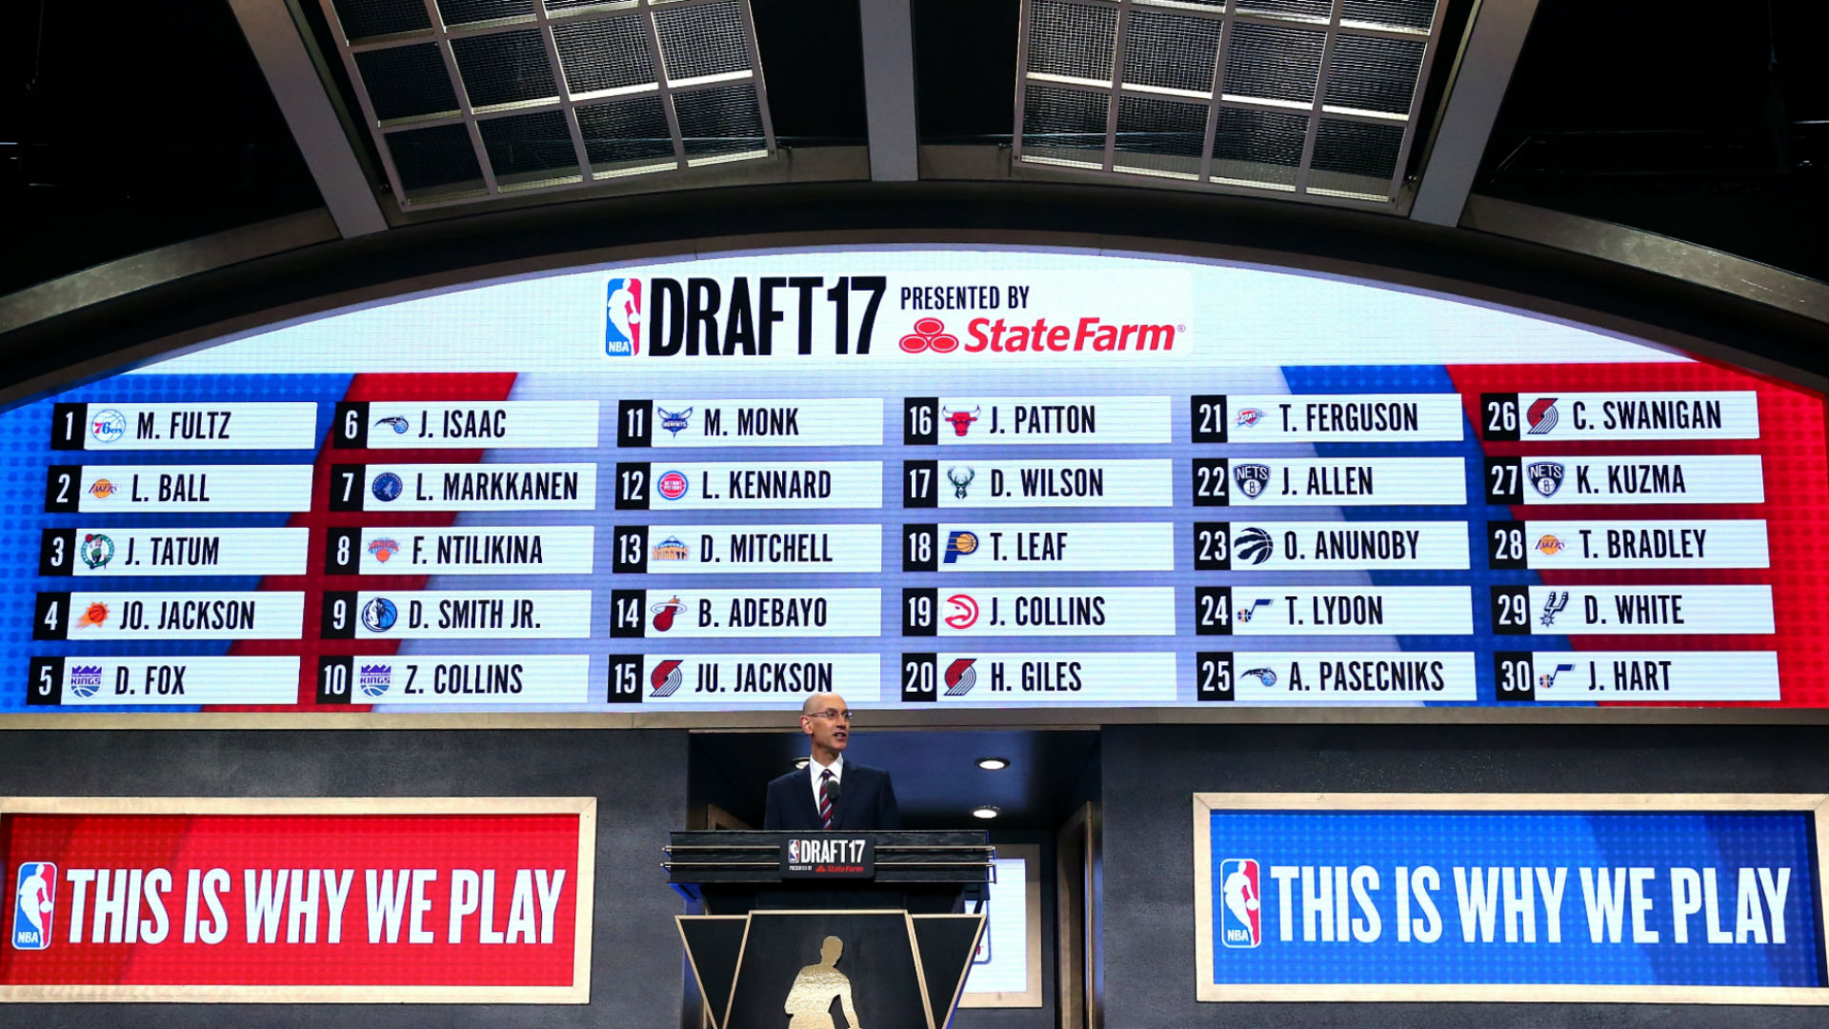
Predicting NBA Prospects’ Career Success

Slide 2


Agenda
Project Relevance and Goals
Exploratory Data Analysis
Linear Regression Model
Random Forest Model
Conclusion
Q & A
Importance & Aims
Exploratory Data Analysis
Linear Regression
Random Forest
Conclusion
Q&A

Slide 3
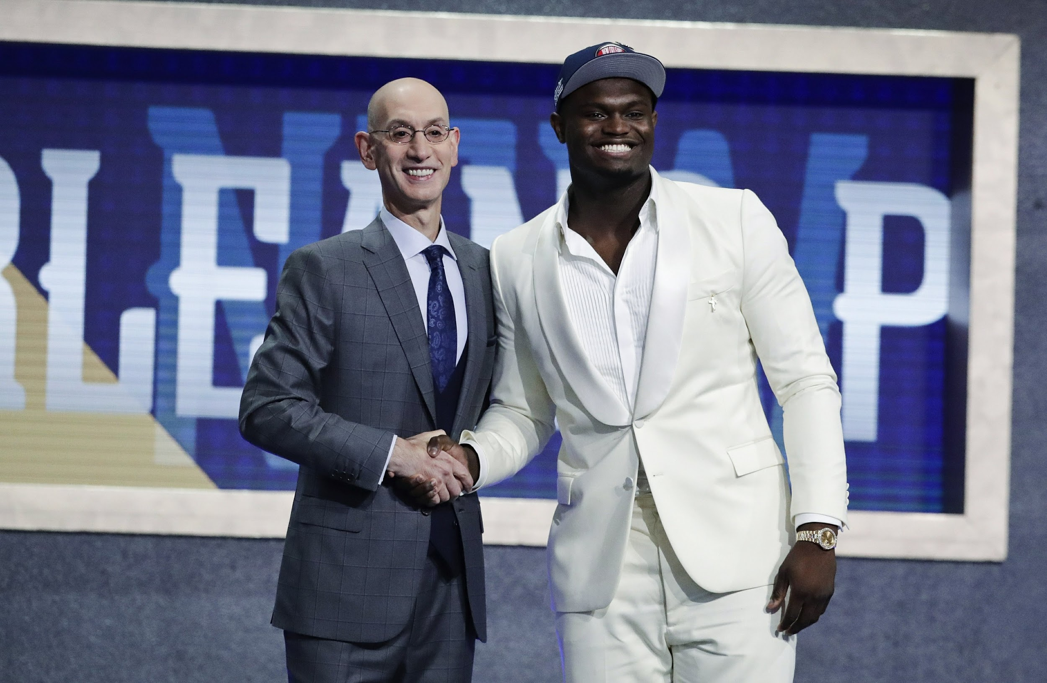


Importance
Cost effective way to greatly improve a team’s future
Teams spend a lot of time and resources towards the draft
Importance & Aims
Exploratory Data Analysis
Linear Regression
Random Forest
Conclusion
Q&A

Slide 4
Aims
1.) Predict how successful a prospects career will be
2.) Determine the value of each draft pick based on expected player success
Hypothesis
We expect to see a decrease in player’s value as the pick number increases.
Importance & Aims
Exploratory Data Analysis
Linear Regression
Random Forest
Conclusion
Q&A

Slide 5

Data Preparation & Model Building
Importance & Aims
Exploratory Data Analysis
Linear Regression
Random Forest
Conclusion
Q&A

Slide 6



Data Pre-processing
Data Collection
Scraped and downloaded data from multiple web sources
Manually inserted additional missing player data
Data Cleaning
Removed variables and players with too many missing values
Final dataset consisted of 16 independent variables with win shares as the measure of success
Data Wrangling
Transformed variables in order to be useful when modelling
Converted two multi level categorical variables to three levels
Importance & Aims
Exploratory Data Analysis
Linear Regression
Random Forest
Conclusion
Q&A
Notes:
Variables relating to players’ physical, background, and statistic data

Slide 7
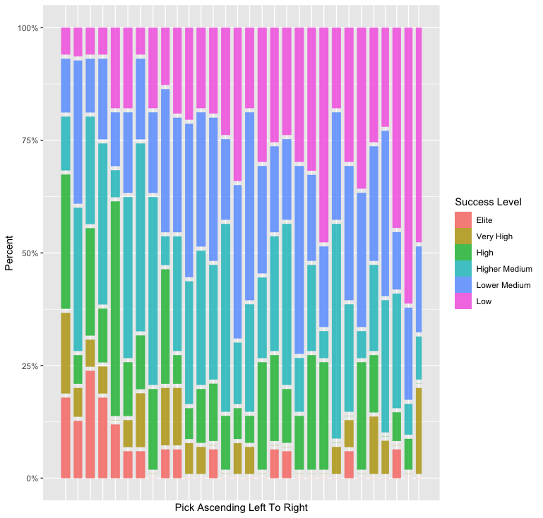
Exploratory Data Analysis
Seldomly find elite players after the first 5 picks
Proportion of high or better players similar for picks 10-30
2nd pick abnormally low proportion of high or better players
Importance & Aims
Exploratory Data Analysis
Linear Regression
Random Forest
Conclusion
Q&A

Slide 8
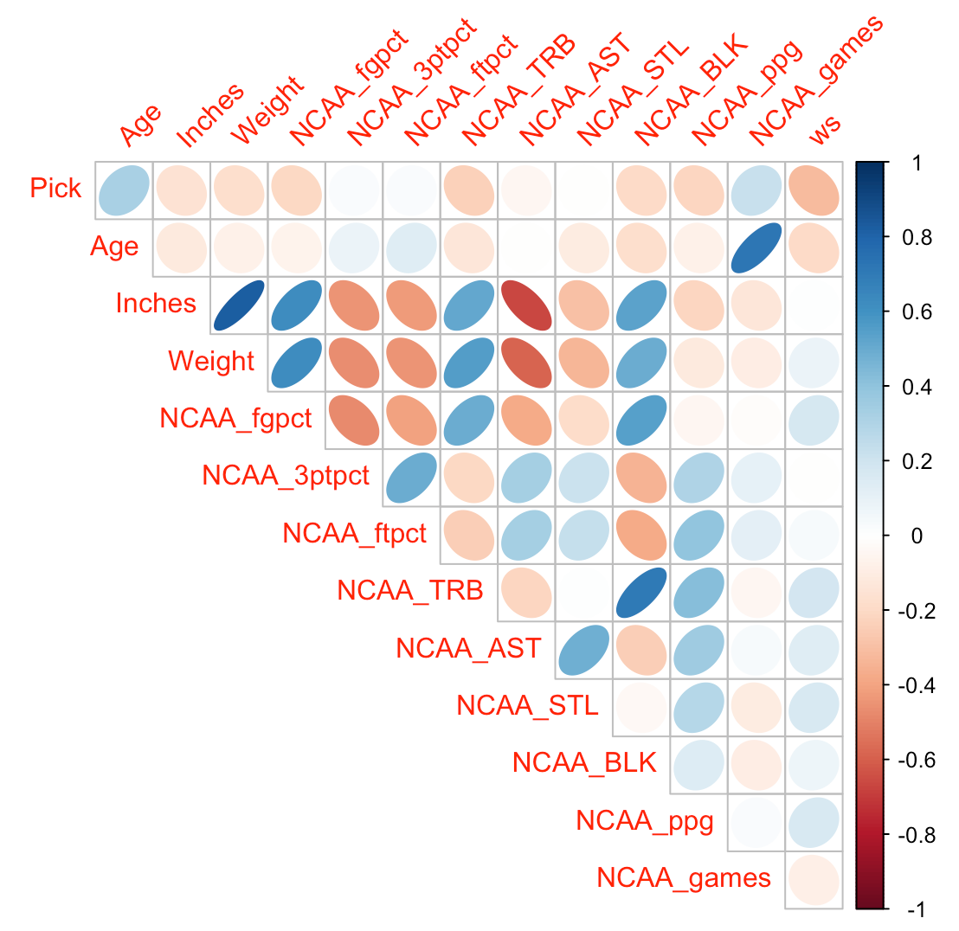
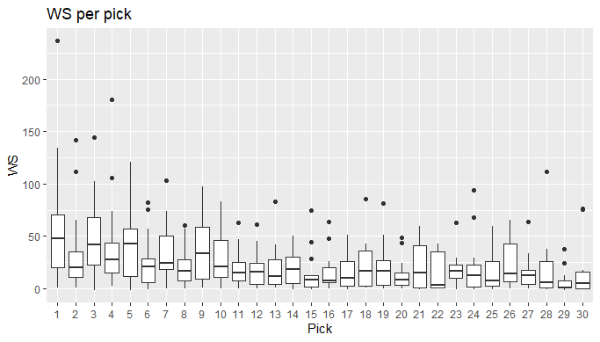
Exploratory Data Analysis
Pick appears to be the most strongly correlated with win shares
Less variability in win shares as pick increases
Importance & Aims
Exploratory Data Analysis
Linear Regression
Random Forest
Conclusion
Q&A
Notes:
No other variables app

Slide 9
Regression Model
Highest performing models
Produced linear models of every combination of independent variables
Recorded model performance metrics: AIC, BIC, and Adj R² for each model and ranked them accordingly
Number of variables | AIC | BIC | Adj R²
6 | 3459.8047 | 3490.9819 | 0.1854
7 | 3458.6545 | 3493.7289 | 0.1898
Importance & Aims
Exploratory Data Analysis
Linear Regression
Random Forest
Conclusion
Q&A
Notes:
80/20 split etc etc.
-Looked at two way interactions, but model became very complex in terms of amount of predictor terms and thus was decided against using.

Slide 10
Regression Model
Six Variable Model | Intercept | Pick | Age | Height (in) | Weight | College fgpct | College steals
Coefficients | 196.0927 | -.8997 | -2.6013 | -2.7692 | 0.2795 | 86.9358 | 8.9628
Seven Variable Model | Intercept | Pick | Age | Height (in) | Weight | College fgpct | College ftpct | College steals
Coefficients | 164.5176 | -.8583 | -2.8831 | -2.7156 | 0.3039 | 96.8072 | 31.6313 | 8.6381
Importance & Aims
Exploratory Data Analysis
Linear Regression
Random Forest
Conclusion
Q&A
Notes:
Six variable model: All factors significant
Seven variable model: Only ft pct non significant at alpha = .05

Slide 11
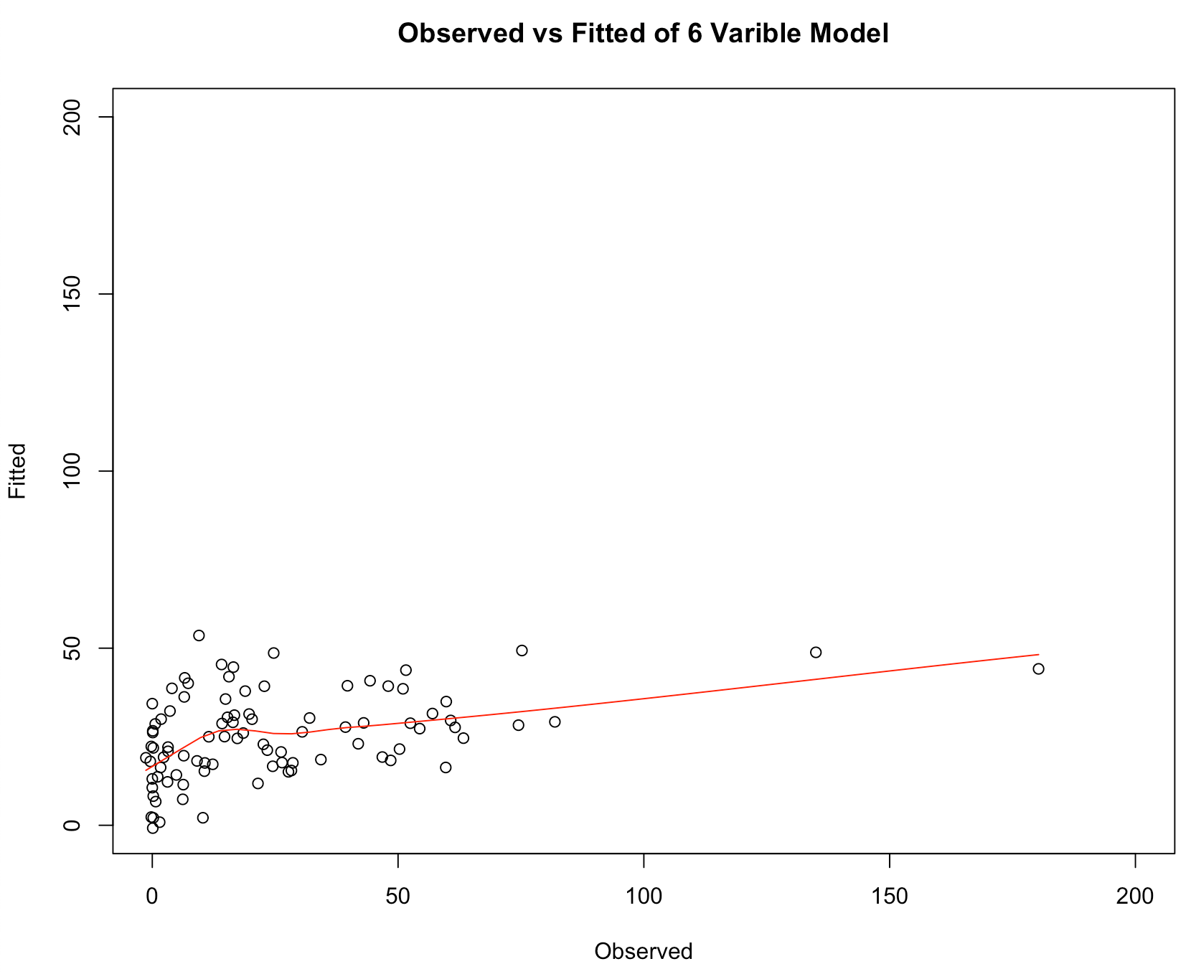
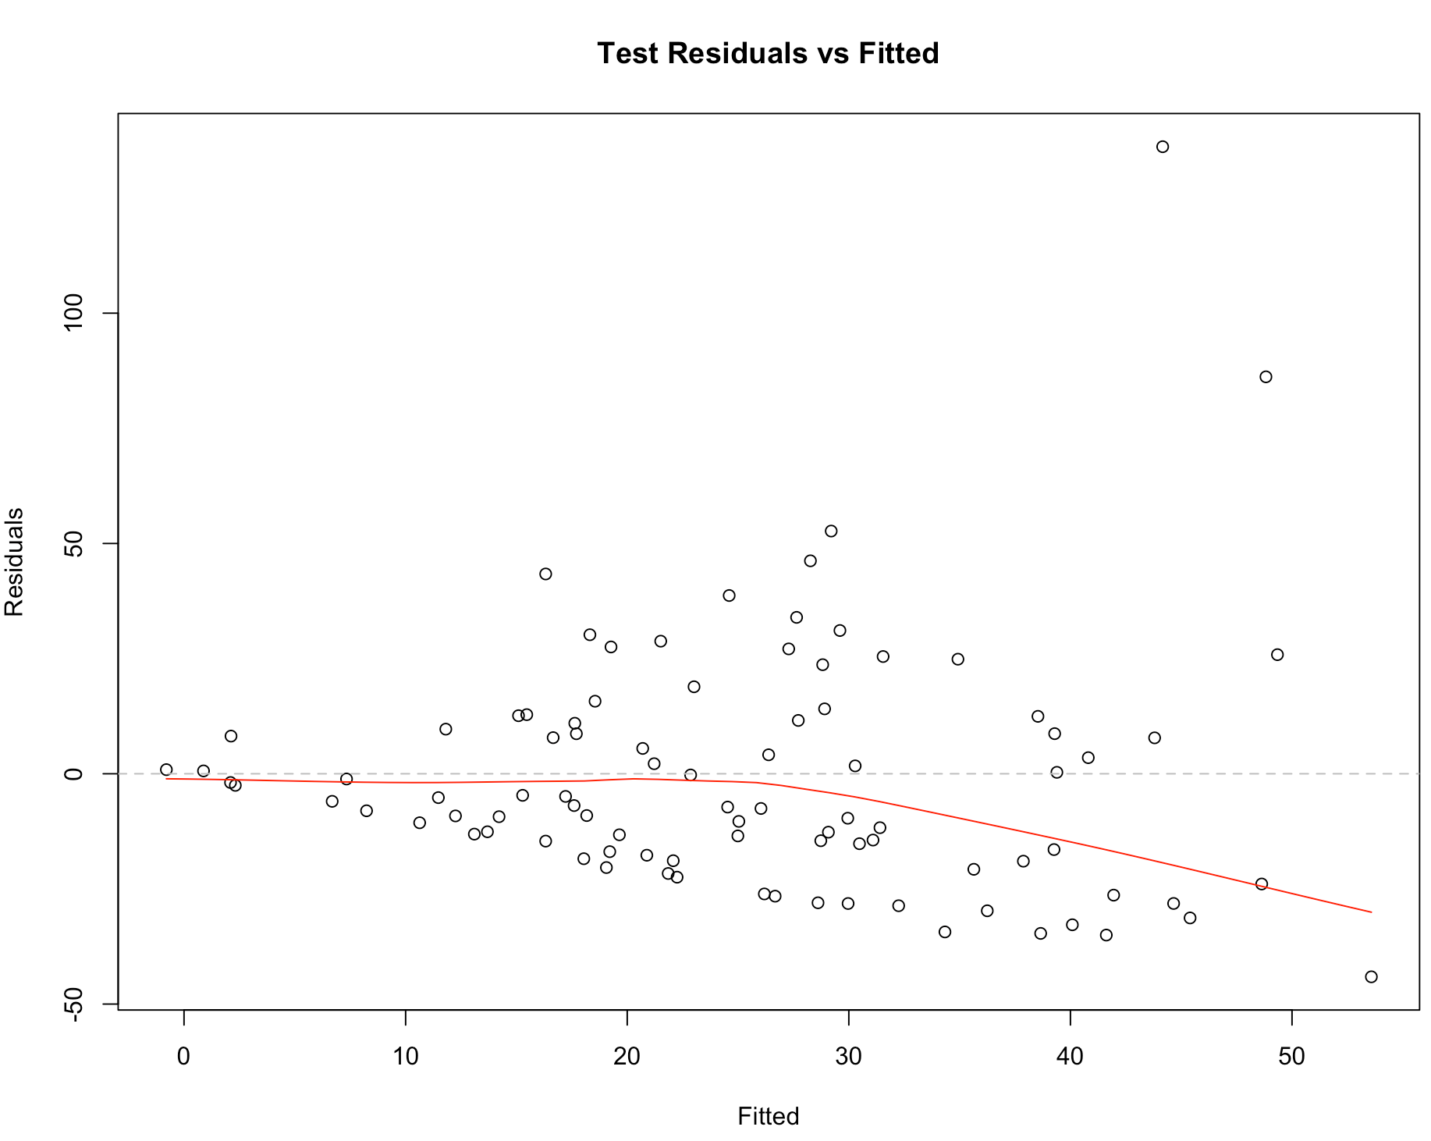
Regression Model
MSPE 6 Variable | 714.019
Variance | 868.2105
Importance & Aims
Exploratory Data Analysis
Linear Regression
Random Forest
Conclusion
Q&A
Notes:
Six variable model: All factors significant
Seven variable model: Only ft pct non significant at alpha = .05

Slide 12
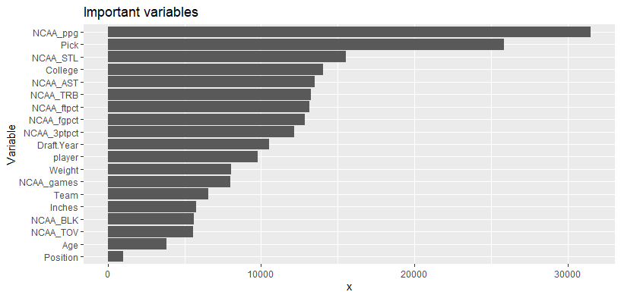
Random Forest Model
Highest performing model
Performed grid search using combinations of tuning parameters to create optimal model based on out of bag error
Points per game and pick number appear to be much more important to the prediction than other variables
mtry | Node size | Sample Size | OOB RMSE
12 | 1 | 0.80 | 25.5754
Importance & Aims
Exploratory Data Analysis
Linear Regression
Random Forest
Conclusion
Q&A

Slide 13
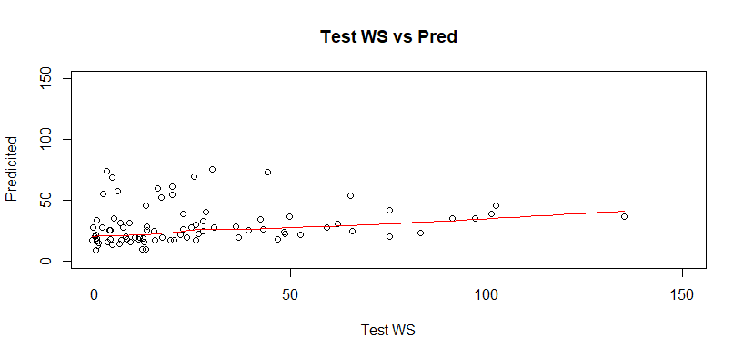
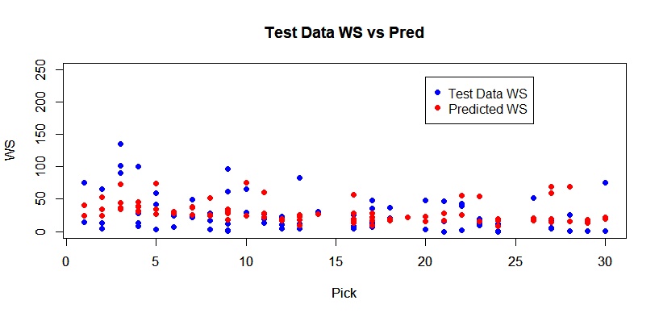
Model Performance
Underpredicted of highest win shares and overpredicted the lowest win share totals
Negative Correlation between Pick & WS
Optimal Random Forest
# Trees | Sample Size | # of Independent variables | Mtry | Node Size | OOB prediction error (MSE) | R Squared (OOB)
500 | 337 | 19 | 12 | 1 | 655.0384 | 0.187656
Importance & Aims
Exploratory Data Analysis
Linear Regression
Random Forest
Conclusion
Q&A

Slide 14
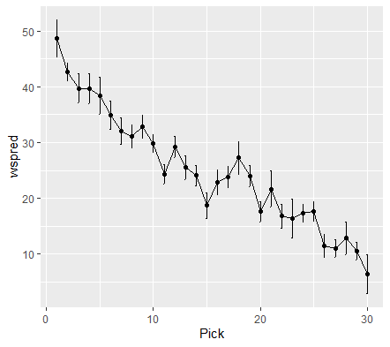
Conclusion
Preferred the regression model over random forest model for predicting win shares
Random forest model was more appropriate for calculating draft pick values
Hypothesis was correct that pick values decrease as pick increases
Importance & Aims
Exploratory Data Analysis
Linear Regression
Random Forest
Conclusion
Q&A

Slide 15
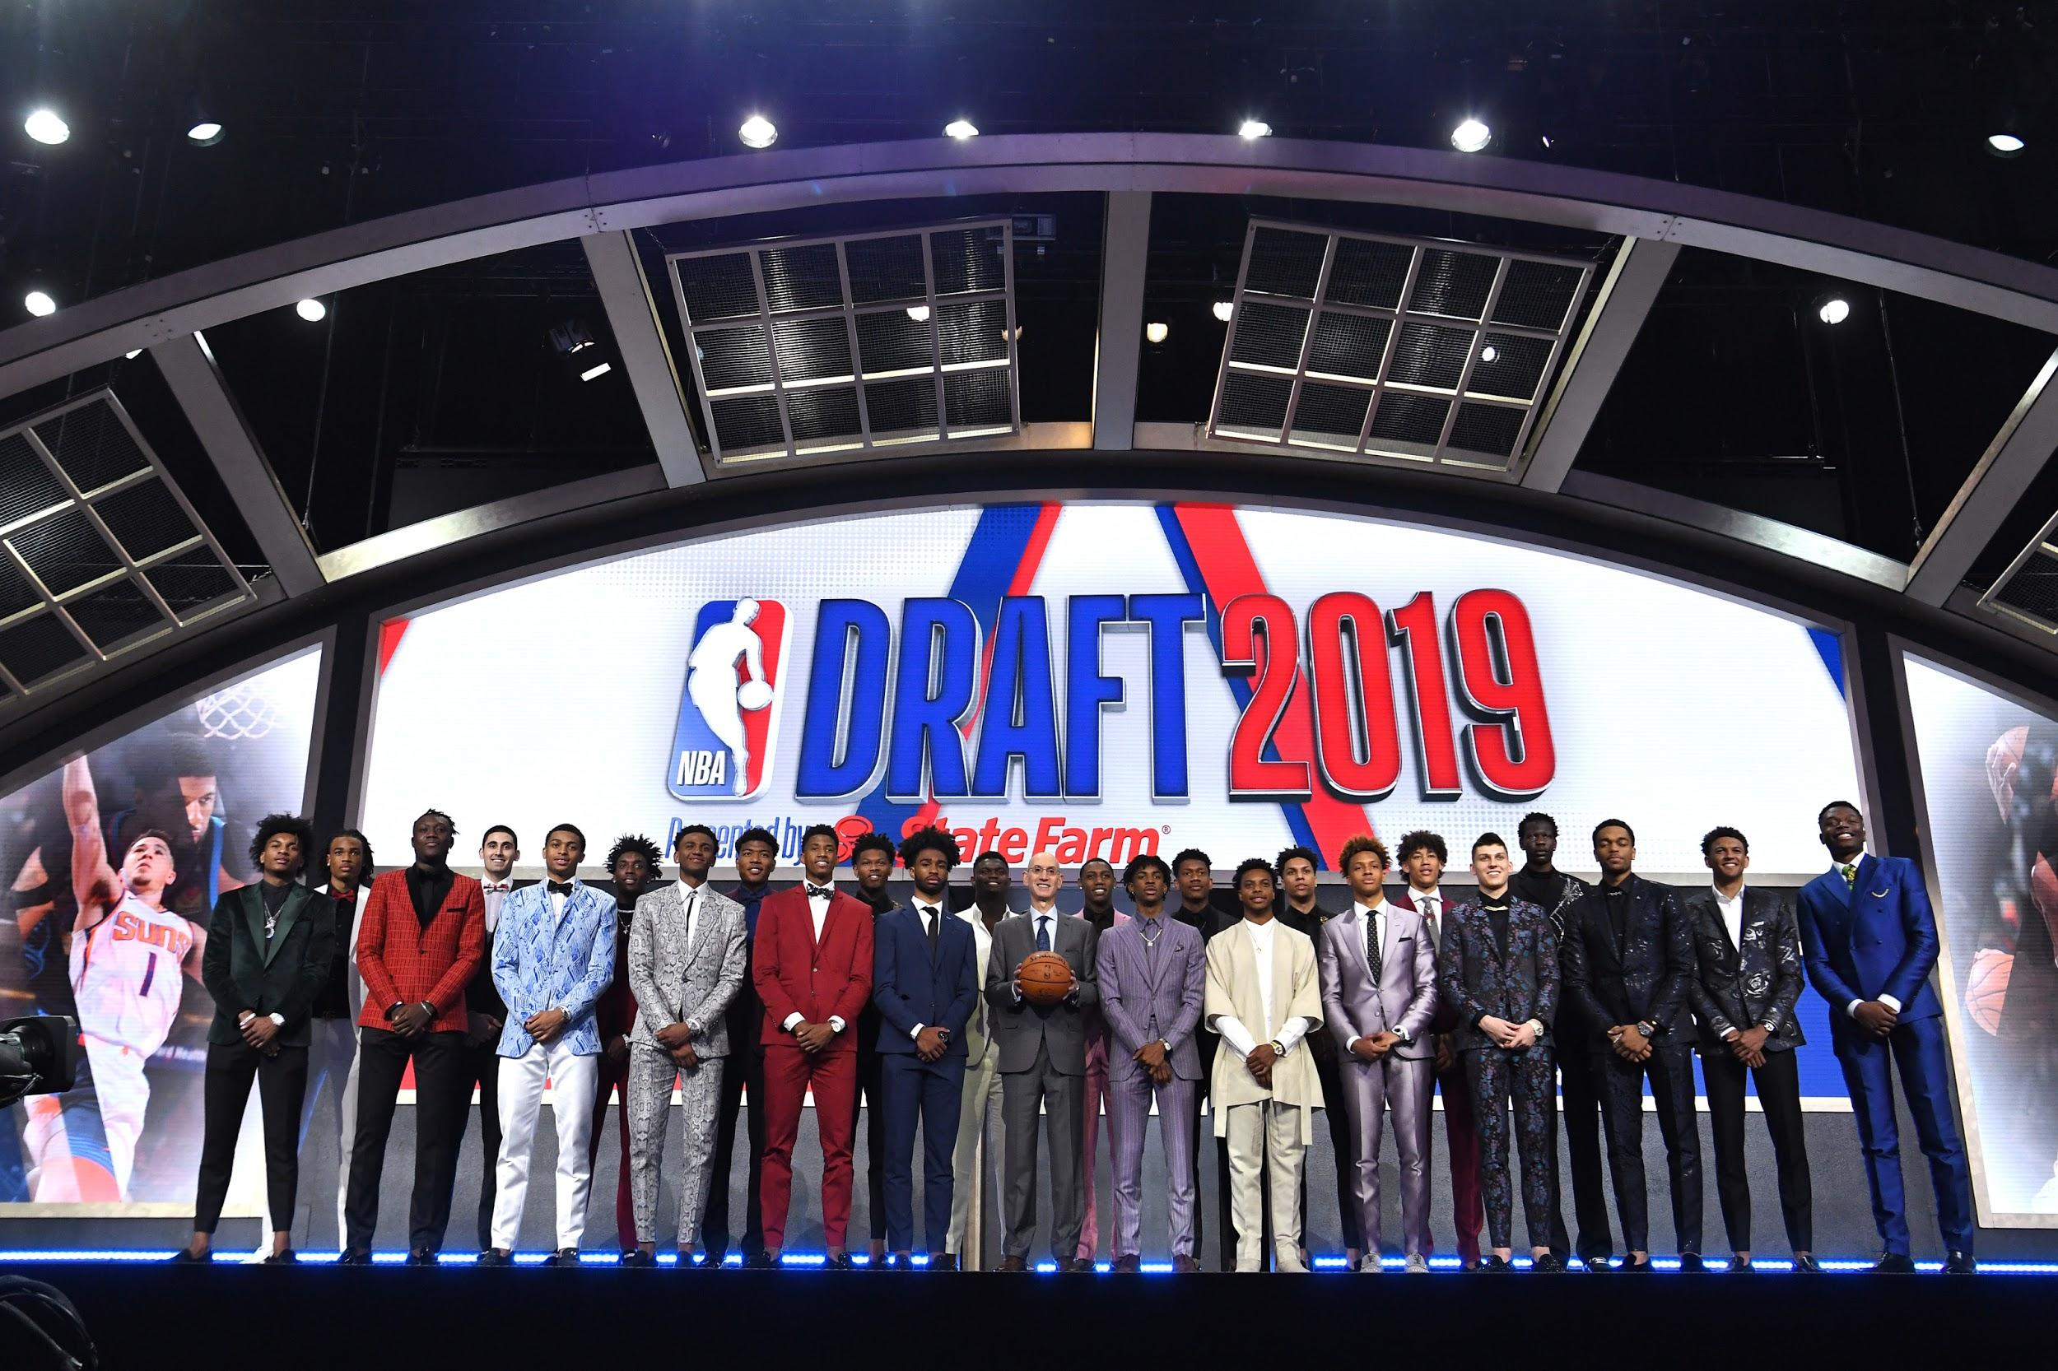

Challenges & Reflections
Immeasurable Factors
Situational Differences
Incomplete data
Importance & Aims
Exploratory Data Analysis
Linear Regression
Random Forest
Conclusion
Q&A
Notes:
Should have only predicted first four years of NBA win shares since our dataset is largely incomplete due to our dataset including players who were drafted in 2015.

Slide 16
Q&A
Importance & Aims
Exploratory Data Analysis
Linear Regression
Random Forest
Conclusion
Q&A

