Slide 1
From Deception to Detection: Evaluating and Optimizing Language Models (LMs) to Detect LLM-Edited Fake News
Ali Azarsina
Majid Faridfar
Bardia Khalafi
LLM
Spring 2024
Final Project

Slide 2
Table of contents
01
02
03
04
Background
Data
In-context Learning
Fine-tuning
05
Result
06
Conclusion

Slide 3
Why Is Fake News Detection Important?

Slide 4
01
Background

Slide 5
Background
(o) What is the problem?
“LLM-generated misinformation can be harder to detect.”
Chen C. and Shu K. (2023)
“LLM-camouflaged fake news content leads to substantial performance degradation.”
Woo J. and Hooi B. (2023)
(o) What are we going to do?
Enhancing performance on LLM-paraphrased news
Maintaining accuracy on human-written content.

Slide 6
02
Data

Slide 7
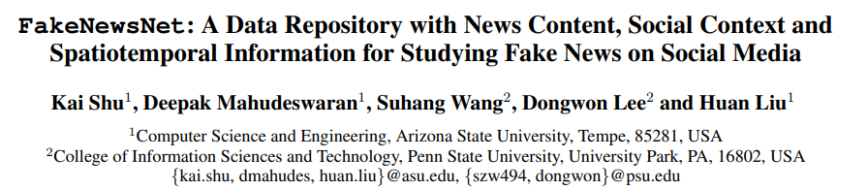
Data
(o) FakeNewsNet

Slide 8
Data
(o) FakeNewsNet
Problem with Twitter API
(1) GossipCop
9,867 samples = 2,988 fakes + 6,879 reals
(1) PolitiFact
921 Samples = 381 fakes + 520 reals
(o) What were the problems with news?
Some required preprocessing steps

Slide 9
Data
(o) Primary dataset
Human written
Cleaned GossipCop and PolitiFact samples
(o) Secondary dataset
LLM-edited
Paraphrased form of around 500 fake and 500 real samples in GossipCop
Using Llama-2-7B-chat-hf

Slide 10
03
In-context Learning

Slide 11
In-context Learning
(o) Selected model: Llama 2
Problem with other models’ APIs
Speed of answering
(o) What were the problem with news?
Model’s context-window size

Slide 12
In-context Learning
(o) Zero-shot
Decrease in samples because of context-window size
(o) Few-shot
More decrease in samples!
2 shots
 | Zero-shot |  |  |  | Few-shot
 | Primary Dataset (PolitiFact) |  | Secondary Dataset |  | Primary Dataset (PolitiFact) |  | Secondary Dataset
 | Acc | F1 | Acc | F1 | Acc | F1 | Acc | F1
Llama 2 | 46 | 59 | 51 | 65 | 66 | 79 | 55 | 71

Slide 13
04
Fine-tuning

Slide 14
Fine-tuning
(o) Selected models: BERT and RoBERTa
Used by Su J. (2024)
(o) What not larger models?
Problems of APIs
Limited GPU access in Google Colab

Slide 15
Fine-tuning
(o) Testing base models on primary dataset
(o) Testing base models on secondary dataset
 | Accuracy | F1-score
BERT | 46 | 63
RoBERTa | 48 | 65
 | Accuracy | F1-score
BERT | 37 | 51
RoBERTa | 45 | 57

Slide 16
Fine-tuning
(o) Testing fine-tuned models on primary dataset
(o) Testing fine-tuned models on secondary dataset
 | Accuracy | F1-score
BERT | 78 | 78
RoBERTa | 77 | 78
 | Accuracy | F1-score
BERT | 80 | 81
RoBERTa | 69 | 74

Slide 17
Fine-tuning
(o) Fine-tuning fine-tuned RoBERTa on secondary dataset
 | Accuracy | F1-score
RoBERTa | 96 | 96

Slide 18
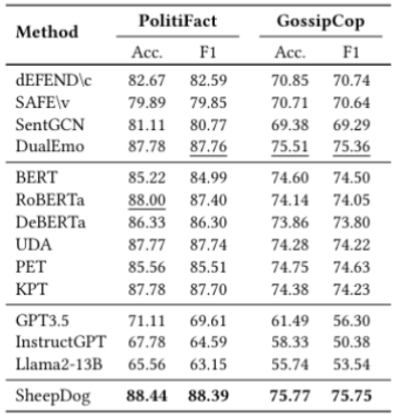
Fine-tuning
(o) SOTA model
Wu and Hooi (2023)

Slide 19
05
Result

Slide 20
Result
Model | Base |  |  |  | Fine-tuned |  |  |  | Fine-Fine-tuned
 | Primary Dataset |  | Secondary Dataset |  | Primary Dataset |  | Secondary Dataset |  | Secondary Datset
 | Acc | F1 | Acc | F1 | Acc | F1 | Acc | F1 | Acc | F1
BERT | 46 | 63 | 37 | 51 | 78 | 78 | 80 | 81 | - | -
RoBERTa | 48 | 65 | 45 | 57 | 77 | 78 | 69 | 74 | 96 | 96
Llama 2 | 46* | 59* | 51* | 65* | 66** | 79** | 55** | 71** | - | -
* Zero-shot ** Few-shot (2)

Slide 21
06
Conclusion

Slide 22
References
(-) Chen, C. and Shu, K. (2023). Can llm-generated misinformation be detected? ICLR.
(-) Shu, K., Mahudeswaran, D., Wang, S., Lee, D., and Liu, H. (2020). Fakenewsnet: A data repository with news con-
tent, social context, and spatiotemporal information for studying fake news on social media. Big data.
(-) Su, J., Zhuo, T. Y., Mansurov, J., Wang, D., and Nakov, P. (2024). Fake news detectors are biased against texts generated by large language models. NAACL.
(-) Wu, J. and Hooi, B. (2023). Fake news in sheep’s clothing: Robust fake news detection against llm-empowered style attacks. arXiv preprint arXiv:2310.10830.
(-) Zhang, X. and Gao, W. (2023). Towards llm-based fact verification on
news claims with a hierarchical step-by-step prompting method.
IJCNLP-AACL.

Slide 23
Thanks!
Any questions?
majid.faridfar@gmail.com
khalafibardia@gmail.com
aliazarsina@gmail.com

