Slide 1
DKTE Society’s Textile & Engineering Institute
COMMUNITY ENGAGEMENT PROJECT
Nutrition & Hygiene Maintenance
A Study on Food Waste Management
FIELD VISIT | SANSKRUTI HOTEL
SANIKA TAVATE 25UAM128
PRACHI MAJALEKAR 25UAM118
GAYATRI SANKPAL 25UAM142
SHREYA BHOSALE 25UAM140
RUTUJA DHOLE 25UAM079
RUKAIYYA SHAIKH 25UAM127

Slide 2


01 • PROJECT OVERVIEW
Introduction & Problem Statement
Why this topic matters
The issue
The concern
Food waste affects resource use, operating costs and the environment. Safe food handling and good sanitation are important for protecting health.
Food can be wasted during preparation, serving and after meals. Inappropriate handling or disposal may also create hygiene concerns.
OUR MESSAGE
Take only what you need — every grain of food carries someone’s hard work.

Slide 3
02 • WHAT WE AIMED TO LEARN
Objectives of the Project
01
Identify causes of food wastage
02
Observe hygiene and sanitation
Understand where and why food is discarded.
Review cleanliness and safe food-handling practices.
03
Study waste management
04
Suggest practical improvements
Understand collection, segregation and disposal.
Recommend actions that may reduce avoidable waste.

Slide 4
03 • NUTRITION AND FOOD WASTE
Nutrition and Food Waste
01
Balanced Diet
02
Essential Nutrients
Provides essential nutrients and supports good health.
Carbohydrates give energy; proteins support growth; vitamins and minerals support health.
03
Nutritional Loss
04
Storage and Waste Reduction
Wasting food also wastes the nutrients it contains.
Keep food covered; prepare as needed, serve suitable portions and store leftovers safely.

Slide 5





04 • STUDY APPROACH
Methodology
STEP 1
STEP 2
STEP 3
STEP 4
Site visit
Staff interaction
Observation
Documentation
Visit Sanskruti Hotel and understand the setting.
Ask about food preparation, leftovers and waste handling.
Observe accessible dining and serving areas with permission.
Record notes and photographs to support the project.

Slide 6
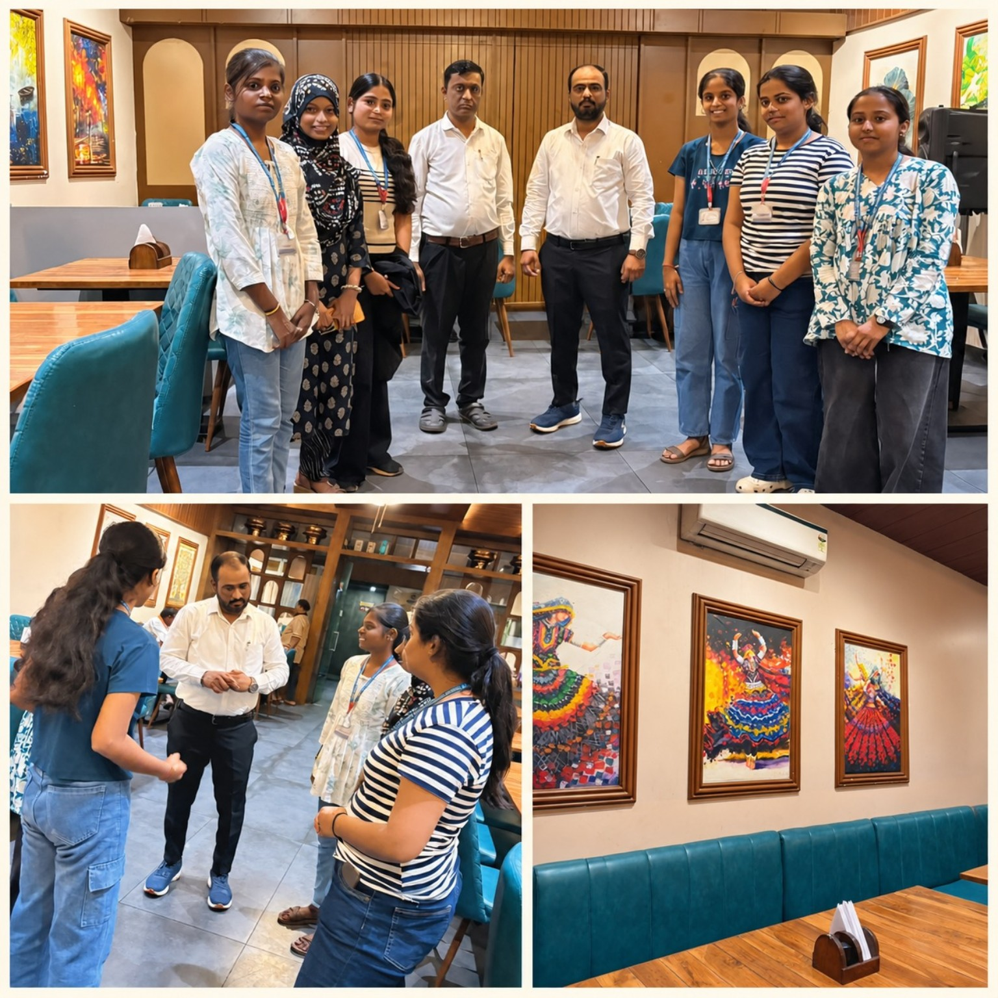


05 • FIELD DOCUMENTATION
Site Visit at Sanskruti Hotel
Team visit
Group photograph with hotel staff.
Staff interaction
Discussion with a staff member.
Visit documentation
Restaurant interior included in the photo collage.

Slide 7


06 • INFORMATION COLLECTION
Staff Interaction & Interview
Interview questions
Record actual answers
1
How much food is prepared on a typical day?
Include staff responses and quantities only if provided.
2
Which food items are wasted most often?
3
How are leftovers handled after service?
4
Are wet and dry waste collected separately?
Ask permission
5
What hygiene practices are followed?
Get approval before taking photographs or recording details.
6
What steps are taken to reduce food wastage?

Slide 8




07 • AREAS TO EXAMINE
Food Waste Management
Preparation
Serving
Plan quantities according to demand.
Encourage suitable portions and mindful serving.
Collection
Segregation
Use appropriate containers for food waste.
Separate organic and other waste where facilities allow.

Slide 9



08 • SAFE FOOD HANDLING
Hygiene & Sanitation
Cleanliness
Personal hygiene
Food storage
Observe preparation and serving surfaces.
Ask about handwashing and safe handling routines.
Ask how ingredients and leftovers are stored safely.

Slide 10



09 • PRACTICAL NEXT STEPS
Recommendations & SDG Contribution
Portion planning
Waste segregation
Prepare quantities based on demand.
Use clearly identified bins where feasible.
Composting
Awareness
Consider a suitable system for organic waste.
Encourage mindful consumption and reduce leftovers.
SUPPORTING THE UN SUSTAINABLE DEVELOPMENT GOALS
SDG 2
SDG 3
SDG 12
SDG 13
Zero Hunger
Good Health
Responsible Consumption
Climate Action

Slide 11
CONCLUSION
Every grain saved makes a difference.
Reducing food waste requires thoughtful planning, mindful portions, safe food handling and suitable waste management. The Sanskruti Hotel visit connects these ideas with real-world practices.
THANK YOU

