Slide 1





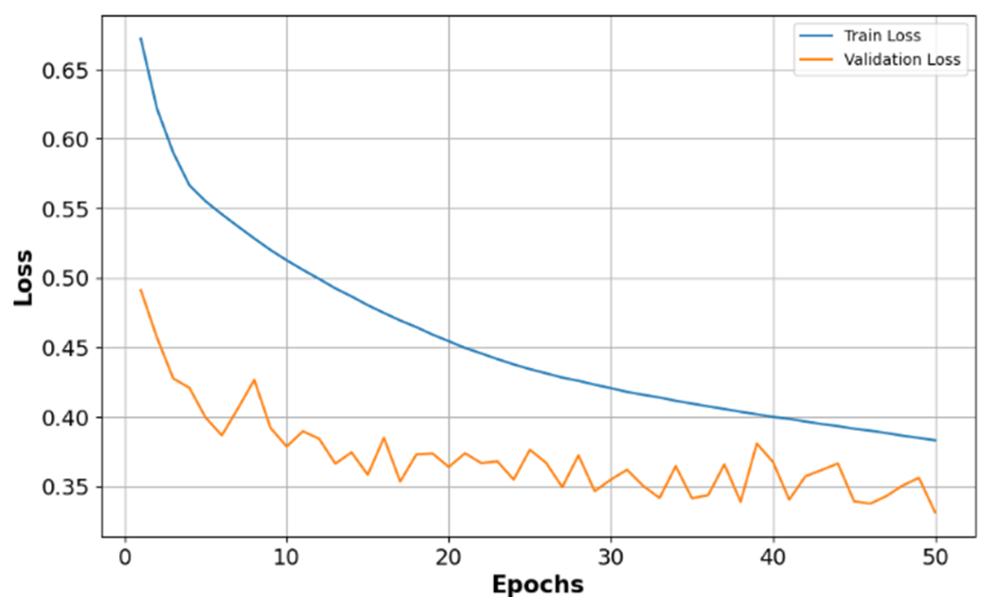
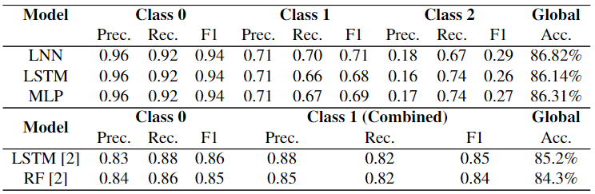

s
Prediction of weather impacted flight delay
Introduction
Flight delays represent a major challenge for airline companies, resulting in financial costs of billions of dollars.
A flight is considered delayed if it operates more than 15 minutes later than the scheduled time [1].
Flight data are exposed to serious imbalances which can have an impact on the accuracy of model predictions.
Several types of delay exist, including weather delays. They are unpredictable and can produce major disruption.
Predicting flight delays brings several benefits in terms of cost reduction, improved environmental sustainability, better resource management and enhanced customer satisfaction.
DELAYED
DELAYED
DELAYED
DELAYED
Aim & Objectives
Aim: To develop a deep learning model for predicting weather impacted flight delays
Objectives
Literature Review & Data Collection
Data Preprocessing & Engineering
Exploratory Data Analysis & Model Development
Model Evaluation & Validation
Model Comparison with Existing Methods
Methodology
1. Problem Definition
2. Data Collection
3. Data Preprocessing
4. Deep Learning Models
5. Parameters Optimsation
6. Evaluation
7. Proposed Solution
Identify and define
the problem
Collect Flight and
Weather data
Clean the data
Encode the data
Normalise the data
Create the target variable
Split the data
Apply the SMOTE
Select the features
LNN
LSTM
MLP
Adjust model hyperparameters
Improve prediction accuracy
Assess model performance and
validation
Prediction of weather impacted flight delays
Figure 1: Diagram of the adopted methodology
Results
Table 1: Comparison of the performance of the best models with two from previous research
The models developed allow a more detailed distinction between types of delay, separating delays due to weather conditions from the other types of delays, This is not the case for the models used in the previous study.
The implemented models show remarkable scores for class 0, outperforming the two models from the previous study.
Among the models developed, the LNN model delivers the best prediction performance, especially for classes 1 and 2.
Figure 2: Training and Validation Loss Over Epochs for the best model
The LNN model shows lower performance for class 2. This reflects the difficulty of predicting the precise impact of weather conditions on flights.
Conclusions
Overall
The most recent weather data before flight departure improves the accuracy of arrival delay predictions.
The LNN model delivers even better interpretability by distinguishing types of delay. This can be crucial in this field.
The LNN model presents limitations in terms of the challenges of predicting weather delays in particular and the large computing resources needed to train it.
Overall, the LNN model provides a solid basis for weather impacted flight delays prediction.
Future Works
Enhance hyperparameter optimisation by testing more configurations for the LNN model, by extending the sets of values for hyperparameters tested during grid search for the LSTM and MLP models, by introducing a new hyperparameter for the SMOTE imbalance ratio.
Collect weather data from flight itineraries to improve predictions, notably for class 2.
Evaluate models using flight and weather data from other airports to ensure generalisation and consistency in predictions across different geographical locations.
Extend the models by adding a second output layer to predict whether a flight is cancelled or not, alongside delays, to widen the initial problem into a more realistic one.
Explore the prediction of flight delays caused by other factors to enhance the robustness of the model.
Author: Majuran Chandrakumar
Supervisors: Irene Moulitsas, Desmond Bisandu
References :
[1] Airline on-time performance and causes of flight delays. https://www.bts.gov/explore-topics-and-geography/topics/airline-time-performance-and-causes-flight-delays , Mar 2021. [Online; Last access 28/07/2024].
[2] S. Kim and E. Park. Prediction of flight departure delays caused by weather conditionsadopting data-driven approaches. Journal of Big Data, 11, 2024.

