Slide 1
Prostate Cancer Diagnose Expert System
Artificial intelligence CS 512
Instructor’s Name: Dr. Aadam Olatunji
CCSIT 2020
Student name | Student ID
Hamad AlAjaji | 2170005762
Majd Ashour | 2170007697
Tawfik Hussein (Leader) | 2170007733
Mohammed Alnemer | 2170000028
Mersudin Hasanovic | 2170007646

Slide 2





Agenda
Abstract
Literature Review Summary
Design and Implementation
Result and Analysis
Conclusion
Tawfik Hussein

Slide 3
Abstract
Prostate cancer is one of the most spread cancer male diseases
The purpose : Expert system to diagnose prostate cancer disease
Awareness of the prostate cancer disease risk before it spread
Using fuzzy logic
Tawfik Hussein

Slide 4
Literature Review Summary
Most Used Approach: Fuzzy
Most Used Attributes:
Age
PSA (Prostate-specific antigen)
PV (Prostate Volume)
Diagnosing Symptoms
Tawfik Hussein

Slide 5
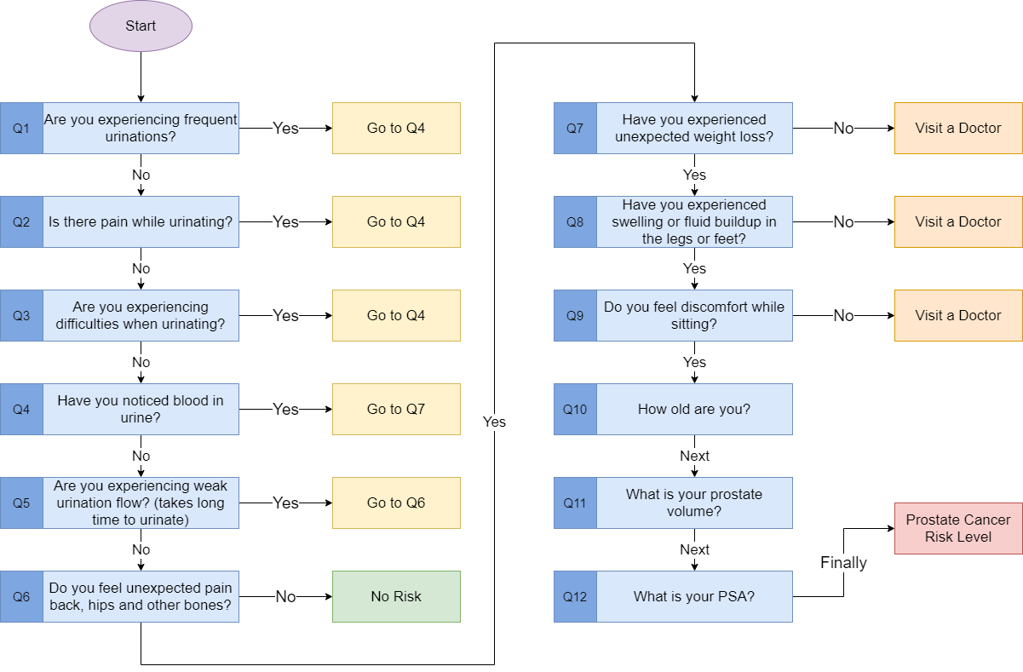
Flowchart
Hamad AlAjaji
5

Slide 6
Rules
R1: IF a patient is Very Young and has Prostate Volume (PV) Very Small and PSA
level is Very Low THEN Prostate Cancer Risk Level is Very Low
R2: IF a patient is Very Young and has Prostate Volume (PV) Very Small and PSA
level is Low THEN Prostate Cancer Risk Level is Very Low
R3: IF a patient is Very Young and has Prostate Volume (PV) Very Small and PSA
level is Middle THEN Prostate Cancer Risk Level is Low
…
R125: IF a patient is Very Old and has Prostate Volume (PV) Very Large and PSA
level is Very High THEN Prostate Cancer Risk Level is Very High
Mohammed Alnemer

Slide 7
Implementation
1- Research about the disease
2- Develop the model
3- Fuzzy approach and Rules
4- Implementation
5- Testing the cases
Mohammed Alnemer

Slide 8
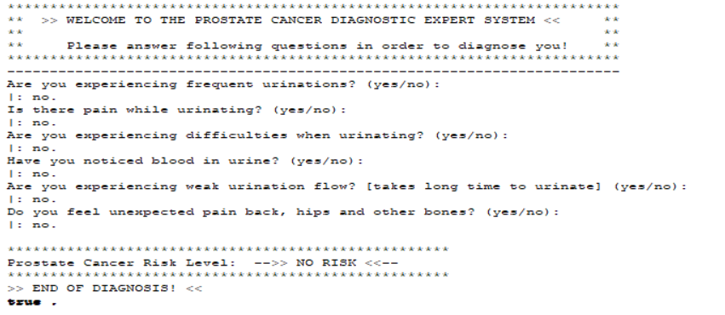
Testing (No Risk)
Mersudin Hasanovic

Slide 9
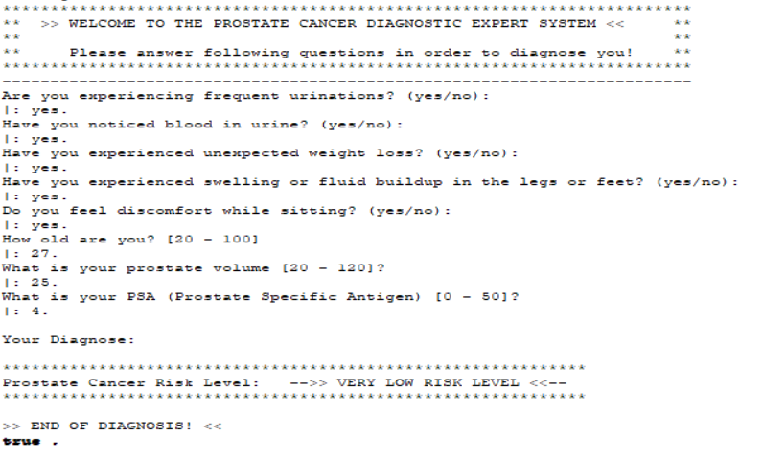
Testing (Very Low Risk)
Mersudin Hasanovic

Slide 10
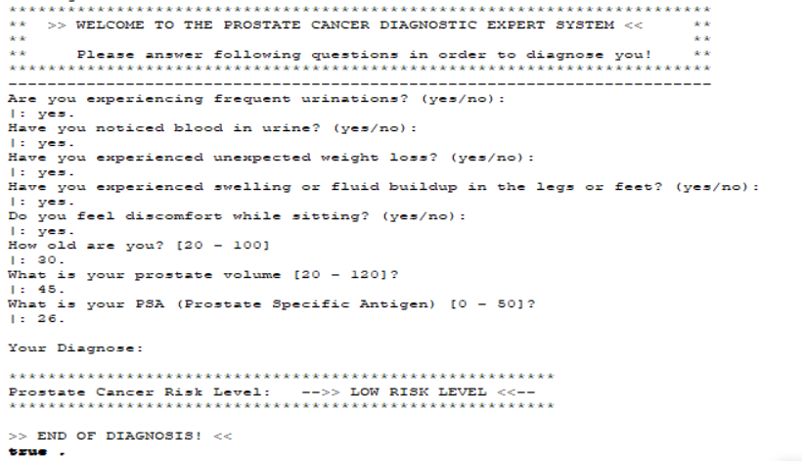
Testing (Low Risk)
Mersudin Hasanovic

Slide 11
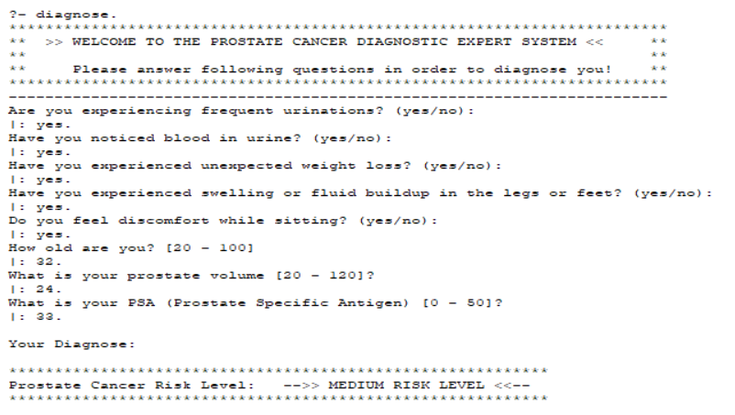
Testing (Medium Risk)
Mersudin Hasanovic

Slide 12
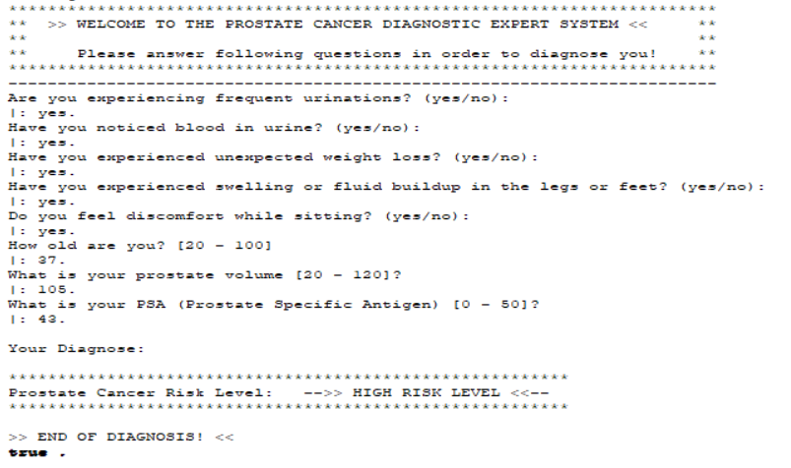
Testing (High Risk)
Mersudin Hasanovic

Slide 13
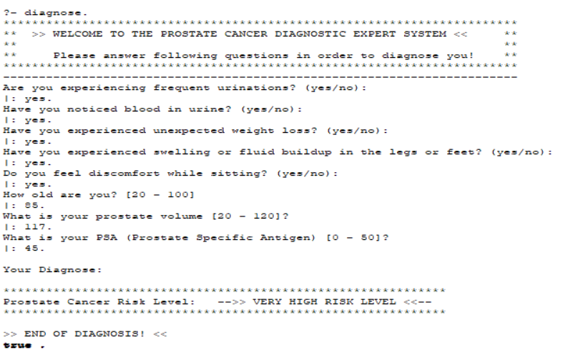
Testing (Very High Risk)
Mersudin Hasanovic

Slide 14
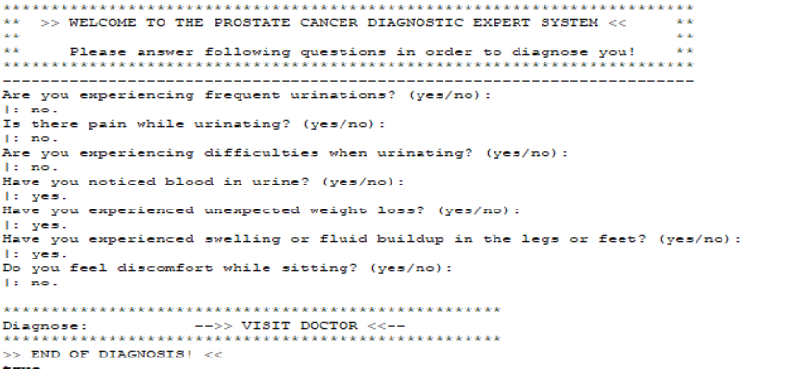
Testing (Visit Doctor)
Mersudin Hasanovic

Slide 15
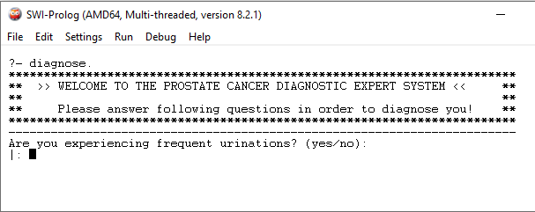
DEMO
Mersudin Hasanovic

Slide 16

Result and Evaluation
Prostate Cancer Risk Factor.
Rule-Based System.
Added New Rules.
Data Limitation.
Majd Ashour

Slide 17



Conclusion & Recommendation
Prostate Cancer
Risk Factor.
Hospital Level Testing.
Hospital Feedback.
Majd Ashour

Slide 18
REFERENCES
[1] I. &. A. N. &. S. I. Saritas, "A fuzzy expert system design for diagnosis of prostate cancer," Proceedings of the International Conference on Computer Systems and Technologies - Compsystech, 2003.
[2] www.sciencedirect.com, "Fuzzification," [Online]. Available: https://www.sciencedirect.com/topics/engineering/fuzzification.
[3] J. Mahanta, "Fuzzy Expert System for Prediction of Prostate Cancer".
[4] H. Seker; M.O. Odetayo; D. Petrovic; R.N.G. Naguib, "A fuzzy logic based-method for prognostic decision making in breast and prostate cancers," IEEE Transactions on Information Technology in Biomedicine, vol. 7, no. 2, pp. 114-122, 2003.
[5] F. A. R. M.J.P.Castanho, "Fuzzy expert system for predicting pathological stage of prostate cancer," Science Direct, [Online]. Available: https://www.sciencedirect.com/science/article/pii/S0957417412009013.
[6] Cancer.Net, "Prostate Cancer - Symptoms and Signs," [Online]. Available: https://www.cancer.net/cancer-types/prostate-cancer/symptoms-and-signs.
[7] Yuksel et al. Journal of Inequalities and Applications, "Application of soft sets to diagnose the," Selcuk University, Konya, Turkey, 2013.
[8] M. B. C. H. B. O. Jonathan L. Edwards, "Diagnosis and Management of Benign Prostatic Hyperplasia," 2008.

Slide 19
Thanks

