Slide 1

Solar System Scope
Automation QA Project

Slide 2

Majd Bader
Hurfiesh Village
A student of 5-TECH QA Automation bootcamp

Slide 3


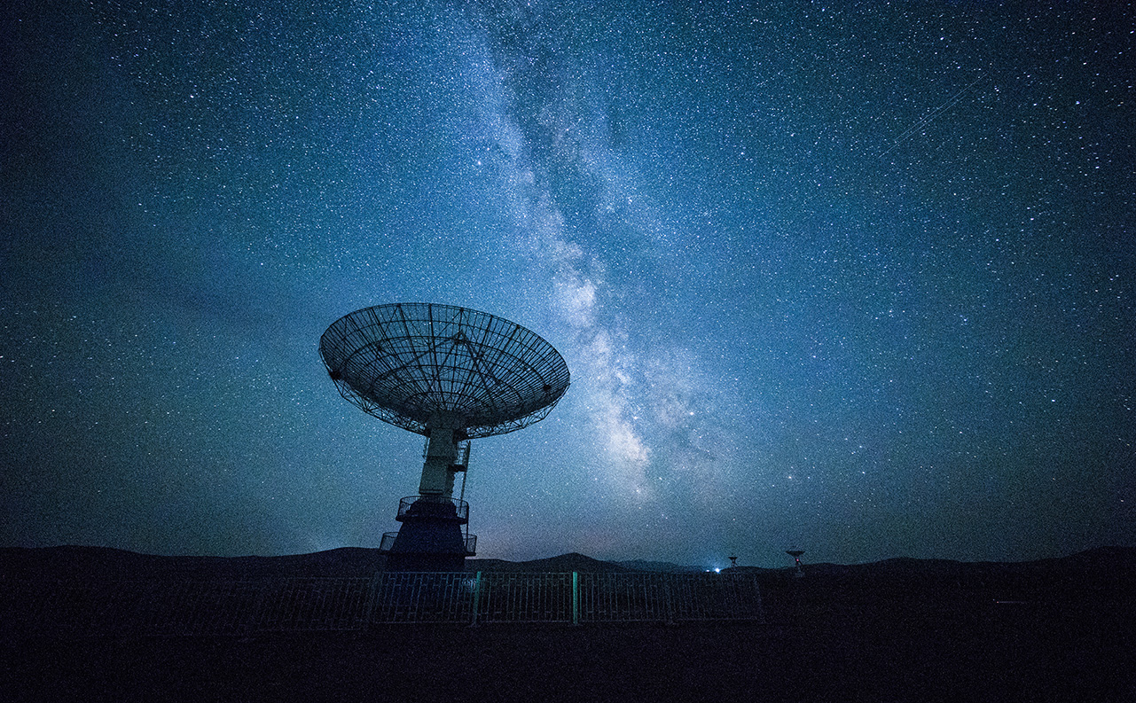
Solar System Scope
An online 3D simulation of the Solar System and night sky in real-time,
the Sun, planets, dwarf planets, comets, stars and constellations.
It is based on NASA elevation and imagery data.
Go To The Website

Slide 4

Automation
&
Code review
Software
Test
Design
Software
Test
Plan
GitHub

Slide 5
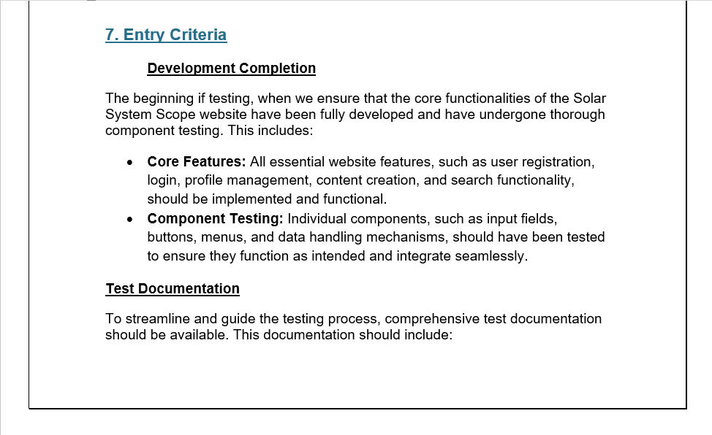
Software
Test
Plan

Slide 6
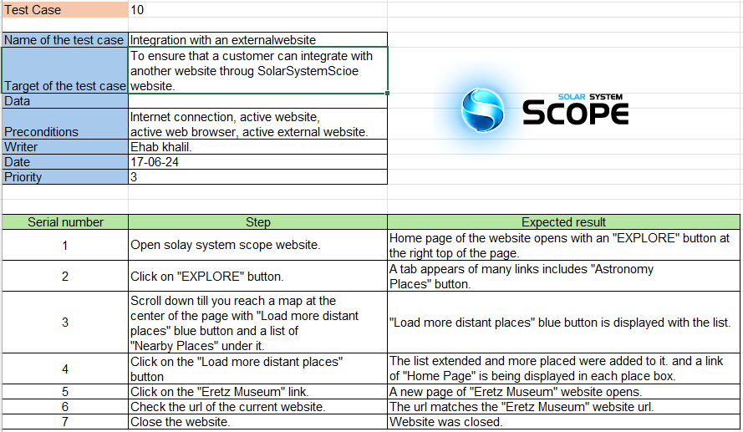
Software
Test
Design

Slide 7


Slide 8
Lets Dive Into The Code

Slide 9


