Slide 1
PART 1
Regression Analysis
Predicting Athlete Performance Score
Dataset: Kaggle — Athlete Performance Evaluation | 1,000 records | 12 features
Majd | DS301 Capstone

Slide 2
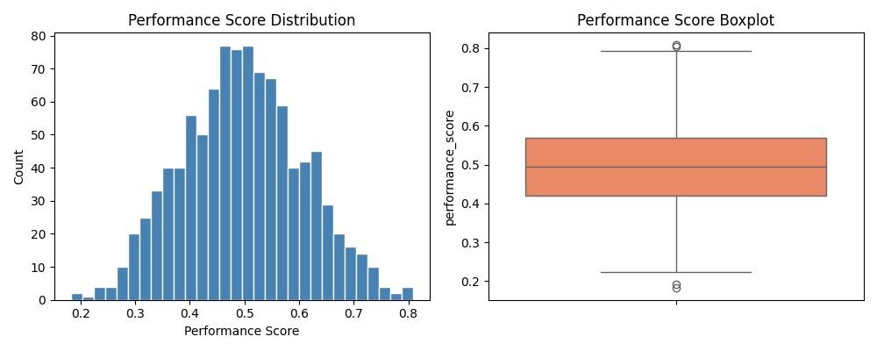
Dataset Overview & Target Distribution
1,000
12
0
80/20
Records
Features
Missing Values
Train/Test Split

Slide 3
7 Required Regression Models
1
Linear Regression
2
Lasso (L1)
3
Ridge (L2)
4
SVR
Baseline — no regularization
alpha=0.01, feature selection
alpha=1.0, recommended model
RBF kernel, StandardScaler Pipeline
5
Decision Tree
6
Random Forest
7
Neural Network
random_state=42
100 trees, feature importances
Keras: Dense(64)→Dense(32)→Dense(1) EarlyStopping, loss=mse

Slide 4
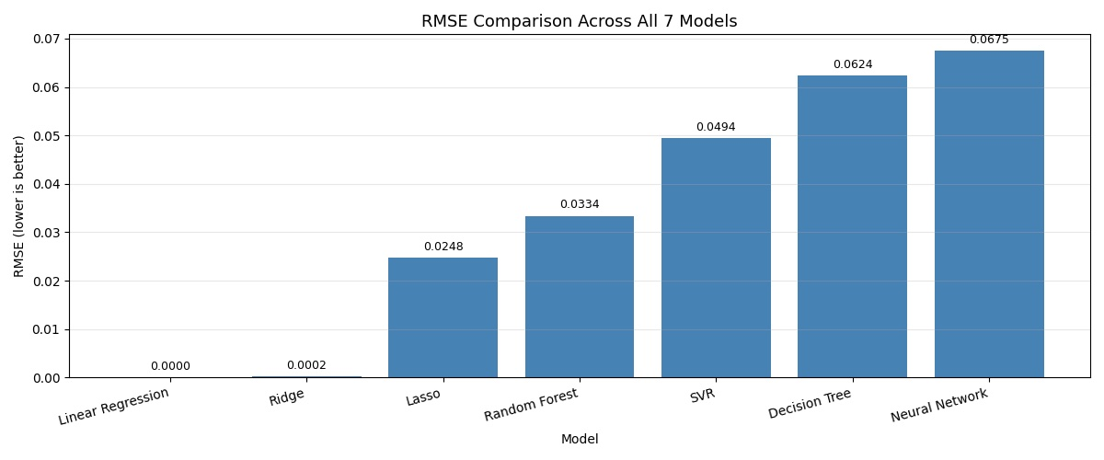
RMSE Comparison — All 7 Models

Slide 5
Model Performance Results
Model
RMSE
MAE
R²
Train Time (s)
Linear Regression
0.0000
0.0000
1.0000
0.0080
Ridge Regression ⭐
0.0002
0.0001
1.0000
0.0059
Lasso Regression
0.0248
0.0202
0.9507
0.0066
Random Forest
0.0334
0.0277
0.9104
0.4666
SVR
0.0494
0.0371
0.8047
0.0077
Decision Tree
0.0624
0.0502
0.6877
0.0095
Neural Network (Keras)
0.0675
0.0527
0.6349
0.9341
Random Forest (Tuned)
0.0325
0.0267
0.9155
—
⭐ Best Model: Ridge Regression — near-perfect accuracy, fast training, robust L2 regularization

Slide 6
Hyperparameter Tuning — Random Forest
GridSearchCV Setup
Best Parameters Found
Method: GridSearchCV (5-fold CV)
n_estimators
200
Model: Random Forest Regressor
Fit on training data ONLY
max_depth
10
min_samples_split
2
Parameter Grid:
n_estimators = [50, 100, 200]
max_depth = [None, 5, 10]
Results
min_samples_split = [2, 5]
Default RF
RMSE: 0.0334 R²: 0.9104
Total combinations: 18
Tuned RF ⭐
RMSE: 0.0325 R²: 0.9155

Slide 7
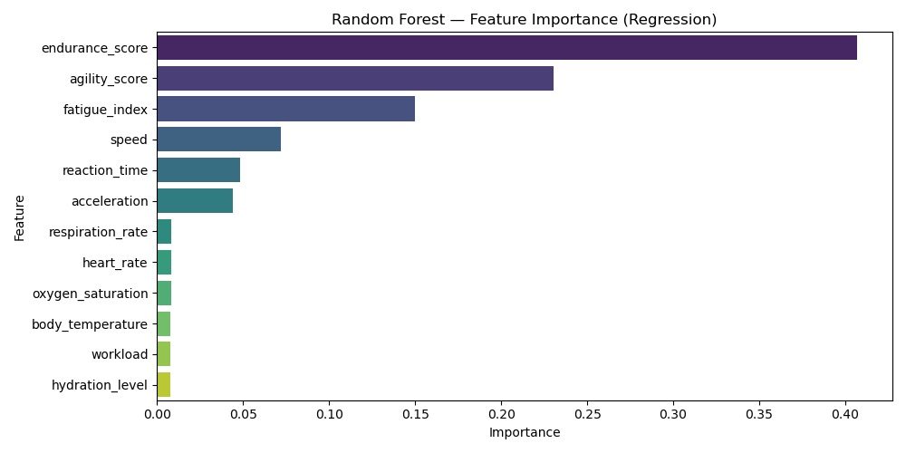
Feature Importance — Random Forest
Key Insight
endurance_score
40.7%
agility_score
23.0%
fatigue_index
15.0%
Top 3 features account for ~79% of predictive power.
Physiological features (heart rate, body temp, oxygen) have minimal impact.

Slide 8
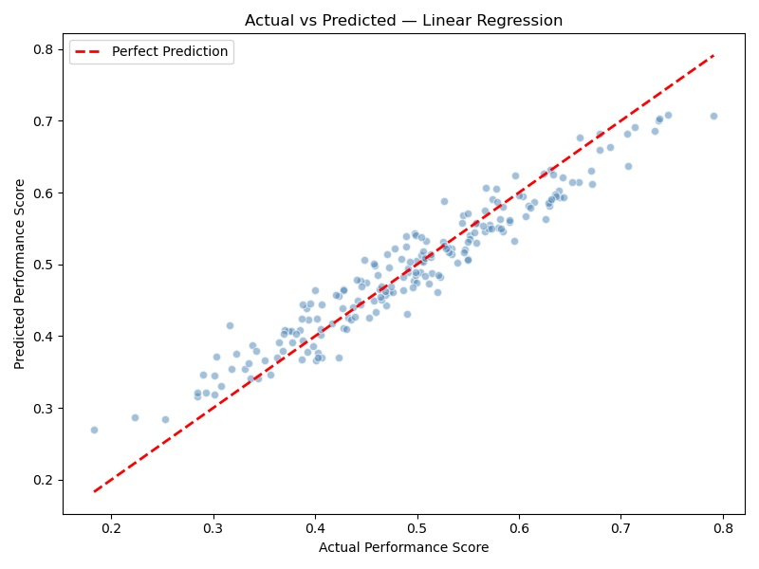
Actual vs. Predicted — Best Model (Ridge Regression)
Note: Plot shows Linear Regression predictions which closely match the diagonal (perfect prediction line), confirming near-perfect R²=1.0000 performance.

Slide 9
Conclusion
7 Models Trained
Best: Ridge Regression
Linear, Lasso, Ridge, SVR, Decision Tree, Random Forest, Neural Network (Keras)
RMSE=0.0002, R²=1.0000 Fastest robust model (0.006s)
Tuning Improved RF
Key Feature
GridSearchCV: RMSE 0.0334 → 0.0325
Endurance score drives 40.7% of all predictions
Majd | DS301 Capstone | Part 1 — Regression

