Slide 1
PART 2
Classification Analysis
Categorizing Athletes: Low | Medium | High Performance
Dataset: Kaggle — Athlete Performance Evaluation | 1,000 records | 12 features
Majd | DS301 Capstone

Slide 2
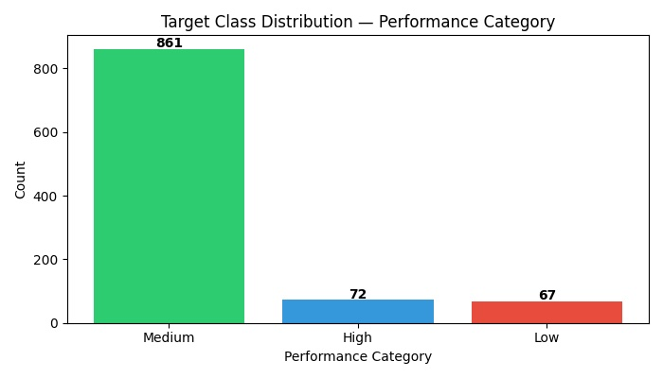
Target Variable & Class Imbalance
⚠ Class Imbalance: 86.1% Medium (861 samples) vs 7.2% High (72) vs 6.7% Low (67). Handled via stratified split and weighted F1-score as primary metric — not accuracy.

Slide 3
5 Required Classification Models
1
Logistic Regression
2
SVC
3
Decision Tree
4
Random Forest
Baseline, max_iter=1000 class_weight='balanced'
RBF kernel, StandardScaler class_weight='balanced'
random_state=42 Visualized at max_depth=3
100 trees Feature importances
5
Neural Network
Keras: Dense(64)→Dense(32) →Dense(3, softmax) loss=sparse_categorical_crossentropy

Slide 4
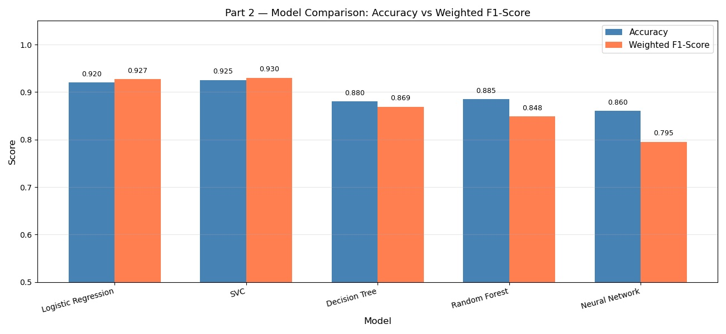
Model Comparison: Accuracy vs F1-Score

Slide 5
Model Performance Results
Model
Accuracy
Precision
Recall
F1-Score
Logistic Regression
0.9200
0.9271
0.9200
0.9271
SVC (Default)
0.9250
0.9298
0.9250
0.9298
SVC (Tuned) ⭐
0.9800
0.9803
0.9800
0.9803
Decision Tree
0.8800
0.8691
0.8800
0.8691
Random Forest
0.8850
0.8484
0.8850
0.8484
Neural Network (Keras)
0.9350
0.9316
0.9350
0.9316
⭐ Best Model: Tuned SVC (C=10, linear) — highest F1 score, primary metric due to class imbalance

Slide 6
Hyperparameter Tuning — SVC
GridSearchCV Setup
Best Parameters
Method: GridSearchCV (5-fold CV)
C
10
Scoring: weighted F1-score
Fit on training data ONLY
kernel
linear
gamma
scale
Parameter Grid:
C = [0.1, 1, 10]
kernel = ['rbf', 'linear']
F1 Improvement
gamma = ['scale', 'auto']
Default SVC
F1-Score: 0.9298
Total combinations: 12
Tuned SVC ⭐
F1-Score: 0.9803
+5.3% improvement through systematic tuning

Slide 7
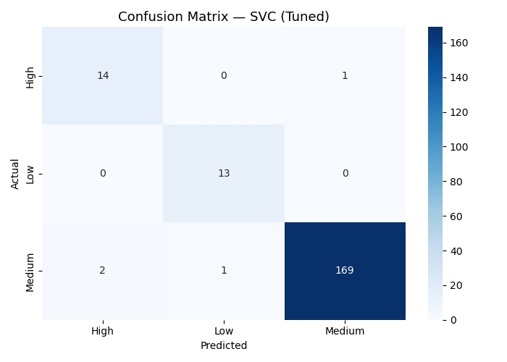
Confusion Matrix — Tuned SVC (Best Model)
Classification Report
Class
Prec
Recall
F1
High
0.88
0.93
0.90
Low
0.93
1.00
0.96
Medium
0.99
0.98
0.99
Wtd Avg
0.98
0.98
0.98
Overall Accuracy: 98.0%
Only 3 errors out of 200

Slide 8
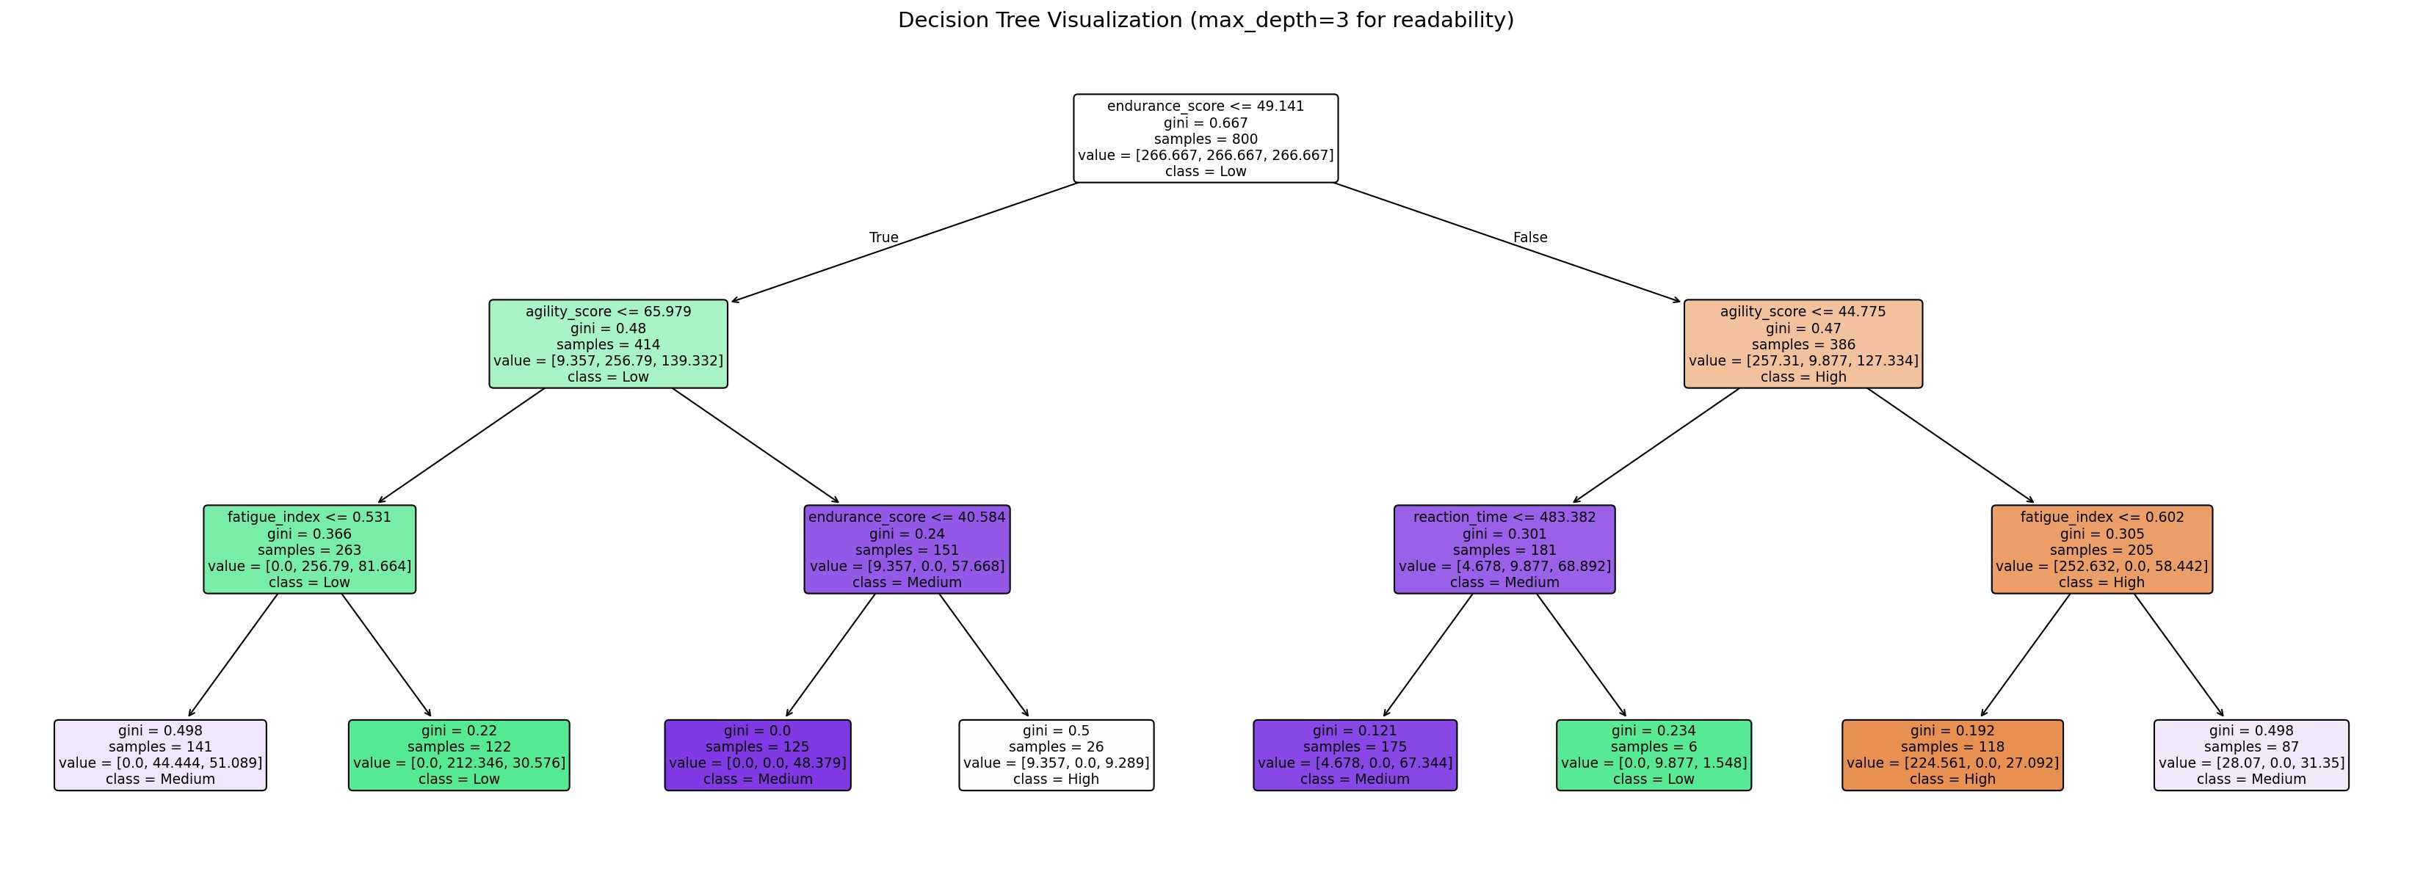
Decision Tree Visualization (max_depth=3)
Top split: endurance_score — confirming it is the most discriminative feature for athlete categorization.

Slide 9
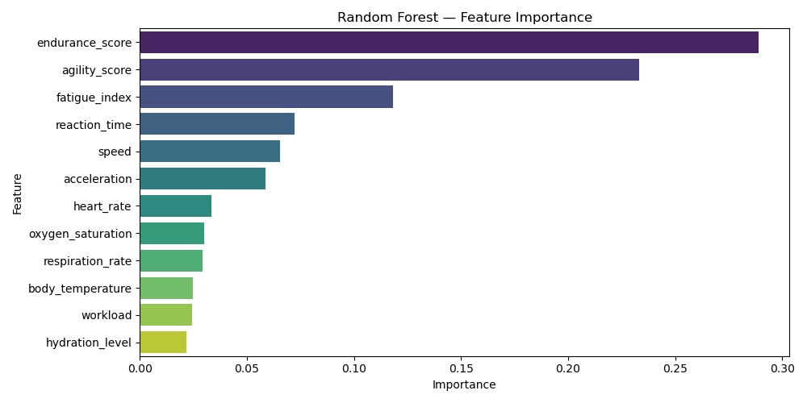
Feature Importance — Random Forest Classifier
Key Insight
endurance_score
28.9%
agility_score
23.3%
fatigue_index
11.8%
Top 2 features account for >52% of predictive power.
Matches regression results — consistent feature ranking.

Slide 10
Conclusion
5 Models Trained
Best: Tuned SVC
Logistic Reg, SVC, Decision Tree, Random Forest, Neural Network (Keras)
C=10, linear kernel 98% accuracy, F1=0.9803
Class Imbalance
Key Features
86.1% Medium handled via stratified split + F1 metric
Endurance + agility drive >52% of classification
Majd | DS301 Capstone | Part 2 — Classification

