Slide 1

Unveiling Human Cognitive Processes: A Case Study on Word Stimuli for Animals
Decoding Human Cognition: Insights from Word Stimuli Analysis Using Psychological Embeddings
COGNITIVE PROCESSES SEMINAR
Majd Hawily

Slide 2
Outline
1- Abstract
2- Problem and Hypothesis
3- Objectives
4- Methodology and Data Collection
5- Embedding Generation, Analysis and Results
6- Evaluation and Implications
COGNITIVE PROCESSES SEMINAR
Majd Hawily

Slide 3
Abstract
This research project was conducted as part of the University of Victoria's "Cognitive Processes Seminar" led by Dr Jim Tanaka with the assistance of Amy vanWell. I worked on this project with my colleague, Eric Mah. The main objective of this research was to understand the cognitive structure of 20 animal/ object-related word stimuli by developing and analyzing psychological embeddings using Brett Roads' machine learning framework, PSiz.
COGNITIVE PROCESSES SEMINAR
Majd Hawily

Slide 4
Majd Hawily
Introduction
— PART 1
COGNITIVE PROCESSES SEMINAR

Slide 5
Cognitive Processes Seminar
Majd Hawily
Problem
Hypothesis
WHAT WE WANT TO SOLVE
WHAT WE WANT TO PROVE
It is hypothesized that using the machine learning framework PSiz to generate and analyze psychological embeddings of animal-related word stimuli can provide a better understanding of the underlying human cognitive structure. Such understanding, in turn, could contribute to the development of more accurate and efficient machine learning models that emulate human cognition.
Existing machine learning models might not sufficiently reflect the complexity and intricacy of human cognitive processes, especially in the perception and processing of certain word stimuli. In this context, the word stimuli of interest are animal terms.

Slide 6
Objectives
The primary goals were to capture the perceived similarities among these terms, as judged by human participants. and to apply the insights gained from this analysis to improve machine learning models.
Cognitive Processes Seminar
Majd Hawily

Slide 7
Majd Hawily
Methodology
— PART 2
Cognitive Processes Seminar

Slide 8
Data Collection Methods
This experiment was designed to evaluate responses to animal-related word stimuli among 25 participants from my close circle. They were asked to rank these words based on perceived similarities.
Cognitive Processes Seminar
Majd Hawily

Slide 9
Cognitive Processes Seminar
Majd Hawily
The collected response data was converted into a format compatible with the PSiz program.
Data Pre-processing

Slide 10
Majd Hawily
Results of
the Study
— PART 3
Cognitive Processes Seminar

Slide 11
Cognitive Processes Seminar
Majd Hawily
Embedding Generation
The preprocessed data was fed into PSiz to generate psychological embeddings for the 20 animal terms. The selected dimensionality of the embeddings balanced detail and data complexity, resulting in representations that mirrored participants' judgments.

Slide 12
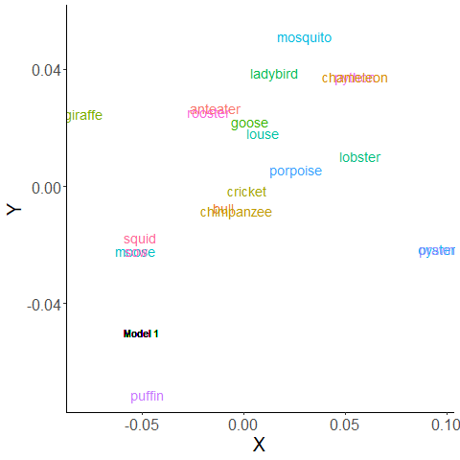
Analysis and Visualization
The generated embeddings were examined and visualized using PSiz's tools. Visualization in two or three dimensions allowed assessment of differences or similarities among the word stimuli. Embeddings were also categorized to discover inherent clusters and recurring patterns.
Cognitive Processes Seminar
Majd Hawily

Slide 13
Majd Hawily
Conclusion
— PART 4
Cognitive Processes Seminar

Slide 14

Cognitive Processes Seminar
Evaluation
Majd Hawily
The accuracy of the embeddings in capturing the cognitive structure of the data was evaluated. The performance of the embeddings was tested against human-derived ground truth data on cognitive tasks, such as classification or recall. The PSiz algorithms were adjusted and the process iterated to enhance the embeddings.

Slide 15
Cognitive Processes Seminar
Implications
Final Notes:
Insights from the analysis of the created embeddings were used to develop new or improved machine learning models. These models aimed to closely mimic human cognition, enabling quicker processing of complex data.
The research team successfully employed PSiz to create and analyze psychological embeddings, providing valuable insights into cognitive processes related to the perception of animal terms. The study revealed patterns and parallels in the data, assisting in the creation or enhancement of machine learning models. These models processed complex information more swiftly and more closely emulated human cognition.
Majd Hawily

Slide 16

Cognitive Processes Seminar
Majd Hawily
Reach out for more info!
Credits to Dr. Jim Tanaka for designing the course along with his TA, Amy VanWell. Also, I'd like to give thanks to Eric Mah for giving me the chance to collaborate with him on this project.
Majd Hawily
Cognitive Scientist and Researcher

