Slide 1
Introduction to Core Database Concepts
Getting started with Databases and Structure Query Language (SQL)

Slide 2
Objectives
Define Databases
Discuss the functionality of relational database management systems.
Define SQL

Slide 3
What is a Database (db)?
A Database (db) is an organized collection of data, typically stored in electronic format.
It allows you to input, manage, organize and retrieve data quickly.
Traditional databases are organized by records (rows), fields (columns) stored in tables which are stored in database files.
It’s a file used to store information.
A database table is a collection of rows and columns that is used to organize information about a single topic or object. Each row within a table corresponds to a single record and contains several different attributes that describe the row.
A database table is the most common and simplest form of data storage in a relational database.
Notes:
Data is the most important part of a database.

Slide 4
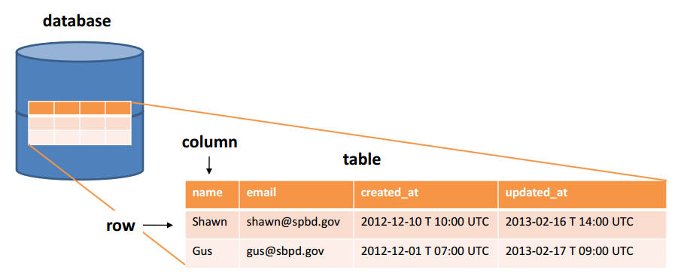
What is a Database (db)?
Notes:
Every table is broken up into smaller entities called fields. The fields in the table are: name, email, created_at, updated_at.
A field is a column in a table that is designed to maintain specific information about every record in the table.
A record, also called a row of data, is each individual entry that exists in a table. For example there are (2) records in the table.
A column is a vertical entity in a table that contains all information associated with a specific field in a table. For example, Name represents the name of the user.

Slide 5
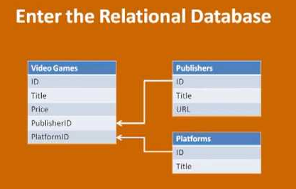
What is a Database (db)?
A relational database is a collection of tables of data all of which are formally described and organized according to the relational model. Each table must identify a column or group of columns, called the Primary Key, to uniquely identify each row.
Entity
Object comprised of various pieces of data.
Attribute
Piece of information (data) that describes an entity.

Slide 6
What is a Database (db)?
Database Management System (DBMS) is a software application/tool used by end users to access the data stored in the database files. A DBMS is also used to perform administrative tasks on the database and objects contained within the database.
DBMS is a collection of applications that allow users and other programs to capture and analyze data by providing additional functionality like reporting services to help you create, deploy and manage reports for your organization.
This application is responsible for handling data requests, committing changes to the data and enforcing the structure of the database including:
Ensuring data is stored properly and that rules for defining data are not violated.
Providing a level of disaster recovery by which data can be restored to a consistent state.
Maintaining relationships between data entities residing in the database.

Slide 7
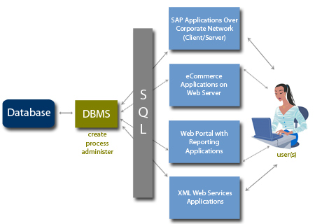
What is a Database (db)?

Slide 8
What is a Database (db)?
Relational Database Management Software (RDBMS) is a software system designed to allow the definition, creation, querying and updating of data stored in a relational database.
A few examples of RDBMS include:
Microsoft SQL Server
Microsoft Access
MYSQL
Oracle
Notes:
Today’s advanced RDBMS is actually much more than data, they also manage data, restricting the kind of data that can go into the system, and facilitating getting data out of the system.

Slide 9
What is a Database (db)?
An instance of an RDBMS such as SQL Server contains many objects.
The database itself
Transaction Log
Tables
Indexes
Filegroups
Views
Stored Procedures
Users/Roles

Slide 10
What is a Database (db)?
The main differences between DBMS and RDBMS are:
A DBMS has to provide some uniform methods independent of a specific application accessing the information that is stored in the tables.
RDBMS adds the additional condition that the system supports a tabular structure for the data, with enforced relationships between the tables.
DBMS does not impose any constraints or security with regard to data manipulation, while RDBMS does utilize an internal security model.
RDBMS is the basis for Structured Query Language (SQL).

Slide 11
What is SQL?
Structure Query Language (SQL)
Used to insert, retrieve, modify and delete data in a relational database.
The language is supported by most relational databases with slight variations.
Originally developed by IBM in mid 1970s.
Transact-SQL (T-SQL)
Used in Microsoft database management systems.

Slide 12
What is Microsoft SQL Server 2012?
Robust, feature laden Relational Database Management System.
Can support the most demanding applications.
The administrative tools and simple installation make it one of the easiest database servers to configure and deploy.

Slide 13
Scalability and Availability
Availability
Ability of a system to be constantly accessible by it’s users.
Provides reliability through features like online backups, failover clustering and log shipping.
Scalability
Ability to easily grow in size to support a growing user base.
Distributed partition view which is a single queriable entity that is horizontally partitioned and housed on multiple physical computers.

Slide 14
Administrative Features
Important administrative tools included with SQL Server:
Enterprise Manager
SQL Query Analyzer
SQL Profiler
Import/Export Data (DTS)
Internet enabled features – XML
Data Warehousing Features

Slide 15
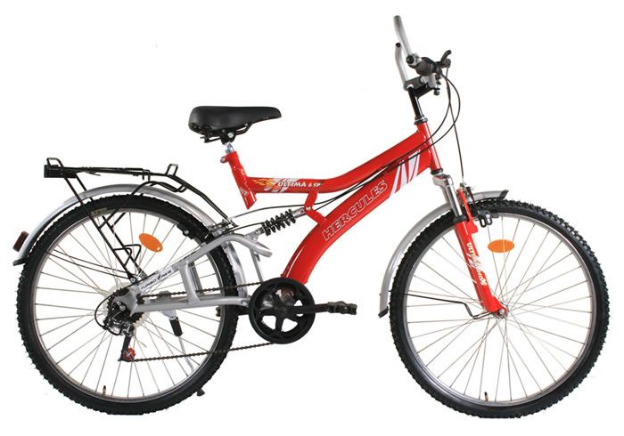



Bicycle Database (db)

Slide 16
Summary
A database (db) is an organized collection of data, typically stored in electronic format.
Microsoft SQL Server and MySQL are examples of relational databases.
DBMS is an application used to perform administrative tasks on database and used to interact with data stored in databases.
Database server hosts DBMS system and one or more instances of SQL Server.
SQL Server Management Studio (SSMS) is the GUI used to manage SQL Server, its databases, and the content contained within the database.
Relational databases allow data entities to be defined in tables.
A set of attributes for a given entity is defined as a row in a table (a collection of column values).

Slide 17
Summary
Relational databases perform the following functions:
Ensure data is stored properly and that rules for defining data are not violated.
Providing some level of disaster recover.
Maintaining relationships between data entities residing in the database.
SQL Server is capable of high availability and scalability through clustering and improved backup functionality.

