Slide 1

Mate Browser
The extendable browser that understands and displays HTML content with many more features

Slide 2
What is mate
A desktop app build with Java 8 And JavaFX
It can load html from Urls/Disk
It can display html content properly by translating it to JavaFX elements
History Log, Bookmarks, PDFViewer , Multi Tabs, DOM tree, games … and more !

Slide 3
Timeline
Representing Tags
Parsing
Drawing
Multi Tabs & History
Game & DOM
Editor
PDF Downloader
Other extras

Slide 4
Tag Specifications
Tags are the base elements of HTML
It Meta describes how to display the content
Each tag has its own specification
Each Tag has Acceptable tag types of children and supported attributes
A tag may have extra validation rules like the order of children
Some tags may required closing, while other may not

Slide 5
Example of Tag specification (HTML tag)
Supported Attributes = The global supported attributes + manifest
Supported Children = HEAD , BODY
Rules:
Each html tag must have exactly two children, A head tag followed by A body tag

Slide 6
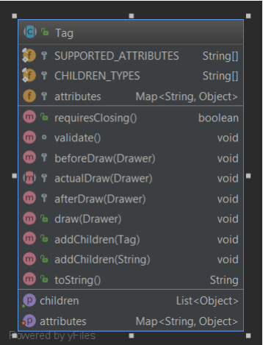
Representing Tags
A list of the supported attributes
A list of the supported children tags
Mapping between attribute and value
Indicator if requires closing tag
to apply extra rules
Action to do before drawing
The order of actions
Action to do after drawing
The process of drawing the tag
to add tag children to tag
to add string children to tag
Tag name
Tag/String children
Attributes mapping

Slide 7
Ex: Implementation of Tag class for HTML tag
public class HTML extends Tag
protected String lang = null;
protected final static String[] CHILDREN_TYPES = {"body", "head"};
protected final static String[] SUPPORTED_ATTRIBUTES = CommonAttributes.joinArrays(CommonAttributes.GLOBAL_HTML_ATTRIBUTES, new String[]{"lang"});
@Override
void validate() throws InvalidContentException {
if (children.size() == 2 && children.get(0).getClass() == HEAD.class && children.get(1).getClass() == BODY.class)
return;
throw new InvalidContentException("HTML TAG MUST HAVE EXACTLY TWO CHILDREN ( HEAD THEN BODY )");
}
@Override
public void actualDraw(Drawer drawer) {
for (Object item : children) {
if (item instanceof Tag)
((Tag) item).draw(drawer);
else
drawer.drawText(item.toString());
}
}

Slide 8
Parsing HTML - Intro
We needed a way to efficiently parse HTML content and convert it to something that we can handle programmatically (Our tag representation)
We had two paths to choose from (Lexical analyzing Or Regular Expressions)
Regular Expressions were more than enough to solve this problem

Slide 9
Parsing HTML – The four steps procedure
First, We need to remove the comments since they’re meaningless in the context of displaying the HTML properly
Second, we needed to detect each tag in order and where it starts and ends
Thirdly, We needed to build the relationships between the following tags
Finally, we needed to extract the attributes of each tag from its definition

Slide 10
Parsing HTML – Removing Comments
We remove the comments based on the regular expression that represents them
The Regular Expression We used is :
<!--(?:.|\s)*?-->
We use this expression to delete all matches in the HTML text

Slide 11
Parsing HTML – Detecting Tag Locations(1)
In order to determine the relationship between tags we need to know the location of every tag ( where it starts and where it ends ) and more precisely we even need to know the start and end of Tag opening / Closing.
In order to do this we matched three regulars expressions that we created to match three types of tags that could appear in the file
We also use a stack to keep log of tags that need to be closed

Slide 12
Parsing HTML – Tag Opening/Closing Regex
We used the following regex to match the Tag Opening
<(!?\w+)(?:\s(?:\w+(?:=(['"]?).+?\2)?\s?)*?)?\s*>
We used the following regex to match the Tag Closing
</(\w+)\s*>
We used the following regex to match The Tag combined Open & Closing
<(!?\w+)(?:\s(?:\w+(?:=(['"]?).+?\2)?\s?)*?)?\s*/>

Slide 13
Parsing HTML – Detecting Tag Locations
We find the next matching for the three regexes we discussed before
If it’s a closing tag we check for the last unclosed tag that matches the current tag, if not found then we have a syntax error
If it’s an opening tag we push it to the stack
If it’s an opening & closing tag we just add it to found tags
Finally we search for the text that we didn’t include in any tag definition and we add it as text Tag to the list of found tags
We repeat these steps until we’re no longer able to find matches

Slide 14
Detecting Tag Locations example
<html>
<head>
<title>Mate Is So Cool!</title>
</head>
<body>
<b id="a_great_item">
This is A bold TEXT!
</b>
</body>
</html>
Cl.end | Cl.start | Op.end | OP.start | Tag
HTML
0
5
111
117
B
HEAD
7
12
43
49
TITLE
13
19
36
42
BODY
“Mate.”
20
35
20
35
TITLE
HEAD
BODY
50
55
103
110
HTML
B
56
76
98
102
“THIS.”
77
97
77
97
Stack

Slide 15
Parsing HTML - Detecting children
After we’ve determined all the required locations we can easily determine if a tag is a children or a sibling to the previous tag
Since we have the tags in order the previous condition holds true
We may throw a content exception that we have more than one root at this step
We can tell if a tag is a children if the locations lay between the begin and the end of the tag

Slide 16
Parsing HTML – Detecting Attributes
After we’ve established the relationships and tags all we need to do now is to know the attributes
We do this by matching the following regex between the opening start and opening end foreach tag
(\w+)(?:=(['"]?)((?:.|\s)+?)\2)?(\s|>|/>)

Slide 17
Drawer
To draw html elements we divided tags to four sections
1-Primitives.
2-Layout tags.
3-Action tags.
4-Style tags.

Slide 18
Primitives
Primitives tags are the tags that appears directly in the page.
Using other tags style and layout.
Example: <img >, text.

Slide 19
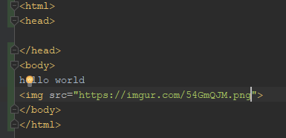

Primitives :

Slide 20
Layout tags
Layout tags are tag defines the way that other elements appear by it in the page
Exapmle: table , list
To make this layouts we create class DrawerPane .

Slide 21
Layout
DrawerPane Has parent from java fx
This abstract class link elements togother
public class DrawerPane { Pane parent; public void add(Node node) { parent.getChildren().add(node); } public void drawLine(){} public void setMarign(double x1, double x2 ,double x3 ,double x4){} public void setAlign(Alignment align){} }
In add function we write the method of adding elements

Slide 22
Example
public class GridDrawerPane extends DrawerPane { Integer row = -1, col = -1; @Override public void add(Node node) { ((GridPane) parent).add(node, col, row); } }
This class extends from DrawerPane
Using this class we can draw Table
We add element in position i,j

Slide 23
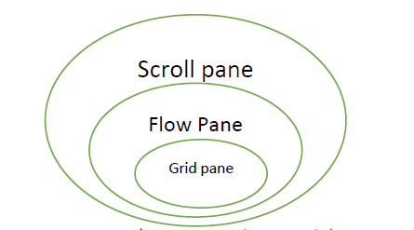
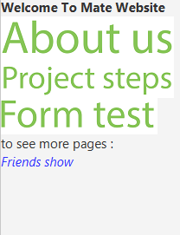
Drawer Pane
Flow pane
Also we can make a nested panes using this class
exsample
vbox

Slide 24
How to make complicated layouts?
Like If we want to make table inside another table …
To do that we have a stack of DrawerPane each element in the stack will be drawn in the last place on the previous element in the stack

Slide 25
How to make complicated layouts?
Element 1 | Element 2
Element 3 | *
Element 1 | Element 2
Element 3
Flow pane
(has an image)
1-element a
2-element b
3-element c
4-
1-element a
2-element b
3-element c
4-*
List
i=4
1-element a
2-element b
3-element c
4-
Table
i=2
J=2

Slide 26
Effects (Style tags)
Style tags detects the look of the primitives elements
Example : bold , italic , underline
To make this tags we defined an array foe each style element (called effect)
When a style tag begin we increase the effect number
When a style tag closed effect number will be decreased
When we draw a primitive we check if effect number is bigger than 0 then we will do the effect .

Slide 27
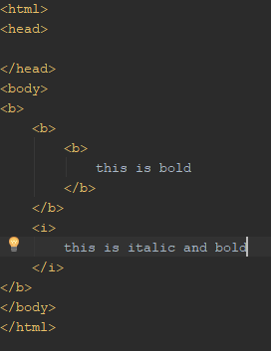
Exapmle
Bold | Italic
3 | 0
Bold | italic
1 | 1

Slide 28
Action tags
Actions in html like send information or reset data or let user input data.
So it is a way to let user interact with the page
We divided this actions into two sections
A-HREF – actions
B-Form-actions

Slide 29
Href actions
Href actions let the user open a new link using tag <a>
So every elements inside <a> must have this action
To make this step we set this action to the top ok drawPne stack
When user click on you then open your link

Slide 30
Example
<html> <head> </head> <body> <table> <a> <img src="img.png"> text <table> ... </table> </a> </table> </body> </html>
NOW WE SET ACTION
TABLE
text
Those elements will have href action
IMG
HREF ACTION
TABLE

Slide 31

Form action
form tag in html has input elements each one have name and value
Example : check box , select list , text field …
So when the user want to send data ,it will be sent like list of pairs (name , value).
To make that we defined hash map contains this information
Data will send like this
Name=mate1&mail=mate2

Slide 32
Form action
To draw a form elements we use javaFX nodes (it is similar to primitives).
But we have to group those nodes together so then we can reset data and send it .
To make that we creat a class FormEntry
Every element has a formEntry.
static private class FormEntry { public Node node; public Object value; }

Slide 33
Example
public void drawInput(String type, String name, String value, String placeHolder) { TextInputControl textField; switch (type) { case "password": textField = new PasswordField() {{ this.setText(value); }}; break; case "hidden": textField = null; break; default:textField = new TextField(value);} textField.setMaxWidth(100); final FormAction action = getLastAction(FormAction.class); action.setAttribute(name, new FormEntry(textField, value)); if (textField == null) return; textField.setPromptText(placeHolder); textField.textProperty().addListener((o, old, newVal) -> action.setAttribute
(name, new FormEntry(textField, value))); visibleItems.add(drawNode(textField));}
To make input text or password

Slide 34
User interface
We control the pages from class Window
It links interface with core methods
It have a methods to update page and change content
Stage
Tab pane
Tabs
Its content is
javaFx.Node
Toolbar
Page

Slide 35
Save pages
User can save pages to check later .
So to save page we have to know what data will be saved ?!.
In our application we have many types od pages and many types of data on it
So we created a function (toBeSaved) in each page we write the suitable data will be saved.
Then we use java IO to save data as a text or html files .
fileWriter = new FileWriter(path); fileWriter.write(fileData);

Slide 36
Load pages
To load a page we use an BufferReader and read data an build the string of data
FileReader inputFile = new FileReader(path); BufferedReader bufferReader = new BufferedReader(inputFile); String line; StringBuilder stringBuilder = new StringBuilder(); while ((line = bufferReader.readLine()) != null) { stringBuilder.append("\n"+line); } inputFile.close(); bufferReader.close(); return stringBuilder.toString();

Slide 37
Load pages
Then we detect the extension of the file and open the file in the right way
If the extension is .htm/.html we compile it and show it
If the extension is .pdf we open it as pdf page
Else we open it as text.

Slide 38
History log
User can surf his old visits using the history
So we store the links he visits
To make that we create a linked list and when the user search we add link to the list
And then he can show history.

Slide 39
Bookmark
User can mark his favorite pages .
We save a title and link for each one .

Slide 40
Bookmark
static public void addToBookmarks(String title , String path) { LinkedList<Pair<String , String>> bookmarks = new LinkedList<>(); File file = new File("bookmarks.bin"); try{ ObjectInputStream objectInputStream = new ObjectInputStream(new FileInputStream(file)); bookmarks = (LinkedList<Pair<String, String>>) objectInputStream.readObject(); objectInputStream.close(); } catch (IOException e) { // e.printStackTrace(); } catch (ClassNotFoundException e) { } bookmarks.addFirst(new Pair<>(title , path)); try { ObjectOutputStream objectOutputStream = new ObjectOutputStream(new FileOutputStream(file)); objectOutputStream.writeObject(bookmarks); objectOutputStream.close(); } catch (IOException e) { e.printStackTrace(); } }

Slide 41

Multi tab
To make a multi tab we use tab pane in javaFX
In this way every tab will run on its own thread

Slide 42

Pdf viewer
To show a pdf files we used JPDF-Viewer FX library
This class returns a javaFx node so we can use
Pdf page
JPDF_Viewer
JavaFx
Node

Slide 43
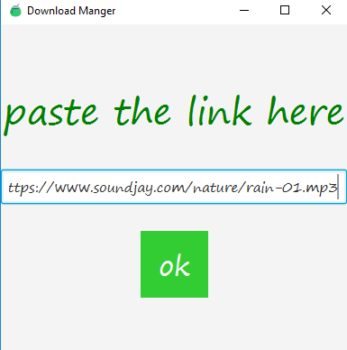
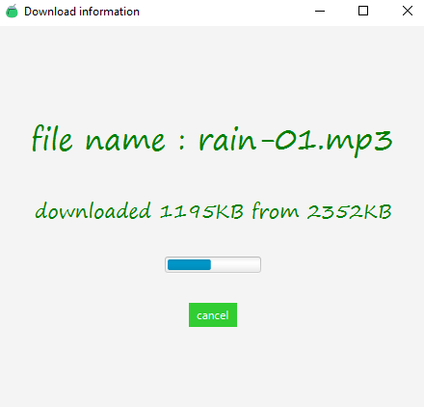

Downloder
User can paste a link in download window and download files from internet
First we make URL connection to gat file name and size and type
Then we start download file and save it by its type

Slide 44

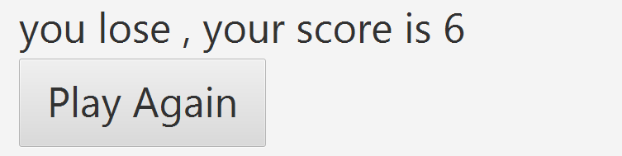
Mate game
If there is no internet you can sit and play our cool game
We will drop mate herbs from the sky and you try to catch them

Slide 45
Mate game
To make mate game we used javaFx animation
We set a random x to the herb and let translation start from y0 to y1 at time t
When the animation is done we check if the herb position is inside the cup position
if ((dropMinX>=holderMinX && dropMinX<=holderMaxX)|| (dropMaxX>=holderMinX && dropMaxX<=holderMaxX)) { player.setScore(player.getScore()+1); System.out.println("Ok"); } else {player.setLives(player.getLives()-1); System.out.println("No");}
translateTransition.setNode(drop); translateTransition.setToY(500); translateTransition.setDuration(new Duration(animationTime/player.getSpeedFactor()));
check
animation

Slide 46
Detecting Errors and exceptions
We display an error page when an exception is thrown during the process of parsing HTML
This exception may be an indicator to determine the error location/cause

Slide 47
Dom Tree
In order to determine the nodes the represent a single tag we created a way to snapshot current visible elements (FX Nodes)
We calculate the difference between the current state and the snapshot and this difference set should be the nodes which addition was triggered by the adding of the current tag

Slide 48
Thank you for listening!

