Slide 1

Puzzle Lab
Mini Project 01
Team 2
Notes:
Welcome the audience and introduce Puzzle Lab, the Team 2 mini-project. Sources: current website Header.tsx and the user-supplied home screenshot.

Slide 2
Introduction
A browser puzzle game built with
React and Express
Players investigate clues, submit answers, and reveal
hints to complete the puzzles in order.
3
9
2
puzzles
stages
hints per stage
Notes:
Introduce the player goal: investigate clues and solve each stage to unlock the next puzzle. There are three puzzles, three stages in each puzzle, and two hints per stage. The theme draws on Breaking Bad. React and TypeScript power the interface; Express owns game progress. Sources: server/data.js, server/store.js, client/package.json, server/package.json.

Slide 3
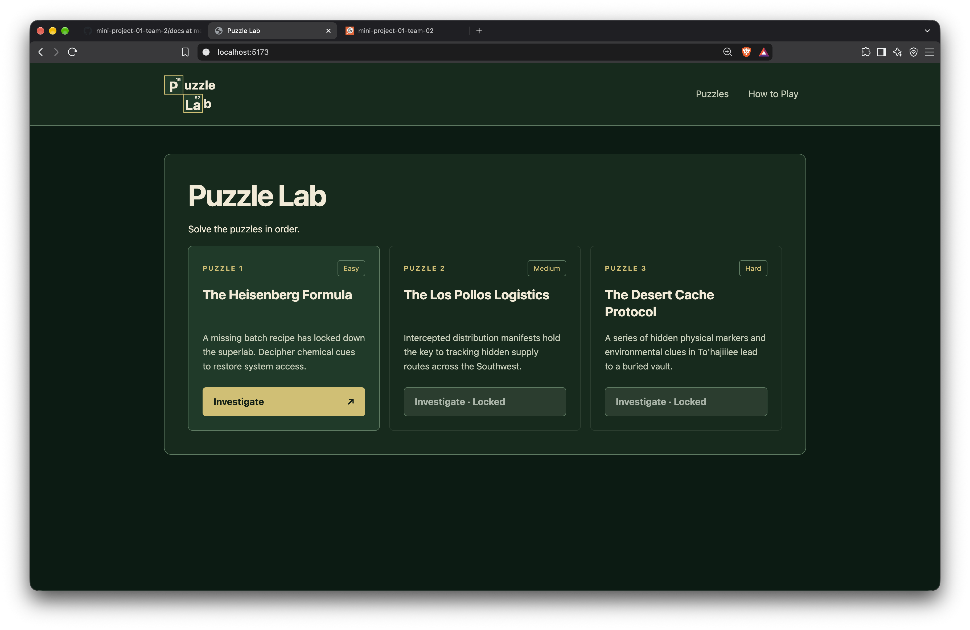
Frontend: Home
Three levels,
one starting point
Easy, Medium, and Hard
Each solved puzzle unlocks the next level.
Notes:
Show the first Investigate button and the disabled buttons for levels 2 and 3. The server supplies the lock state. Sources: PuzzlesSection.tsx and PuzzleCard.tsx.
Screenshot source: docs/puzzle-lab-screenshots/1-homepage.png

Slide 4
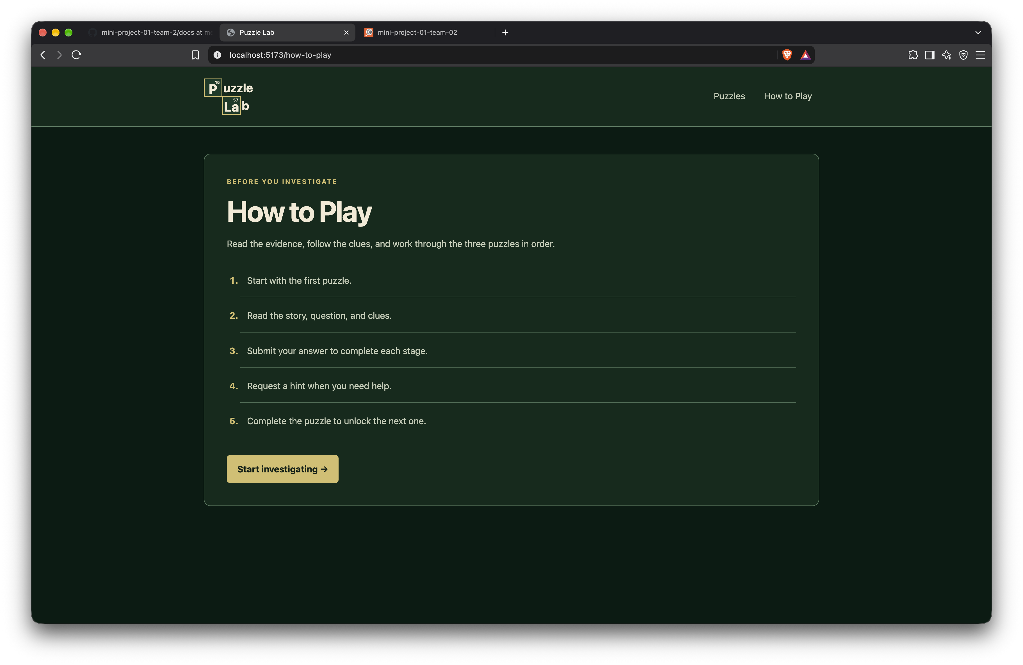
Frontend: How to Play
A clear guide
for new players
Five short steps explain the journey before play begins.
Notes:
Explain that the guide introduces stories, clues, answers, hints, and ordered completion. Source: HowToPlayPage.tsx.
Screenshot source: docs/puzzle-lab-screenshots/2-how-to-play.png

Slide 5
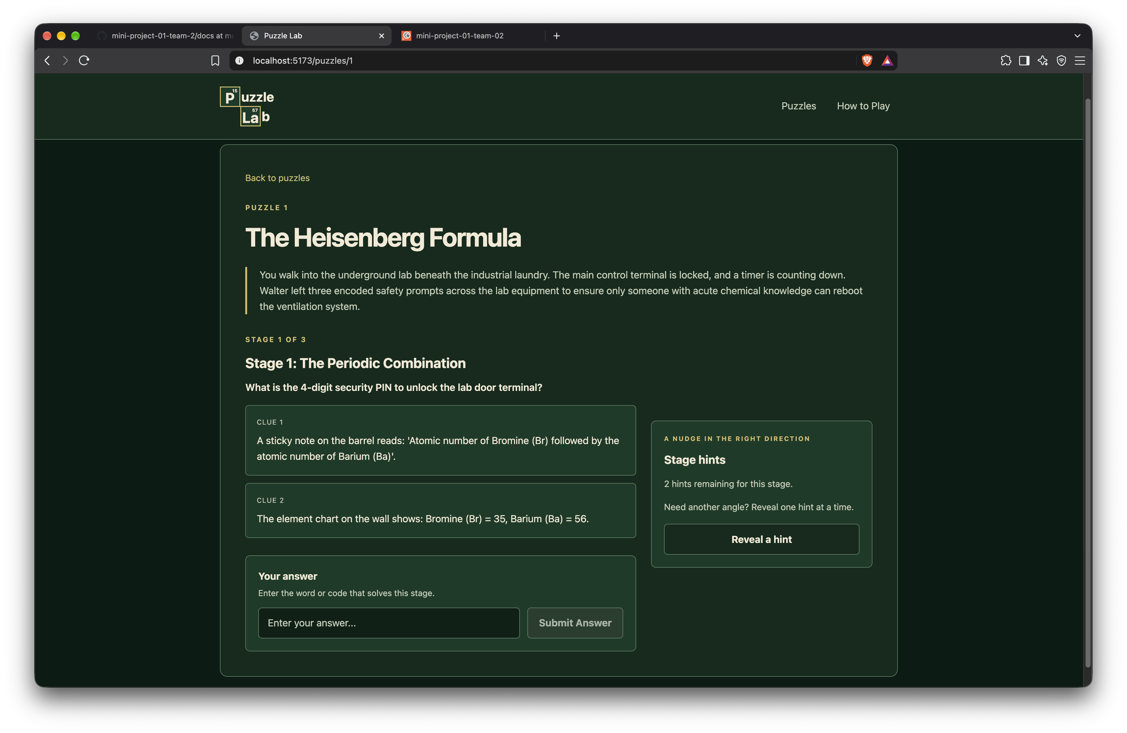
Frontend: Gameplay
Evidence and
answers together
The story and clues guide each stage.
Hints offer help when the player needs it.
Notes:
Show the question, clues, answer input, and hints panel. Explain that a wrong answer keeps the current stage and a correct answer advances it. Sources: PuzzleSection.tsx, SubmitAnswerForm.tsx, server/controllers/puzzles.js.
Screenshot source: docs/puzzle-lab-screenshots/3-gameplay.png

Slide 6
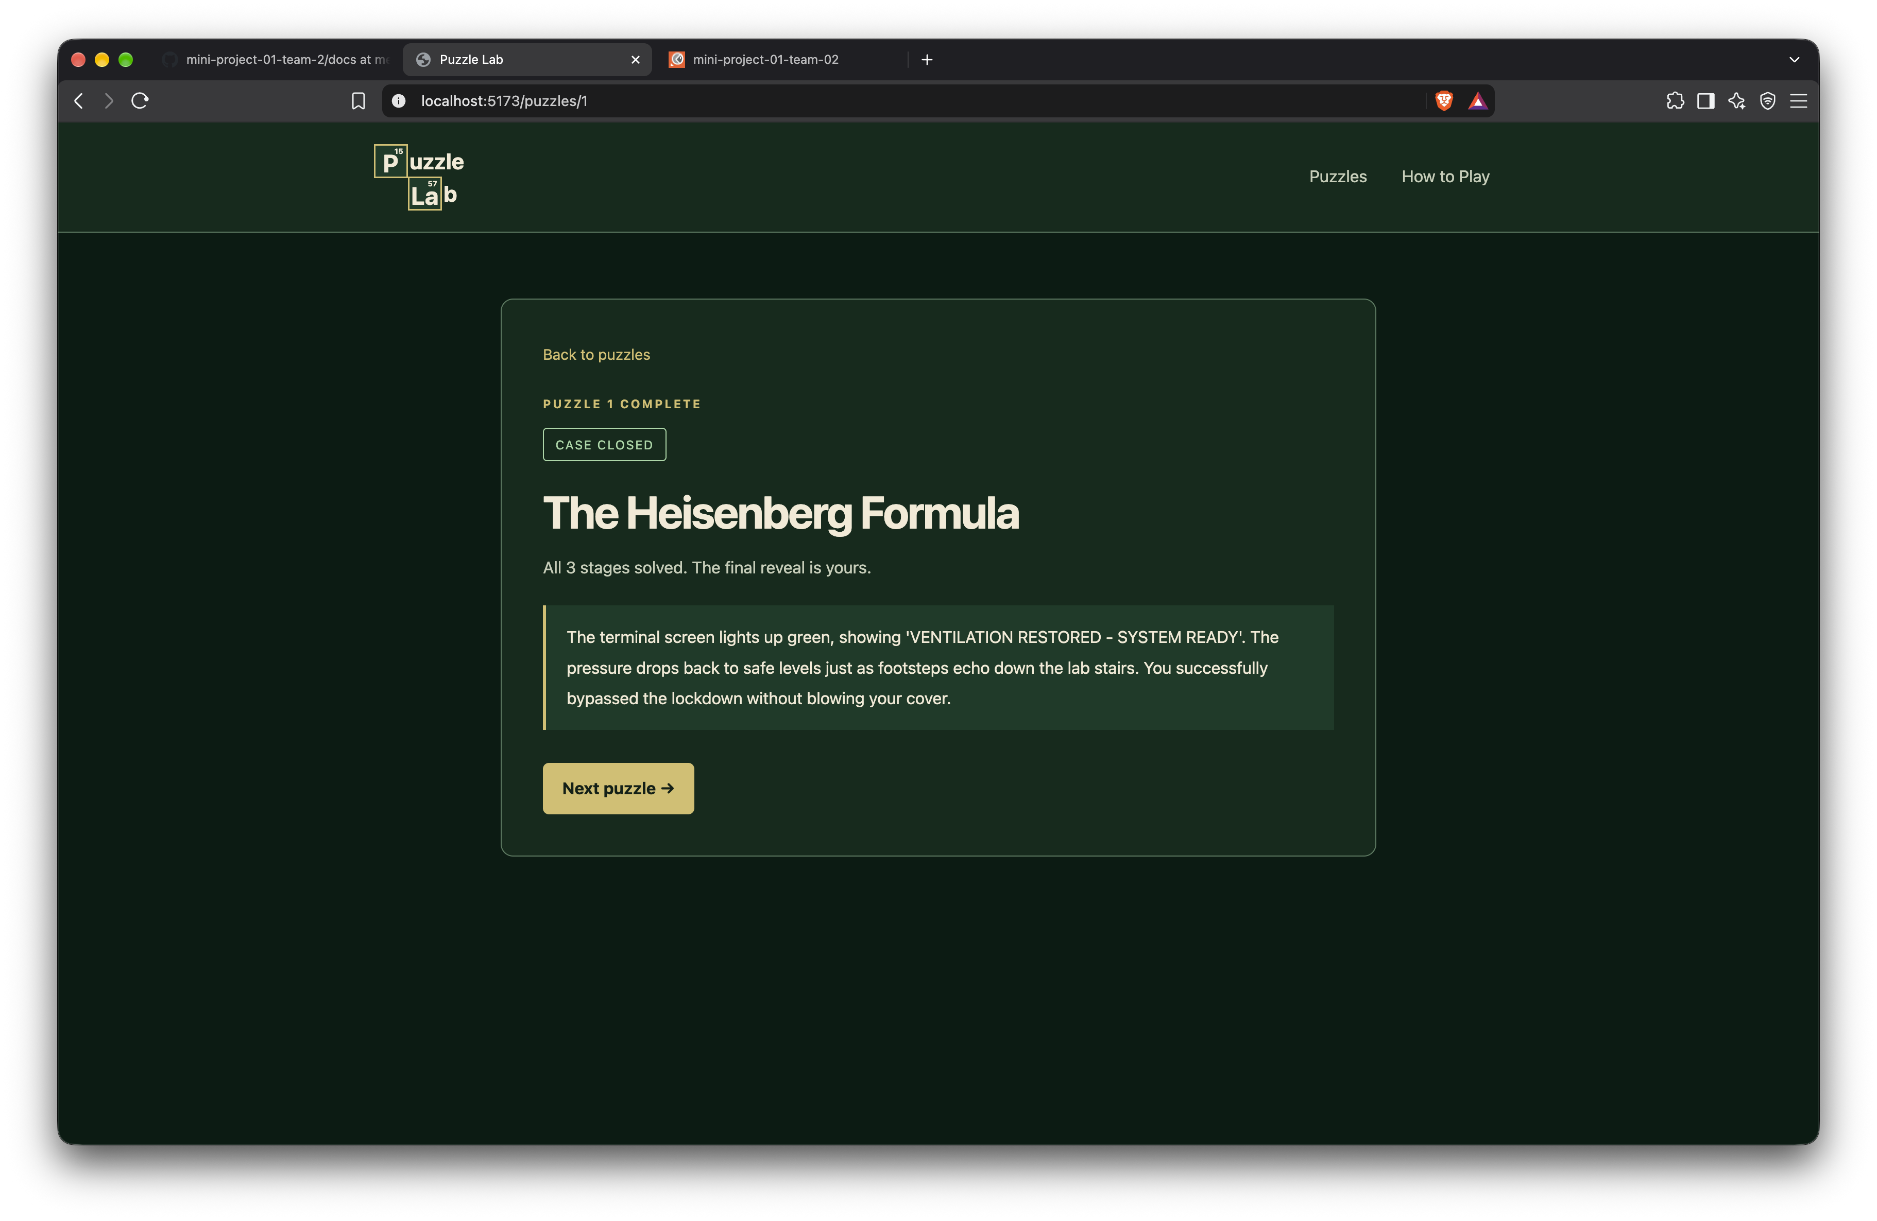
Frontend: Final Reveal
A clear ending
for each puzzle
The final answer reveals the ending.
Players continue to the next puzzle or return home.
Notes:
Explain that the same puzzle route changes to the solved view. Puzzles 1 and 2 offer Next puzzle. Puzzle 3 offers Back to home. Sources: PuzzleSection.tsx and server/store.js.
Screenshot source: docs/puzzle-lab-screenshots/4-final-reveal.png

Slide 7
Backend: Five APIs
Express validates requests and owns game progress
Method | Endpoint | Purpose
GET | /getAllPuzzles | List puzzle summaries
GET | /getPuzzleById/:id | Load the current stage
GET | /getCluesById/:id/clues | Read current clues
POST | /submitAnswer/:id/answers | Check an answer
PATCH | /requestHints/:id/hint | Reveal the next hint
Base URL: http://localhost:3001/api/
Notes:
Describe the five real Express routes at a high level. Progress stays in server memory and resets when Express restarts. Sources: server/routes/puzzles.js, server/controllers/puzzles.js, server/store.js. API documentation: https://documenter.getpostman.com/view/28699747/2sBYHNYPUM

Slide 8
Difficulties: GitHub Collaboration
Keeping seven branches consistent
Parallel work created different project versions.
We needed a shared version for integration and testing.
Our approach
Assigned branches for member work
Review before integration
Synchronization after shared changes
Notes:
Describe GitHub collaboration as a challenge in keeping versions consistent across seven branches. Do not single out members or discuss private performance judgments. We used assigned member branches, reviewed changes, and synchronized accepted project versions. Sources: team agreements and the publication history recorded in private-docs/git-workflow.

Slide 9
Team Workflow
01
Shared agreements
Story, API, and styling contracts
02
Clear assignments
Tasks matched to member roles
03
Review and integration
Majed coordinated the shared version
Notes:
Majed presents this slide. Suggested explanation: I organized the team around clear roles and short phases. We agreed on the story, API, and styling contracts before assigning practical tasks. I reviewed submissions and integrated accepted work into the shared project. Keep the explanation at this level and avoid task details or member performance discussions. Sources: user agreements, phase-1-agreement documents, and local project handbook.

Slide 10
The Puzzle Lab team thanks you for listening
Questions
Notes:
Closing statement requested by the user: The Puzzle Lab team thanks you for listening. Invite questions. Logo source: user-supplied home screenshot.

