Slide 1
UART DIGITAL system design
Instructor: Dr Safeer hyder Presented by:
Muhammad Riaz Ali
Malak Majeedullah

Slide 2
Table of contents
What is UART
Working principle of uart
Uart transmission
Uart receiving

Slide 3
What is uart
Stands for Universal Asynchronous receiver transmitter
sends parallel data through a serial line.
Data is transmitted as frames

Slide 4
Where it is used?
frequently used in conjunction with the EIA (Electronic Industries Alliance) RS-232 standard, which specifies the electrical, mechanical, functional, and procedural characteristics of two data communication equipment
Popularity of Uart is however decreasing because of SPI between components
But still important for lower-speed, low-throughput applications

Slide 5
Working of uart

Slide 6
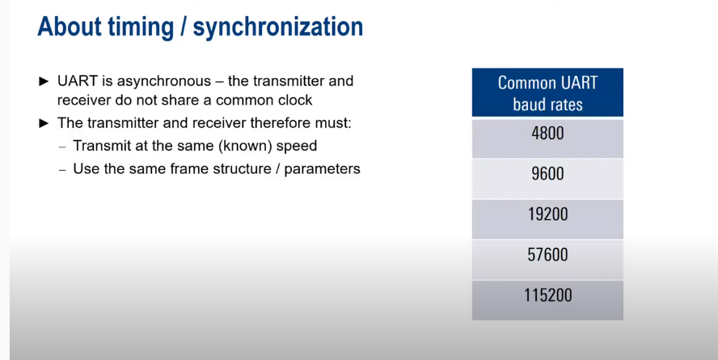

Slide 7
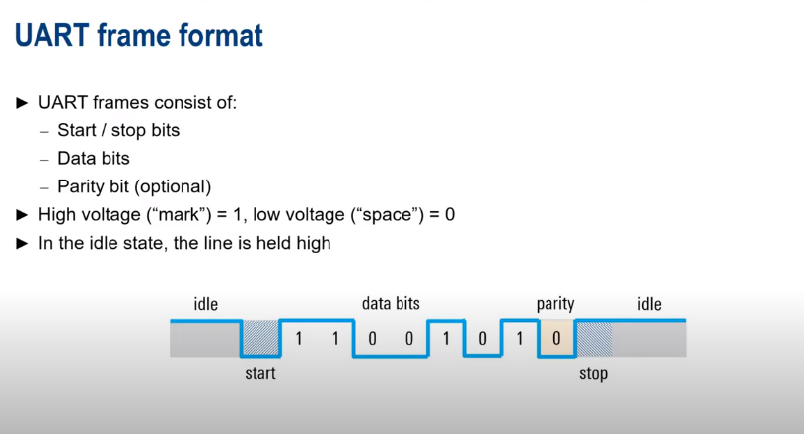

Slide 8
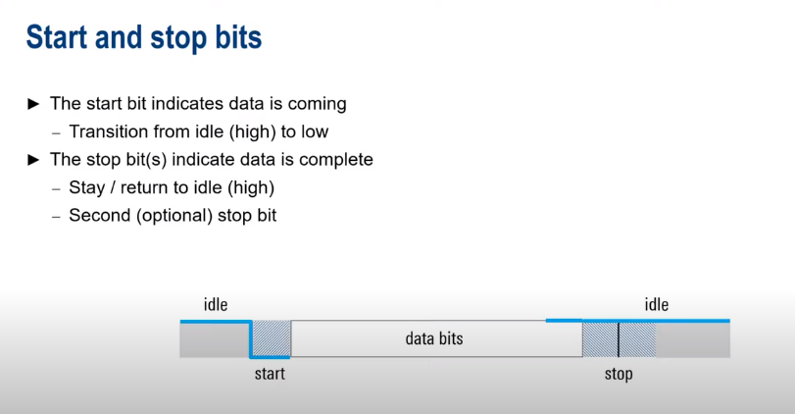

Slide 9
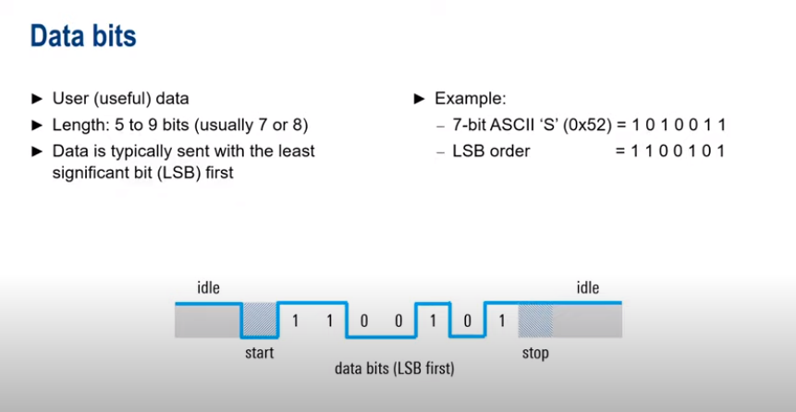

Slide 10
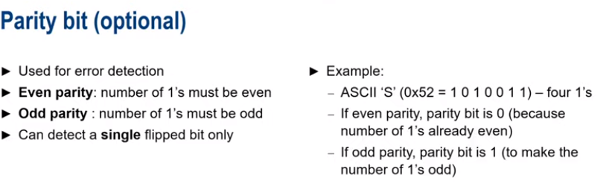
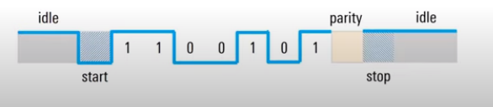
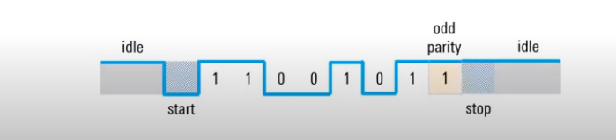
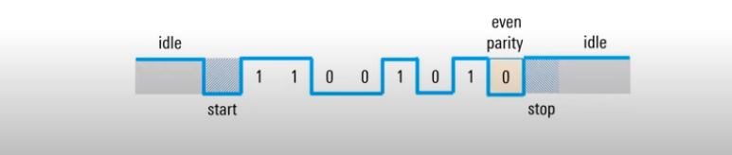

Slide 11
UART Transmitter
a special shift register that loads data in parallel and then shifts it out bit by bit at a specific rate
UART transmitter usually shares the baud rate generator of the UART receiver and uses an internal counter to keep track of the number of enable ticks

Slide 12
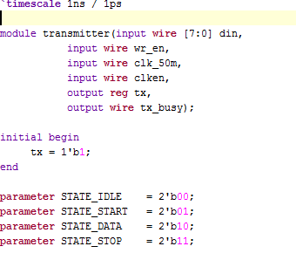
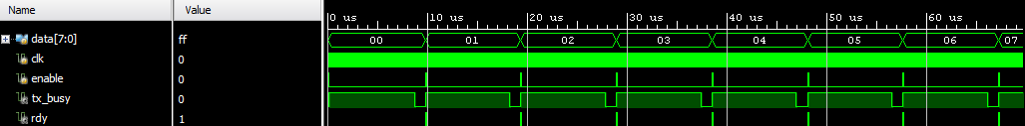

Slide 13
UART Receiver
shifts in data bit by bit and then reassembles the data
receiver can retrieve the data bits only by using the predetermined parameters because of no clock information
obtain the data word via oversampling.
oversampling scheme basically performs the function of a clock signal.
it utilizes sampling ticks to estimate the middle point of each bit.

Slide 14
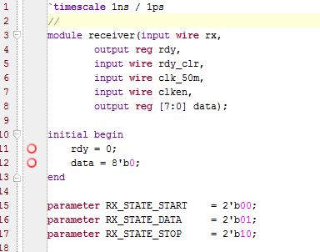

Slide 15
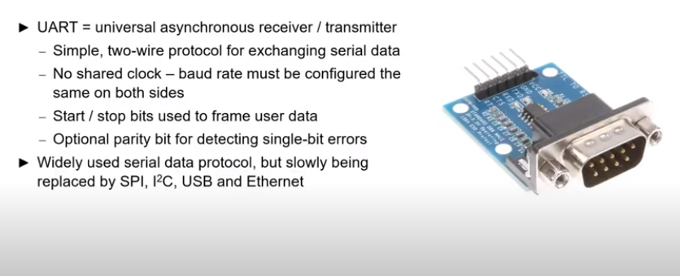
Conclusion

Slide 16
References
FPGA prototyping by Verilog examples (pong p. chu)
https://stackoverflow.com/questions/50142192/uart-module-and-op
https://github.com/jamieiles/uart/blob/master/receiver.v
https://github.com/jamieiles/uart/blob/master/transmitter.v

