Slide 1

A Parallel Algorithm for Constructing Multiple Independent Spanning Trees in Bubble-Sort Networks
Authors: Shih-Shun Kao, Ralf Klasing, Ling-Ju Hung, Chia-Wei Lee, Sun-Yuan Hsieh.
Presented by:
Affan Ali 22i-1215
Abdul Majeed 22i-1216
Abdul Wasay 22i-0947
Notes:
Good morning, everyone! Thank you for joining us today. We’re excited to present our Phase 1 analysis of the research paper titled “A Parallel Algorithm for Constructing Multiple Independent Spanning Trees in Bubble-Sort Networks” by Shih-Shun Kao and colleagues. This is part of our Parallel and Distributed Computing project, and we’ll cover the paper’s key findings and propose a parallelization strategy. My name is [Presenter 1’s Name], and I’m joined by [Presenter 2’s Name] and [Presenter 3’s Name]. Let’s dive in!
(Pause briefly, then transition) I’ll start by introducing bubble-sort networks. [Presenter 1’s Name], over to you for the next slide.

Slide 2

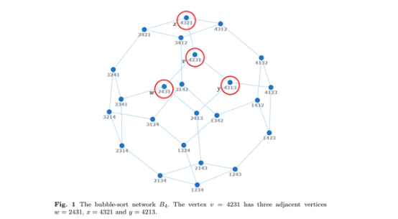
Introduction to Bubble-Sort Networks
Bubble-sort network ( B_n ) is a Cayley graph. Vertices are permutations of ( {1, 2, ..., n} ). Edges connect permutations differing by adjacent transpositions.
Key properties include ( n! ) vertices, connectivity of ( n-1 ), and diameter of ( n(n-1)/2 ).
Vertex-transitive
Significance
Vertex-transitive for ( n >= 4 ), but not edge-transitive.
Used in parallel computing for interconnection networks.
Notes:
(Displays Slide 2 with Figure 1 from PAGE4) Bubble-sort networks are a fascinating structure used in parallel computing to connect processors efficiently. Formally, a bubble-sort network, denoted Bn B_n Bn​, is a graph where each vertex represents a unique permutation of the numbers 1 to n, and edges connect permutations that differ by swapping adjacent numbers.
(Points to Figure 1) Here’s an example of B4​, with 24 vertices since 4!=24. Look at vertex 4231—it connects to 2431 by swapping positions 1 and 2, 4321 by swapping 2 and 3, and 4213 by swapping 3 and 4.
These networks have key properties: they have n! vertices, a connectivity of n−1, meaning they’re robust, and a diameter of n(n−1)/2, which measures the longest communication path. They’re also vertex-transitive for n≥4, meaning the network looks symmetric from any vertex. These properties make bubble-sort networks ideal for parallel systems, setting the stage for our topic.

Slide 3
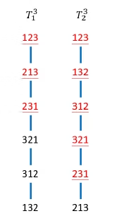

Problem Addressed
Constructing multiple independent spanning trees (ISTs) in bubble-sort networks.
ISTs enhance network reliability and security by providing disjoint paths.
1
Applications
Fault tolerance and secure data transmission.
2
Challenge
Previous algorithm was recursive, making parallelization difficult.
Notes:
(Displays Slide 3 with Figure 2(b) from PAGE5) The paper focuses on constructing multiple independent spanning trees, or ISTs, in bubble-sort networks. ISTs are trees that connect all vertices to a common root, but the paths from any vertex to the root in different trees are completely disjoint, sharing only the start and end points.
(Points to Figure 2(b)) This figure shows two ISTs for B3​. From vertex 231 to the root 123, the first tree takes the path 231 to 213 to 123, while the second goes 231 to 321 to 123. These paths share no edges or vertices except 231 and 123, ensuring independence.
Why is this important? ISTs enable fault-tolerant broadcasting—if one path fails, another tree provides a backup. They also support secure message distribution by splitting data across different paths to prevent interception. The challenge was that a 2019 algorithm by Kao et al. was recursive, making it hard to parallelize, leaving an open problem. This paper solves that with a parallel approach.
(Transition)

Slide 4



Proposed Parallel Algorithm
Algorithm 1 constructs ( n-1 ) ISTs rooted at the identity permutation ( 1_n = 12...n ).
Key features: Non-recursive and fully parallelized.
Auxiliary Functions
Pre-processing
FindPosition and Swap determine the parent.
Computes inverse permutation in O(n) time.
Notes:
Slide 4The paper introduces Algorithm 1, a game-changer for constructing n−1 independent spanning trees rooted at the identity permutation​
Unlike the recursive 2019 algorithm, this one is non-recursive, meaning computations are independent, and it’s fully parallelized—each vertex figures out its parent in constant time.
Here’s a simplified version of the algorithm. It uses two helper functions: FindPosition finds the rightmost symbol out of place in a permutation, and Swap adjusts the permutation to compute the parent. A pre-processing step sets up each vertex’s inverse permutation in O(n) time.
(Transition)
Let’s look at how the algorithm works in detail

Slide 5

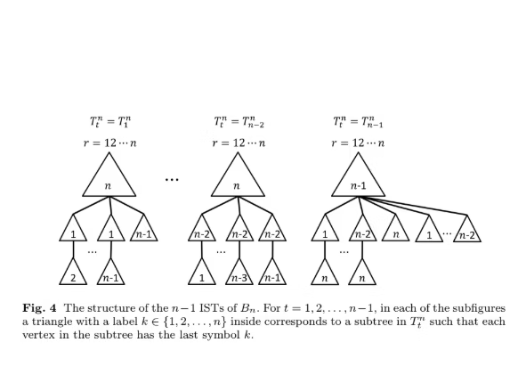

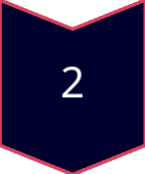
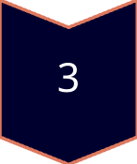
Algorithm Workflow
Pre-process each vertex to compute inverse permutation and ( r(v) ).
For each vertex v≠1_n​ and tree Ttn​ (where t=1,...,n−1): Apply rules based on the last symbol ( v_n ) to determine the parent.
Use FindPosition and Swap to determine the parent.
CASE A
( v_n = n ) handles root connections.
CASE B
( v_n = n-1 ) manages transitions to ( n ).
CASE C
( v_n = j ) for ( j ∈ {1, ..., n-2} ) general case.
Notes:
Slide 5Here’s how Algorithm 1 operates. First, each vertex pre-processes its permutation to compute its inverse and the rightmost misplaced symbol, called r(v), in O(n) time. Then, for each vertex except the root and each of the n−1 trees, the algorithm checks the last symbol, and applies one of six rules to find the parent using FindPosition or Swap.
This flowchart shows the process: pre-process, check the last symbol, and apply rules for three cases:
CASE A: When the last symbol is n, it connects vertices near the root.
CASE B: When it’s n−1, it handles transitions to vertices ending in vn
CASE C: For other symbols, it covers general connections.(Points to Figure 4)
This figure shows the structure of the ISTs. Each triangle represents a subtree for vertices with the same last symbol, like n or n−1. The algorithm ensures paths in different trees are disjoint

Slide 6
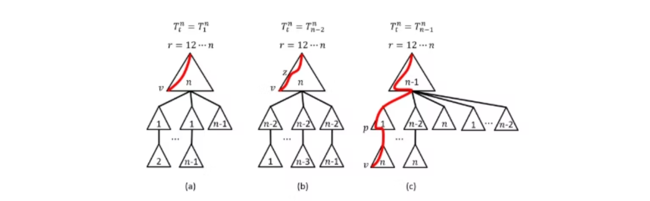
Results Obtained
Time Complexity: ( O(n . n!) ), asymptotically optimal.
Correctness (Theorem 1):
Constructs ( n-1 ) ISTs with unique, vertex-disjoint paths.
Each vertex computes its parent in constant time
Height of ISTs (Theorem 2):
Maximum height: D(Bn)+n−1 = n(n−1)/2+n−1.
Ensures efficient communication paths.
Notes:
The algorithm delivers impressive results. Its time complexity is O(n⋅n!), which is asymptotically optimal. Since there are n! vertices and n−1 trees, the lower bound is Ω(n⋅n!), so it’s as efficient as possible.
This graph shows the complexity matches the theoretical minimum, confirming optimality.
Theorem 1 proves the algorithm constructs n−1 ISTs correctly, with unique, vertex-disjoint paths except at the root and vertex, and each parent computation takes constant time. Theorem 2 shows the trees’ height is at most the network’s diameter, n(n−1)/2, plus n−1, ensuring short communication paths.
This figure illustrates Theorem 1 for CASE A, where the last symbol is n. The red path in tree is disjoint from others, proving path independence.
To wrap up, [Presenter 3’s Name] will discuss the contributions and our parallelization strategy.

Slide 7
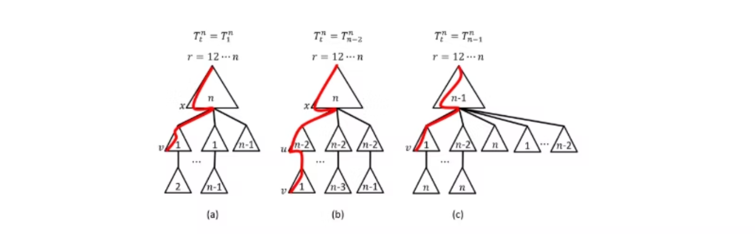
Key Contributions
Developed a parallel, non-recursive algorithm.
Achieved asymptotically optimal time complexity ( O(n . n!) ).
ISTs
Fault Tolerance
Future Work
Ensured maximum number of ISTs (( n-1 )).
Enhanced fault tolerance and security.
Extending to ((n, k))-bubble-sort graphs and butterfly graphs.
Notes:
(Displays Slide 7 with Figure 6(a) from PAGE11) Thanks, [Presenter 2’s Name]! The paper’s biggest contribution is a parallel, non-recursive algorithm that solves the open problem from 2019, making IST construction feasible in parallel systems. It achieves an optimal time complexity of O(n⋅n!) O(n \cdot n!) O(n⋅n!) and builds the maximum possible ISTs, n−1 n-1 n−1, matching the network’s connectivity.
(Points to Figure 6(a)) This figure shows paths for CASE B, where the last symbol is n−1 n-1 n−1. The red path in tree T1n T_1^n T1n​ is disjoint, reinforcing the algorithm’s ability to ensure independence across all cases.
The algorithm enhances fault tolerance and security in interconnection networks, critical for distributed systems. The authors also suggest future work, like extending this to (n,k)(n, k)(n,k)-bubble-sort graphs or butterfly graphs, opening new research paths.
(Transition) Next, I’ll outline how to implement this algorithm in parallel.

Slide 8
Proposed Parallelization Strategy
METIS for Graph Partitioning:
MPI for Inter-Node Communication:
OpenMP/OpenCL for Intra-Node Parallelism:
Partition ( B_n ) into ( k ) balanced subgraphs.
Handle communication between partitions.
Parallelize parent computation within each subgraph.
Assign each subgraph to an MPI process.
Minimal communication due to independent parent computation.
OpenMP for multi-core CPUs; OpenCL for GPUs if available.
Workflow:
Partition graph using METIS.
Distribute subgraphs to MPI processes.
Parallelize vertex computations using OpenMP/OpenCL.
Combine results via MPI.
Notes:
(Displays Slide 8 with parallel architecture diagram) To implement this algorithm, we propose using three tools: METIS, MPI, and OpenMP or OpenCL.
(Points to diagram) Here’s the plan. First, METIS partitions the bubble-sort network into k k k balanced subgraphs, minimizing connections between them. Each subgraph is assigned to an MPI process, which handles communication between processors. Since parent computations are independent, communication is minimal, mainly for combining results.
Within each process, OpenMP parallelizes computations across CPU cores, or OpenCL leverages GPUs for faster processing, taking advantage of the algorithm’s constant-time operations. The workflow is: partition with METIS, distribute with MPI, compute in parallel with OpenMP or OpenCL, and combine results.
This strategy ensures efficient, scalable implementation.
(Transition)

Slide 9
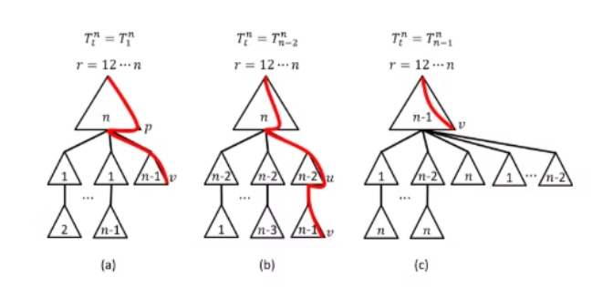
Practical Implications
1
Applications:
Fault-tolerant broadcasting in distributed systems.
Secure message distribution in network communication.
2
Benefits:
Scalable for large networks due to parallel design.
Optimal complexity ensures efficiency.
3
Relevance to Project:
Aligns with learning parallel and distributed computing.
Prepares for Phase 2 implementation and scalability analysis.
Notes:
(Displays Slide 9 with Figure 7(c) from PAGE12) This algorithm has real-world impact. It supports fault-tolerant broadcasting, ensuring data reaches all nodes even if links fail, and secure message distribution, splitting data across paths to prevent eavesdropping.
(Points to Figure 7(c)) This figure shows a path in tree Tn−1n T_{n-1}^n Tn−1n​ for a complex case, highlighting the algorithm’s ability to maintain independent paths, which is key for these applications.
The parallel design makes it scalable for large networks, and its optimal complexity ensures efficiency. For our project, this aligns with learning parallel computing and prepares us for Phase 2, where we’ll implement and test this algorithm’s scalability. Imagine this in data centers or secure networks—pretty powerful!
(Transition)

Slide 10
Conclusion
Addressed Challenge
We developed a parallel algorithm for IST construction in bubble-sort networks.
Optimal Complexity
The algorithm is non-recursive with optimal time complexity.
Parallelization Strategy
We outlined parallelization using METIS, MPI, and OpenMP/OpenCL.
Notes:
(Displays Slide 10 with infographic) To sum up, this paper tackled the challenge of building ISTs in bubble-sort networks with a parallel, non-recursive algorithm that’s optimally efficient. It constructs n−1 n-1 n−1 ISTs, enhancing fault tolerance and security. We proposed implementing it using METIS for partitioning, MPI for communication, and OpenMP or OpenCL for parallel computation.

Slide 11
References
Kao, S.-S., Klasing, R., Hung, L.-J., Lee, C.-W., & Hsieh, S.-Y. (2023). A parallel algorithm for constructing multiple independent spanning trees in bubble-sort networks. Journal of Parallel and Distributed Computing.

