Slide 1
Security Definitions and Comments on Round5

Slide 2
What does it mean?
IND – Indistinguishability
(not being able to guess if ciphertext or random)
NM – Non-Malleability
(not being able to make changes, for example to obtain y’=x+1 from y=x)
CPA – chosen plaintext attack (equals to formal security)
CCA1 – chosen ciphertext attack
CCA2 – adaptative chosen ciphertext attack
RO – random oracle (mystery box able to encrypt/decrypt data)

Slide 3
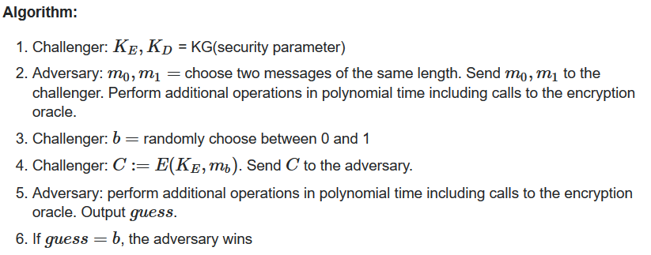
IND-CPA – description of a game
In words: the adversary generates two messages of equal length. The challenger decides, randomly, to encrypt one of them. The adversary tries to guess which of the messages was encrypted

Slide 4
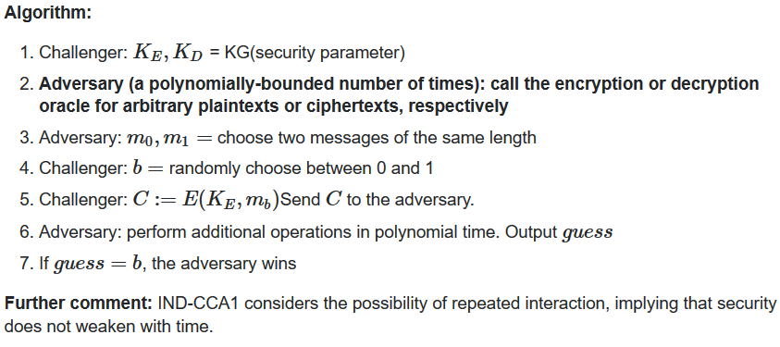
IND-CCA1 – description of a game
In words: the target of the game is the same as in IND-CPA. The adversary has an additional capability: to call an encryption or decryption oracle. That means: the adversary can encrypt or decrypt arbitrary messages before obtaining the challenge ciphertext.

Slide 5
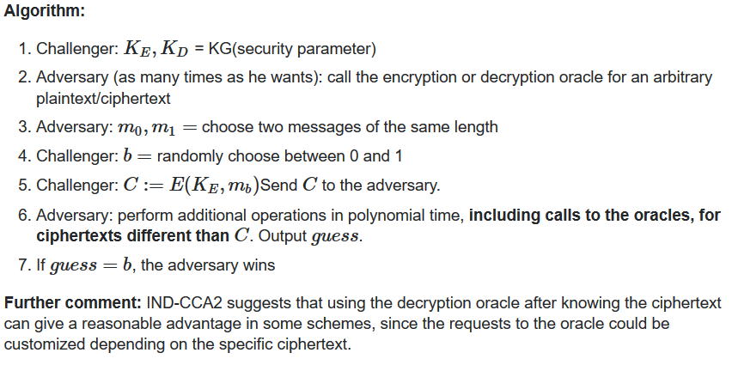
IND-CCA2 – description of a game
In words: In addition to its capabilities under IND-CCA1, the adversary is now given access to the oracles after receiving C, but cannot send C to the decryption oracle.

Slide 6
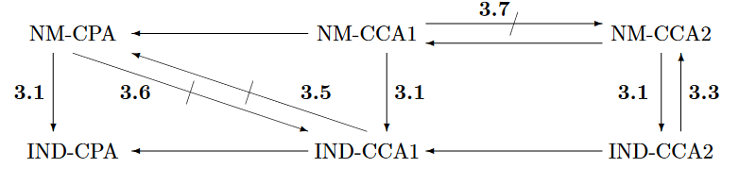
Dependencies on attacks:

Slide 7
Sources:
Bellare et al. Relations among Notions of Security for Public-Key Encryption Schemes, CRYPTO’98 (check in Zotero)
Bellare and Rogaway, Random Oracles Are Practical: A Paradigm for Designing Efficient Protocols (check in Zotero)
https://crypto.stackexchange.com/questions/26689/easy-explanation-of-ind-security-notions

Slide 8
Round5 – discussion about CPA vs. CCA KEM
Pro CPA vs. CCA
Pro CCA vs. CPA
Better bandwidth for {1,3,5} security level (10%, 6%, 12% respectively)
Lower key sizes might be crucial in some protocols (eq. IKEv2 RFC 7296)
In some applications CCA might not be as important
NIST allow CPA-KEMs
CPA has very high failure rate (around 2^(-60))
The difference in bandwidth is only ~10%.
CCA version still fits in IKEv2 RFC 7296 package
Let’s aim the highest possible security than use potentially weaker ones
Other proposals use CCA version

Slide 9
Dan Bernstein’s main question:
What is the difference in running time between CPA and CCA version?

Slide 10
Dan Bernstein’s main question:
What is the difference in running time between CPA and CCA version
Let’s see how it look like in FPGA!
Security level | CPA Encaps | CCA Encaps | CPA Decaps | CCA Decaps
1 | 2,985 | 2,990 | 1,480 | 4,063
3 | 3,862 | 4,248 | 1,901 | 5,839
5 | 5,031 | 5,836 | 2,450 | 7,999

Slide 11
Round5 – differences in CPA and CCA KEM
CPA KEM Decaps
CCA KEM Decaps
R5_cpa_dec
hash
R5_cpa_dec
Hash
R5_cpa_enc
hash

