Slide 1
Round5 – Hardware overview
By Michal Andrzejczak

Slide 2
Round5 – CPA_PKE_ENC
1. Unpack PK
2. Create matrix A (from seed) - cSHAKE
3. Create matrix R (from another seed) - cSHAKE
4. Polynomial Multiplication (12 bit x {-1,0,1})
5. Rounding (from 12 bit to 8 bit)
6. Polynomial Multiplication (8 bit x {-1,0,1})
7. Rounding (from 8 bit to 4 bit)
8. Add msg
9. Pack CT

Slide 3
Round5 - CPA_PKE_DEC
1. Create matrix S (from sk) - cSHAKE
2. Unpack ct
3. Decompress matrix
4. Polynomial multiplication (8 bit x {-1,0,1})
5. Diff results (from point 3 sub point 4)
6. Rounding(from 8 bit to 1 bit)

Slide 4
Polynomial multiplication
1. Lift poly
  a) input: polynomial mod 2048
  b) input: polynomial mod 256
2. NTRU polynomial multiplication
  a) multiplication by trinomial mod 2048
  b) multiplication by trinomial mod 256
3. Unlift poly
  a) input: polynomial mod 2048
  b) input: polynomial mod 256
  c) long data dependency path! c[i] = c[i-1]-a[i]

Slide 5
Main difficulties:
1. Round Poly:
    a) three different parameter set (2 for encyption, 1 for decryption)
    b) can be implemented as three separated units
    c) or one unit performing similar operations
    d) executes in 1 clock cycle (maybe use less elements with shift register)
2. Polynomial Multiplication
    a) operates modulo two different values
    b) can calculate both values at once, only output should be duplicated (first port for result mod a, second for result mod b)
3. Lift & Unlift Poly
    a) operates on two parameter set, similar case as with polynomial multiplication

Slide 6
Round5- Building blocks
1. CPA_PKE: sampling(cSHAKE), poly mult
2: CPA_KEM: CPA_PKE + 2 x SHAKE hash function
3. CCA_KEM: CPA_PKE + 3 x SHAKE hash function
4. CCA_PKE: CCA_KEM + round5_dem function

Slide 7
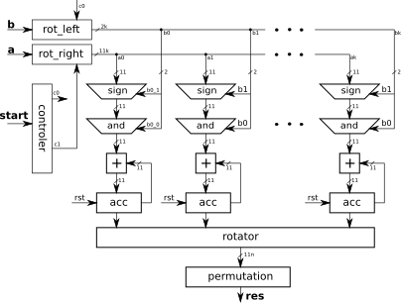
NTRU polynomial multiplication

Slide 8
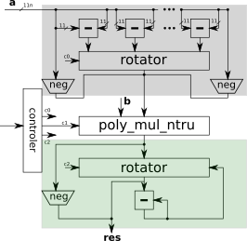
Polynimial multiplication with division

Slide 9
Clock latency estimation
Version | Polynomial | Performance | Minimal
R5ND_1KEM_0c | 618 | 2472 | 768 800
R5ND_3KEM_0c | 786 | 3144 | 1241 888
R5ND_5KEM_0c | 1018 | 4072 | 2 080 800
R5ND_1PKE_0c | 586 | 2344 | 691 488
R5ND_3PKE_0c | 852 | 3408 | 1 458 632
R5ND_5PKE_0c | 1170 | 4680 | 2 747 168
R5ND_1KEM_5c | 490 | 1960 | 484 128
R5ND_3KEM_5c | 756 | 3024 | 1 149 128
R5ND_5KEM_5c | 940 | 3760 | 1 774 728
R5ND_1PKE_5c | 508 | 2032 | 520 200
R5ND_3PKE_5c | 756 | 3024 | 1 149 128
R5ND_5PKE_5c | 940 | 3760 | 1 774 728

