Slide 1
Introduction to Common Java Development Tools (1)
Notes:
以Java类的开发工具为主（1）目前Java还是最流行的开发语言（2）项目组这边项目使用Java较多（3）有些工具跟语言无关
大多数同学都具有Java开发的经验，使用过相关工具：讲的时候有些内容会一翻而过，如果有清楚的随时可以提出问题来

Slide 2
Contents
Eclipse IDE and its plugins
Version Control with Subversion
Comparison Tool: WinMerge
Building tool: Ant
Unit Test using JUnit
Other Tools
Notes:
今天主要讲前三个，后面几个看时间，可能也会提及一下

Slide 3
Contents
Eclipse IDE and its plugins
Version Control with Subversion
Comparison Tool: WinMerge
Building tool: Ant
Unit Test using JUnit
Other Tools

Slide 4
About IDEs
An IDE is an Integrated Development Environment
Different IDEs meet different needs
  BlueJ, DrJava are designed as teaching tools
    Emphasis is on ease of use for beginners
    Little to learn, so students can concentrate on learning Java
  Eclipse, JBuilder, NetBeans are designed as professional-level work tools
    Emphasis is on supporting professional programmers
    More to learn, but well worth it in the long run
We will use Eclipse, but other professional IDEs are similar

Slide 5
Eclipse
Eclipse is an IDE (Integrated Development Environment)
It’s an open source project
  http://www.eclipse.org
  Consortium of companies, including IBM
  Launched in November 2001
It’s a framework for software tools (“plug-ins” in Eclipse terminology)
  Main component is the workbench
  Ships with two plug-ins JDT (Java Development Tools) and PDE (Plug-in Development Environment)
Notes:
最流行的Java开发IDE， 功能十分丰富，可以通过安装插件来扩展功能

Slide 6
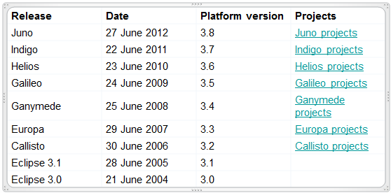
Release
Notes:
木卫1：IO，伊奥
木卫4：Callisto，卡里斯托
木卫2：Europa，欧罗巴 ：可能存在大量液态水
木卫3：Ganymede，盖尼米德.(值得一提的是早于伽利略2000年前,有记录表明战国时期中国的甘德在公元前346年就已发现了木卫3)
但是Eclipse从3.1到3.4的命名（codename）并非按照木卫1-4的顺序，而是根据这四颗卫星距离木星从近到远的顺序
Eclipse 3.5 版本代号 Galileo 【伽利略】 Eclipse 3.6 版本代号 Helios 【太阳神】 Eclipse 3.7 版本代号 Indigo 【靛dian青】

Slide 7
Installation
Prerequisite
Eclipse 3.0 1.4-compatible JRE+
Eclipse 3.3 Java 5 JRE+
Install
Download Eclipse:
  http://www.eclipse.org/downloads/
Unzip it and run eclipse.exe
Notes:
无需安装，直接解压即可

Slide 8
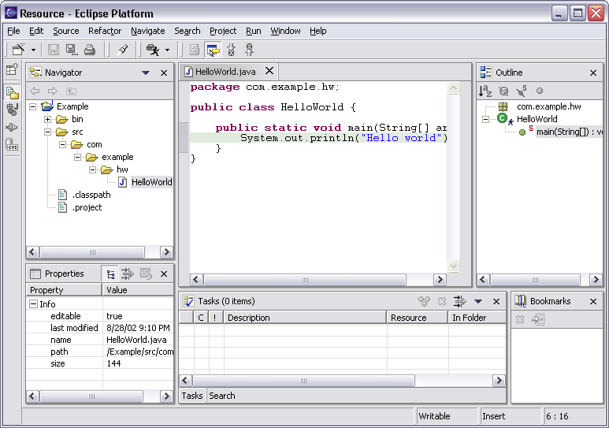
Workbench Terminology
Menu bar
Text
editor
Tool bar
Perspective
and
Fast View
bar
Outline
view
Resource
Navigator
view
Bookmarks
view
Properties
view
Message
area
Editor
Status
area
Stacked
views
Tasks
view
Notes:
Workbench:工作台
Perspective:
View:

Slide 9
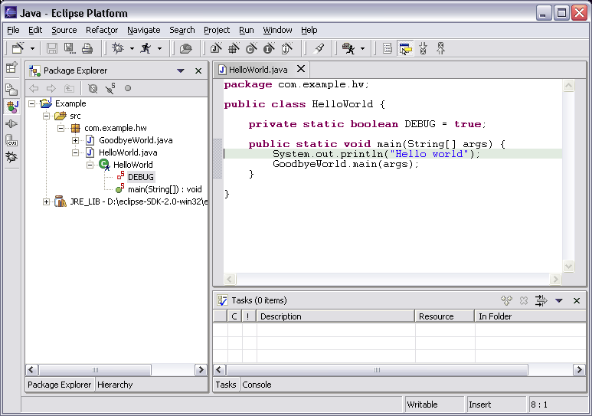
Java Perspective
Java-centric view of files in Java projects
  Java elements meaningful for Java programmers
Java
project
package
class
field
method
Java
editor

Slide 10
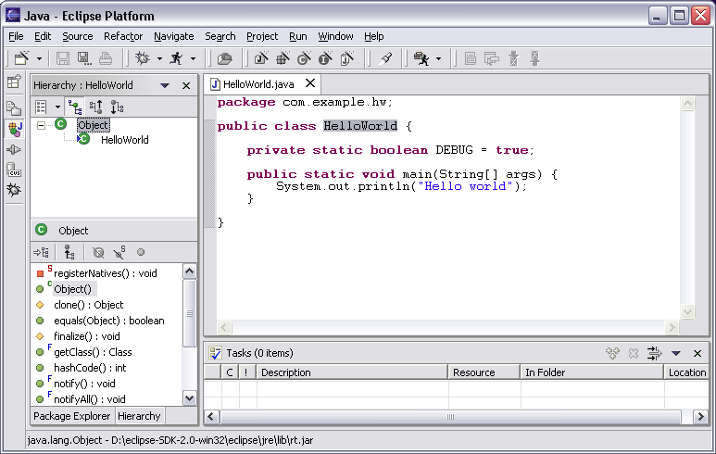
Java Perspective
Browse type hierarchies
  “Up” hierarchy to supertypes
  “Down” hierarchy to subtypes
Type
hierarchy
Selected
type’s
members

Slide 11
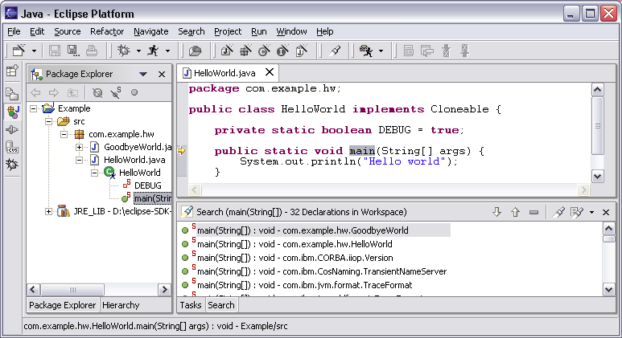
Java Perspective
Search for Java elements
  Declarations or references
  Including libraries and other projects
Hits
flagged
in margin
of editor
All search results
Notes:
Reference搜索

Slide 12
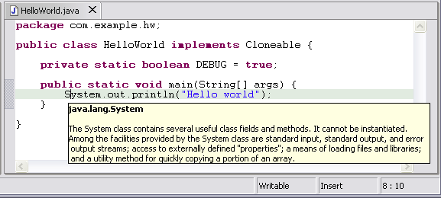
Java Editor
Hovering over identifier shows Javadoc spec
Notes:
[Contains animated elements]

Slide 13
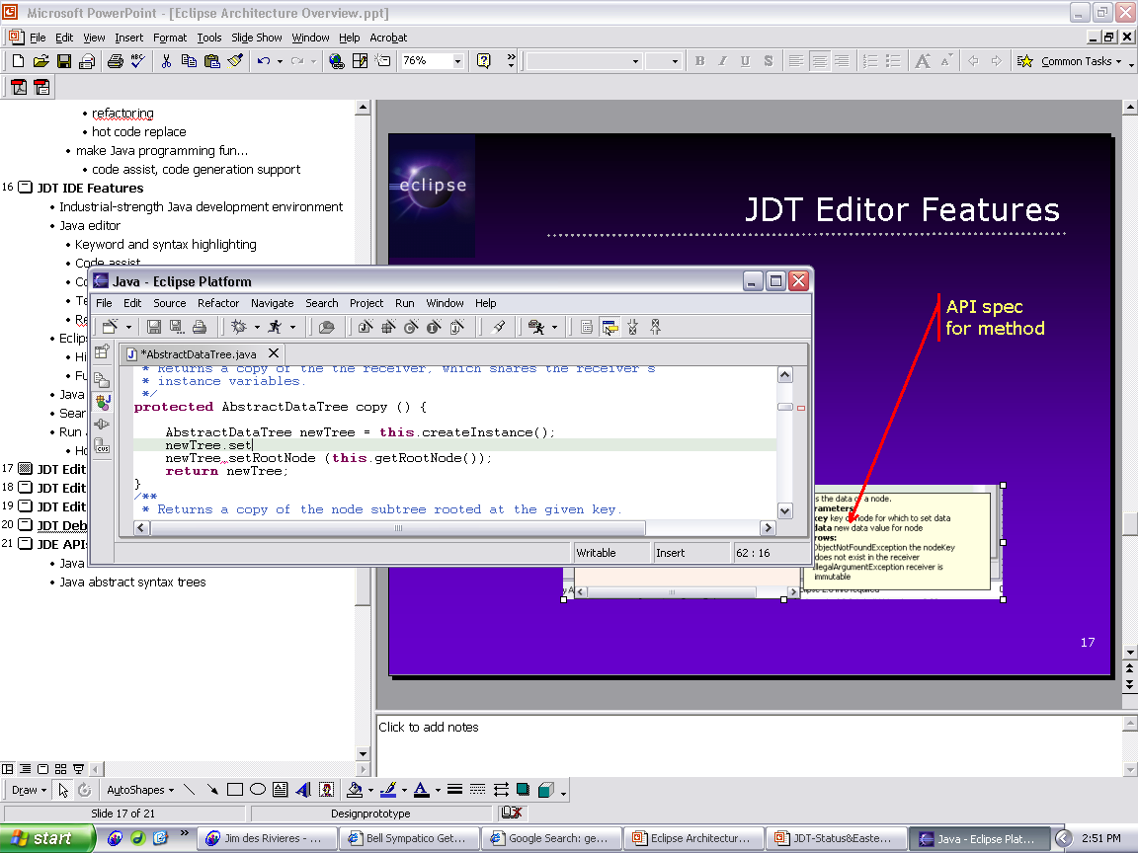
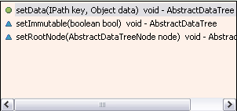
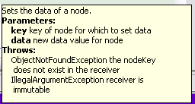
Java Editor
Method completion in Java editor
List of plausible methods
Doc for method
Notes:
[Contains animated elements]

Slide 14
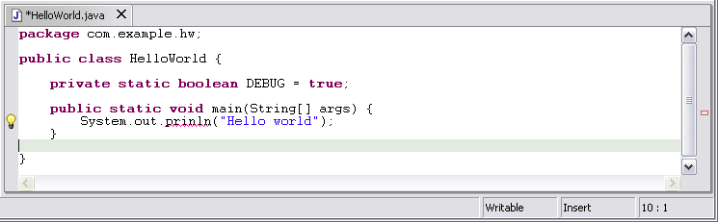
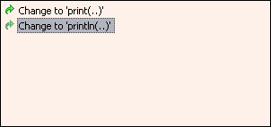
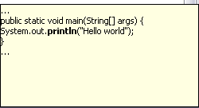
Java Editor
On-the-fly spell check catches errors early
Click
to see
fixes
Problem
Preview
Quick
fixes
Notes:
[Contains animated elements]
Syntax and spell checking are done on-the-fly.
Calls Java compiler to parse source code and resolve names in context.
Developers refer to those wavy red lines as “the red sea” :-).
Problem markers are appear in the left margin of editor.
“Red X” instead of “light bulb” if no proposed corrections.

Slide 15

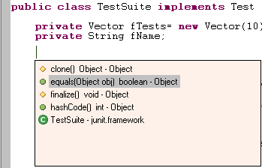
Java Editor
Java editor creates stub methods
Method stub insertion for anonymous inner types
Method stub insertion
for inherited methods
Notes:
[Contains animated elements]

Slide 16
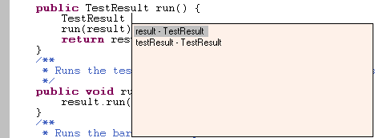
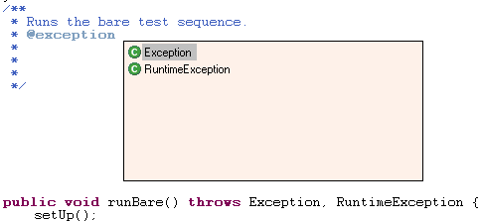

Java Editor
Java editor helps programmers write good Java code
Variable name
suggestion
JavaDoc
code assist
Argument hints and
proposed argument
names
Notes:
[Contains animated elements]

Slide 17
Java Editor
Other features of Java editor include
  Code formatter
  Source code for binary libraries
  Built-in refactoring

Slide 18
Refactoring
Refactoring actions rewrite source code
  Within a single Java source file
  Across multiple interrelated Java source files
Refactoring actions preserve program semantics
  Does not alter what program does
  Just affects the way it does it
Encourages higher code quality
  Makes it easier to rewrite poor code
Notes:
Martin Fowler
Code refactoring is "a disciplined way to restructure code",^{[1]} undertaken in order to improve some of the nonfunctional attributes of the software.

Slide 19
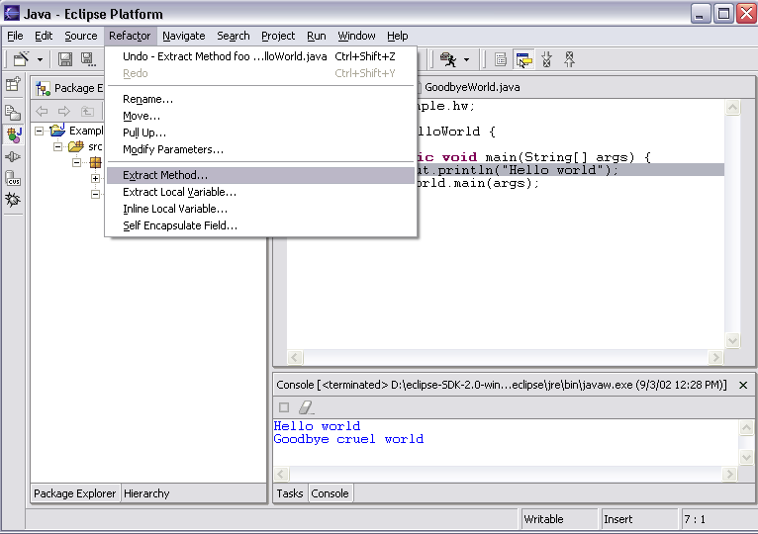
Refactoring
JDT has actions for refactoring Java code
Notes:
Eclipse里展示
Martin Fowler

Slide 20
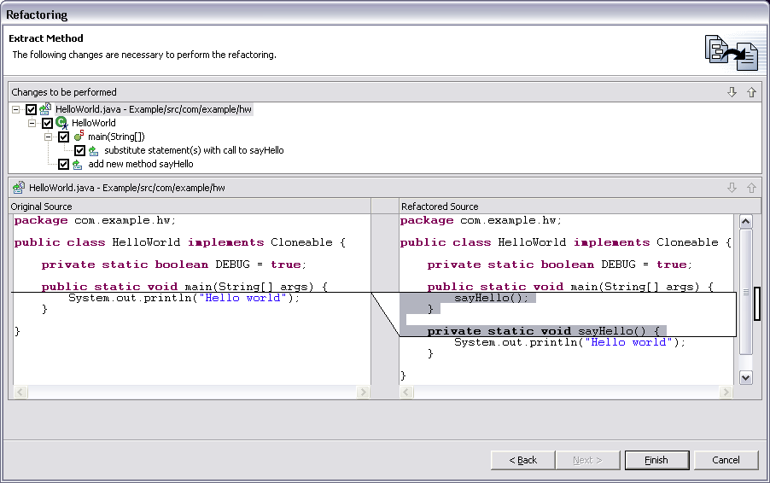
Refactoring
Full preview of all ensuing code changes
  Programmer can veto individual changes
List of changes
“before” vs. “after”
Notes:
Screen shot shows Extract Method applied to the print statement in HelloWorld.main method.
Veto:

Slide 21
Refactoring
Growing catalog of refactoring actions
  Organize imports
  Rename {field, method, class, package}
  Move {field, method, class}
  Extract method
  Extract local variable
  Inline local variable
  Reorder method parameters
  Fowler, Martin (1999). Refactoring. Improving the Design of Existing Code. Addison-Wesley.

Slide 22
Eclipse Java Compiler
Eclipse Java compiler
  JCK-compliant Java compiler
  Helpful error messages
  Generates runnable code even in presence of errors
  Fully-automatic incremental recompilation
  High performance
  Scales to large projects
Multiple other uses besides the obvious
  Syntax and spell checking
  Analyze structure inside Java source file
  Name resolution
  Content assist
  Refactoring
  Searches
Notes:
实时动态检查拼写错误

Slide 23
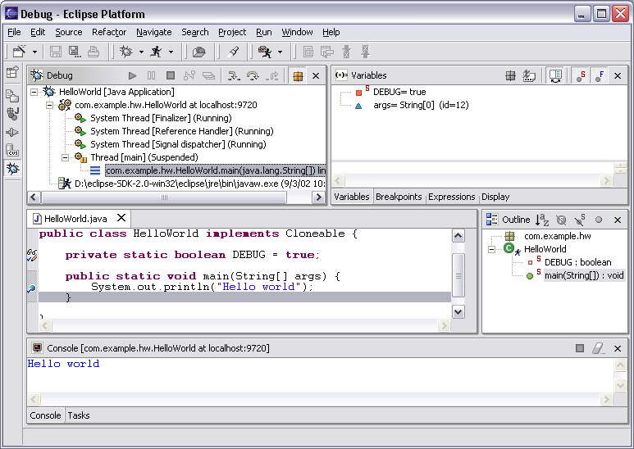
Eclipse Java Debugger
Run or debug Java programs
Local variables
Threads and stack frames
Editor with breakpoint marks
Console I/O

Slide 24
Shortcut Key
Ctrl+D: Delete current line
Ctrl+/ : Commnt/Uncommnt current line
Ctrl+K: Find Next Selected
Ctrl+Shift+K: Find Previous Selected
Ctrl+Space: Content Assitant (may conflict with some input methods, but can be customized)
Ctrl+Shift+F: Code Format
F3: Open Declaration
F5: Step Into
F6: Step Over
F7: Step Return
F8 : Continue
F11: Debug Last Launched

Slide 25
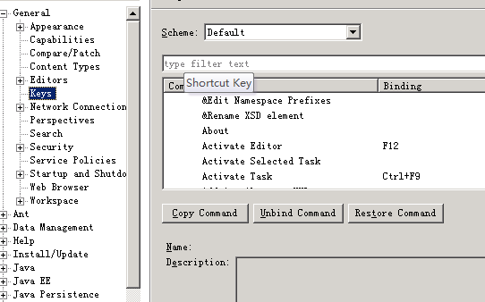
Customized Shortcut key
Window->Preferences->General->Keys

Slide 26
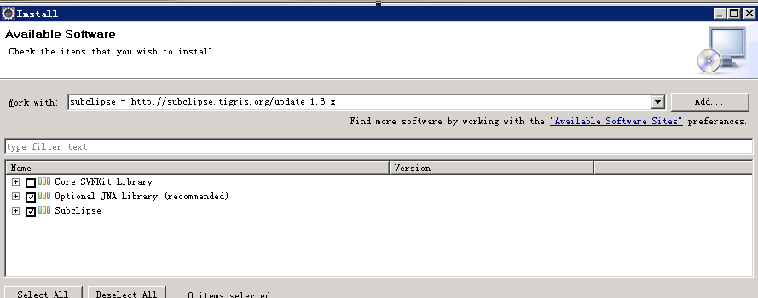
Install Plugin
Help->Install New Software
Notes:
有好几种方法

Slide 27
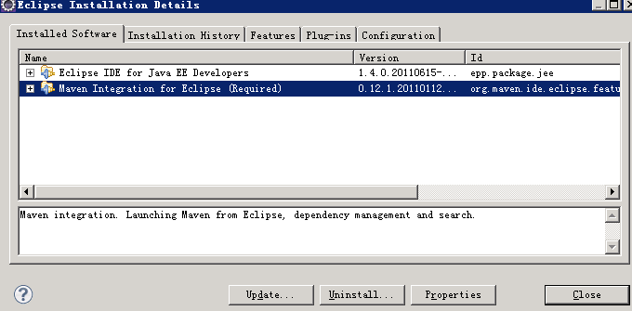
Uninstall Plugin
Window->Preference->Install/Update

Slide 28
Useful Plugins
AnyEdit
checkstyle
jadclipse
m2eclipse
openexplorer
subclipse
Notes:
简单描述各个插件功能，然后跳几个讲一下

Slide 29
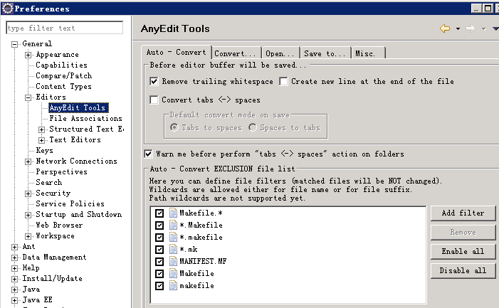
AnyEdit
Install
http://andrei.gmxhome.de/eclipse/
UI
more usage: http://andrei.gmxhome.de/anyedit/features.html

Slide 30
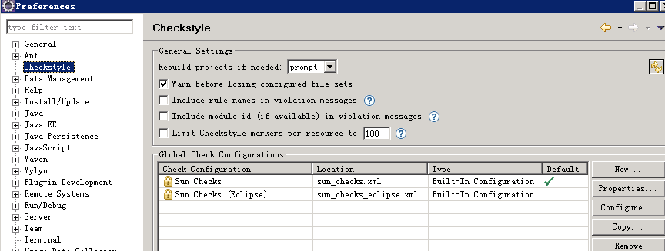
CheckStyle
Install
http://eclipse-cs.sf.net/update/
UI

Slide 31
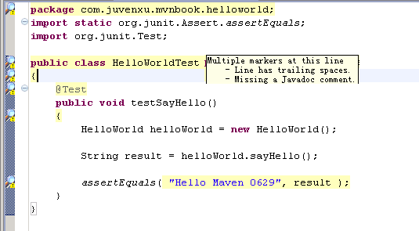
CheckStyle Effect

Slide 32
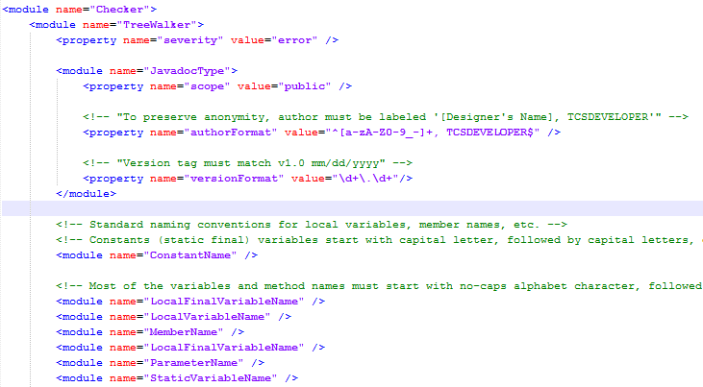
CheckStyle Configuration File

Slide 33
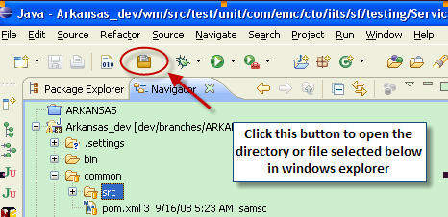
Openexplorer
Install
download from https://github.com/samsonw/OpenExplorer/archives/master
Put it into your Eclipse plugin directory, which is:“$ECLIPSE_HOME/plugins”
Restart Eclipse workbench, and that’s it.

Slide 34
Contents
Eclipse IDE and its plugins
Version Control with Subversion
Comparison Tool: WinMerge
Building tool: Ant
Unit Test using JUnit
Other Tools

Slide 35
Motivations
A place to store your code
Historical record of what was done over time
Synchronization between developers
Developer not tied to one machine
  Work from home
  Work from any machine
We’ve had problems
。。。

Slide 36
Working copy
Repository
Internet
Working copy
Working copy

Slide 37
Repository versus Working Copy
Project code is stored in a server in a data store referred to as a “repository.”
Developers “check out” copies of the project code into their local environments. These copies are referred to as “working copies.”
After making changes to a working copy, the developer “commits” changes to the repository.
Other developers get these changes by “updating” their working copies.

Slide 38
Why Subversion?
CVS with added features
  Uses relational DB
  Faster performance
  Supports all file types
Available for many platforms
Easy to set up
Tools with UI support
Good internal structure
  Opportunities for future improvements

Slide 39
Tools
Tortoise SVN
  http://tortoisesvn.net/downloads
Eclipse Plug-in
  Subclipse (recommended)
    Eclipse Update Site: http://subclipse.tigris.org/update_1.4.x

Slide 40
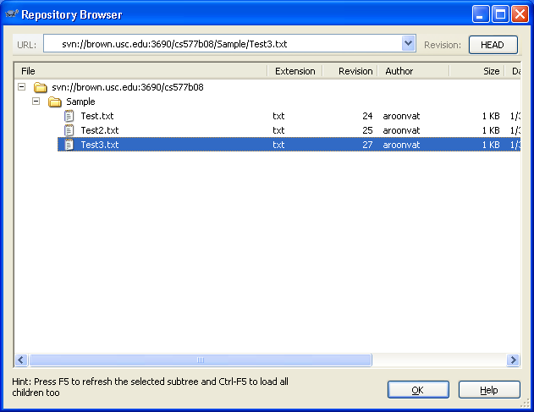
Repo-Browser
Repository browser
Notes:
一遍演示，介绍几个常用的操作
先要起服务

Slide 41
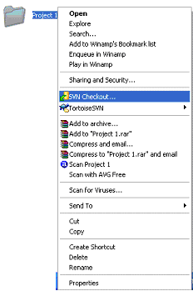
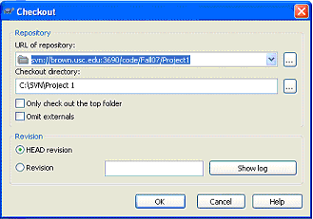
Initial Check Out
Create directory on computer to download to
SVN Checkout…

Slide 42
Adding/Deleting File
SVN Add
  Create file in the working directory
  Right click on file and choose “Add…”
    Add single files to the repository
  OR
  Right click on the working directory and choose “SVN Commit”
    Add all files/Changes to the repository
SVN Delete
  Deletes locally until committed

Slide 43
Update vs. Commit
SVN Update
  Updates the working copy with the latest version in repository
  Merges the version in repository with working copy
SVN Commit
  Modifies the version in the repository
  Merges the working copy with the repository

Slide 44
Other Basic Features
Revert
  Reverts all changes of the working copy to the version since last commit
Get Lock
  Locks the file so that it is only accessible by you
Release Lock
  Releases the file to make it accessible to others again
View Difference (Diff)
  View differences between working copy and the repository

Slide 45
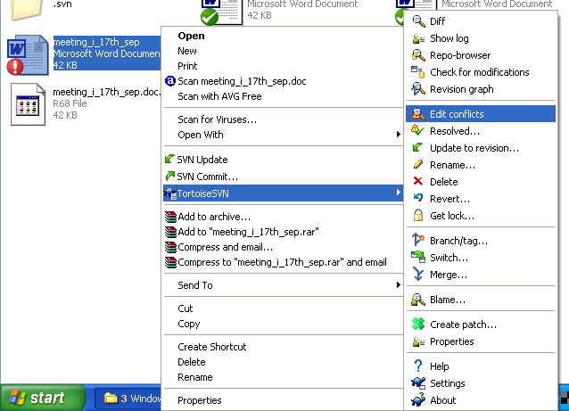
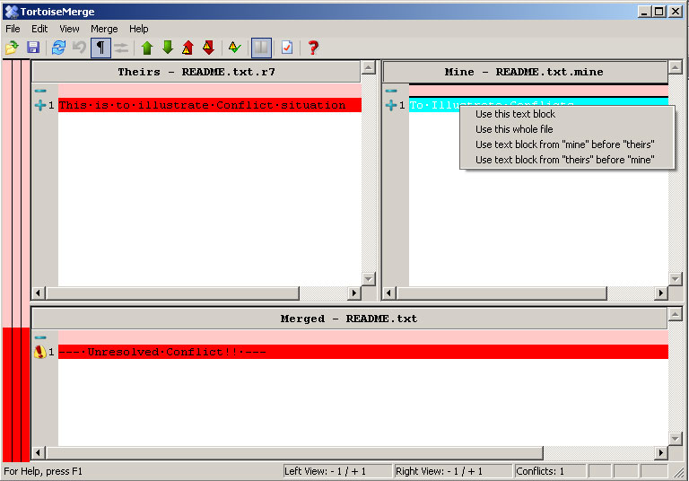
Conflict Resolution
File is simultaneously modified by multiple users
3 Files created
  Mine, OLDREV, NEWREV
The “TortoiseMerge” window
SVN Resolved

Slide 46
Advanced Features
Refer to the user manual for more advanced features
  Branch/tag
  Revision graph
  Relocate
  Export

Slide 47
Update and Commit
 | update | commit
Unchanged, and current | does nothing | does nothing
Locally changed, and current | does nothing | writes changes into repo
Unchanged, and out-of-date | replaces working file with new one | does nothing
Locally changed, and out-of-date | merges changes into working file | operation fails with out-of-date error
Notes:
演示

Slide 48
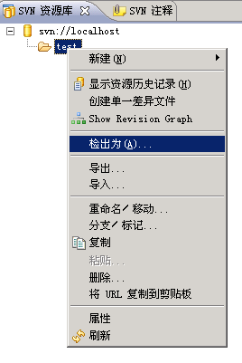
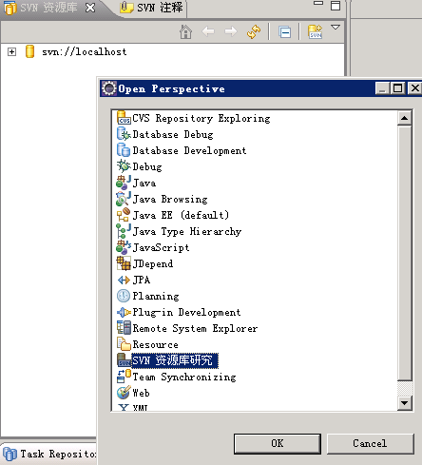
Subclipse: subversion plugin for Eclipse

Slide 49
Contents
Eclipse IDE and its plugins
Version Control with Subversion
Comparison Tool: WinMerge
Building tool: Ant
Unit Test using JUnit
Other Tools

Slide 50
WinMerge
WinMerge is an Open Source differencing and merging tool for Windows.
WinMerge can compare both folders and files, presenting differences in a visual text format that is easy to understand and handle.

Slide 51
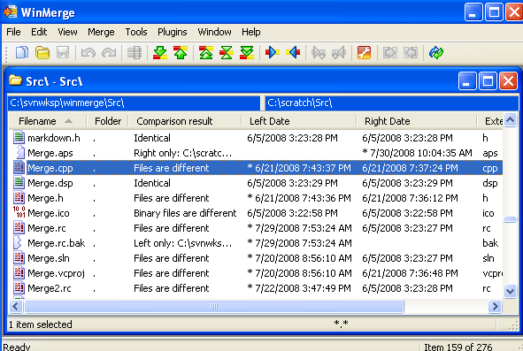
Folder Comparison

Slide 52
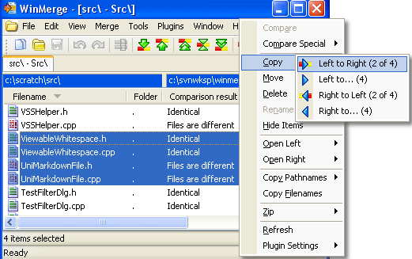
Folder Comparison

Slide 53
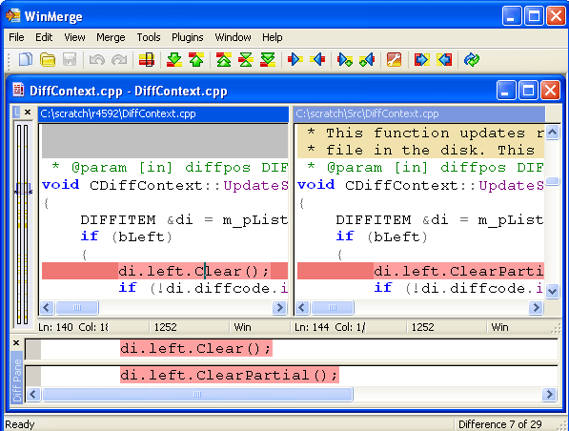
File Comparison
Useful
Shortcut
Key
Alt ->
Alt <-
Alt ↑
Alt ↓

Slide 54
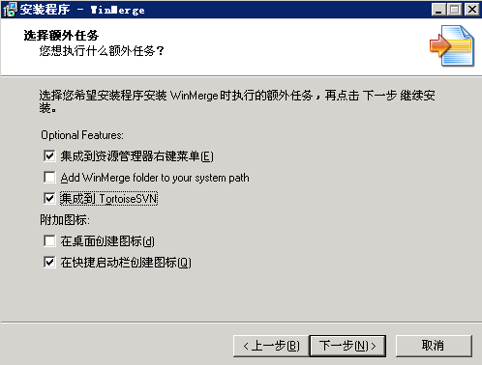
Integrated With TortoiseSVN

Slide 55
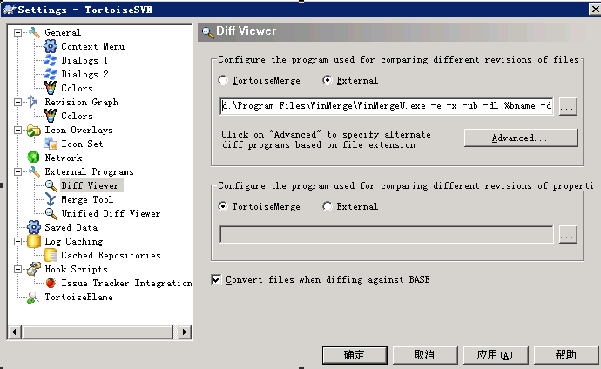
Integrated With TortoiseSVN

Slide 56
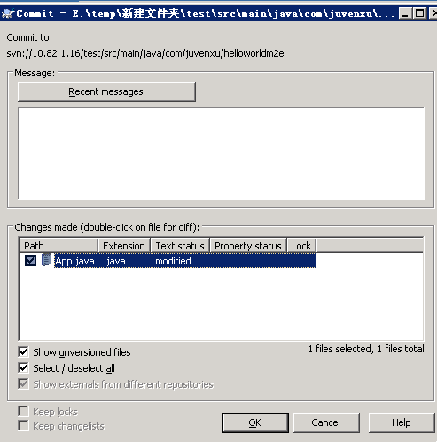
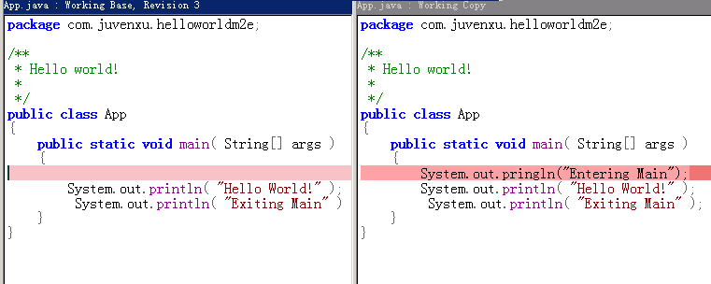
Compare & Merge before Commit

Slide 57
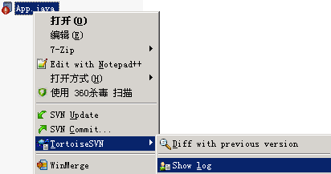
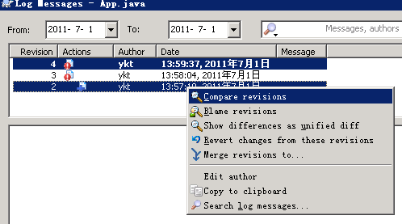
Compare revisions

Slide 58
Thank You!

