Slide 1
Introduction to Common Java Development Tools (2)

Slide 2
Contents
Eclipse IDE and its plugins
Version Control with Subversion
Comparison Tool: WinMerge
Building tool: Ant
Unit Test using JUnit
Other Tools

Slide 3
What is Ant?
Ant is a build tool -- it builds software according to a set of rules.
Ant can determine which products depend on which sources, and only build the parts that are out-of-date.
An Apache Jakarta project
  Jakarta is an umbrella heading for all the Java related Apache projects
Open source, Apache License
Project Home: http://ant.apache.org/

Slide 4
Installing Ant
Ant can be downloaded from…
  http://ant.apache.org/
Ant comes bundled as a zip file or a tarball
Simply unwrap the file to some directory where you want to store the executables
  I typically unwrap the zip file into C:\Program Files, and rename to C:\Program Files\ant\
  This directory is known as ANT_HOME

Slide 5
Ant Setup
Set the ANT_HOME environment variable to where you installed Ant
Add the ANT_HOME/bin directory to your path
Set the JAVA_HOME environment variable to the location where you installed Java
Setting environment variables
  Windows: right click My Computer → Properties → Advanced → Environment Variables
  UNIX: shell specific settings

Slide 6


Project Organization
The following example assumes that your workspace will be organized like so…
Project Directory
build.xml
src
bin
doc
*.java
*.class
*.html

Slide 7
Anatomy of a Build File
Ant’s build files are written in XML
  Convention is to call file build.xml
Each build file contains
  A project
  At least 1 target
Targets are composed of some number of tasks
Build files may also contain properties
Comments are within <!-- --> blocks

Slide 8
Projects
The project tag is used to define the project you wish to work with
Projects tags typically contain 3 attributes
  name – a logical name for the project
  default – the default target to execute
  basedir – the base directory for which all operations are done relative to
Additionally, a description for the project can be specified from within the project tag

Slide 9
Build File
<project name="Sample Project" default="compile" basedir=".">
<description>
A sample build file for this project
</description>
</project>

Slide 10
Properties
Build files may contain constants (known as properties) to assign a value to a variable which can then be used throughout the project
  Makes maintaining large build files more manageable
Projects can have a set of properties
Property tags consist of a name/value pair
  Analogous to macros from make

Slide 11
Build File with Properties
<project name="Sample Project" default="compile" basedir=".">
<description>
A sample build file for this project
</description>
<!-- global properties for this build file -->
<property name="source.dir" location="src"/>
<property name="build.dir" location="bin"/>
<property name="doc.dir" location="doc"/>
</project>

Slide 12
Targets
The target tag has the following required attribute
  name – the logical name for a target
Targets may also have optional attributes such as
  depends – a list of other target names for which this task is dependant upon, the specified task(s) get executed first
  description – a description of what a target does
Like make files, targets in Ant can depend on some number of other targets
  For example, we might have a target to create a jarfile, which first depends upon another target to compile the code
A build file may additionally specify a default target

Slide 13
Build File with Targets
<project name="Sample Project" default="compile" basedir=".">
...
<!-- set up some directories used by this project -->
<target name="init" description="setup project directories">
</target>
<!-- Compile the java code in src dir into build dir -->
<target name="compile" depends="init" description="compile java sources">
</target>
<!-- Generate javadocs for current project into docs dir -->
<target name="doc" depends="init" description="generate documentation">
</target>
<!-- Delete the build & doc directories and Emacs backup (*~) files -->
<target name="clean" description="tidy up the workspace">
</target>
</project>

Slide 14
Tasks
A task represents an action that needs execution
Tasks have a variable number of attributes which are task dependant
There are a number of build-in tasks, most of which are things which you would typically do as part of a build process
  Create a directory
  Compile java source code
  Run the javadoc tool over some files
  Create a jar file from a set of files
  Remove files/directories
  And many, many others…
    For a full list see: http://ant.apache.org/manual/coretasklist.html

Slide 15
Initialization Target & Tasks
Our initialization target creates the build and documentation directories
  The mkdir task creates a directory
<project name="Sample Project" default="compile" basedir=".">
...
<!-- set up some directories used by this project -->
<target name="init" description="setup project directories">
<mkdir dir="${build.dir}"/>
<mkdir dir="${doc.dir}"/>
</target>
...
</project>

Slide 16
Compilation Target & Tasks
Our compilation target will compile all java files in the source directory
  The javac task compiles sources into classes
  Note the dependence on the init task
<project name="Sample Project" default="compile" basedir=".">
...
<!-- Compile the java code in ${src.dir} into ${build.dir} -->
<target name="compile" depends="init" description="compile java sources">
<javac srcdir="${source.dir}" destdir="${build.dir}"/>
</target>
...
</project>

Slide 17
Javadoc Target & Tasks
Our documentation target will create the HTML documentation
  The javadoc task generates HTML documentation for all sources
<project name="Sample Project" default="compile" basedir=".">
...
<!-- Generate javadocs for current project into ${doc.dir} -->
<target name="doc" depends="init" description="generate documentation">
<javadoc sourcepath="${source.dir}" destdir="${doc.dir}"/>
</target>
...
</project>

Slide 18
Cleanup Target & Tasks
We can also use ant to tidy up our workspace
  The delete task removes files/directories from the file system
<project name="Sample Project" default="compile" basedir=".">
...
<!-- Delete the build & doc directories and Emacs backup (*~) files -->
<target name="clean" description="tidy up the workspace">
<delete dir="${build.dir}"/>
<delete dir="${doc.dir}"/>
<delete>
<fileset defaultexcludes="no" dir="${source.dir}" includes="**/*~"/>
</delete>
</target>
...
</project>

Slide 19
Completed Build File (1 of 2)
<project name="Sample Project" default="compile" basedir=".">
<description>
A sample build file for this project
</description>
<!-- global properties for this build file -->
<property name="source.dir" location="src"/>
<property name="build.dir" location="bin"/>
<property name="doc.dir" location="doc"/>
<!-- set up some directories used by this project -->
<target name="init" description="setup project directories">
<mkdir dir="${build.dir}"/>
<mkdir dir="${doc.dir}"/>
</target>
<!-- Compile the java code in ${src.dir} into ${build.dir} -->
<target name="compile" depends="init" description="compile java sources">
<javac srcdir="${source.dir}" destdir="${build.dir}"/>
</target>

Slide 20
Completed Build File (2 of 2)
<!-- Generate javadocs for current project into ${doc.dir} -->
<target name="doc" depends="init" description="generate documentation">
<javadoc sourcepath="${source.dir}" destdir="${doc.dir}"/>
</target>
<!-- Delete the build & doc directories and Emacs backup (*~) files -->
<target name="clean" description="tidy up the workspace">
<delete dir="${build.dir}"/>
<delete dir="${doc.dir}"/>
<delete>
<fileset defaultexcludes="no" dir="${source.dir}" includes="**/*~"/>
</delete>
</target>
</project>

Slide 21
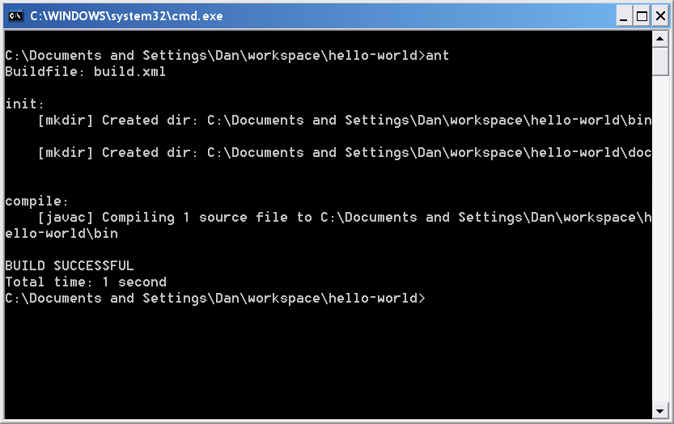
Running Ant – Command Line
Simply cd into the directory with the build.xml file and type ant to run the project default target
Or, type ant followed by the name of a target

Slide 22
Contents
Eclipse IDE and its plugins
Version Control with Subversion
Comparison Tool: WinMerge
Building tool: Ant
Unit Test using JUnit
Other Tools

Slide 23
History
Kent Beck developed the first xUnit automated test tool for Smalltalk in mid-90’s
Beck and Gamma (of design patterns Gang of Four) developed JUnit on a flight from Zurich to Washington, D.C.
Martin Fowler: “Never in the field of software development was so much owed by so many to so few lines of code.”
Junit has become the standard tool for Test-Driven Development in Java (see Junit.org)
Junit test generators now part of many Java IDEs (Eclipse, BlueJ, Jbuilder, DrJava)
Xunit tools have since been developed for many other languages (Perl, C++, Python, Visual Basic, C#, …)

Slide 24
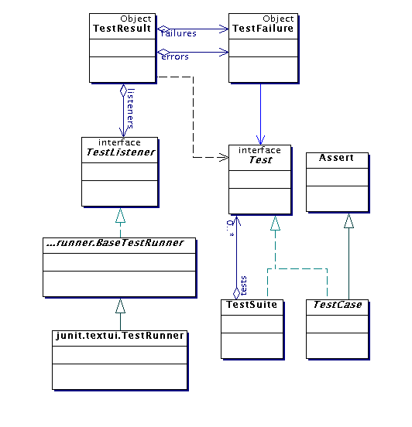
Architectural overview
JUnit test framework is a package of classes that lets you write tests for each method, then easily run those tests
TestRunner runs tests and reports TestResults
You test your class by extending abstract class
TestCase
To write test cases, you need to know and understand the
Assert class

Slide 25
Test suites
Obviously you have to test your code to get it working in the first place
  You can do ad hoc testing (testing whatever occurs to you at the moment), or
  You can build a test suite (a thorough set of tests that can be run at any time)
Disadvantages of writing a test suite
  It’s a lot of extra programming
    True—but use of a good test framework can help quite a bit
  You don’t have time to do all that extra work
    False—Experiments repeatedly show that test suites reduce debugging time more than the amount spent building the test suite
Advantages of having a test suite
  Your program will have many fewer bugs
  It will be a lot easier to maintain and modify your program
    This is a huge win for programs that, unlike class assignments, get actual use!

Slide 26
Example: Old way vs. new way
int max(int a, int b) {
if (a > b) {
return a;
} else {
return b;
}
}
void testMax() {
int x = max(3, 7);
if (x != 7) {
System.out.println("max(3, 7) gives " + x);
}
x = max(3, -7);
if (x != 3) {
System.out.println("max(3, -7) gives " + x);
}
}
public static void main(String[] args) {
new MyClass().testMax();
}
@Test
void testMax() {
assertEquals(7, max(3, 7));
assertEquals(3, max(3, -7));
}

Slide 27
JUnit
JUnit is a framework for writing tests
  JUnit was written by Erich Gamma (of Design Patterns fame) and Kent Beck (creator of XP methodology)
  JUnit uses Java’s reflection capabilities (Java programs can examine their own code)
  JUnit helps the programmer:
    define and execute tests and test suites
    formalize requirements and clarify architecture
    write and debug code
    integrate code and always be ready to release a working version
  JUnit is not included in Sun’s SDK, but almost all IDEs include it

Slide 28
Terminology
A test fixture sets up the data (both objects and primitives) that are needed to run tests
  Example: If you are testing code that updates an employee record, you need an employee record to test it on
A unit test is a test of a single class
A test case tests the response of a single method to a particular set of inputs
A test suite is a collection of test cases
A test runner is software that runs tests and reports results
An integration test is a test of how well classes work together
  JUnit provides some limited support for integration tests

Slide 29
Once more, in pictures
test suite
test runner
another unit test
test case (for one method)
A unit test tests the methods in a single class
A test case tests (insofar as possible) a single method
  You can have multiple test cases for a single method
A test suite combines unit tests
The test fixture provides software support for all this
The test runner runs unit tests or an entire test suite
Integration testing (testing that it all works together) is not well supported by JUnit
another test case
another unit test
another test case
another test case
another test case
unit test (for one class)
test case (for one method)
another test case
test fixture

Slide 30
Writing a JUnit test class, I
  Start by importing these JUnit 4 classes:
import org.junit.*;
import static org.junit.Assert.*; // note static import
  Declare your test class in the usual way
public class MyProgramTest {
  Declare an instance of the class being tested
  You can declare other variables, but don’t give them initial values here
public class MyProgramTest {
MyProgram program;
int someVariable;

Slide 31
Writing a JUnit test class, II2
  Define a method (or several methods) to be executed before each test
  Initialize your variables in this method, so that each test starts with a fresh set of values
@Before
public void setUp() {
program = new MyProgram();
someVariable = 1000;
}
  You can define one or more methods to be executed after each test
  Typically such methods release resources, such as files
  Usually there is no need to bother with this method
@After
public void tearDown() {
}

Slide 32
More stuff in test classes
Suppose you want to test a class Counter
public class CounterTest
extends junit.framework.TestCase {
  This is the unit test for the Counter class
public CounterTest() { } //Default constructor
protected void setUp()
  Test fixture creates and initializes instance variables, etc.
protected void tearDown()
  Releases any system resources used by the test fixture
public void testIncrement(), public void testDecrement()
  These methods contain tests for the Counter methods increment(), decrement(), etc.
  Note capitalization convention

Slide 33
A simple example
Suppose you have a class Arithmetic with methods int multiply(int x, int y), and boolean isPositive(int x)
import org.junit.*;
import static org.junit.Assert.*;
public class ArithmeticTest {
}
@Test
public void testMultiply() {
assertEquals(4, Arithmetic.multiply(2, 2));
assertEquals(-15, Arithmetic.multiply(3, -5));
}
@Test
public void testIsPositive() {
assertTrue(Arithmetic.isPositive(5));
assertFalse(Arithmetic.isPositive(-5));
assertFalse(Arithmetic.isPositive(0));
}

Slide 34
Assert methods I
Within a test,
  Call the method being tested and get the actual result
  Assert what the correct result should be with one of the assert methods
  These steps can be repeated as many times as necessary
An assert method is a JUnit method that performs a test, and throws an AssertionError if the test fails
  JUnit catches these Errors and shows you the result
static void assertTrue(boolean test)
static void assertTrue(String message, boolean test)
  Throws an AssertionErrorif the test fails
  The optional message is included in the Error
static void assertFalse(boolean test)
static void assertFalse(String message, boolean test)
  Throws an AssertionErrorif the test fails

Slide 35
Example: Counter class
For the sake of example, we will create and test a trivial “counter” class
  The constructor will create a counter and set it to zero
  The increment method will add one to the counter and return the new value
  The decrement method will subtract one from the counter and return the new value
We write the test methods before we write the code
  This has the advantages described earlier
  However, we usually write the method stubs first, and let the IDE generate the test method stubs
Don’t be alarmed if, in this simple example, the JUnit tests are more code than the class itself

Slide 36
JUnit tests for Counter
public class CounterTest {
Counter counter1; // declare a Counter here
@Before
void setUp() {
counter1 = new Counter(); // initialize the Counter here
}
@Test
public void testIncrement() {
assertTrue(counter1.increment() == 1);
assertTrue(counter1.increment() == 2);
}
@Test
public void testDecrement() {
assertTrue(counter1.decrement() == -1);
}
}
Note that each test begins with a brand new counter
This means you don’t have to worry about the order in which the tests are run

Slide 37
The Counter class itself
public class Counter {
int count = 0;
public int increment() {
return count += 1;
}
public int decrement() {
return count -= 1;
}
public int getCount() {
return count;
}
}
Is JUnit testing overkill for this little class?
The Extreme Programming view is: If it isn’t tested, it doesn’t work
You are not likely to have many classes this trivial in a real program, so writing JUnit tests for those few trivial classes is no big deal
Often even XP programmers don’t bother writing tests for simple getter methods such as getCount()
We only used assertTrue in this example, but there are additional assert methods

Slide 38
Warning: equals
You can compare primitives with ==
Java has a method x.equals(y), for comparing objects
  This method works great for Strings and a few other Java classes
  For objects of classes that you create, you have to define equals
assertEquals(expected, actual) uses == or equals
To define equals for your own objects, define exactly this method:
public boolean equals(Object obj) { ... }
  The argument must be of type Object, which isn’t what you want, so you must cast it to the correct type (say, Person):
  public boolean equals(Object something) {
  Person p = (Person)something;
  return this.name == p.name; // test whatever you like here
  }

Slide 39
Assert methods II
assertEquals(expected, actual)
assertEquals(String message, expected, actual)
  expected and actual must be both objects or the same primitive type
  For objects, uses your equals method, if you have defined it properly, as described on the previous slide
assertSame(Object expected, Object actual)
assertSame(String message, Object expected, Object actual)
  Asserts that two arguments refer to the same object
assertNotSame(Object expected, Object actual)
assertNotSame(String message, Object expected, Object actual)
  Asserts that two objects do not refer to the same object

Slide 40
Assert methods III
assertNull(Object object)
assertNull(String message, Object object)
  Asserts that the object is null (undefined)
assertNotNull(Object object)
assertNotNull(String message, Object object)
  Asserts that the object is null
fail()
fail(String message)
  Causes the test to fail and throw an AssertionFailedError
  Useful as a result of a complex test, when the other assert methods aren’t quite what you want

Slide 41
Writing a JUnit test class, III
This page is really only for expensive setup, such as when you need to connect to a database to do your testing
  If you wish, you can declare one method to be executed just once, when the class is first loaded
@BeforeClass
public static void setUpClass() throws Exception {
// one-time initialization code
}
  If you wish, you can declare one method to be executed just once, to do cleanup after all the tests have been completed
@AfterClass
public static void tearDownClass() throws Exception {
// one-time cleanup code
}

Slide 42
Special features of @Test
  You can limit how long a method is allowed to take
  This is good protection against infinite loops
  The time limit is specified in milliseconds
  The test fails if the method takes too long
@Test (timeout=10)
public void greatBig() {
assertTrue(program.ackerman(5, 5) > 10e12);
}
  Some method calls should throw an exception
  You can specify that a particular exception is expected
  The test will pass if the expected exception is thrown, and fail otherwise
@Test (expected=IllegalArgumentException.class)
public void factorial() {
program.factorial(-5);
}

Slide 43
Test-Driven Development (TDD)
It is difficult to add JUnit tests to an existing program
  The program probably wasn’t written with testing in mind
It’s actually better to write the tests before writing the code you want to test
This seems backward, but it really does work better:
  When tests are written first, you have a clearer idea what to do when you write the methods
  Because the tests are written first, the methods are necessarily written to be testable
  Writing tests first encourages you to write simpler, single-purpose methods
  Because the methods will be called from more than one environment (the “real” one, plus your test class), they tend to be more independent of the environment

Slide 44
Stubs
In order to run our tests, the methods we are testing have to exist, but they don’t have to be right
Instead of starting with “real” code, we start with stubs—minimal methods that always return the same values
  A stub that returns void can be written with an empty body
  A stub that returns a number can return 0 or -1 or 666, or whatever number is most likely to be wrong
  A stub that returns a boolean value should usually return false
  A stub that returns an object of any kind (including a String or an array) should return null
When we run our test methods with these stubs, we want the test methods to fail!
  This helps “test the tests”—to help make sure that an incorrect method doesn’t pass the tests

Slide 45
Ignoring a test
  The @Ignore annotation says to not run a test
@Ignore("I don’t want Dave to know this doesn’t work")
@Test
public void add() {
assertEquals(4, program.sum(2, 2));
}
  You shouldn’t use @Ignore without a very good reason!

Slide 46
Test suites
  You can define a suite of tests
@RunWith(value=Suite.class)
@SuiteClasses(value={
MyProgramTest.class,
AnotherTest.class,
YetAnotherTest.class
})
public class AllTests { }

Slide 47
JUnit in Eclipse
If you write your method stubs first (as on the previous slide), Eclipse will generate test method stubs for you
To add JUnit 4 to your project:
  Select a class in Eclipse
  Go to File → New... → JUnit Test Case
  Make sure New JUnit 4 test is selected
  Click where it says “Click here to add JUnit 4...”
  Close the window that appears
To create a JUnit test class:
  Do steps 1 and 2 above, if you haven’t already
  Click Next>
  Use the checkboxes to decide which methods you want test cases for;
  don’t select Object or anything under it
    I like to check “create tasks,” but that’s up to you
  Click Finish
To run the tests:
  Choose Run → Run As → JUnit Test

Slide 48
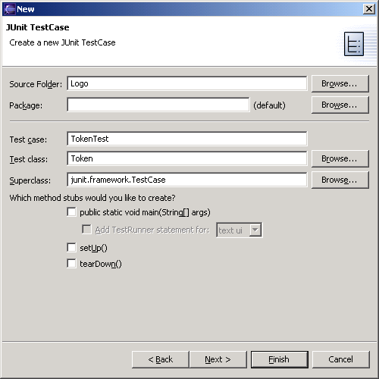
JUnit in Eclipse
To create a test class, select File→ New→ Other... → Java, JUnit, TestCase and enter the name of the class you will test
Fill this in
This will be filled in automatically

Slide 49
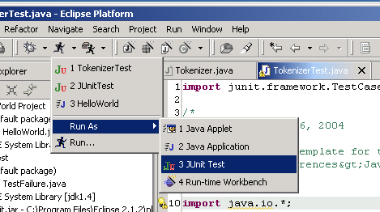
Running JUnit
Second, use this pulldown menu
First, select a Test class
Third, Run As → JUnit Test

Slide 50
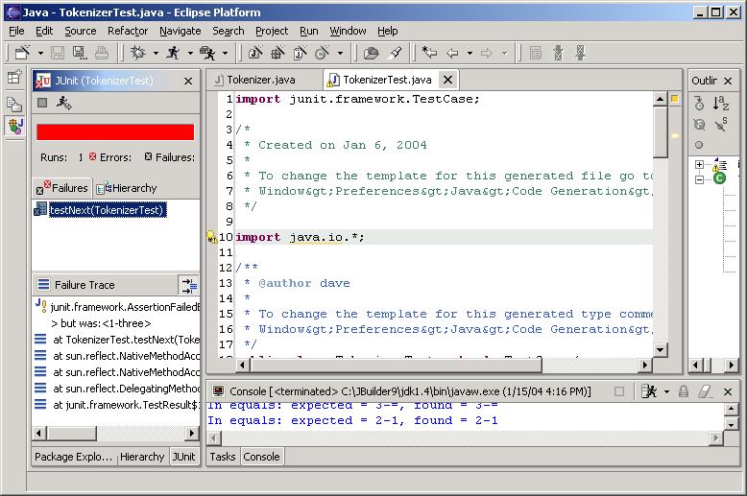
Results
Your results are here

Slide 51
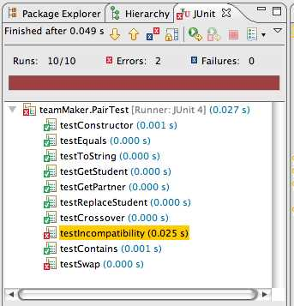
Viewing results in Eclipse
Ran 10 of
the 10 tests
No tests
failed, but...
Something unexpected
happened in two tests
Bar is green if
all tests pass,
red otherwise
This is how
long the
test took
This test passed
Something is wrong
Depending on your
preferences, this
window might show
only failed tests

Slide 52
Recommended approach
Write a test for some method you intend to write
  If the method is fairly complex, test only the simplest case
Write a stub for the method
Run the test and make sure it fails
Replace the stub with code
  Write just enough code to pass the tests
Run the test
  If it fails, debug the method (or maybe debug the test); repeat until the test passes
If the method needs to do more, or handle more complex situations, add the tests for these first, and go back to step 3

Slide 53
Contents
Eclipse IDE and its plugins
Version Control with Subversion
Comparison Tool: WinMerge
Building tool: Ant
Unit Test using JUnit
Other Tools

Slide 54
Other Tools
Maven
Code Coverage
Bugzilla
Text Editor
Decompiler

Slide 55
Maven
Maven is a software tool for project management and build automation.
Maven serves a similar purpose to the Apache Ant tool, but it is based on different concepts and works in a profoundly different manner.
Maven dynamically downloads Java libraries and Maven plug-ins from one or more repositories.
More to see: http://maven.apache.org/

Slide 56
Code Coverage Tool
Code Coverage: describe the degree to which the source code of a program has been tested
Cobertura: a free Java tool that calculates the percentage of code accessed by tests.
  Can be executed from ant or from the command line.
  Instruments Java bytecode after it has been compiled.
  Can generate reports in HTML or XML.
  Shows the percentage of lines and branches covered for each class, each package, and for the overall project.
Notes:
Cobertura: 西班牙语

Slide 57
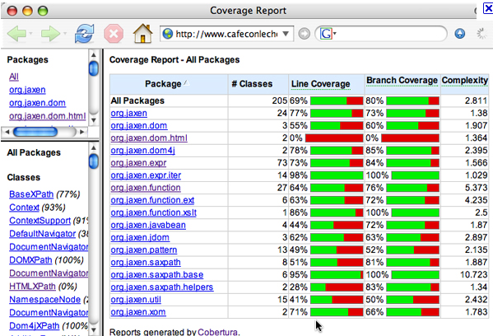
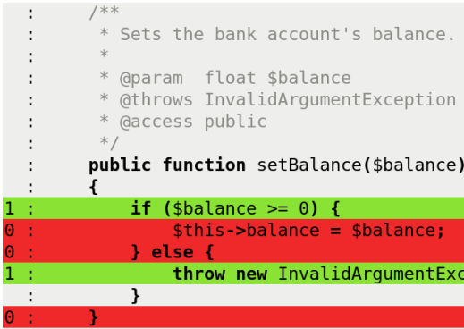
Coverage Report

Slide 58
Bugzilla
Bugzilla is a bug- or issue-tracking system.
  Bug-tracking systems allow individual or groups of developers effectively to keep track of outstanding problems with their product.
An Open Source product
  covered by the Mozilla Public License
Written in Perl, uses MySQL database
”De-facto standard defect-tracking system against which all others are measured”
See: http://www.bugzilla.org

Slide 59
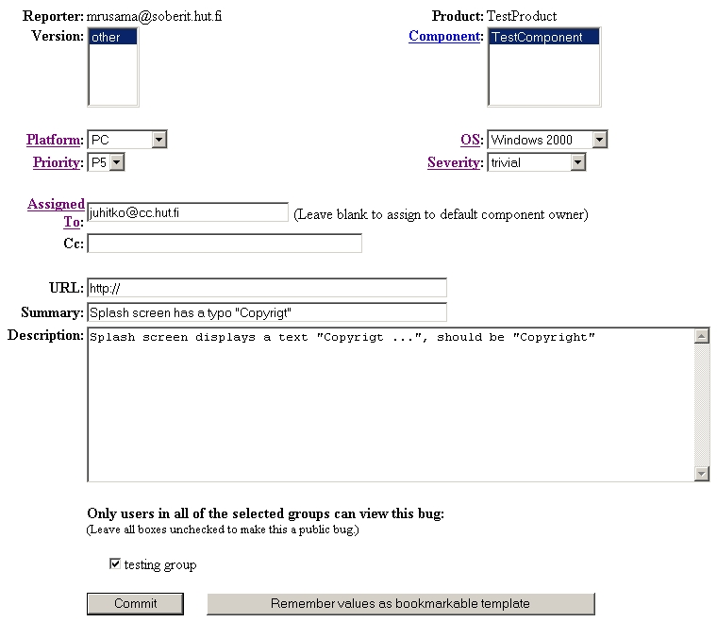

Slide 60
Other Tools
Text Editor:
    Notepad++, UltraEditor
Decompiler:
    DJ Java Decompiler, Jadclipse for Eclipse
Issue & Project Tracking:
    JIRA
Project Plan:
    MS Project
……

Slide 61
Thank You!

