Slide 1
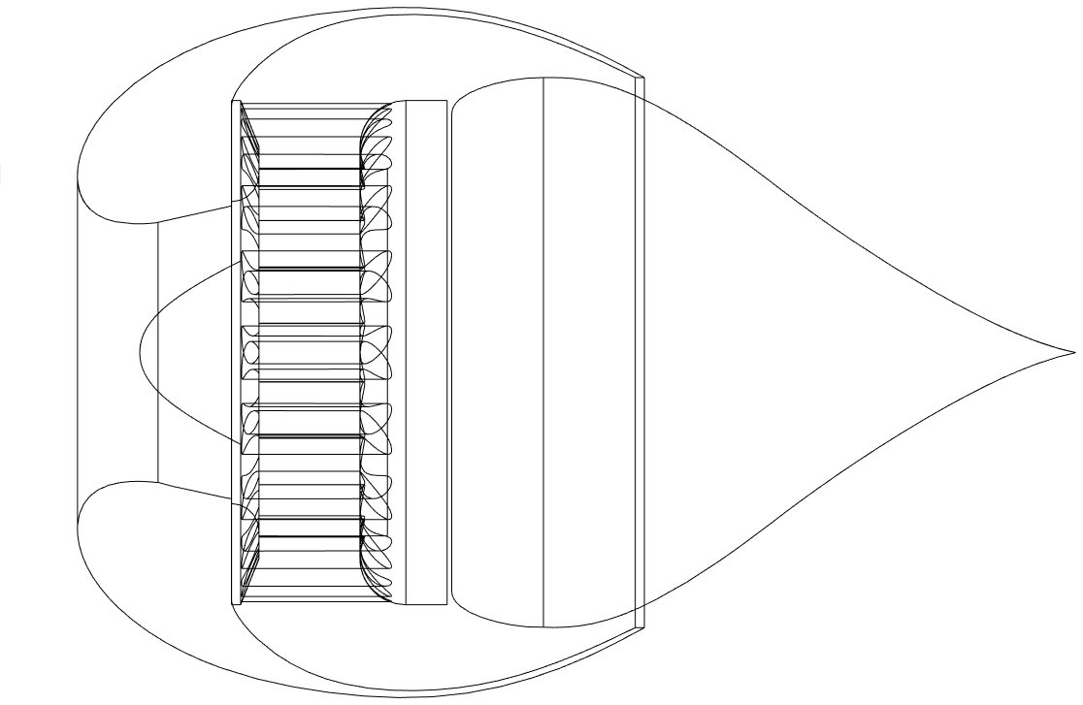
Stator (Compressor)
Accelerating Channel
Fan
Ring Exhaust
Air Intake
Adjustable Aerospike
Shell
High Pressure Chamber

