Slide 1
R
L1
L2
2
3
4
1
w
x
y
z
s
t
u
v
A,B
C,D,E
F,G
H,I,J,”Q”
K,L
M,N
Q,R
O,P, “Q”

Slide 2
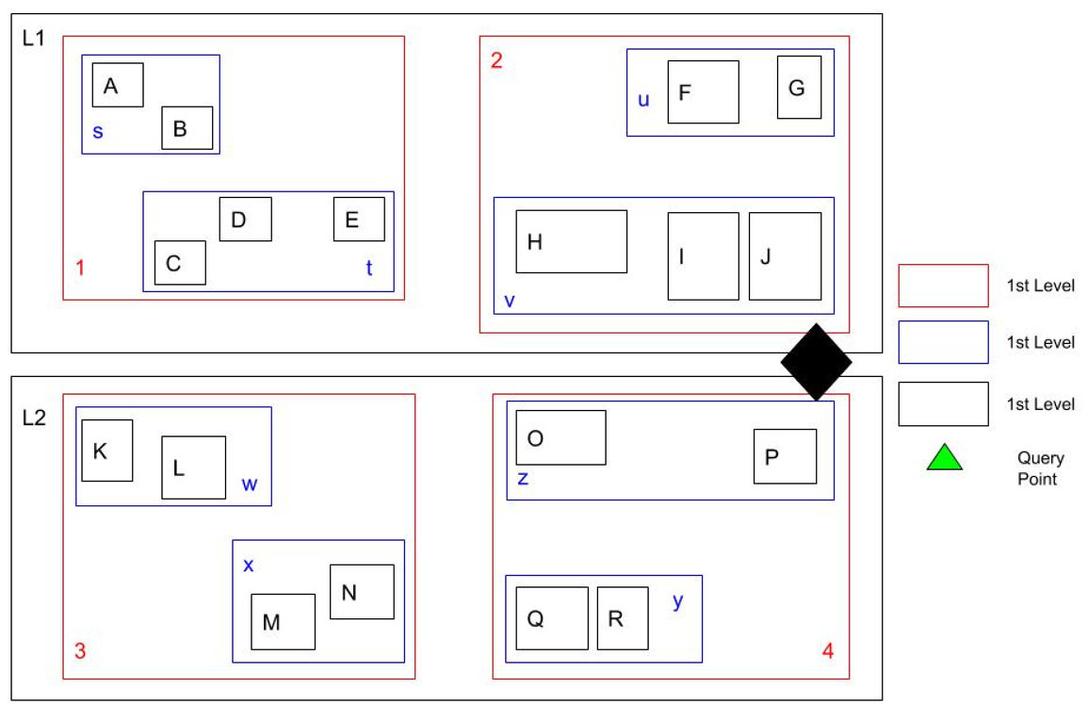


L2
u
4
r
v
L1
z
2
y

Slide 3
R
L1
L2
3
2
4
1
y
v
r
u
z
s
t
w
x
A,B
C,D,E
Q,R
O,H
I,J
F,G
P,”Q”
K,L
M,N

Slide 4
12
10
8
6
4
2
2
4
6
8
10
12

Slide 5
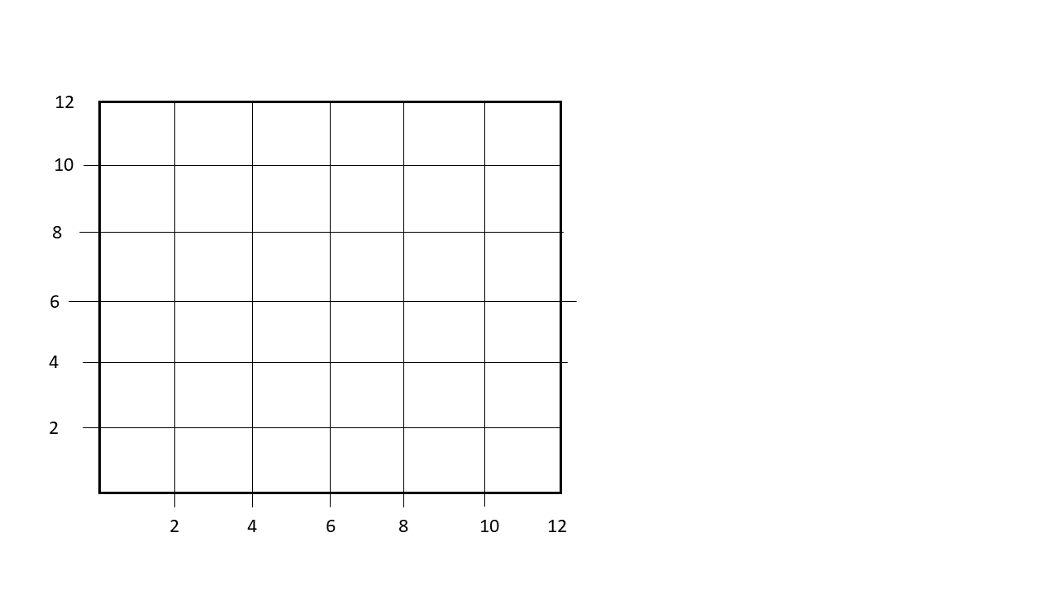
y
2.5
8.5
A B C
D E Overflow
K
D E F
G H Overflow
J
I
G H I
G
H
5.5
G H I
E
F
C
D
B
A
x

Slide 6
y
1.5
5.5
A B
C Overflow
K
C D
E Overflow
J
I
E F
7
G Overflow
G
H
G H
E
F
I Overflow
3.5
I J
K Overflow
C
D
B
A
x

Slide 7
A
Wainiha
Princeville
B
Kapolie
Kailua
40
70
30
65
50
40
Lahaina
Kilai
C
80
40
20
Eleele
Lihue
Honolulu
Wailoka Village
Hilo
D
70
60
60
40
50
Milolil
Pahola

Slide 8
Princeville
Kailua
200
Kilai
105
70
80
50
Lahaina
40
80
75
40
85
Lihue
Kapolie
Honolulu
65
70
Hilo
Wailoka Village

