Slide 1
Opening Cappuccino Coffee Shop in San Francisco neighborhood Using Data Analysis Techniques.

Slide 2
Introduction
In this project, we will use the Foursquare API to explore neighborhoods in San Francisco, get the most common venue categories in each neighborhood, use the k-means clustering algorithm to find similar neighborhoods, use the Folium library to visualize the neighborhoods in San Francisco

Slide 3
Data
We analyze the following page
http://www.healthysf.org/bdi/outcomes/zipmap.htm,
In order to obtain the data that is in the table of postal codes and to transform the data into a pandas data frame.

Slide 4
Convert Addresses into Latitude and Longitude
In order to utilize the Foursquare location data, we need to get the latitude and the longitude coordinates of each neighborhood

Slide 5
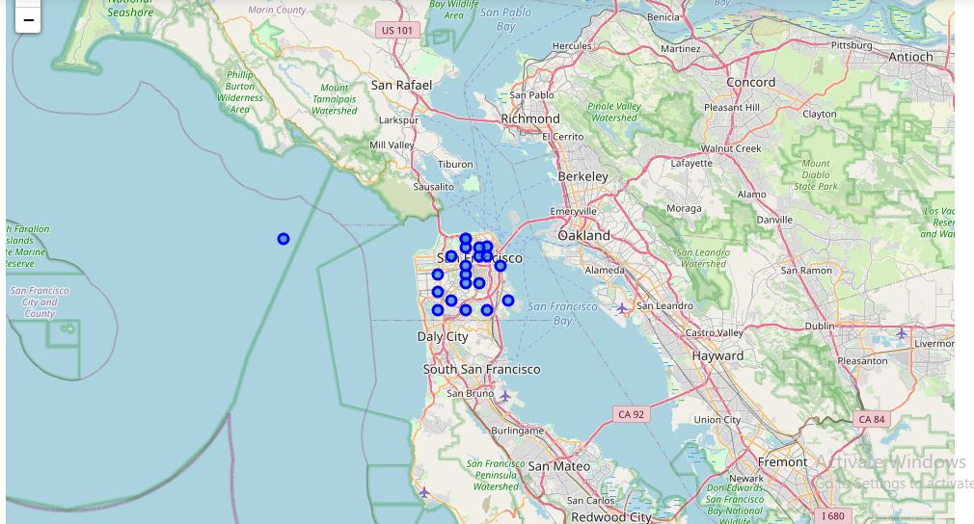
Explore Neighborhoods in San Francisco

Slide 6
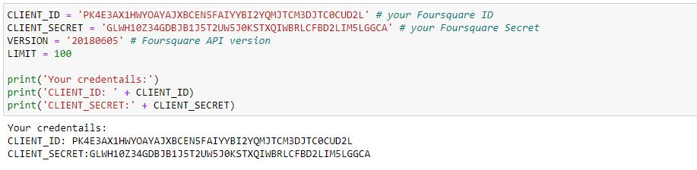
Define Foursquare Credentials and Version

Slide 7
Cluster Neighborhoods
k-means is especially useful if you need to quickly discover
insights from unlabeled data.
Run k-means to cluster the neighborhood into 5 clusters.
k-means will then partition our neighborhoods into 5 groups.
The neighborhoods in each cluster are similar to each other
in terms of the features included in the dataset.

Slide 8
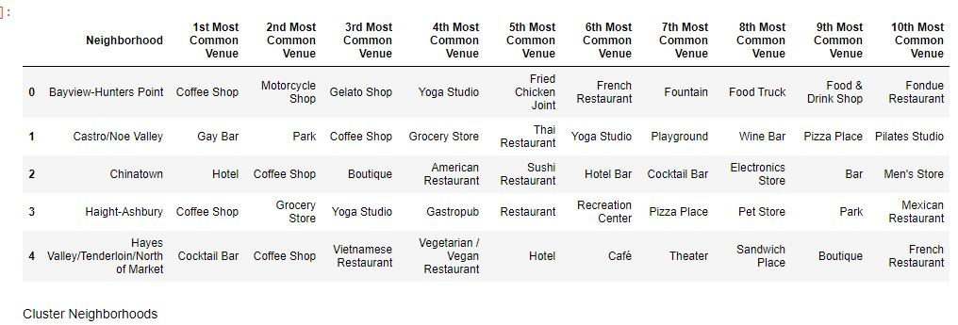

Slide 9
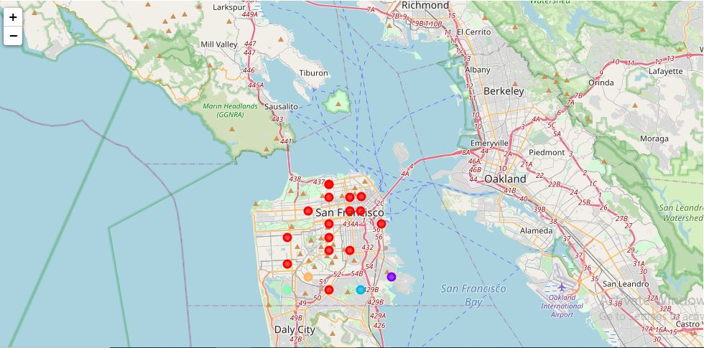

Slide 10
Examine Clusters
K-mean cluster method was found for clusters. k-means is especially useful if you need to quickly discover insights from unlabeled data. Run k-means to cluster the neighborhood into 5 clusters. k-means will then partition our neighborhoods into 5 groups. The neighborhoods in each cluster are similar to each other in terms of the features included in the dataset. Based on the data analysis, the coffee shop can be open in the second cluster because the data analysis showed that numbers of coffee shops in the area are still small and can reduce the competition. However, it also found that the second cluster has the smallest number of area and have a potential smaller profit if the coffee shop is open in the first cluster.

