Slide 1
Introduction
Use case – Container in action
Containers vs VM
Container Technology in AWS
Container Technology in GCP
Container Orchestration
Container in different Architecture & Pipeline
Container in Decentralized Architecture
Container in Micro Services Architecture
Container in CI CD
Container security

Slide 2
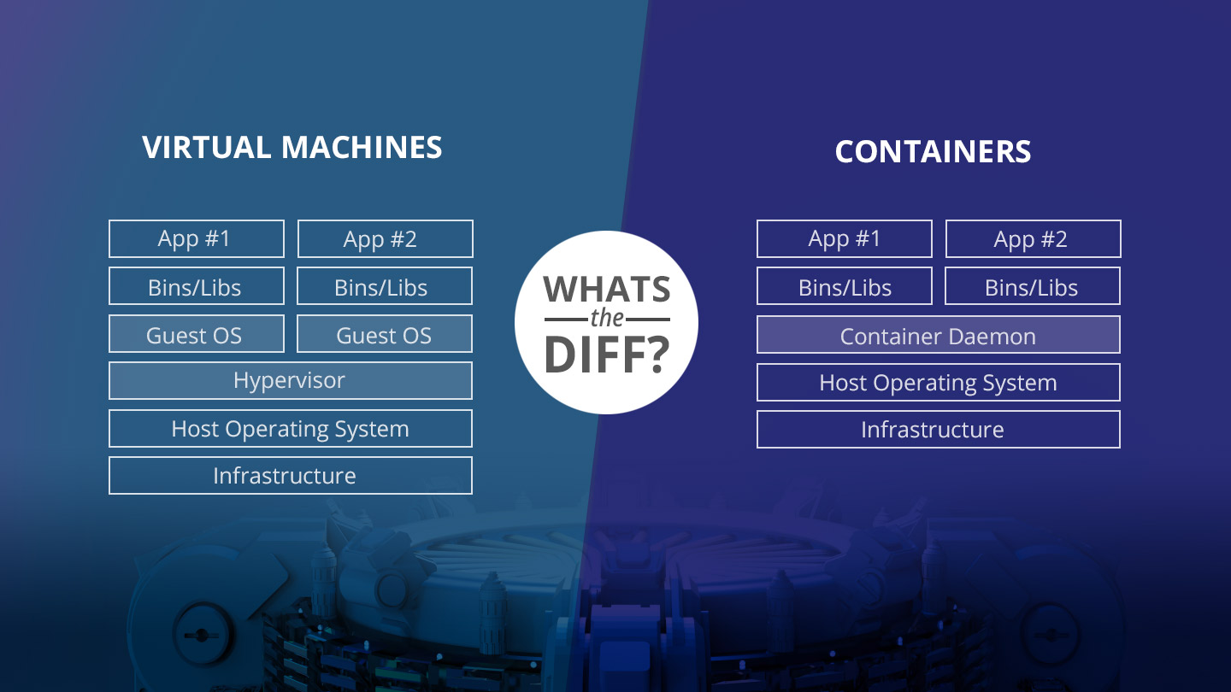
<< Insert Text >>>

Slide 3
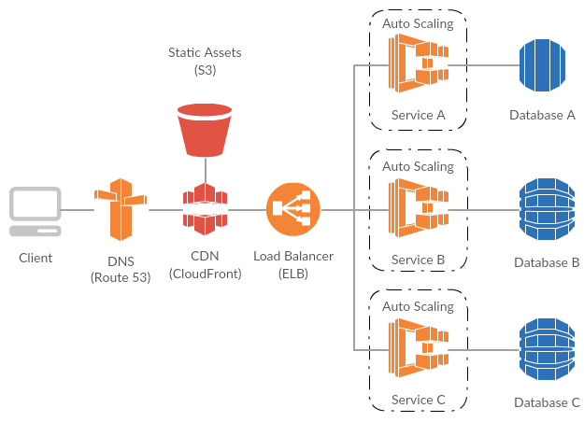
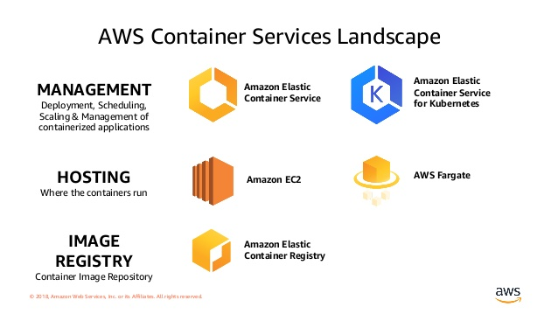
Use Case : Hello World website - Hosted in EC2 / ECS / ServerLess

Slide 4
Containers Technology in GCP

Slide 5
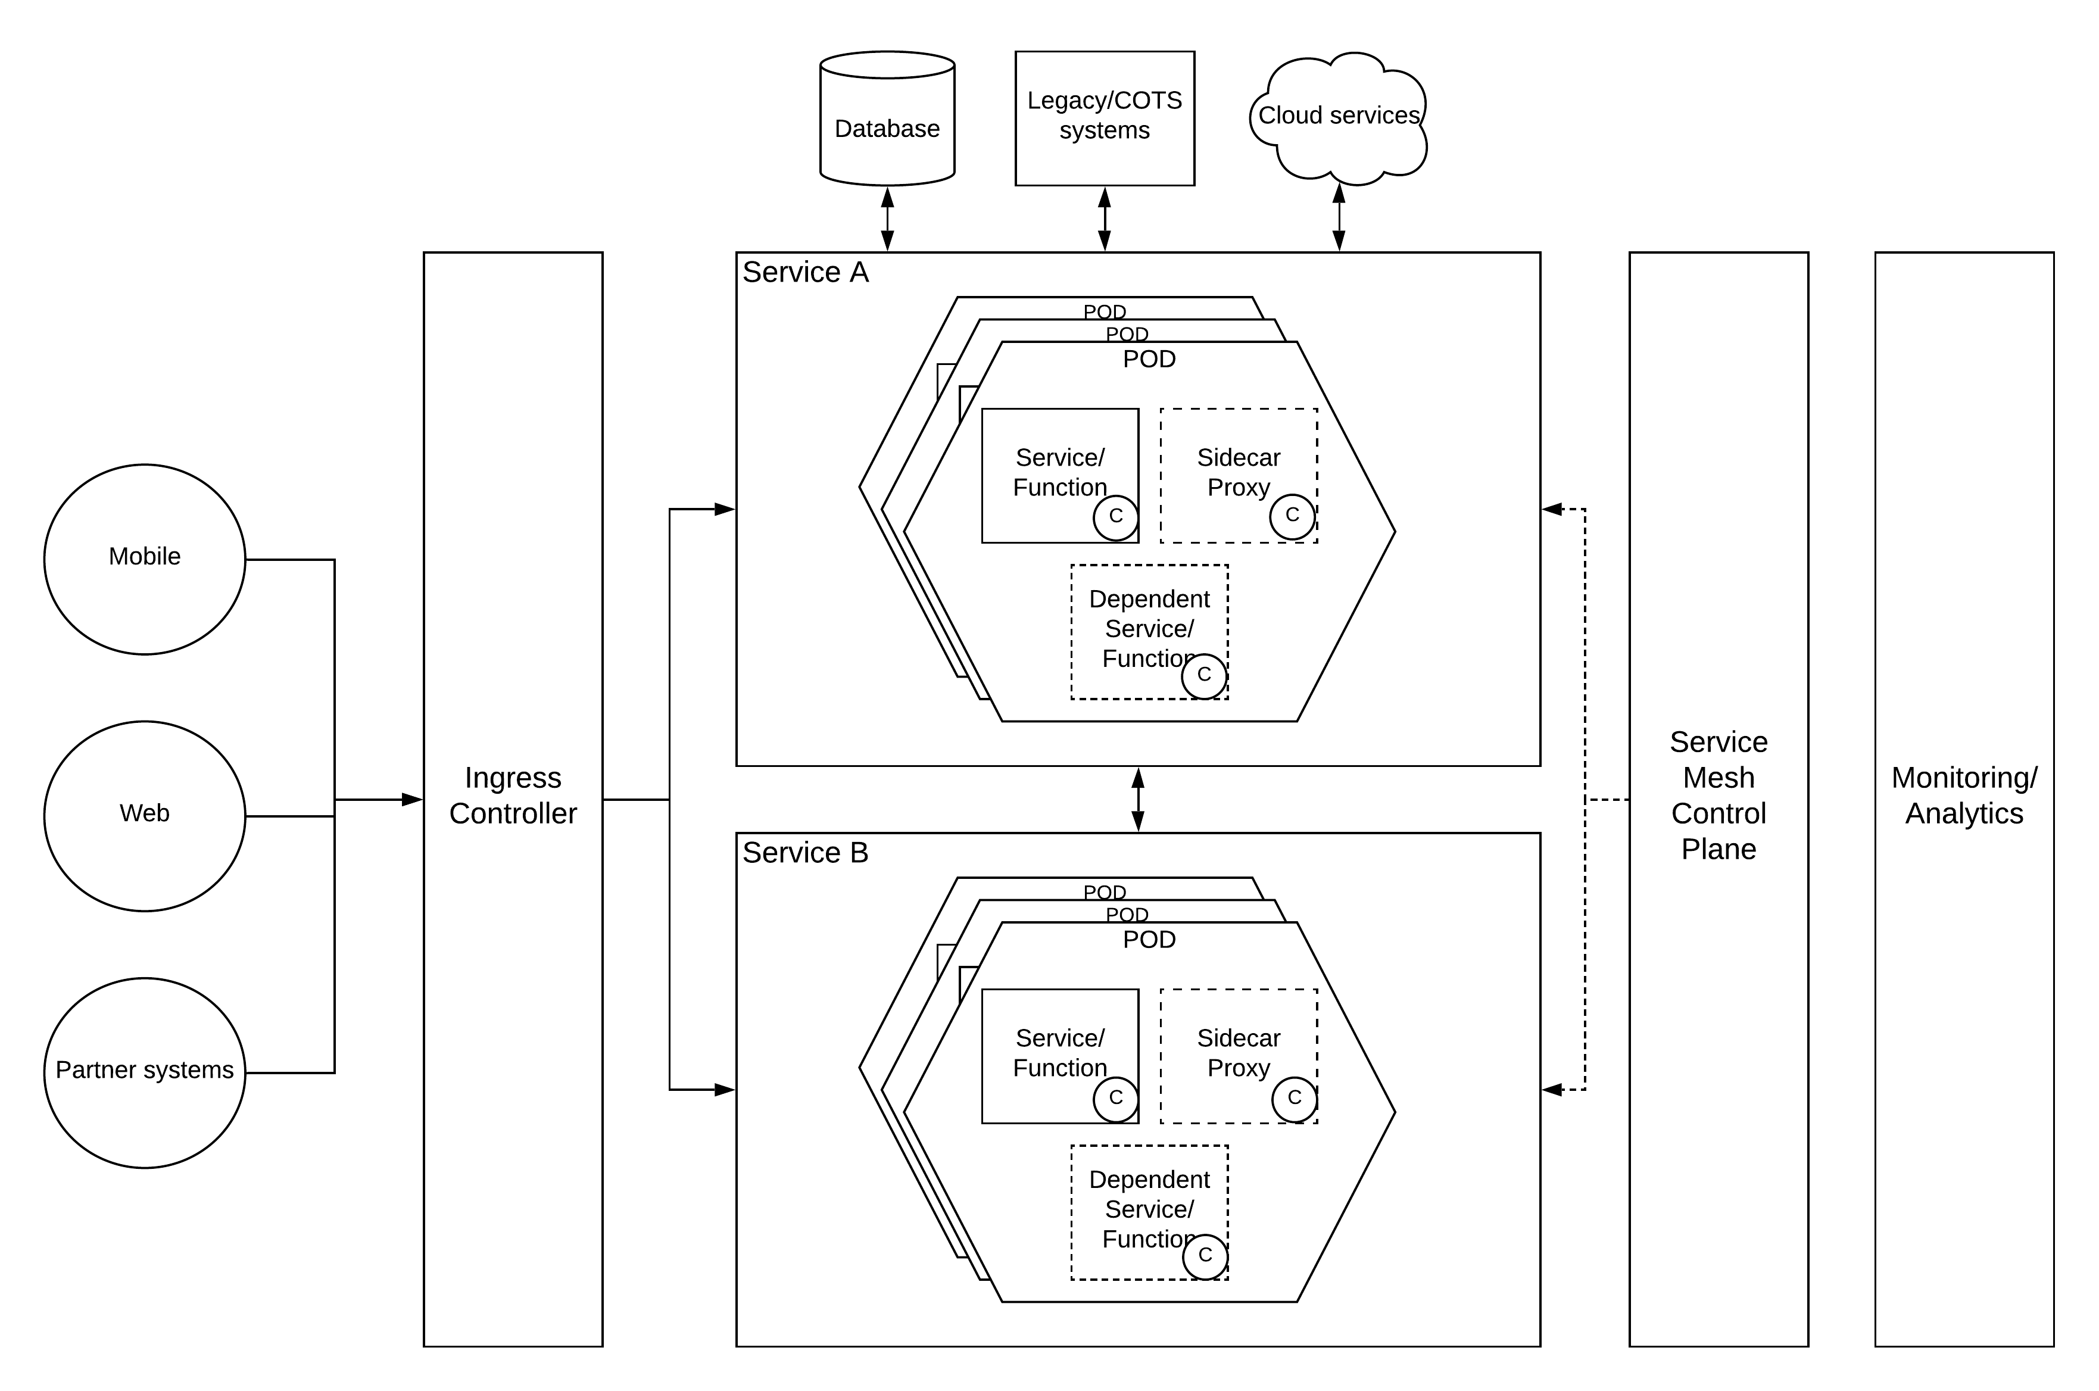
Containers in Decentralized Architecture
<< Insert Text >>>

Slide 6
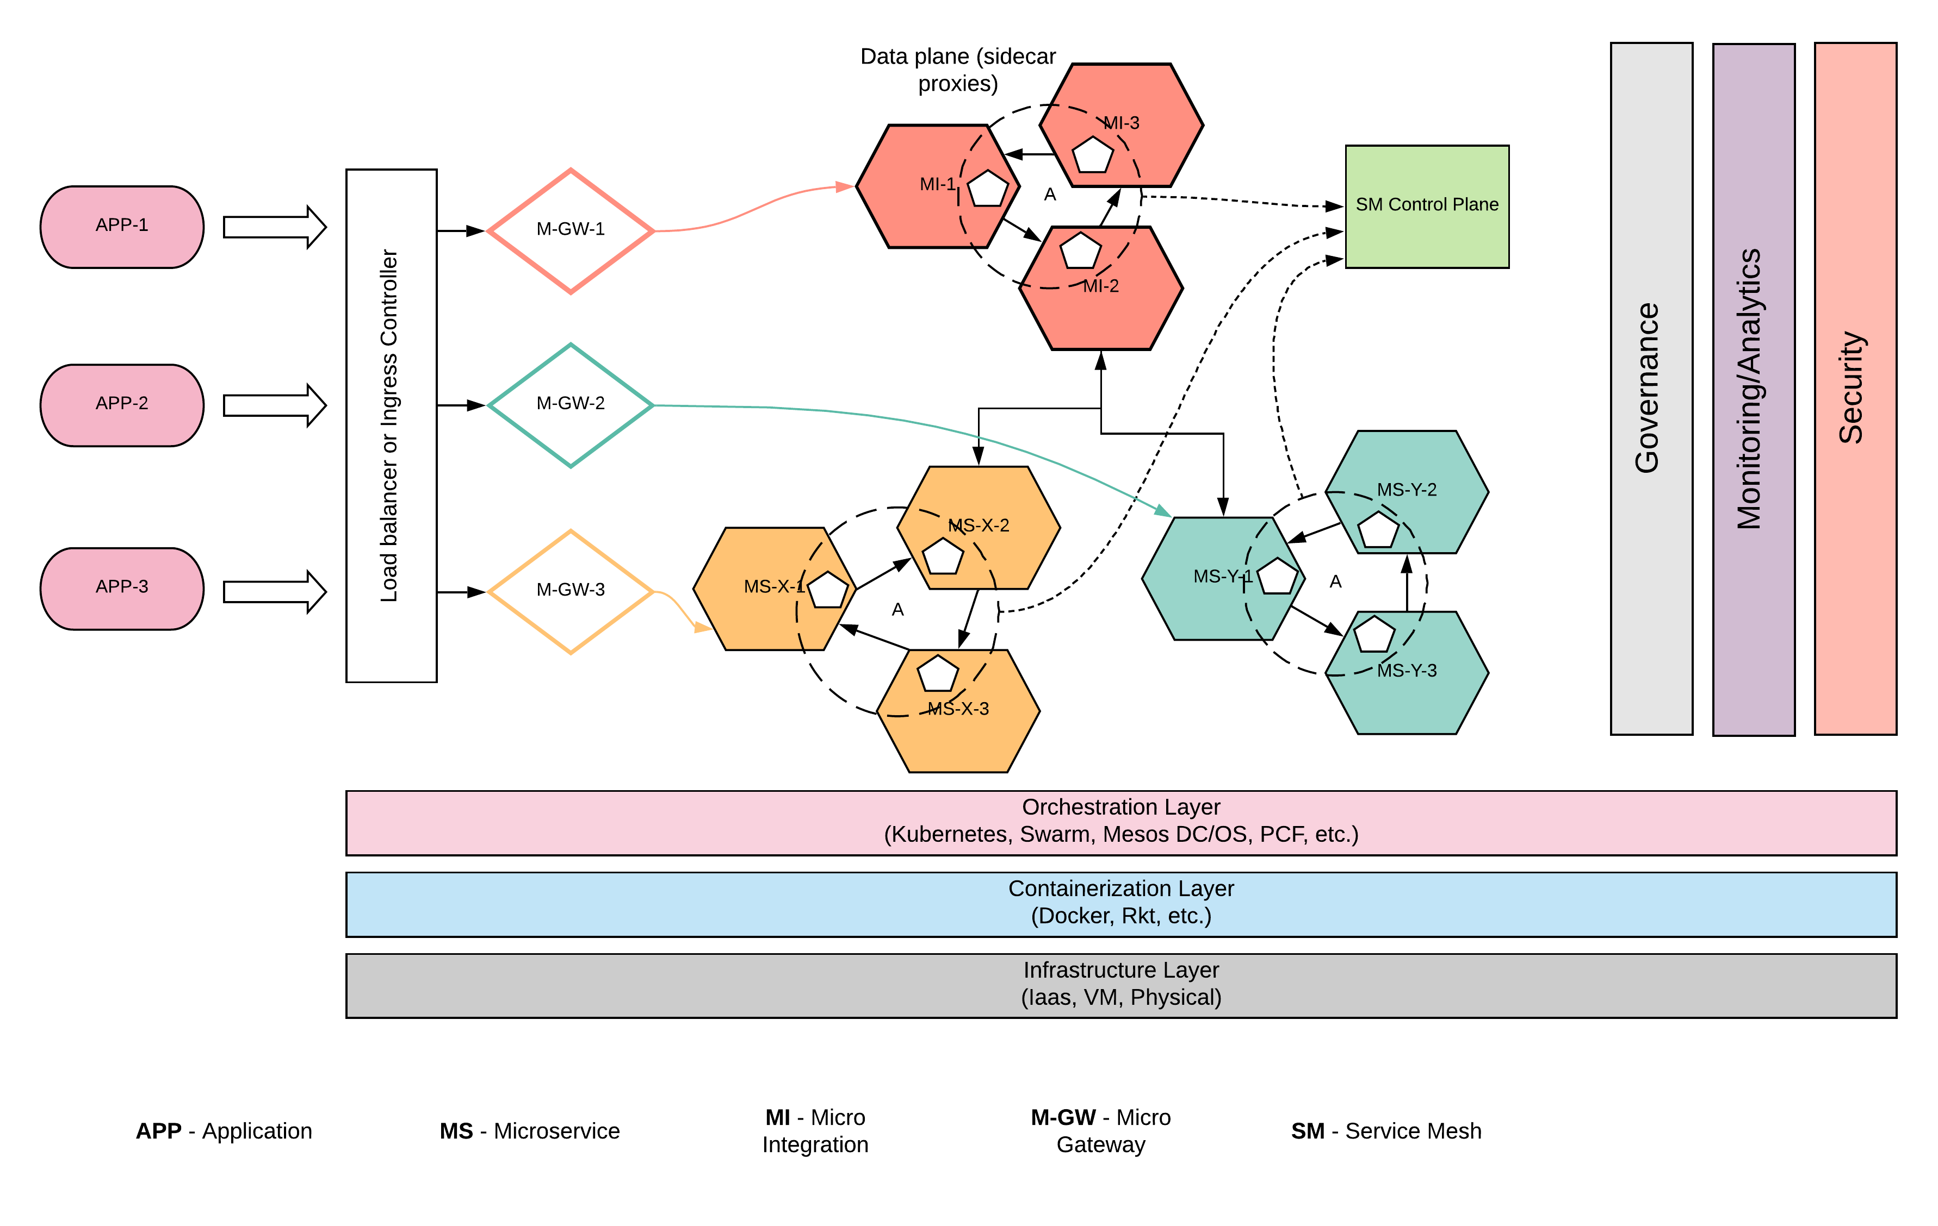
Containers in Micro Services Architecture
<< Insert Text >>>

Slide 7
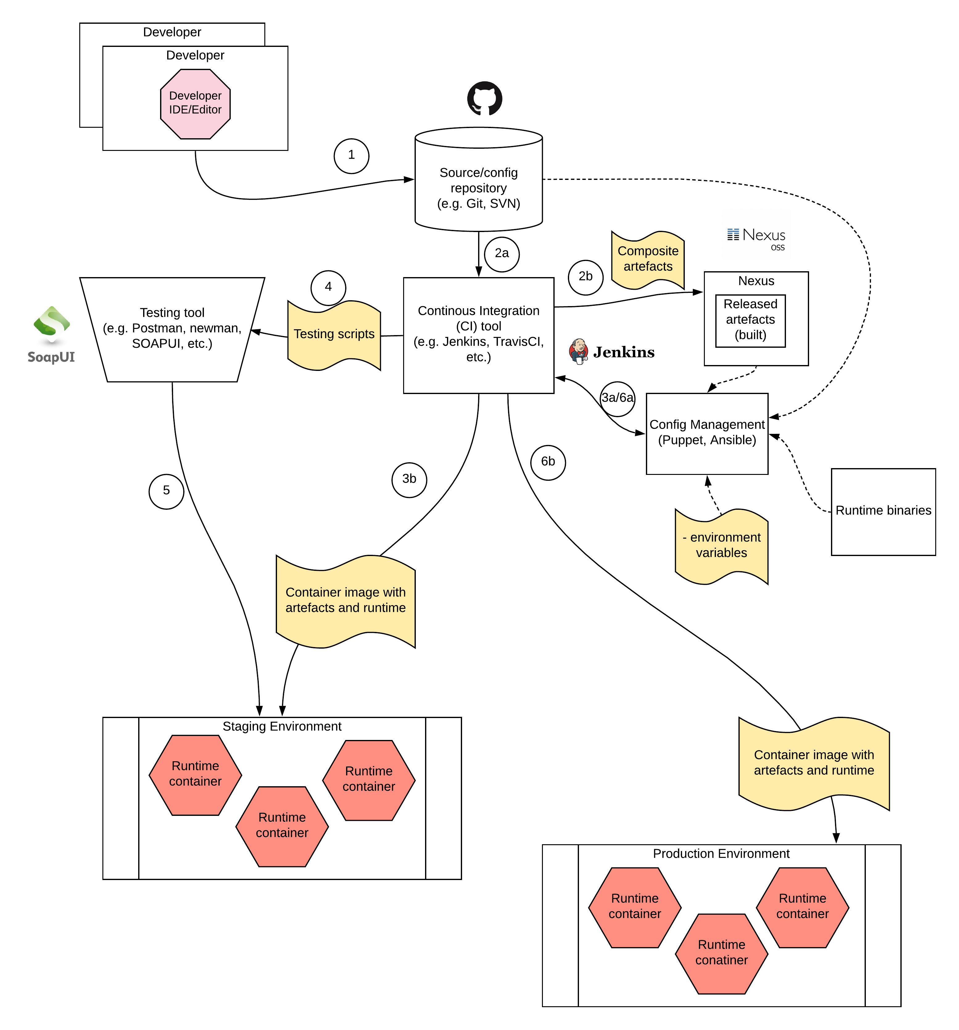
Containers in CI \CD
<< Insert Text >>>

Slide 8
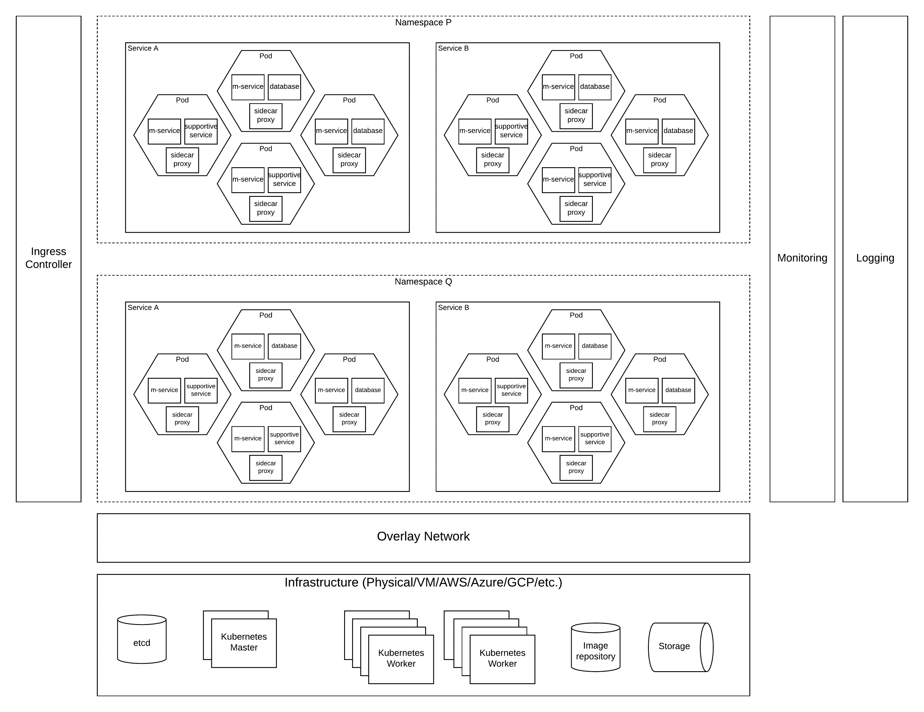
Containers Orchestration
<< Insert Text >>>

Slide 9
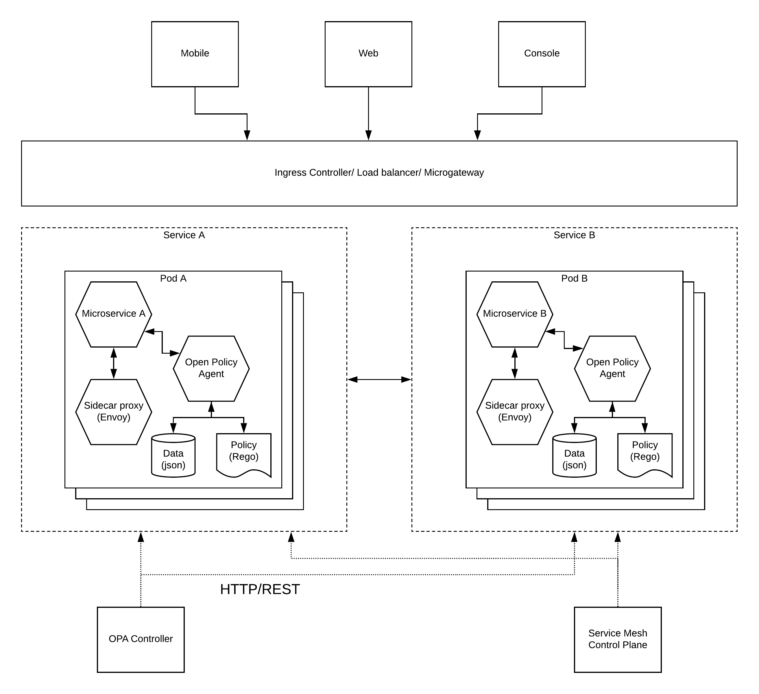
Security in Containers
<< Insert Text >>>

