Slide 1
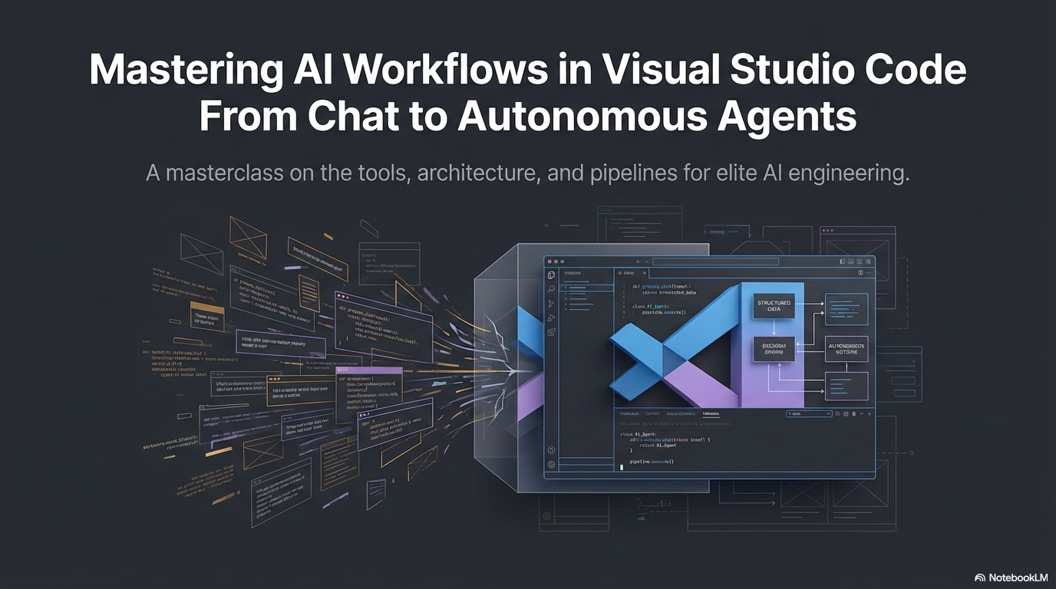

Slide 2
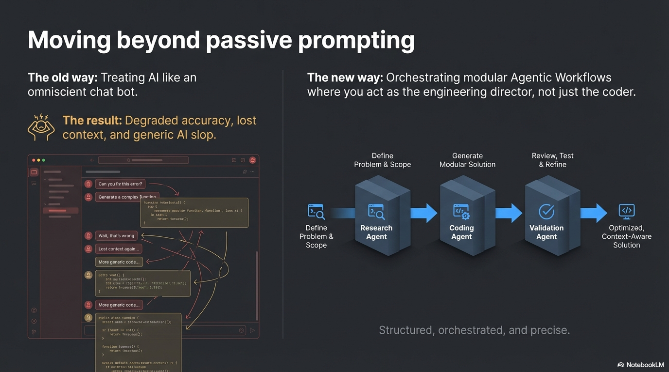

Slide 3
Executive Summary
The Problem
The Solution
Traditional AI chat degrades accuracy by
58% in long conversations
Generic, context-unaware responses
Endless iterations without improvement
High API costs with poor results
95% cost reduction
with smart workflows
Context-rot-proof architecture
Modular, step-by-step execution
You orchestrate, AI executes

Slide 4
Phase 1: The New Arsenal
Five immediate upgrades to how you interface with Copilot in VS Code
/
⚡
🌐
🔀
🔗
Agent Skills
Message Steering
Browser Integration
Forking
Hooks
Slash commands for precision
Guide mid-generation
Autonomous testing
Safe exploration
Lifecycle automation
Designed to give you granular control, autonomous execution, and built-in safeguards

Slide 5
Exercising Unprecedented Control Mid-Flight
Agent Skills
Message Steering
Use slash commands like /frontend-design to instantly apply specific guidelines to a prompt
• Keeps output tight and project-specific
• Avoids generic AI slop
• Enforces consistent standards
Add follow-up details, clarifications, or course corrections while the agent is actively working
• No need to stop generation
• Real-time feedback incorporation
• Saves iteration cycles
Example: Message Steering in Action
User: Create a React component for authentication
AI: Generating... (thinking)
User (mid-generation): Use the new React 18 hooks for this.
AI: ✓ Incorporating feedback and using useTransition...

Slide 6
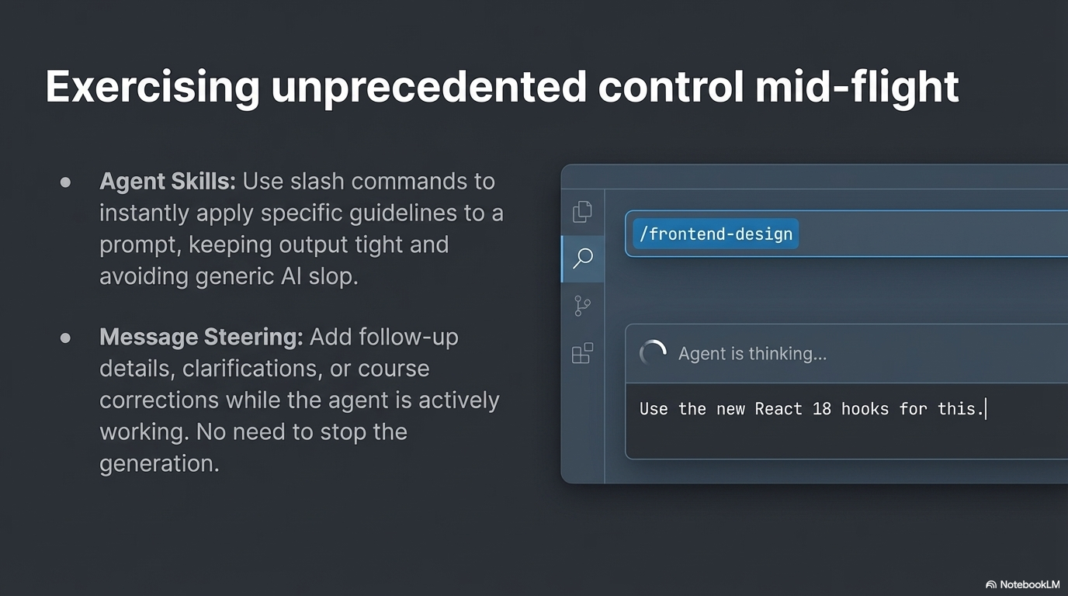

Slide 7
Autonomous Action & Safe Exploration
Integrated Browser
Forking Conversations
The agent can autonomously:
• Open web pages and navigate
• Click elements and fill forms
• Run Playwright code for testing
• Verify its own UI changes
Use /fork to branch an active chat session
• Explore alternative designs
• Compare architectures side-by-side
• Never lose original context
• Fearless experimentation
💡 Use Case Example
Main conversation: Designing PostgreSQL schema for e-commerce
Fork 1: Explore MongoDB alternative without losing SQL discussion
Fork 2: Test GraphQL API vs REST while keeping both database explorations
Result: Compare all approaches, pick the best, continue from that point

Slide 8
Baking Automations into Agent Lifecycles
Hook Support
Example: Auto-Commit Hook
Execute custom shell commands at key lifecycle points:
on_start - When agent session begins
on_stop - When agent session ends
on_error - When errors occur
on_file_change - When files are modified
{
"name": "auto-commit",
"trigger": "on_stop",
"commands": [
"git add .",
"git commit -m 'Auto-save'",
"git push origin main"
]
}
✓ Never lose generated work again!

Slide 9
Phase 2: The Engine Under the Hood
To truly control the agent, you must understand exactly how it thinks
Every chat message triggers a massive compilation of data
before it ever reaches the model

Slide 10
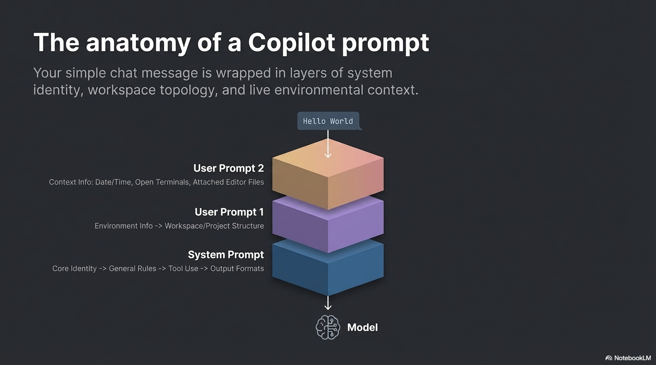

Slide 11
The Anatomy of a Copilot Prompt
Your simple message is wrapped in layers of system identity, workspace topology, and live context
System Prompt (Layer 1)
Core Identity → General Rules → Tool Use → Output Formats
User Prompt 1 (Layer 2)
Environment Info → Workspace/Project Structure → Dependencies → File Tree
User Prompt 2 (Layer 3)
Context Info: Date/Time → Open Terminals → Attached Files → YOUR MESSAGE
Understanding these layers helps you craft better prompts and target customizations precisely

Slide 12
The Silent Killer: Context Rot
As context window grows, model performance degrades rapidly
88%
30 %
Accuracy with
short conversations
Accuracy at
32,000 tokens
Why This Happens:
• Earlier context gets 'diluted' by new information
• Model struggles to maintain coherence across long history
• Important details from early messages are forgotten
• The AI focuses more on recent messages, ignoring earlier context
SOLUTION: Clear context intentionally between phases

Slide 13
Phase 3: The Building Blocks
Three components that inject specific data into exact locations within the prompt architecture
📦
Custom Instructions
Project-level context (NextJS, TypeScript best practices)
Sets global standards for all conversations
End of System Prompt
📄
Prompt Files
Reusable templates with model switching
Auto-switch to Opus for complex tasks
Top of User Prompt
🤖
Custom Agents
Complete behavior override with specialized roles
Build Plan Mode, Implementation Mode, etc.
End of System Prompt
⚠️ These are NOT interchangeable—each targets a specific injection point

Slide 14
Phase 4: The Master Agentic Workflow
Combining Prompt Files, Custom Agents, and exact model selection
to build a context-rot-proof pipeline
The Strategy: One-shot complex logic with large models,
execute with fast models, clear context between every step
1
Plan
2
Generate
3
Implement
→
→
Large Model
(Opus 4.5)
Large Model
(Opus 4.5)
Fast Model
(GPT-4o-mini)
Analyze codebase
Create PR plan
Read plan
Generate code
(Markdown only)
Read checklist
Write files
Review & commit
🗑️
🗑️
🗑️
Clear Context
Clear Context
Clear Context

Slide 15
The 3-Step Assembly Line (Detailed)
Step 1: Plan
Step 2: Generate
Step 3: Implement
• Use Prompt File + Large Model (Opus)
• Analyze codebase comprehensively
• Create high-level step-by-step plan
• [Clear Context]
• Use Prompt File + Large Model
• Read plan from Step 1
• Generate ALL code in Markdown
• NOT in project files yet
• [Clear Context]
• Use Custom Agent + Fast Model
• Read Markdown checklist verbatim
• Write files one by one
• You review and commit each
• Fast, cheap, reliable
Why This Works
✓ Context cleared between phases prevents degradation
✓ Expensive models used ONLY for complex thinking (Steps 1-2)
✓ Cheap models used for repetitive execution (Step 3)
✓ Can save 95% on API costs for large projects
✓ Maintains high quality throughout entire workflow
✓ Developer maintains control—review before committing

Slide 16
Cost Optimization Results
Traditional Approach
3-Step Workflow
All Opus, All the Time
Right Model for Each Job
50 messages × $0.015
= $0.75 per feature
Step 1: $0.015 (Opus)
Step 2: $0.015 (Opus)
Step 3: $0.008 (40× Mini)
= $0.038 per feature
❌ Context rot at 30 messages
❌ Degraded quality
❌ High costs
✓ No context rot
✓ Consistent quality
✓ 95% cost savings
SAVINGS: $0.75 → $0.038 (95% reduction)

Slide 17
Results & Immediate Actions
Key Metrics
Immediate Action Items
95%
Cost Reduction
Using 3-Step Workflow
This Week
• Configure Agent Skills in VS Code
• Create Custom Instructions for your main project
• Try /fork command when exploring alternatives
This Month
• Build your first Prompt File
• Set up post-stop hook for auto-commit
• Implement 3-step workflow on a real feature
Success Criteria
• Measure cost savings and accuracy improvements
• Track iteration reduction
• Share results with your team
58%
Accuracy Drop Prevented
With Context Management
50-70%
Faster Development
For Complex Features

Slide 18
You Are the Orchestrator
By combining custom instructions, prompt files, and agents,
you dictate the pipeline.
Stop fighting context rot.
Start building modular, step-by-step systems.
The AI is your engineering team.
Explore the Awesome Copilot repository for community-built workflows →
Thank You

