Slide 1
MICROSOFT · OPEN-SOURCE · SKILL OPTIMIZATION
Stop hand-writing SKILL.md.
Start training it.
SkillOpt treats a skill document the way deep learning treats a model: it reads execution traces, proposes edits to the markdown, tests them on held-out tasks, and keeps only what measurably works. The model stays frozen — the instructions get smarter.
TODAY
WITH SKILLOPT
Educated guesswork
Measured iteration
The agent fails on a task
Someone opens SKILL.md and rewrites it by hand
No edit budget, no validation set, no baseline
Nobody can prove the change actually helped
Successes and failures are collected as traces
Bounded add / delete / replace edits are proposed
A candidate is accepted only if it beats a held-out score
Rejected edits are buffered and reused next cycle
Best or tied-best in all 52 model x benchmark x harness cells — +23.5 points on GPT-5.5 in direct chat, +19.1 inside Claude Code.
Notes:
Framing slide. Today, improving a skill file is trial and error: an agent fails, someone rewrites the markdown, and no one knows whether the edit helped. SkillOpt borrows the discipline of model training and applies it to the text file instead — traces in, proposed edits out, validated before they are accepted. Key point for our audience: the model is never retrained, so this is cheap, auditable and reversible.

Slide 2
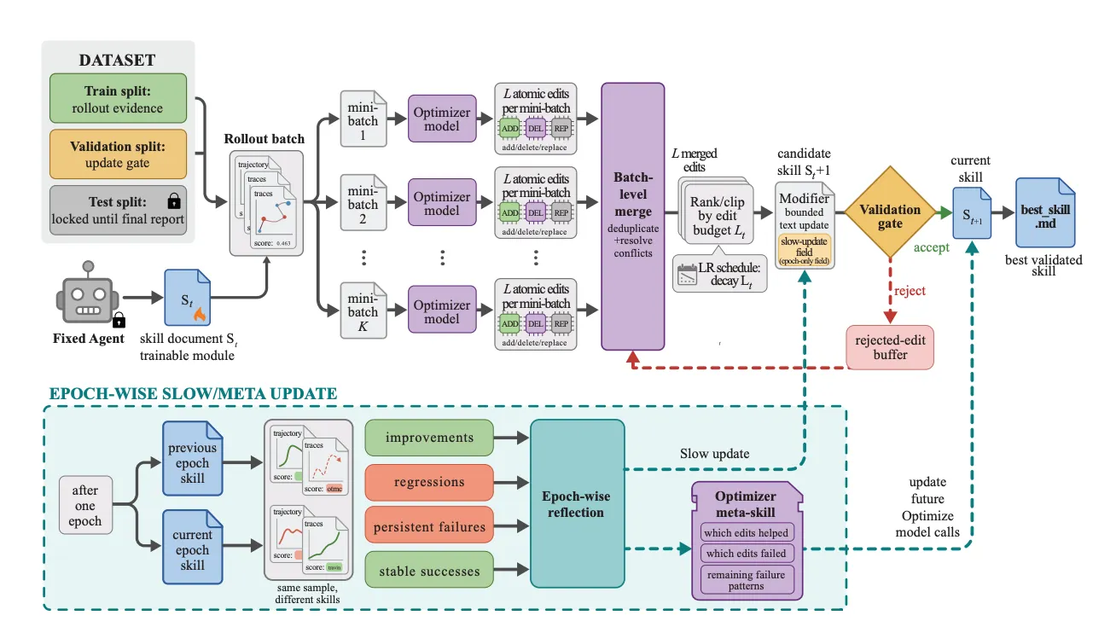
Inside the loop that rewrites SKILL.md
Our Copilot app's SKILL.md becomes the trainable module: the agent and the model stay frozen, the file is edited, gated and versioned.
READ IT LIKE TRAINING
Traces in, edits out
Rollouts on the train split become atomic ADD / DEL / REP edits to the markdown.
Edit budget = learning rate
Merged edits are ranked and clipped to a budget that decays each epoch, so the file cannot drift.
Validation gate = val split
A candidate is accepted only if it strictly improves the held-out score; rejects are buffered.
Reflection = momentum
Each epoch distils what helped and what failed into an optimizer meta-skill.
We ship one best_skill.md
300–2,000 tokens, zero extra model calls at inference. The repo already ships Copilot backends and an integration shell.
SkillOpt training pipeline — microsoft/SkillOpt (MIT) · pip install skillopt · arXiv 2605.23904
Notes:
This is the SkillOpt pipeline applied to our Copilot skill file. Left to right: rollouts on the train split produce evidence, optimizer models propose atomic add/delete/replace edits per mini-batch, those edits are merged and clipped to an edit budget that decays like a learning rate, and the candidate file only becomes the current skill if it clears the validation gate. Rejected edits are kept in a buffer so the optimizer learns from them. The band at the bottom of the figure is the slow update: after each epoch, improvements, regressions and persistent failures are distilled into a meta-skill that guides later edits. The agent and the model are frozen throughout; the test split stays locked until the final report.

