Slide 1
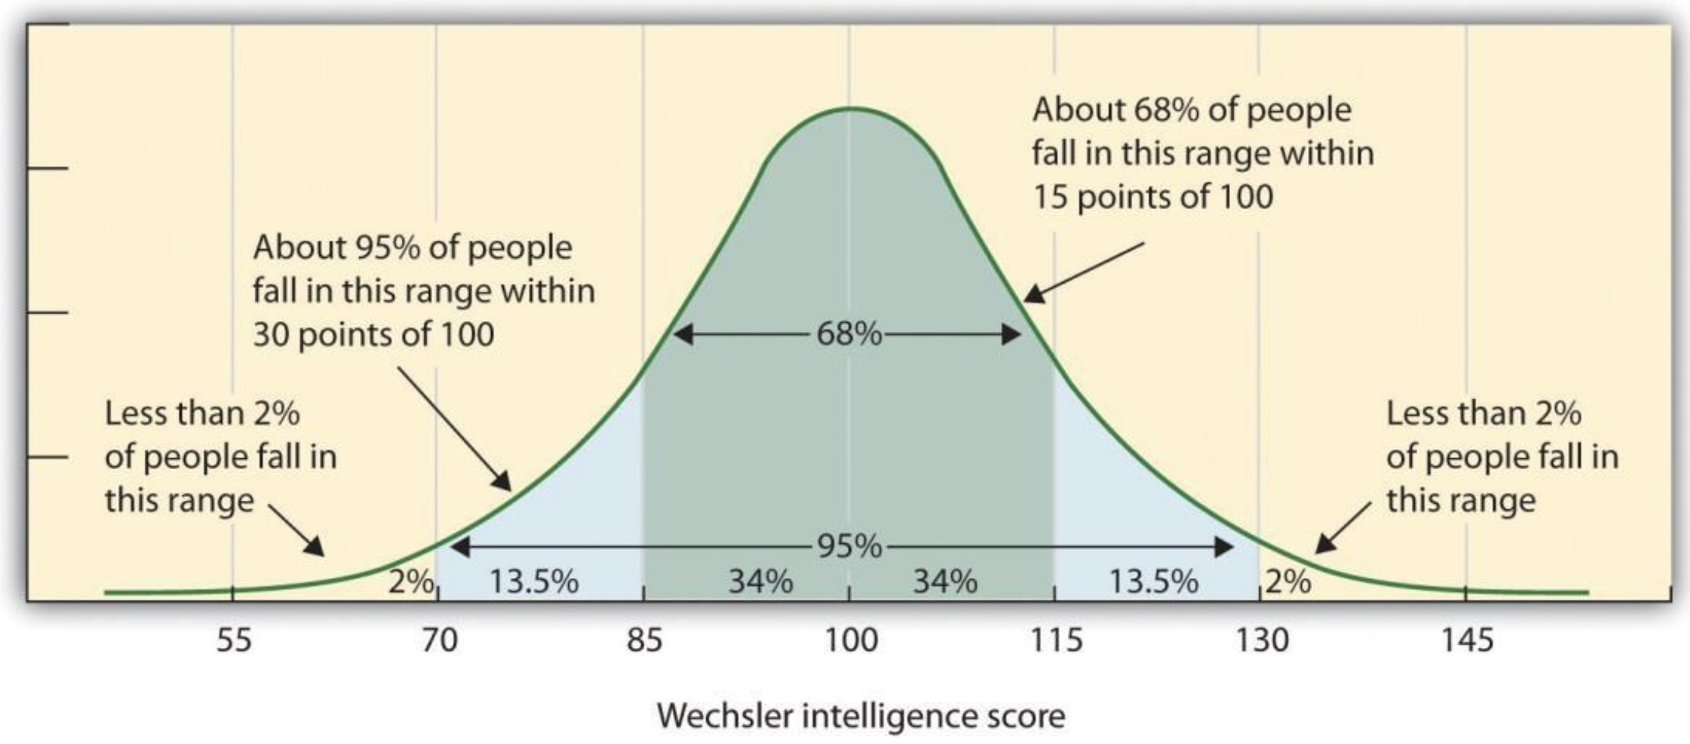

Slide 2
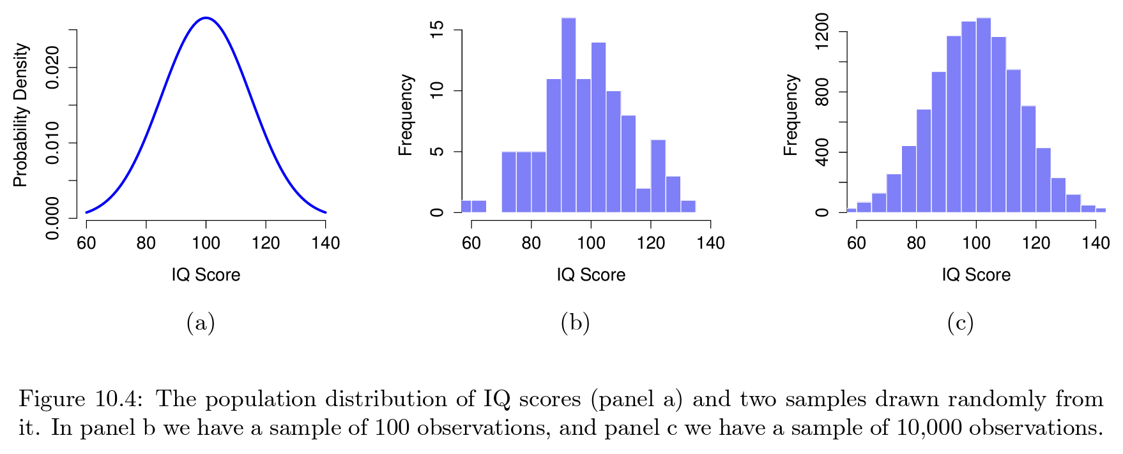

Slide 3
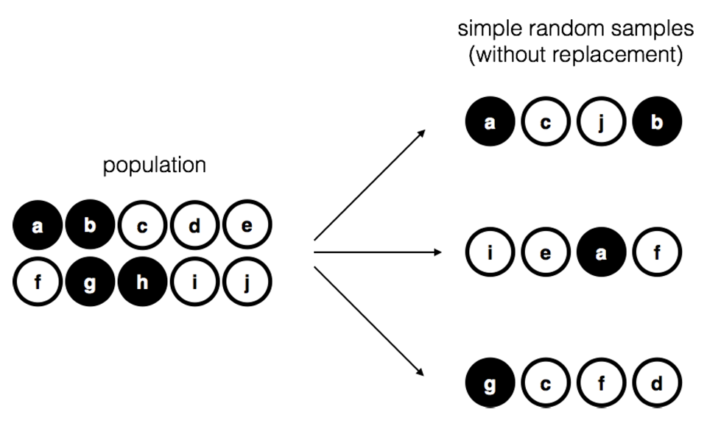

Slide 4
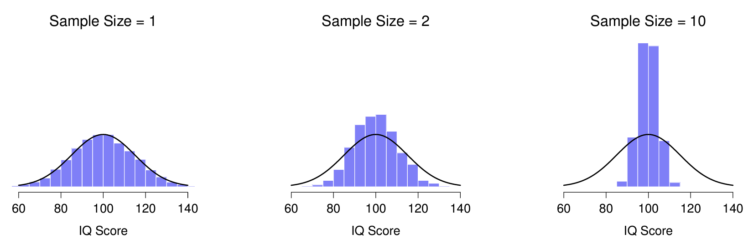

Slide 5
• The mean of the sampling distribution is the same as the mean of the population
• The standard deviation of the sampling distribution (i.e., the standard error) gets smaller as the sample size increases
• The shape of the sampling distribution becomes normal as the sample size increases

Slide 6
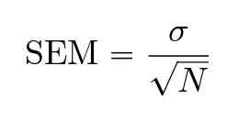

Slide 7
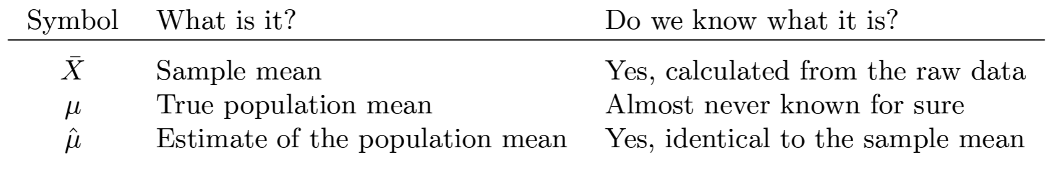
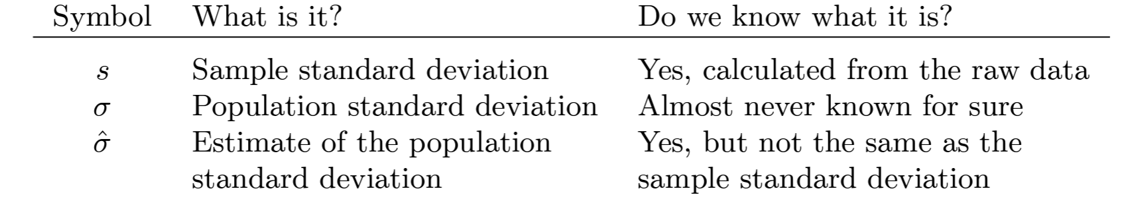

Slide 8
