Slide 1
Session 5

Slide 2
Research Question
Do individuals with Asperger's syndrome have higher intelligence?
Research Hypothesis:
Individuals with Asperger's syndrome have higher intelligence.

Slide 3
Research Hypothesis:
Individuals with Asperger's syndrome have higher intelligence.
Defining the sample we want to study.
Essence of comparison.
The other group we want to compare with.
Quantifying the measure of interest.

Slide 4
Proposed approaches
to answer the research questions?

Slide 5
Research Hypothesis:
Individuals with Asperger's syndrome have higher intelligence.

Slide 6
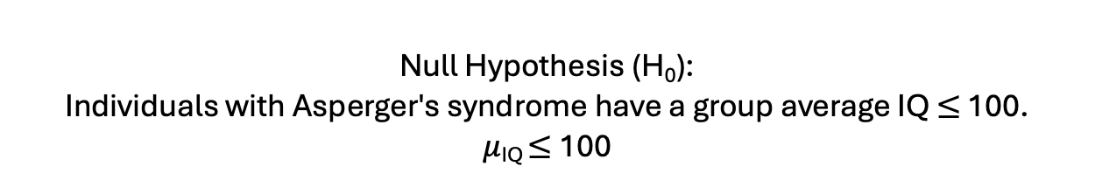
Research Hypothesis:
Individuals with Asperger's syndrome have higher intelligence.
Null Hypothesis (H₀):
Individuals with Asperger's syndrome have a group average IQ $≤$ 100.
$μ$_{IQ} $≤$ 100

Slide 7
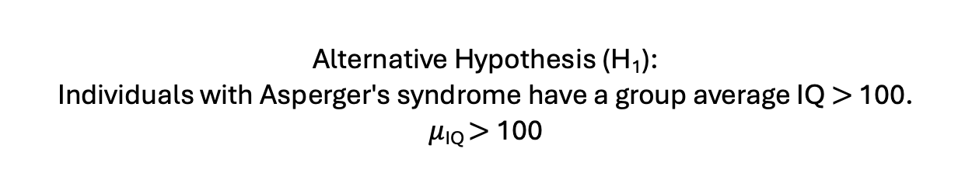
Research Hypothesis:
Individuals with Asperger's syndrome have higher intelligence.
Null Hypothesis (H₀):
Individuals with Asperger's syndrome have a group average IQ $≤$ 100.
$μ$_{IQ} $≤$ 100
Alternative Hypothesis (H₁):
Individuals with Asperger's syndrome have a group average IQ $>$ 100.
$μ$_{IQ} $>$ 100

Slide 8

H₀ $: μ$_{IQ} $≤$ 100
H₁ $: μ$_{IQ} $>$ 100
Decision Matrix |  | Test Decision
 |  | H₀ | H₁
Actual | H₀ | Correct Decision | Error (Type I)

Slide 9
H₀ $: μ$_{IQ} $≤$ 100
H₁ $: μ$_{IQ} $>$ 100
Decision Matrix |  | Test Decision
 |  | H₀ | H₁
Actual | H₀ | Correct Decision | Error (Type I)
 | H₁ | Error (Type II) | Correct Decision

Slide 10
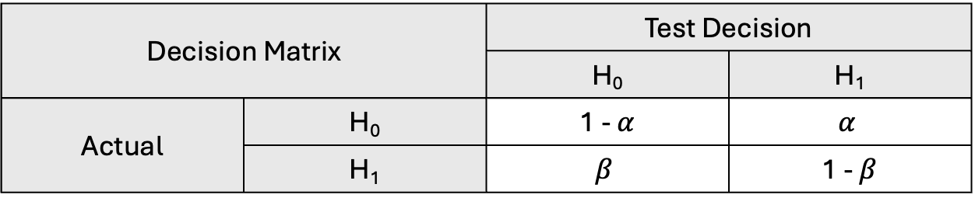
H₀ $: μ$_{IQ} $≤$ 100
H₁ $: μ$_{IQ} $>$ 100
Decision Matrix |  | Test Decision
 |  | H₀ | H₁
Actual | H₀ | Correct Decision | Error (Type I)
 | H₁ | Error (Type II) | Correct Decision
Decision Matrix |  | Test Decision
 |  | H₀ | H₁
Actual | H₀ | 1 - $α$ | $$α$$
 | H₁ | $$β$$ | 1 - $β$

Slide 11
H₀ $: μ$_{IQ} $≤$ 100
H₁ $: μ$_{IQ} $>$ 100
Decision Matrix |  | Test Decision
 |  | H₀ | H₁
Actual | H₀ | Correct Decision | Error (Type I)
 | H₁ | Error (Type II) | Correct Decision
Decision Matrix |  | Test Decision
 |  | H₀ | H₁
Actual | H₀ | 1 - $α$ | $$α$$
 | H₁ | $$β$$ | 1 - $β$
Significance level ($α$): Risk of rejecting the null hypothesis when it's actually true.
Power (1 - $β$): Probability of detecting true effect when alternative is actually true.

Slide 12
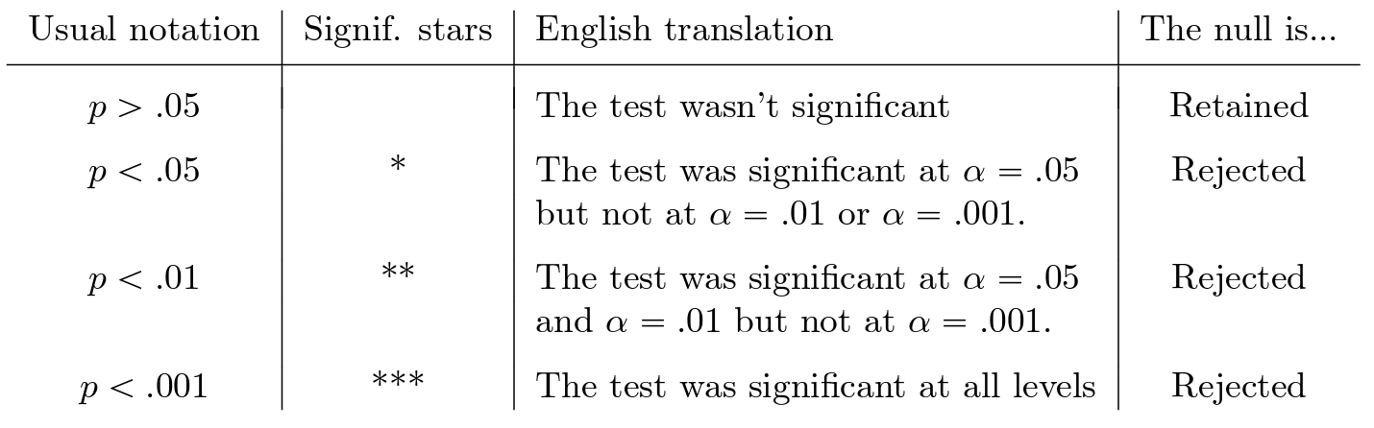

Slide 13
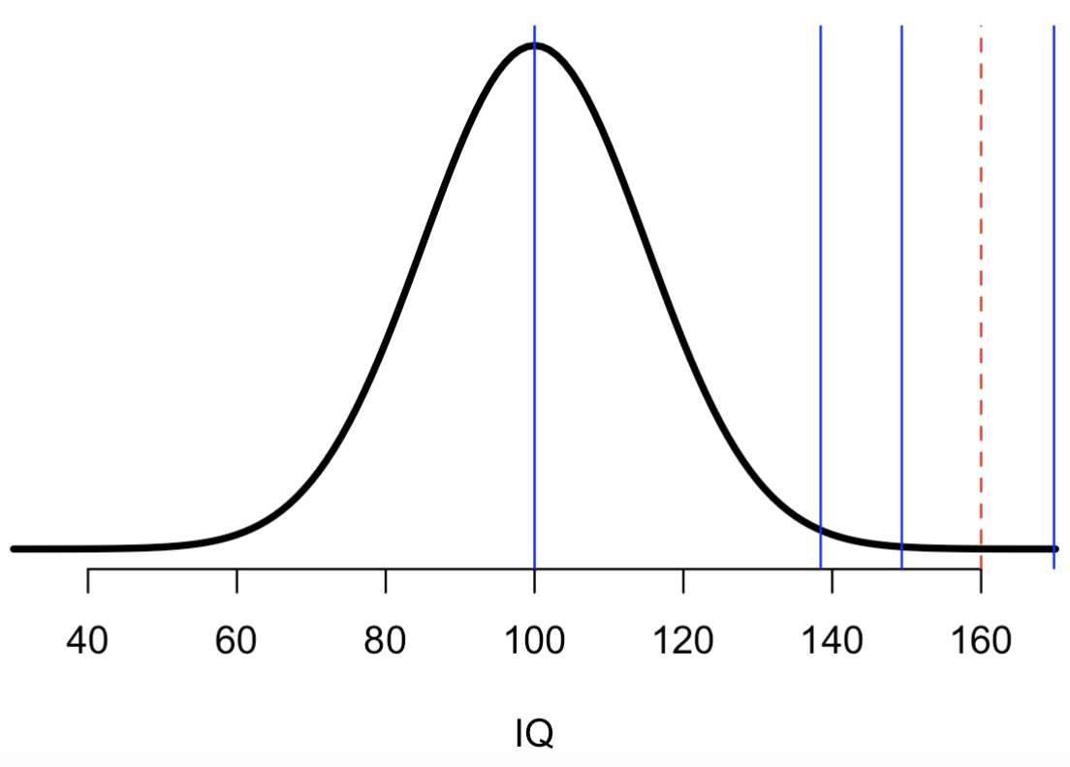
50%
95%
99%
99.9%

Slide 14
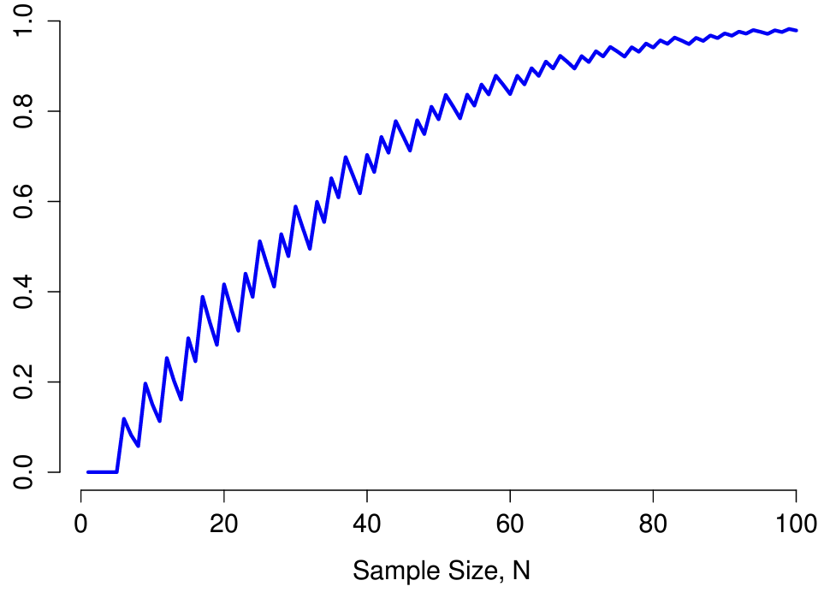

Power (1 - $β$)

Slide 15
Effect size
is a quantitative measure of the experimental effect's magnitude directly impacting the test's power.

Slide 16
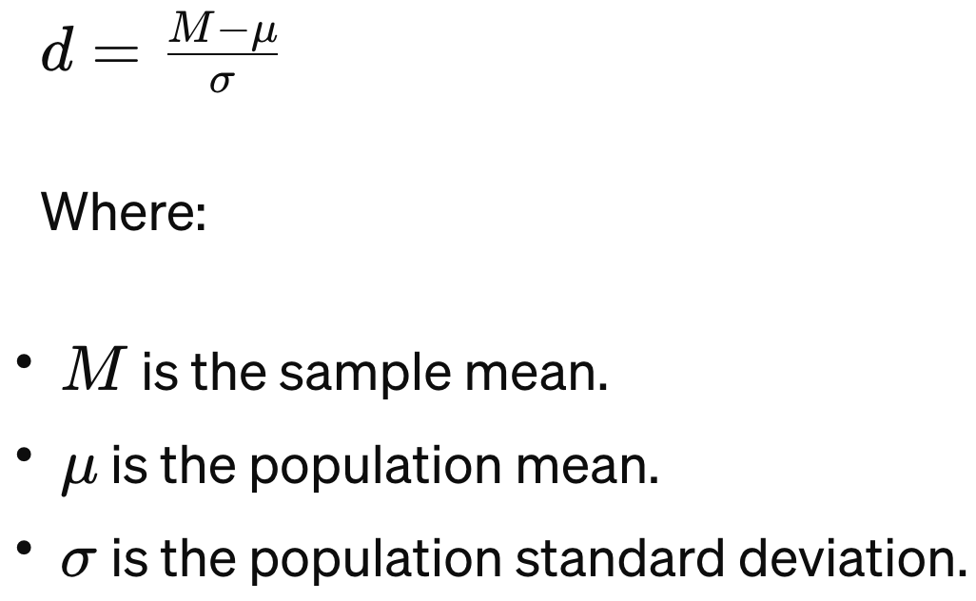
Effect size
is a quantitative measure of the experimental effect's magnitude directly impacting the test's power.
Cohen’s d
standardized effect size for measuring the difference
between a single sample and population means
Small effect size: d = 0.2
Medium effect size: d = 0.5
Large effect size: d = 0.8

Slide 17
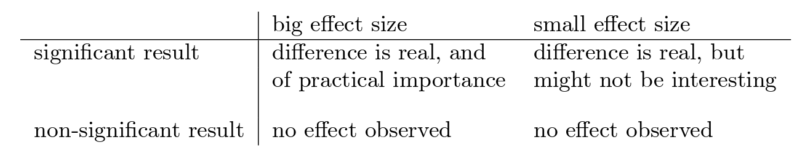

Slide 18
