Slide 1
Session 6

Slide 2
Comparison of Central Tendencies

Slide 3
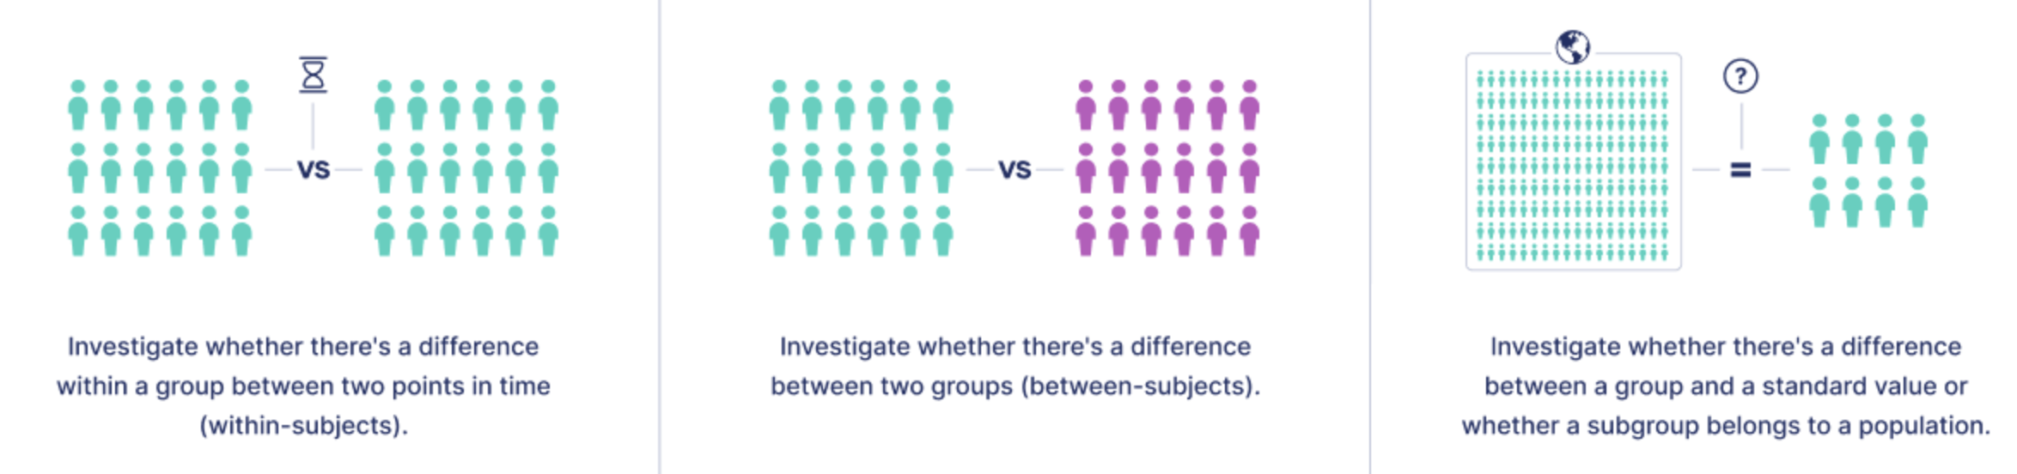
Comparison of Central Tendencies
Two sample dependent test (paired test)
Two sample independent test (unpaired test)
One sample test

Slide 4
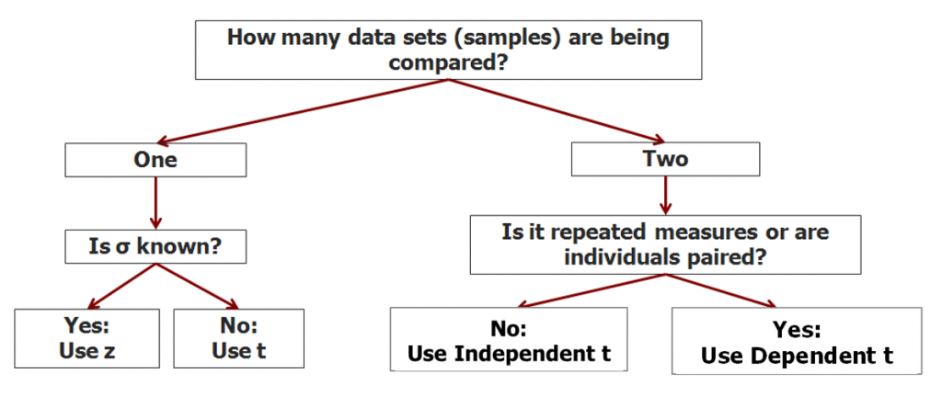
Comparison of Central Tendencies
Two sample dependent test (paired test)
Two sample independent test (unpaired test)
One sample test

Slide 5
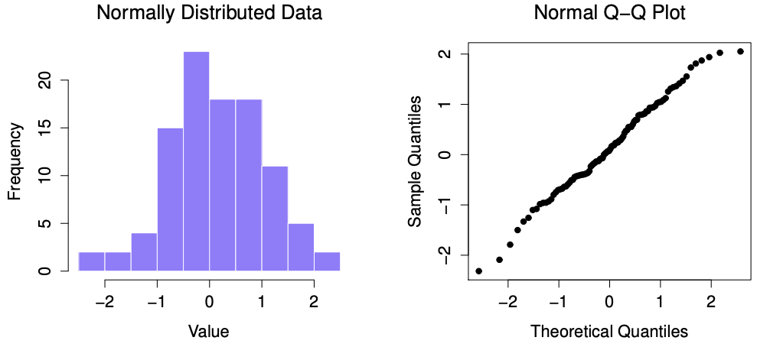
Normality Check

Slide 6
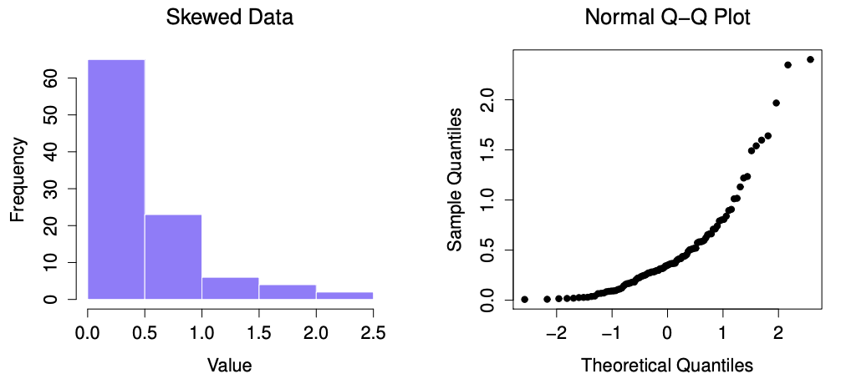
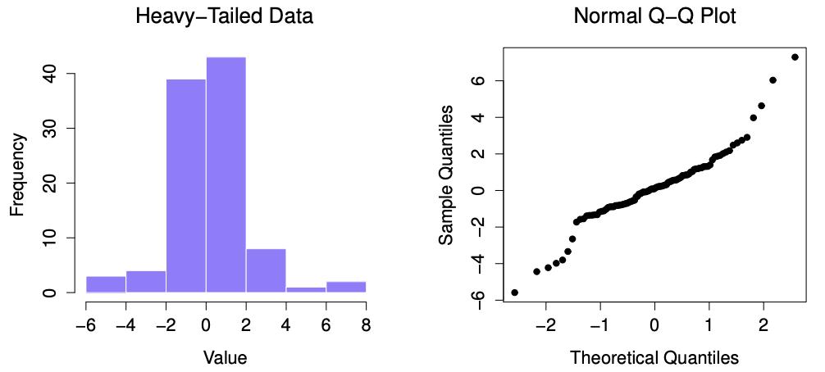
Normality Check

Slide 7
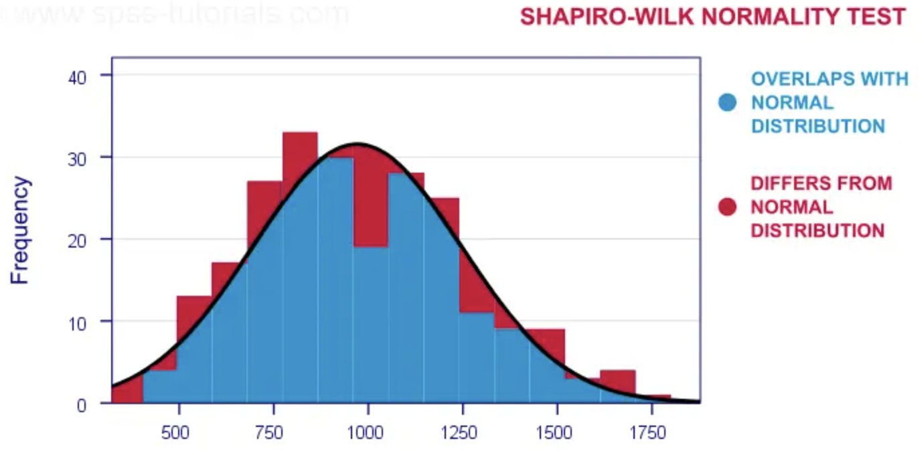
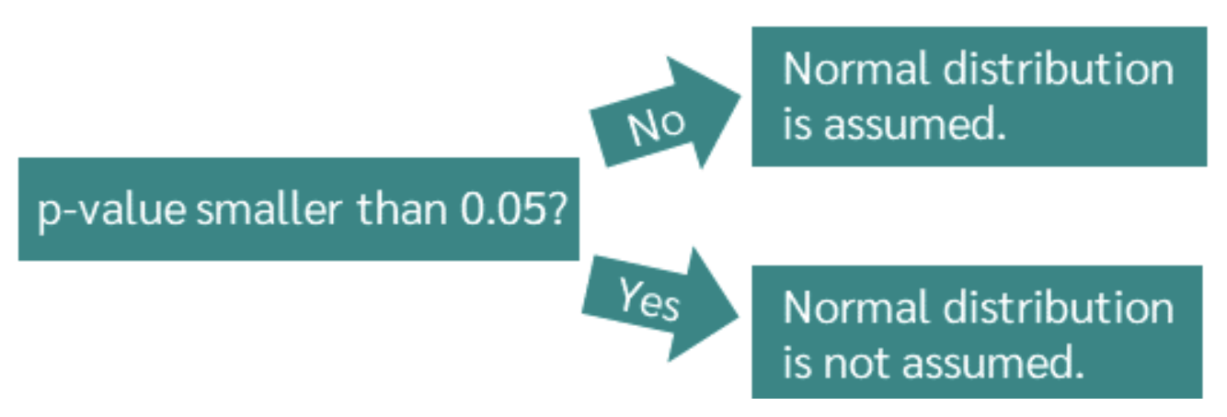
Normality Check

Slide 8
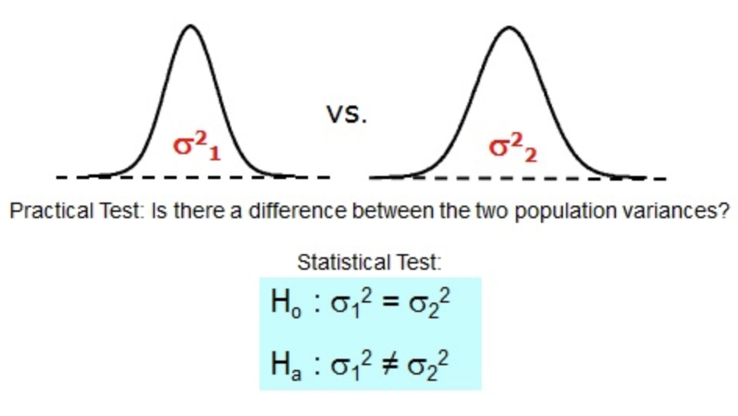
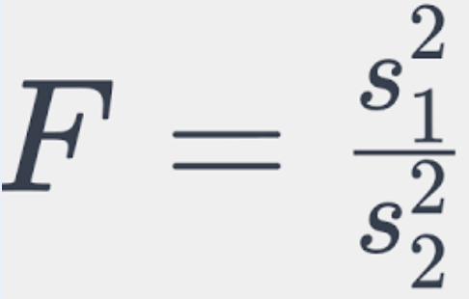
Variance Equality Check

Slide 9
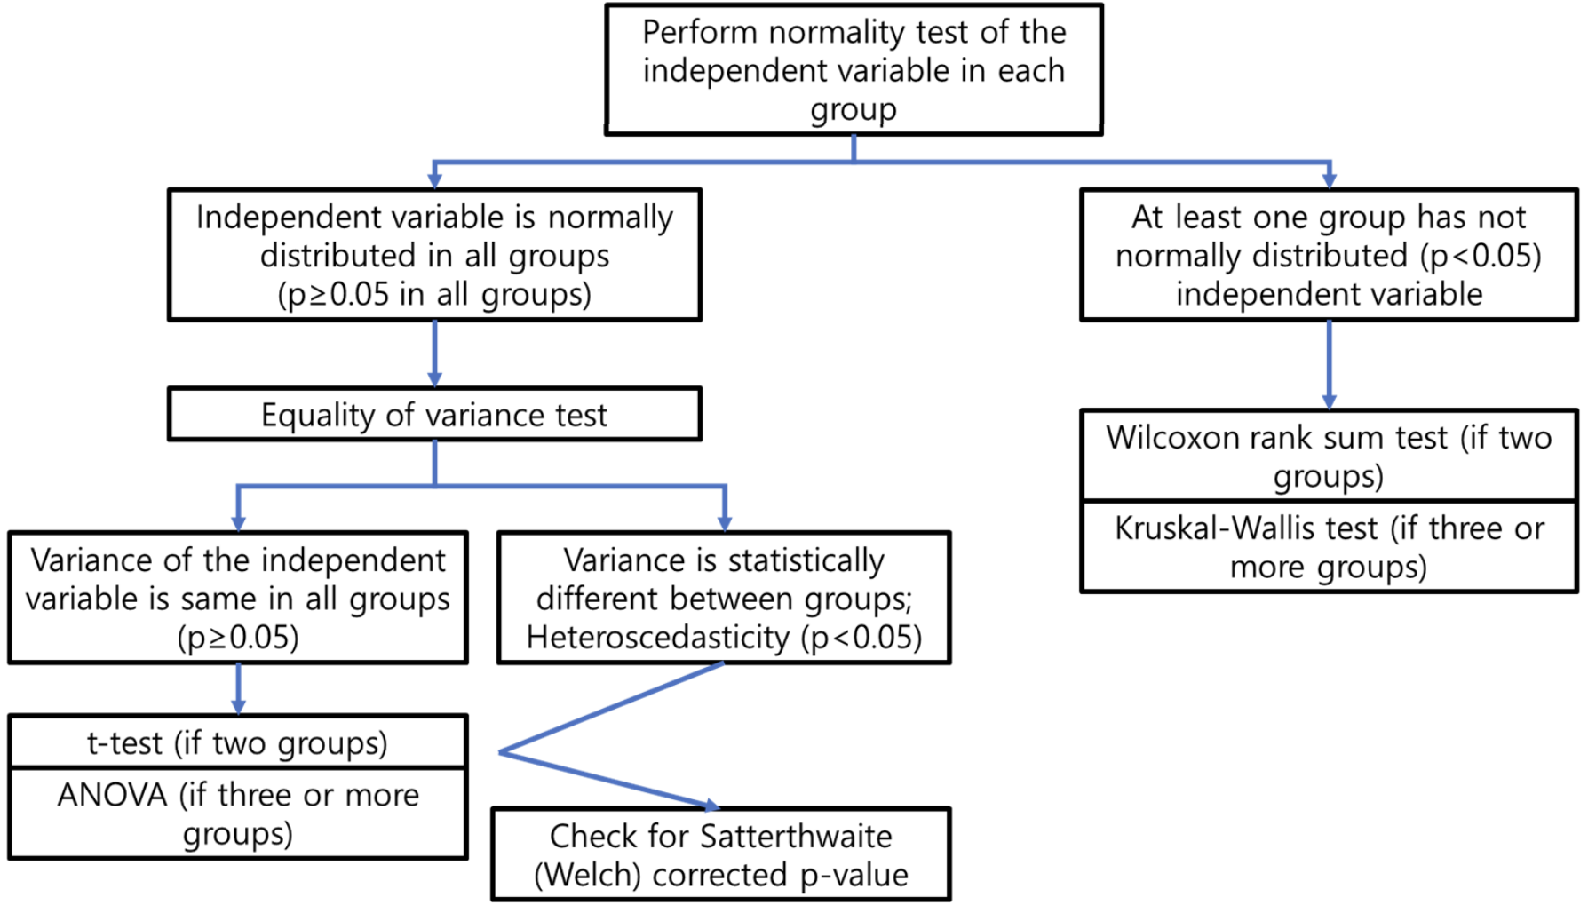
Decision Chart

Slide 10
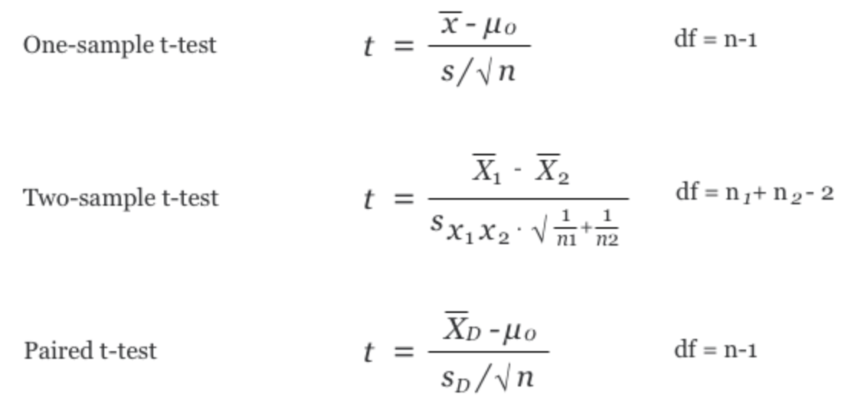
Central Tendency Testing
Parametric tests

Slide 11
Central Tendency Testing
Parametric tests
Non-parametric tests
Wilcoxon signed rank test
Wilcoxon rank sum test (Mann–Whitney U test) Wilcoxon signed rank test

