Slide 1
OORPC (Object Oriented Remote Procedure Call)
-- Yet another RPC framework from Jeff Max

Slide 2
Features
Native like, synchronous remote method invocation.
Light-weighted, clean and easy to use.
Normal C++ syntax for service definition.
1. Supports all c++ native data type and user defined data type.
2. Reference and pointer support.
3. Polymorphism for method parameter and return type.
Type safe.
As the framework is based on c++ template, all type mismatch will be raised at compilation time.
TCP/IP as underlying transportation protocol.
Full conformance to ISO c++ standard.
Unicode support.

Slide 3
Supported compiler
Visual Studio 6 + Intel c++ compiler 9.0
GCC 3.3.1
Visual Studio 2005 c++

Slide 4
Quick Start
Service Definition
// Define parameter type:
Class TestArg
{
  public:
  virtual void Serialize(CPstream & strm) { }
  public:
  virtual void doSomething() {};
  …
  DECLARE_SERIAL(TestArg)
  };
  IMPLEMENT_SERIAL(TestArg)
  // A polymorphism implementation of TestArg:
  Class TestArgImpl : public TestArg
  {
  public:
  virtual void Serialize(CPstream& strm) { …}
  virtual void doSomething () {
  … // Do something action instead dummy.
  }
  …
  DECLARE_SERIAL(TestArgImpl)
  }
  IMPLEMENT_SERIAL(TestArgImpl)
// Define service interface:
Class TestService
{
Public:
TestArg & echo(TestArg * arg, int version) = 0;
void echo1 (double & dd) = 0;
};
// Expose service methods:
BEGIN_DEFINE_SERVICE(TestService)
EXPOSE_METHOD(TestService, echo)
EXPOSE_METHOD(TestService, echo1)
END_DEFINE_SERVICE

Slide 5
2. Client code:
SocketTransportImpl trans;
Proxy<TestInterface> proxy(trans);
// connect to the service server.
trans.connect(“10.193.91.30:999”);
// Invoke method echo(…) againest the service.
TestArgImpl inputArg;
TestArg & retArg = proxy.invoke(&TestService::echo)( &inputArg, 99);
// Free the returned obj. It’s allocated by the framework.
delete & retArg;
// invoke method echo1(…) againest the service.
double dd = 99.99;
proxy.invoke(&TestService::echo1)( dd);

Slide 6
3. Server code
// Implement the service interface:
class TestServiceImpl: public TestService
{
Public:
TestArg & echo(TestArg * arg, int version)
{
arg->dosomething();
return *( new TestArg );
}
void echo1 (double & dd)
{
cout<<“ echo1 is called, input:”<< dd <<endl;
}
};
// Start server.
TestServiceImpl service;
SocketTransportImpl trans;
ServiceDriver<TestService> driver(service, trans);
driver.serve(“10.193.91.30:999”);

Slide 7
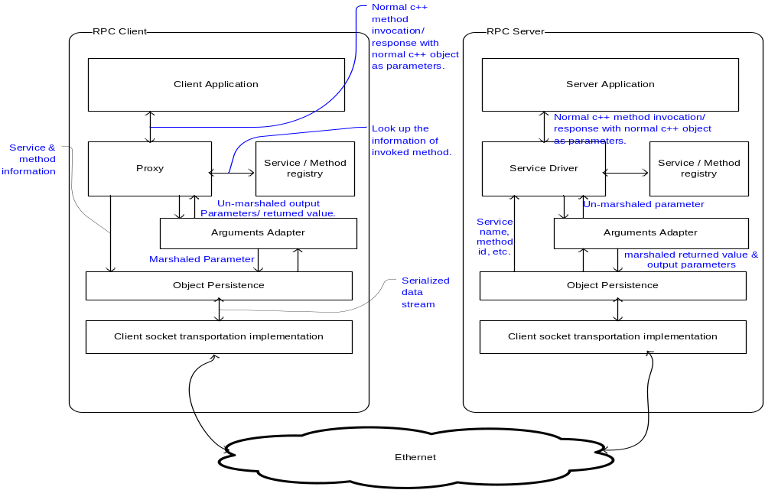
Runtime Architecture

Slide 8
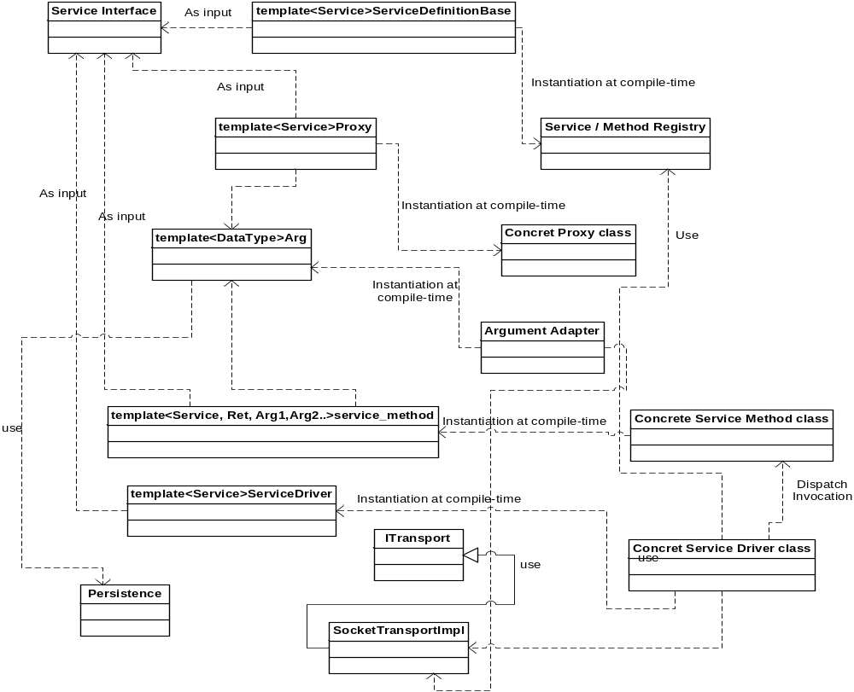
Static Architecture

Slide 9
To-Do
Encryption
Sock4/5 proxy support.
Exception handling.
Contact the author by:
jeffmax1@hotmail.com

