Slide 1
August 9, 2026 • Brandon _ India • brandon@majikl.com
Shareholder Briefing | Product Usability
Four Working Value Engines,
Seen From The User's Chair
A walk through the functional value streams of Market Intelligence as customers actually operate them: what they click, what they get, and the market evidence that each capability moves numbers a business cares about.
Production application | www.majikl.com | Screenshot placeholders ready for live captures
Notes:
Good afternoon, everyone, and thank you for your time. Over the next twenty minutes I am going to show you our product the way a customer sees it. Not an architecture diagram, and not a roadmap. The actual screens, the actual clicks, and the market evidence that each of those clicks moves a number this company is paid to move. Everything in this deck is running in production today at www.majikl.com, and every screenshot frame you will see was captured, or will be captured, from that live application.

Slide 2
Introduction
Why Usability Is What We Are Reporting
Software creates shareholder value only when customers can operate it without us in the room. This briefing therefore reports the product as a set of functional value streams: end-to-end processes a customer completes on screen, each ending in a work product that moves a KPI. The language and stream numbering come directly from our value stream analysis, so what you hear today reconciles line by line with that document.
1
2
3
What You Will See
How To Judge It
Where The Numbers Come From
Live screens with the exact clicks a customer performs, one screenshot frame per capability.
Each section opens with the business question it answers; each slide names the value streams at work.
Market metrics are third-party research, cited on the slide where they appear, never our own estimates.
One ask as we go: judge every capability by the question at the top of its section. If the screen does not answer the question, say so.
Market Intelligence | Shareholder Briefing
Introduction
2
Notes:
Let me set the frame for how to watch this. Software creates shareholder value only when customers can operate it without us in the room, so today I am not reporting features. I am reporting value streams: end-to-end processes a customer completes on screen, each one ending in a work product that moves a KPI. The language and the stream numbers you will hear come straight from our value stream analysis, so everything reconciles with the document you already have. Three ground rules. First, everything is a live screen. Second, every section opens with the business question it exists to answer. Third, every market number on these slides is third-party research, cited where it appears. And one ask: as each screen comes up, judge it against the question at the top of the section. If the screen does not answer the question, I want to hear that today, not next quarter.

Slide 3
Contents
Table Of Contents
Introduction
Why usability is what we are reporting
2
The Frame
Four sections, seven value domains, one question each
4
Section 1 | Automated Content Production, Research
The content engine, the post lifecycle
5
Section 2 | Visual Content
A design team in a side panel
7
Section 3 | Analytics, Advocacy Amplification
Honest numbers, then the reach multiplier
8
Section 4 | Capacity, Cost, Continuity
Scale the output, cap the spend
10
The Takeaway
Usability is the investment thesis
11
Market Intelligence | Shareholder Briefing
Contents
3
Notes:
Here is our route, and I will keep us to time. Two minutes of framing, then four sections. Section one is the heart of the product: how content gets produced and researched without a writing staff. Section two is visual content, the cheapest engagement lever we ship. Section three is measurement and then advocacy, which is where reach multiplies. Section four is the business controls: capacity, cost, and continuity. We finish with the takeaway slide, which you can lift directly into the board pack. Feel free to interrupt anywhere; the deck is built to absorb questions at every stop.

Slide 4
The Frame
Four Sections, Seven Value Domains, One Question Each
Automated Content Production + Research, Market Awareness
1
Domains A, D
How do we publish credible content constantly without a writing staff, and know what to say first?
Visual Content
2
Domains B
How do we raise engagement per post without a design team?
Organization Analytics + Advocacy Amplification
3
Domains E, F
How do we know what worked, then multiply reach through our own people?
Capacity, Cost, Continuity
4
Domains G
How do we scale output while controlling spend and risk?
Language and stream IDs follow the company's value stream analysis; every section shows the live screen a customer uses.
Market Intelligence | Shareholder Briefing
The Frame
4
Notes:
One slide of structure before the screens. The product's value streams group into seven domains, A through G, and this briefing walks them in four sections. Each section is defined by the question on this slide, and I will read that question aloud as we enter each one, because it is the test the screens have to pass. Section one covers two domains at once, content production and research, because in this product they are one motion: the research is why the content is credible. Section three pairs analytics with advocacy for the same reason: you amplify what you have measured. Hold this map; everything from here is a live screen.

Slide 5
Section 1
Automated Content Production | Research, Market Awareness
The Content Engine Starts With A Topic, Not A Writer
A customer types a topic they want to own. The platform proposes ten content angles, discovers the industry feeds worth trusting (each validated and graded before acceptance), and begins reading the market on a schedule. No writing staff was hired in the making of this pipeline.
Usability On Screen
[ ]
Create a topic in one form; accept AI-proposed angles (D1)
Insert Screenshot
One click discovers feeds; each arrives graded before joining (D2)
www.majikl.com/app/topics
Articles populate the research monitor; refresh on demand (D4)
The radar runs while the customer sleeps (A1)
2x
Businesses posting weekly on LinkedIn see twice the engagement of inconsistent publishers. Consistency is exactly what automation guarantees.
Source: LinkedIn data via Cognism, 2026
Value Streams: D1, D2, D4, A1 | Domains A, D
Market Intelligence | Shareholder Briefing
Section 1: The Engine
5
Notes:
Section one, and I will read its question: how do we publish credible content constantly without a writing staff, and know what to say first? It starts here, with the screen a customer sees on day one. They type a topic they want to own. The platform immediately proposes ten content angles. One more click and it discovers the industry feeds worth trusting, and here is the detail I want you to hold: every feed is validated and graded before the customer accepts it. Bad sources never get in, so bad drafts never come out. From that moment the research monitor fills on its own schedule and refreshes on demand. The market stat on the right is why this matters commercially: businesses that post weekly on LinkedIn see twice the engagement of inconsistent publishers, and consistency is precisely what an always-on engine guarantees. No writer was hired on this slide.

Slide 6
Section 1
Automated Content Production | Research, Market Awareness
From Research To A Post
Every draft is born researched: sources read live, claims corroborated across independent outlets, verified figures inserted mechanically so the AI never types a number. The customer reviews a queue, edits or one-click rewrites, and approves. Nothing publishes without that click.
Usability On Screen
[ ]
Generate on demand or let the twice-daily cycle draft (A1, A2)
Insert Screenshot
Every draft carries a named primary source, or it does not exist (A4)
www.majikl.com/app
Review, edit, rewrite, approve; schedule to the minute (A5, C2)
One pipeline posts to the company page or a personal profile (C3)
Value Streams: A1 To A5, C2, C3 | Domains A, D
84%
Of B2B marketers say LinkedIn delivers their best platform value. This engine feeds that channel a defensible post at a time.
Source: Cognism LinkedIn Statistics, 2026
Market Intelligence | Shareholder Briefing
Section 1: The Lifecycle
6
Notes:
This is the other half of section one: what happens between research and a published post. Every draft is born already researched. Sources are read live, claims are corroborated across independent outlets, and verified figures are inserted mechanically, which means the AI never types a number itself. If no credible source can be attached, the draft simply does not exist; the system refuses rather than invents. The customer's experience is a review queue: edit, one-click rewrite, approve, or schedule to the minute. Nothing publishes without that human click, and the same pipeline serves the company page and personal executive profiles. Eighty-four percent of B2B marketers call LinkedIn their best-value platform; this lifecycle is how we feed that channel one defensible post at a time.

Slide 7
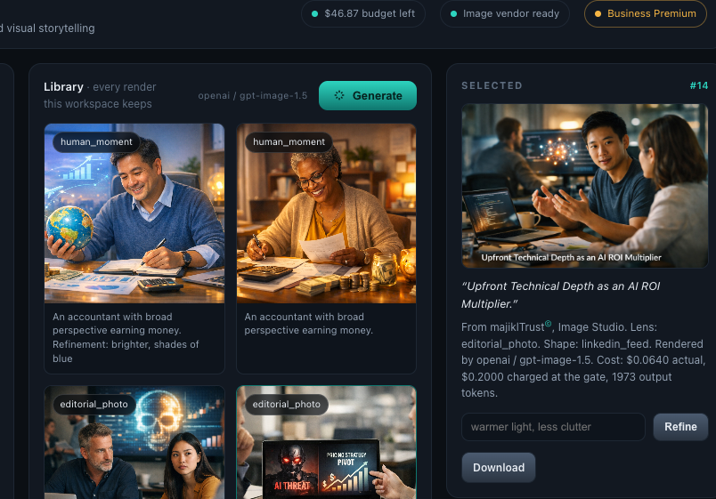
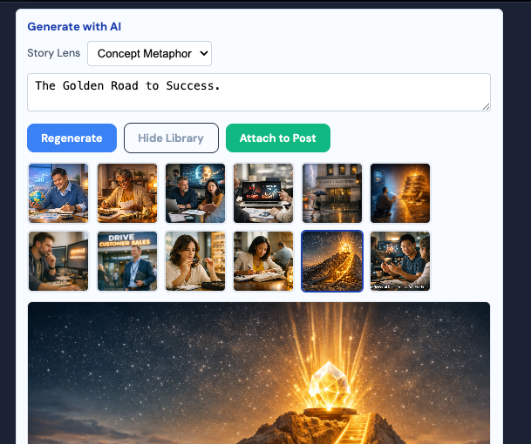
Section 2
Visual Content
A Design Team In A Side Panel
Inside the post editor, the customer opens a gallery: free images harvested from the source articles, plus an AI studio that paints from the post's own research in the company palette, within a hard dollar budget. Attaching the right image is one click, and it is the single cheapest engagement lever we ship.
Usability On Screen
[ ]
Open the gallery; article imagery is already waiting (B3)
Insert Screenshot
Generate a custom image from the post's brief, on palette (B1)
www.majikl.com/app (Image Picker)
Refine in plain words; reuse from the library (B2)
Every render prices itself against the owner's budget cap
Value Streams: B1, B2, B3 | Domain B
+98%
More comments on LinkedIn posts that carry an image versus none. Video earns 5x static engagement; imagery is the floor, not the ceiling.
Source: LinkedIn data via Cognism, 2026
Market Intelligence | Shareholder Briefing
Section 2: Visual Content
7
Notes:
Section two: how do we raise engagement per post without a design team? The answer lives inside the post editor. When a customer opens the image gallery, free imagery harvested from the source articles is already waiting, cost zero. One tab over is the studio: it paints a custom image from that post's own research, in the company's palette, and every render prices itself against a budget the owner set. Past the cap, it refuses; there is no surprise invoice. The number on the right is the whole argument: posts with images earn ninety-eight percent more comments on LinkedIn, and video earns five times static engagement, so imagery is the floor, not the ceiling. This is the cheapest engagement lever we ship, and it is one click wide.

Slide 8
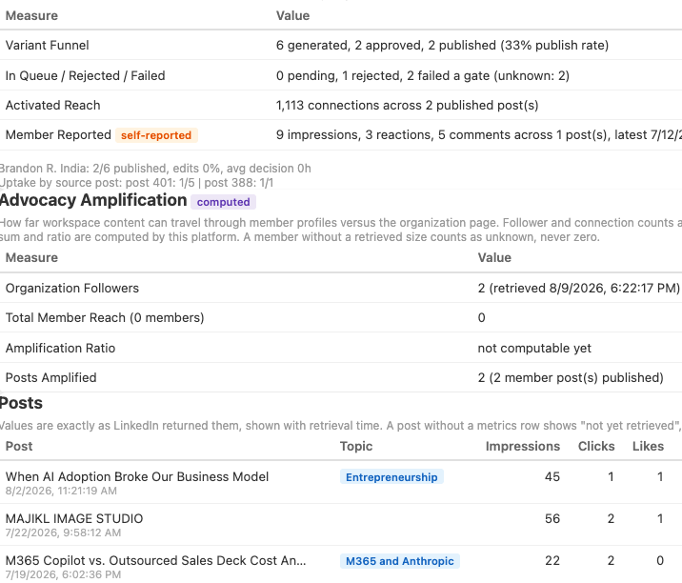
Section 3
Organization Analytics | Advocacy Amplification
Numbers To Repeat Out Loud
The analytics page syncs real LinkedIn results: per-post metrics, topic rollups, a day-by-hour heatmap of when the audience actually engages, and follower demographics. A value not yet retrieved says so; nothing is dressed up as a zero. The one-click narrative cites every figure it states, or it refuses to render.
Usability On Screen
[ ]
Sync organization metrics on demand (E1)
Insert Screenshot
Read the heatmap; let it retune posting hours (E3)
www.majikl.com/app/analytics
Generate the cited executive narrative (E2)
Benchmark honestly against a 3.8% platform average
Value Streams: E1, E2, E3 | Domain E
3.8%
Average LinkedIn engagement rate. Our heatmap and topic rollups exist to beat the benchmark with evidence, not anecdotes.
Source: Cognism LinkedIn Statistics, 2026
Market Intelligence | Shareholder Briefing
Section 3: Analytics
8
Notes:
Section three opens with measurement, because you cannot multiply what you have not measured. This is the analytics page after a sync: real per-post results, topic rollups, follower demographics, and a day-by-hour heatmap of when this audience actually engages. Two things distinguish it. First, honesty: a value the platform has not retrieved says so on screen; it is never dressed up as a zero. Second, the one-click narrative: an executive summary in which every quantitative sentence carries a citation back to the data, or the narrative refuses to render at all. Fabrication is structurally impossible, which is why these numbers can be repeated in this room without a caveat. The platform average engagement rate is three point eight percent; this page exists to beat that benchmark with evidence.

Slide 9
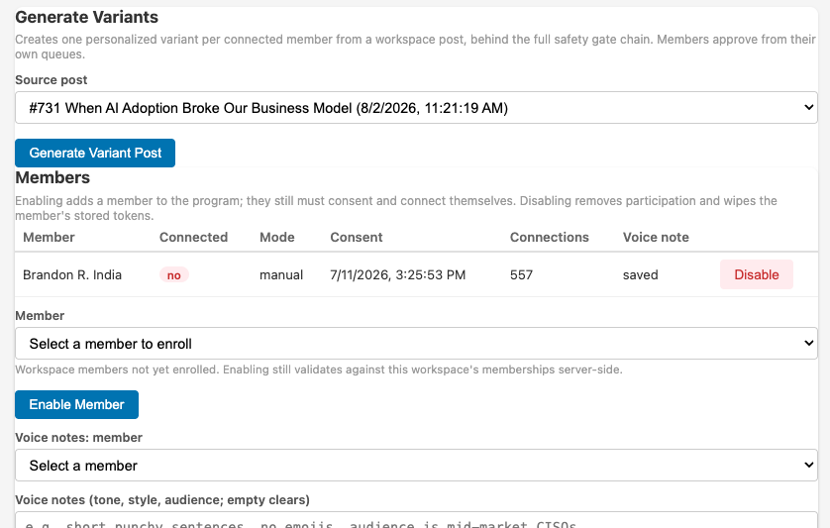
Section 3
Organization Analytics | Advocacy Amplification
The Reach Multiplier
One click fans a published company post into personal variants, one per consenting employee, written in each person's voice from notes they provided. Members approve their own; publishing uses their identity, never the brand's. The market math on this is the strongest in social.
Usability On Screen
[ ]
Select a published post; generate per-member variants (F1)
Insert Screenshot
Members approve, edit, or decline their own version (F2)
www.majikl.com/app/advocacy
Track activated reach v. page followers on one card (F3)
Consent is architectural: joining, leaving, voiding are member-owned
Value Streams: F1, F2, F3 | Domain F
8x
Engagement on employee-shared v. brand-shared content; employee networks average 10x page followers; advocacy leads convert 7x.
Source: MSLGroup; LinkedIn; IBM
Market Intelligence | Shareholder Briefing
Section 3: Advocacy
9
Notes:
Now the multiplier. A company page's reach is capped by its followers. Its people are not. On this screen, one click fans a published company post into personal variants, one per consenting employee, each written in that person's voice from notes they provided themselves. Every member approves or declines their own version, and publishing always uses their identity, never the brand's. Consent is not a checkbox here, it is the architecture: employees enroll themselves, can leave cleanly, and anything unpublished dies with their departure. The market math is the strongest in social: employee-shared content earns eight times the engagement of brand-shared content, employee networks average ten times the page's followers, and advocacy-sourced leads convert seven times more often. This is reach we do not pay for.

Slide 10
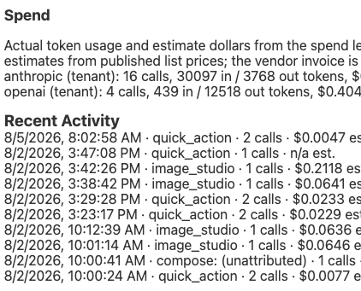
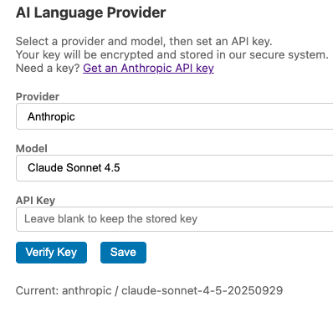
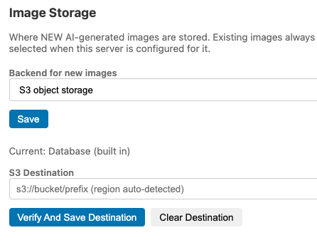
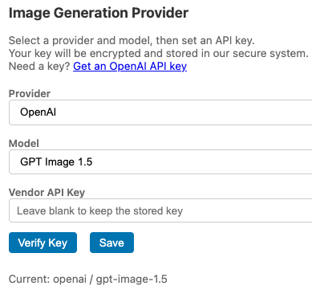
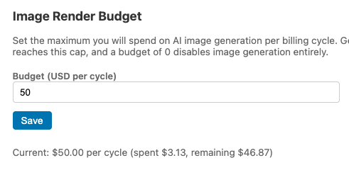
Section 4
Capacity, Cost, Continuity
Scale, Cap, and Keep The Receipts
The admin page is where an owner runs the business side in minutes: invite editors and viewers under strict roles, choose the AI vendor and validate its key before a cent flows, watch a 30-day spend ledger by provider, and trust connections that renew themselves and complain loudly when they cannot.
Usability On Screen
[ ]
Invite the team; roles enforce who drafts, approves, observes (G1)
Insert Screenshot
Bring your own AI vendor; keys validate before storage (G2)
www.majikl.com/app/admin
Read the spend ledger; image budgets refuse past their cap (G3)
Publishing tokens self-renew; failures surface, never silent (G4)
Value Streams: G1 To G4 | Domain G
63%
Higher engagement on personal profiles (2.60%) v. company pages (1.74%): the dual-audience pipeline this platform governs at zero added headcount.
Source: Metricool LinkedIn Study, 2026
Market Intelligence | Shareholder Briefing
Section 4: The Business Side
10
Notes:
Section four: how do we scale output while controlling spend and risk? This is the admin page, and I want you to notice it is one page. Team scaling is invitations under strict roles: editors produce, viewers observe, owners govern, and nobody can exceed their role. The AI relationship belongs to the customer: they choose the vendor, and a key is validated against that vendor before it is ever stored, so a broken credential can never burn a cent. Spend is a thirty-day ledger by provider, and image budgets refuse past their cap. Continuity runs itself: publishing tokens renew on their own, and when something does need a human, it says so loudly instead of failing silently. The closing stat: personal profiles out-engage company pages by sixty-three percent, and this is the page that lets one owner govern both surfaces with zero added headcount.

Slide 11
The Takeaway
Usability Is The Investment Thesis
Publish constantly without a writing staff
Topics in, approved posts out; weekly consistency is automated
2x engagement for consistent publishers
Raise engagement without a design team
One-click imagery from the post's own research, on budget
+98% comments on image posts
Multiply reach through our own people
Consent-first variants in every employee's voice
8x engagement, 10x network, 7x conversion
Scale while controlling spend, risk
Roles, validated keys, budgets, self-healing connections
Zero surprise invoices by design
Metrics: Cognism LinkedIn Statistics 2026; MSLGroup Social Employee Advocacy Study; IBM Social Selling Case Study; Metricool LinkedIn Study 2026.
Market Intelligence | Shareholder Briefing
The Takeaway
11
Notes:
Let me land this. Four questions, four working answers, and every one of them demonstrated on a production screen rather than promised on a roadmap. We publish constantly without a writing staff, because topics go in and approved posts come out. We raise engagement without a design team, because imagery is one click and ninety-eight percent more comments. We multiply reach through our own people, ethically, at eight times the engagement and zero media spend. And we scale all of it with roles, validated keys, and budget caps, so growth cannot outrun governance. That is the investment thesis in one sentence: this product is operable by its customers, and every operable screen you saw moves a number this business is valued on. I will leave the value stream analysis and this deck with you; thank you, and I am happy to take questions.

Slide 12
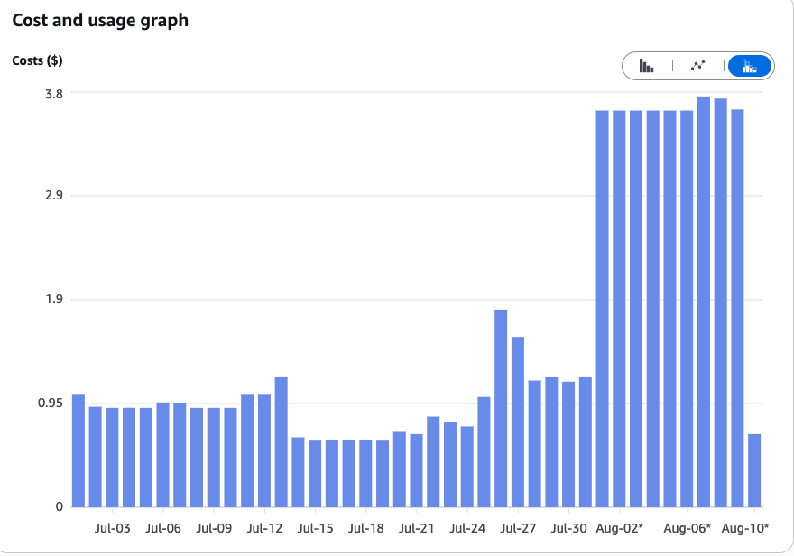
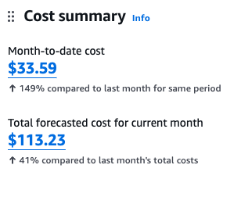
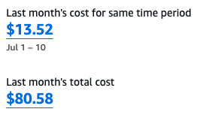
OpEx Development Costs
$200 / month

