Slide 1
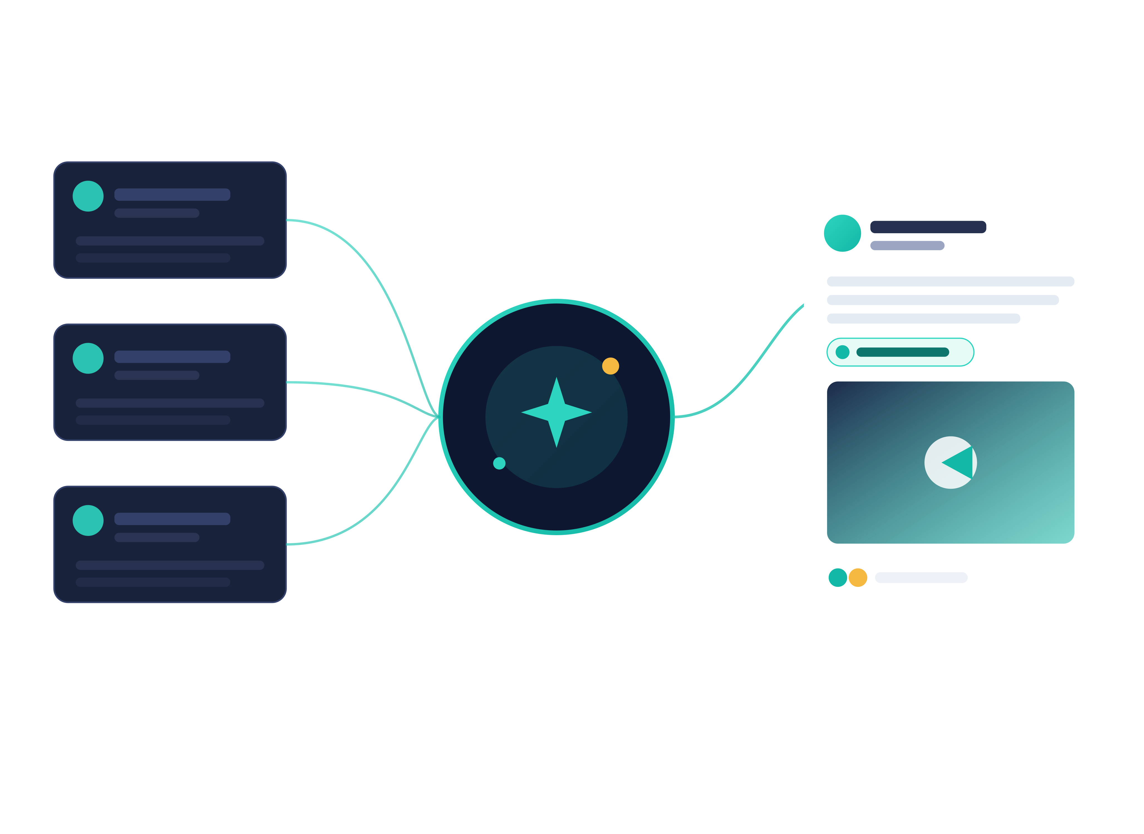
June 25, 2026 • Brandon _ India •
accountadmin@majikl.com
MAJIKL · MARKET INTELLIGENCE RELEASE · 1.9.35
Market Intelligence
The AI Content Agent
Live research in. Governed, on-brand posts out, published to your company page, with a human in command.
alpha.majikl.com
Investor Overview

Slide 2
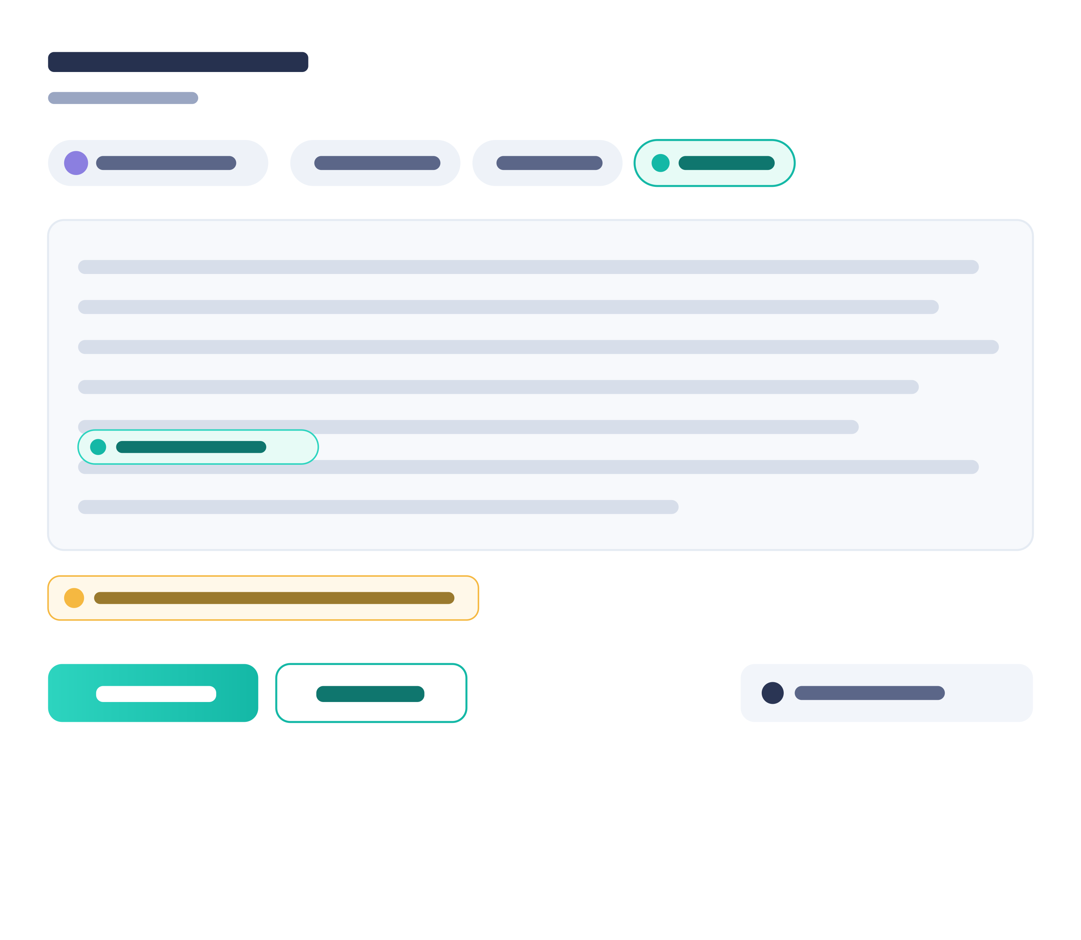




WHAT IT IS
From a research feed to a published post, autonomously, with a human in command.
Isolated per organization
Multi-tenant SaaS: every tenant gets a private, row-level-secured workspace and its own data.
Grounded in live sources
The agent reads your RSS/Atom feeds and drafts posts from current, corroborated research.
A human approval gate
Nothing reaches the company page until an owner approves it. The gate is server-enforced.
Publishes on schedule
Approved posts publish automatically to your LinkedIn organization page at the right time.
majikl · Market Intelligence · Confidential

Slide 3
WHO USES IT
Two roles, one governed workspace.
DH
Dana, Owner
Marketing Director
MR
Marcus, Member
Content Strategist
PA
Priya, Member
Research Analyst
Runs the workspace. Invites teammates, sets roles, owns the global topics, and is the one who approves what ships.
Turns topics into posts. Builds angles, generates drafts from research, refines with AI, and submits for approval.
Keeps the sourcing honest. Discovers and validates feeds, tags domains, and tunes the research instructions.
Manage users
Own topics
Feed discovery
All topics
Generate & refine
Research tuning
Approve / reject
Submit for approval
Sourced accuracy
majikl · Market Intelligence · Confidential

Slide 4



HOW A POST MOVES
The content pipeline
Five user-visible states. The approval gate is the control point, and a client can never skip it.
Draft
Pending
approval
Approved
Scheduled
Published
STATE 1
STATE 2
STATE 3
STATE 4
STATE 5
◆ human gate
Internal states handled by the publisher, not the client: publishing → posted / failed / blocked.
majikl · Market Intelligence · Confidential

Slide 5



WORKFLOW · USER MANAGEMENT (OWNER ONLY)
DH
Dana
Owner
Bring the team in, and control exactly who can do what.
1
2
3
4
Invite by email
They join the tenant
Assign a role
Change or revoke anytime
The owner sends an invite from the admin panel; pending invites are tracked and revocable.
The teammate accepts and becomes a member of that organization, and only that one.
Grant Owner or Member. Roles map to real permissions: who can manage topics, and who approves.
Promote, demote, or remove access in one click. Synthetic dev-bypass users are blocked outright.
Owner-gated by the manage_users permission, blocked for dev-bypass identities, and isolated per tenant by row-level security: three independent gates on one screen.
majikl · Market Intelligence · Confidential

Slide 6



WORKFLOW · TOPICS & ANGLES
MR
Marcus
Member
Define what to talk about, and how to keep it fresh.
1
Create a topic
Name it, describe it, add hashtags, and set scope: a shared global topic or your own personal one.
CONTENT ANGLES
Contrarian take
2
Define content angles
Give the topic a set of angles: the distinct takes the agent can write from.
Data-backed trend
3
Rotate or pin
The agent auto-rotates angles to avoid repeating itself, or you pin a specific angle for a post.
Practitioner how-to
Myth vs. reality
4
Let AI draft a starter
Not sure where to begin? AI proposes a ready-to-edit topic to get you moving.
Angles are a closed set: arbitrary free text is rejected (fail-closed), so user input never flows into the prompt.
majikl · Market Intelligence · Confidential

Slide 7
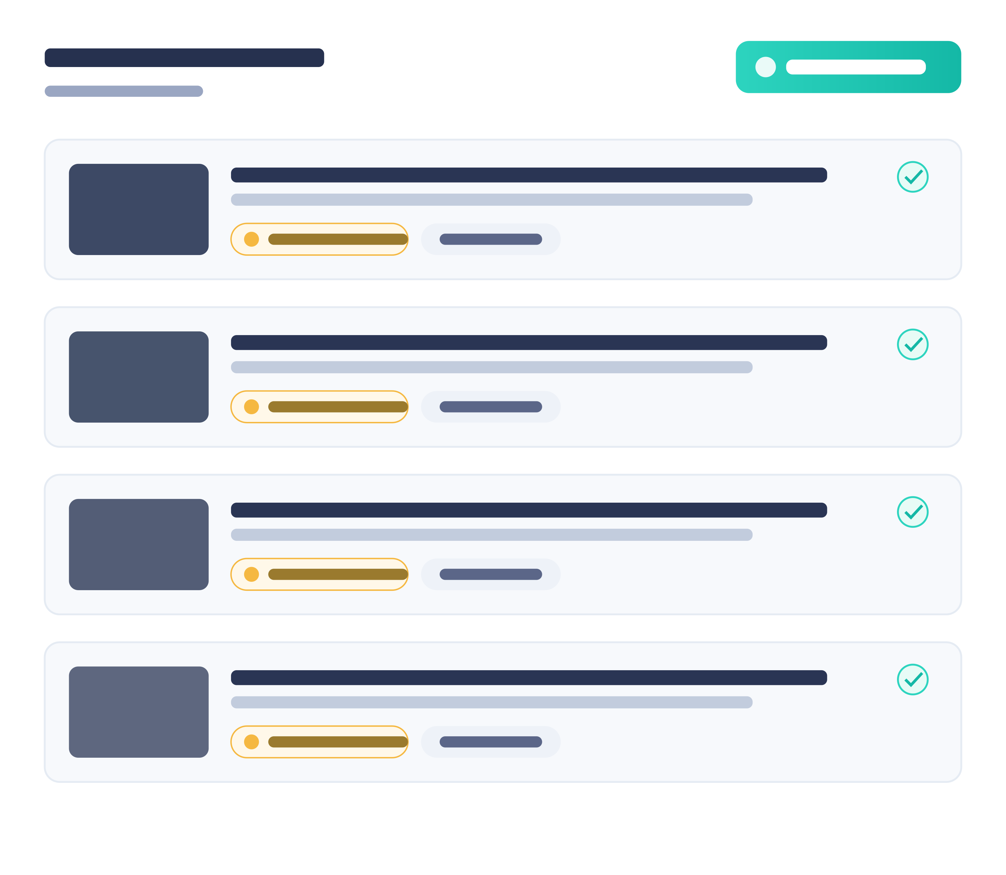



WORKFLOW · FEED DISCOVERY & RESEARCH
PA
Priya
Member
Point the agent at the right sources, safely.
1
Discover feeds with AI
Describe a topic and the agent suggests relevant RSS/Atom feeds to pull from.
2
Validated before added
Every candidate URL is RSS-validated and SSRF-checked, so only safe, real feeds get in.
3
Tag & instruct
Tag feeds by domain and set research instructions that steer what the agent looks for.
4
Continuous ingestion
The research engine keeps pulling and corroborating articles in the background.
majikl · Market Intelligence · Confidential

Slide 8


POSTING · 1: GENERATE
MR
Marcus
Member
Turn the latest research into a draft in one click.
1
Pick topic & angle
Choose what to post about and which angle to write from, or let it auto-select.
2
Draft from research
The agent composes a LinkedIn post grounded in the most recent corroborated articles.
3
Verified metrics, sourced
Numbers are woven in with their source attached. An unsourced figure never ships.
4
Your model, your key
Pick the model that fits; each tenant brings its own AI key (BYOK).
majikl · Market Intelligence · Confidential

Slide 9


POSTING · 2: REFINE WITH AI & EDIT
MR
Marcus
Member
Shape the draft until it sounds like you.
1
2
3
4
Ask AI to rewrite
Edit directly
Iterate freely
Every call is traceable
Tighten it, reframe the hook, or shift the tone. The agent rewrites on request.
Prefer the keyboard? Edit the post text inline and keep full control of the wording.
Generate, rewrite, tweak. Loop as many times as it takes to get it right.
AI requests are logged end-to-end, so what the model did is always auditable.
Refine and Generate share the same disciplined pipeline: the exact request sent to the model is the exact request logged, so the trace can never lie about what shipped.
majikl · Market Intelligence · Confidential

Slide 10


POSTING · 3: IMAGES
MR
Marcus
Member
Give every post the right picture, fetched safely.
1
Pull the lead image
The agent extracts the lead image straight from the source article.
2
Smart OG fallback
No lead image? It falls back to the article’s Open-Graph preview image.
3
Fetched through a guarded proxy
Images load via an SSRF-guarded proxy: no server-side request forgery.
4
Preview before it ships
See the post exactly as it will appear on the company page.
majikl · Market Intelligence · Confidential

Slide 11
POSTING · 4: DRAFT → PENDING APPROVAL
MR
Marcus
Member
Save it, submit it, and route it for sign-off.
1
2
3
4
Save as draft
Submit for approval
Owner reviews
The gate can’t be skipped
The generated post is saved as a draft you can return to and keep editing.
When it’s ready, send it to pending approval. It now awaits an owner.
The owner approves it, or sends it back to draft with the change in one move.
Status is server-enforced: no client can fake an approval or jump the queue.
MR
Marcus submits
DH
Dana approves
Approval is a real hand-off between roles: the strategist proposes, the owner disposes.
majikl · Market Intelligence · Confidential

Slide 12
POSTING · 5: SCHEDULE & PUBLISH
DH
Dana
Owner
Queue it once: the agent posts it for you.
1
Queue for a time
Put an approved post on the calendar for the date and time you want it live.
THE QUEUE
Scheduled · Tue 9:00
2
Track schedule status
See what’s queued, what’s gone out, and what needs attention at a glance.
SCHEDULED
Posted · Mon 9:00
POSTED
3
Auto-publish to your page
The scheduler posts to your LinkedIn organization page: no manual step.
Pending approval
PENDING
4
End-to-end status
Posted, failed, and blocked are all tracked, so nothing silently disappears.
Failed · retry queued
FAILED
majikl · Market Intelligence · Confidential

Slide 13
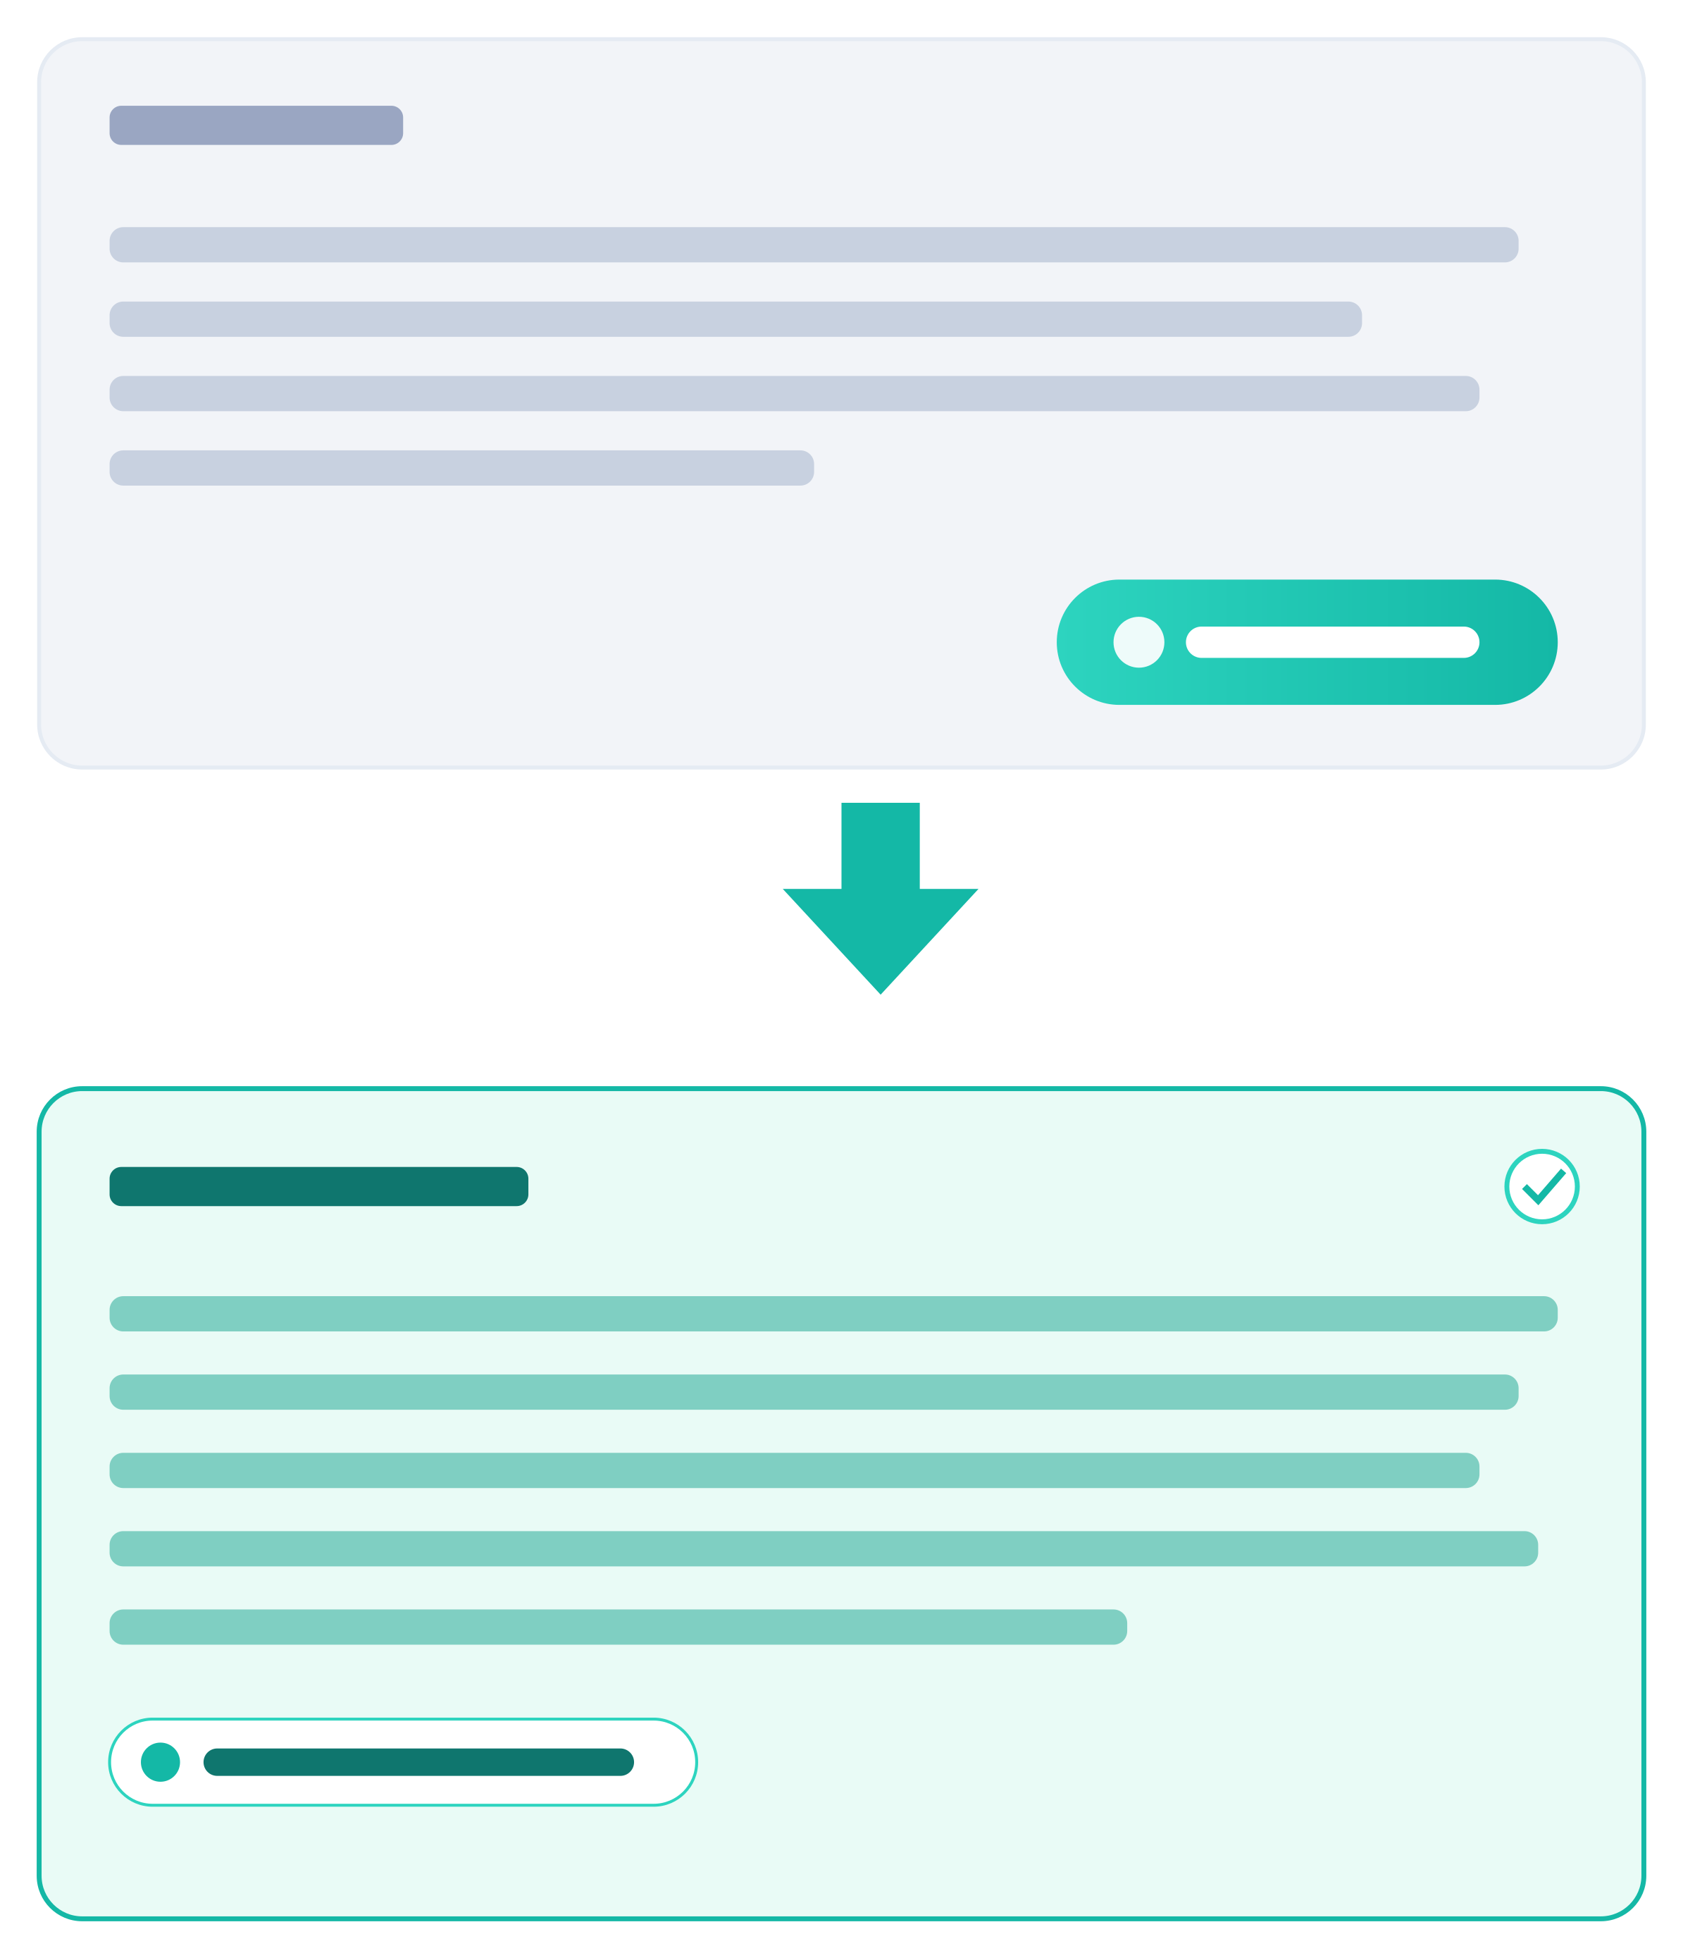
NEW
WORKFLOW · REWRITE WITH AI
Marcus
Member
MR
Reshape a draft without starting over.
1
One click, no prompt
Hit Rewrite with AI and it reuses the post’s own topic, angle, and the research it was built on.
2
Polishes, never fabricates
The refine pass tightens and reframes the existing copy. It is metric-free, so it cannot invent a new number.
3
Returns to draft for sign-off
Rewriting a post that was awaiting approval drops it back to draft, so a changed post is always re-approved.
4
Gated and traceable
Guarded by the edit_post permission, and every rewrite is logged exactly like a generation.
Rewrite runs the same audited pipeline as Generate, on a separate metric-free prompt, so a polished draft stays as accountable as the original.
majikl · Market Intelligence · Confidential

Slide 14
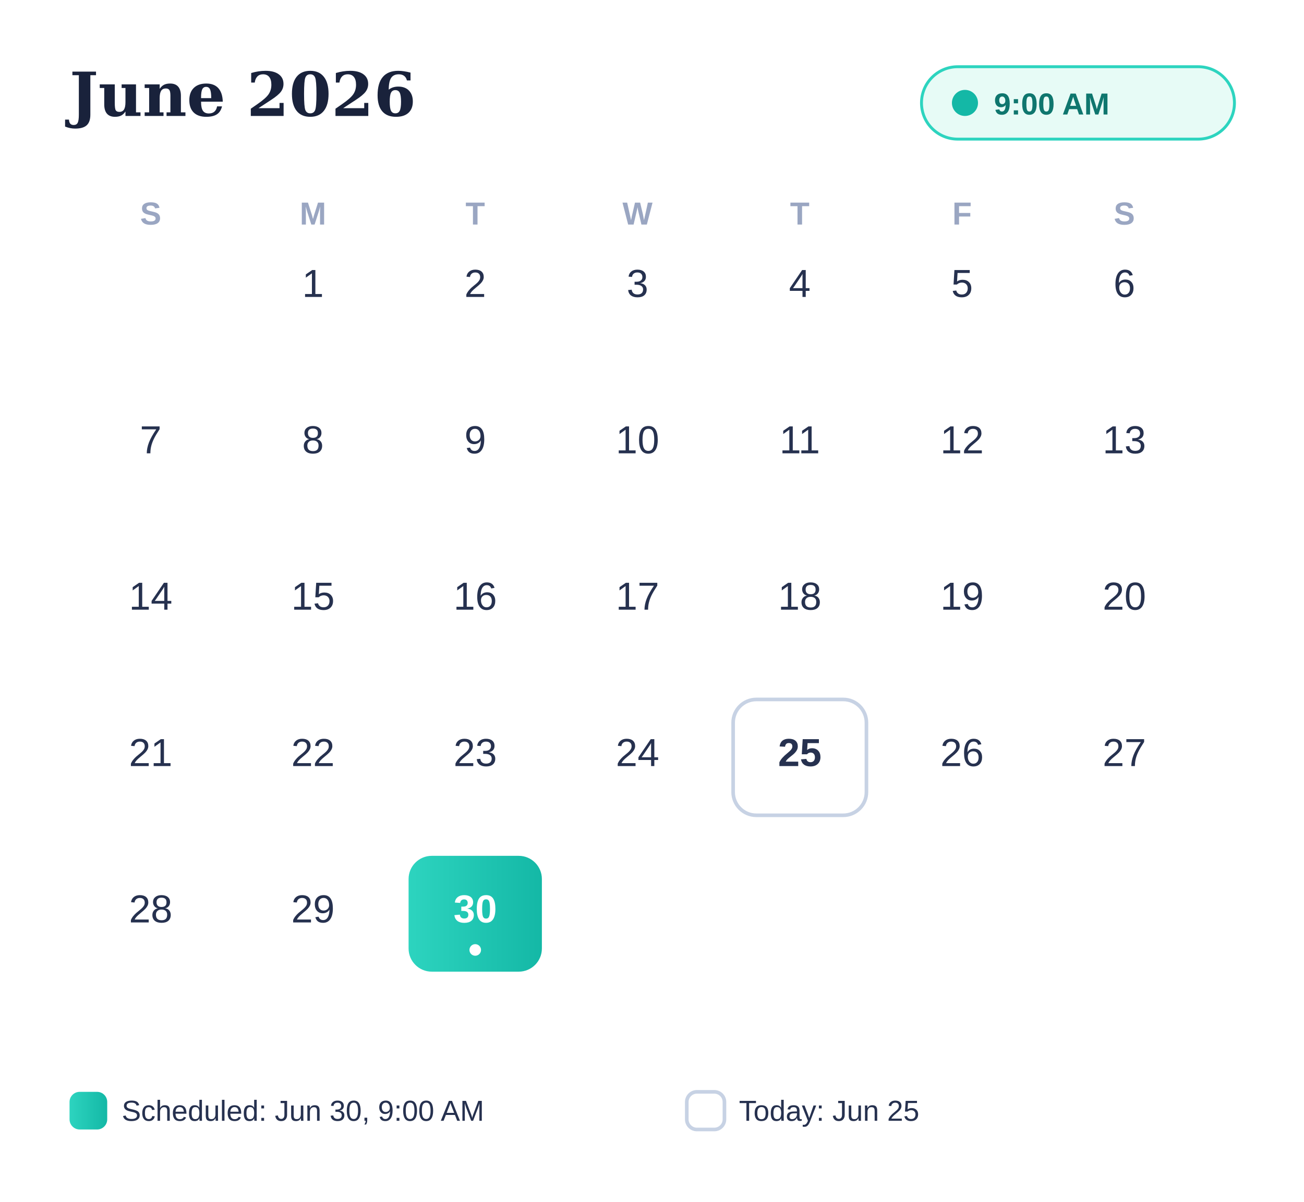
NEW
SCHEDULE · PUBLISHING ON A FUTURE DATE
Dana
Owner
DH
Set it today. It posts itself next Tuesday.
1
Start from a ready post
Pick a post that has cleared approval and is ready to go out.
2
Pick a future date & time
Choose Scheduled and set when it should publish. The system rejects any time that isn’t in the future.
3
It joins the queue
The post shows a Scheduled status with your chosen time and stays editable right up until it fires.
4
It posts itself
At that moment the scheduler publishes to your LinkedIn org page: posted, or failed / blocked, all tracked.
An optional spacing rule keeps scheduled posts from bunching, separate from the always-on engine that paces autonomous posts (roughly 4 per 10 days, 72h apart).
majikl · Market Intelligence · Confidential

Slide 15
NEW
WORKFLOW · RESEARCH INSTRUCTIONS
Priya
Member
PA
Tell the agent what counts as a good source.
Research instructions are a few search templates on each topic. They steer what the agent looks for, instead of letting it guess from the topic name.
LEFT EMPTY
WITH RESEARCH INSTRUCTIONS
The agent derives generic queries from the topic name:
You give it templates that target citable material:
AI in cybersecurity
AI in cybersecurity trends
{{TOPIC_NAME}} breach incident report {{YEAR_RANGE}}
AI security {{KEYWORDS}} enforcement action
{{ANGLE}} case study results survey
You get: broad explainers and vendor hype: a vague post with no hard evidence.
You get: incident reports, enforcement actions, and studies with numbers: a specific, sourced post.
Up to five templates, four placeholders: {{TOPIC_NAME}} {{ANGLE}} {{KEYWORDS}} {{YEAR_RANGE}}. The AI drafts them; you review and save. Sharper sourcing means stronger metrics and fewer rejected drafts.
majikl · Market Intelligence · Confidential

Slide 16
POSTING · 6: THE WHOLE THING, ON ITS OWN
A governed loop that runs continuously
Research never stops, so neither does the pipeline, with human approval as the one deliberate pause.
Hands-free throughput
Posts keep flowing without anyone babysitting the tool.
Research
Always current
Every post reflects the newest corroborated research, not last month’s.
Publish
Draft
One human checkpoint
The owner’s approval is the only gate: deliberate, not bureaucratic.
Nothing slips
Failed or blocked posts surface immediately with their status.
Schedule
Approve
majikl · Market Intelligence · Confidential

Slide 17
WHY IT EARNS TRUST
Security is the product, not a feature
Zero-Trust from the database to the UI: the moat for selling AI publishing to serious organizations.
Row-level multi-tenancy
Postgres RLS isolates every tenant’s data, enforced in the database, not just the app.
Per-tenant BYOK keys
Each organization brings its own AI key; keys are encrypted and never logged.
Encrypted prompt vault
Prompts and secrets sealed with AES-256-GCM + HKDF at rest.
Human approval gate
No post reaches a public page without an owner’s sign-off, server-enforced.
SSRF-guarded fetches
Feed discovery and image fetches are validated against server-side request forgery.
Full AI traceability
Every model request is logged exactly as sent, so output is always auditable.
majikl · Market Intelligence · Confidential

Slide 18
THE OPPORTUNITY
Market intelligence
that posts itself, safely.
A governed AI agent that researches, drafts, and publishes on-brand LinkedIn content for every organization on the platform, with the owner always in command.
Research
Governance
Scale
live, corroborated sources in
human approval before publish
multi-tenant, isolated by design
alpha.majikl.com

