Slide 1
July 8, 2026 • Brandon _ India •
accountadmin@majikl.com
PRODUCT VISION / RELEASE 2.2.19
The closed-loop
content intelligence system
Market Intelligence
Most LinkedIn tools schedule the content you bring them. Market Intelligence creates it from live research, publishes it, measures what performs, and makes the next cycle smarter.
Measure
Amplify
Bridge to paid
Optimize
Market Intelligence
1

Slide 2






THE IDEA
Every other tool schedules. Ours creates, then learns.
Buffer, Hootsuite, and Sprout Social time the content you give them. Market Intelligence runs the entire loop, so each cycle is smarter than the last.
→
→
Research
Generate
Publish
Live sources, on your topics
Grounded drafts, your voice
Profile or company page
↑
↓
←
←
Optimize
Learn
Measure
Next cycle improves
What resonates, and why
Real results per post
1
Measure
2
Amplify
3
Bridge to paid
4
Optimize
Market Intelligence
2

Slide 3



ROADMAP
Four phases, one compounding advantage
PHASE
PHASE
PHASE
PHASE
1
2
3
4
Organization
Analytics Dashboard
Employee
Advocacy
Organic-to-Paid
Bridge
Closed-Loop
Optimization
Measure what every post actually does.
Turn your team into a distribution engine.
Boost proven posts into paid, in one click.
The platform gets smarter every cycle.
AVAILABLE NOW
AVAILABLE NOW
IN DEVELOPMENT
IN DEVELOPMENT
Phases 1 and 2 are live in release 2.2.19. Phases 3 and 4 are in active development.
Market Intelligence
3

Slide 4
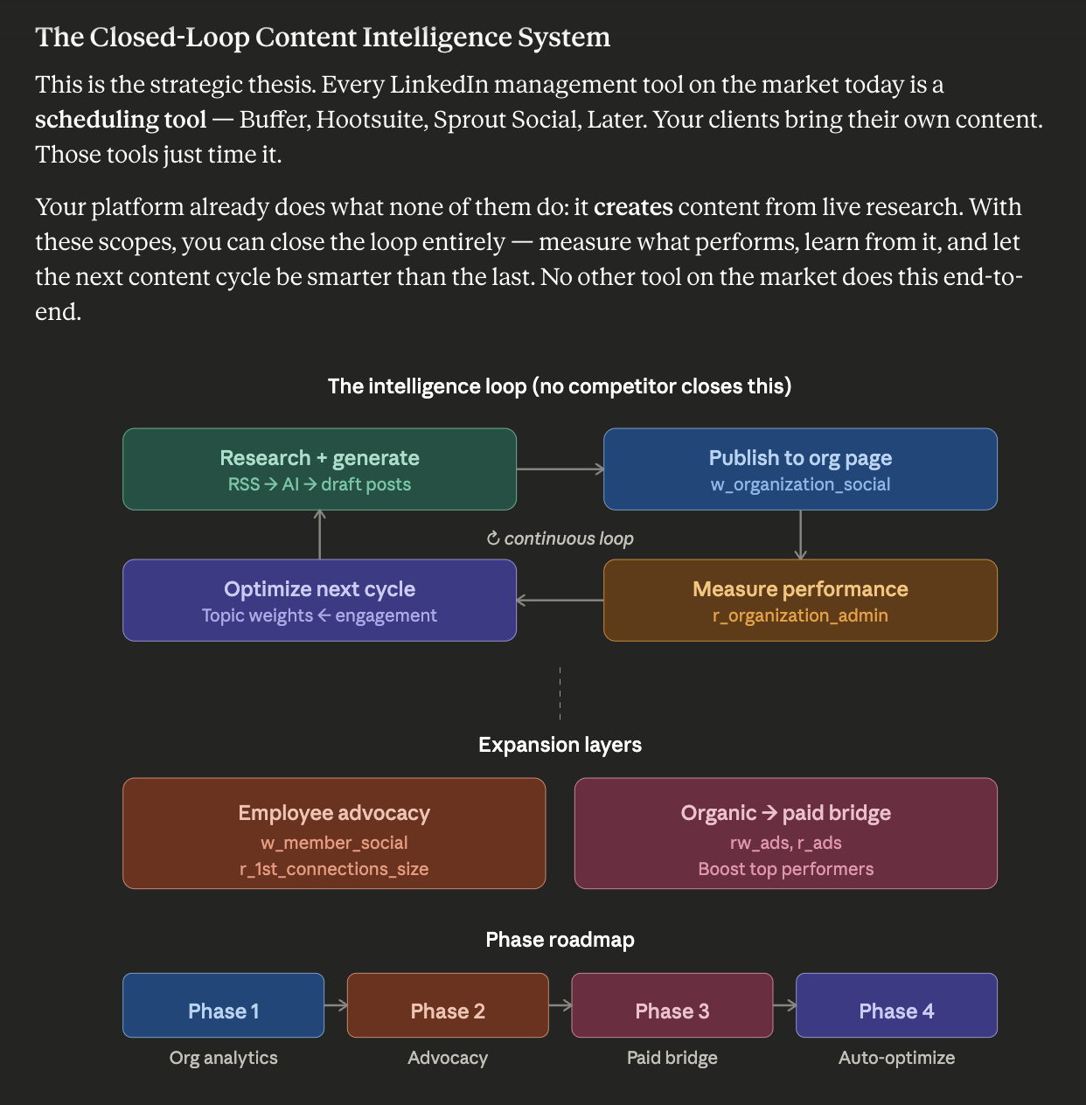

Slide 5








PHASE 1 / ORGANIZATION ANALYTICS DASHBOARD
AVAILABLE NOW
See exactly what your content does
Impressions
Clicks
Likes
Comments
Shares
Shown exactly as LinkedIn reports them, and linked to the topic that produced each post.
Performance by topic
Best day and time
Follower demographics
Which of your topics drive the most reach and engagement.
A day-and-hour heatmap of when your audience shows up.
Who you reach, by industry, seniority, and geography.
Market Intelligence
4

Slide 6


PHASE 2 / EMPLOYEE ADVOCACY
AVAILABLE NOW
Turn your team into a distribution engine
Organic reach on a company page is limited, often cited at only 2 to 5 percent of followers. Employee shares reach their full networks instead.
Example potential reach
25,000
One post, every network
The same research, personalized for each team member.
50 team members, about 500 connections each
Consent and control
Members opt in and approve every post in their name.
5 to 10x the reach of your company page followers alone
A publishing tool becomes a distribution engine.
Market Intelligence
5

Slide 7
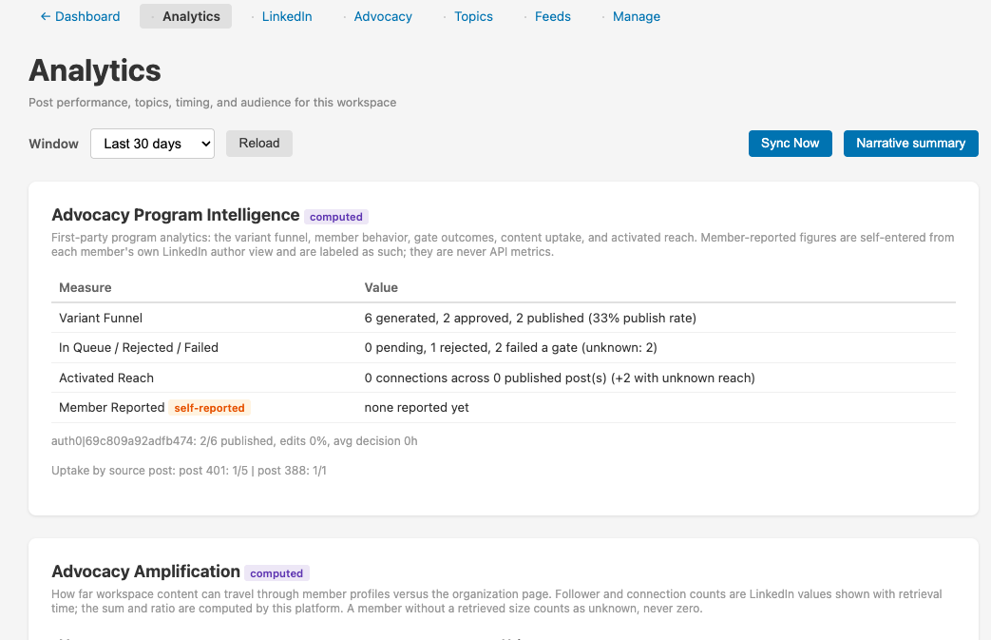
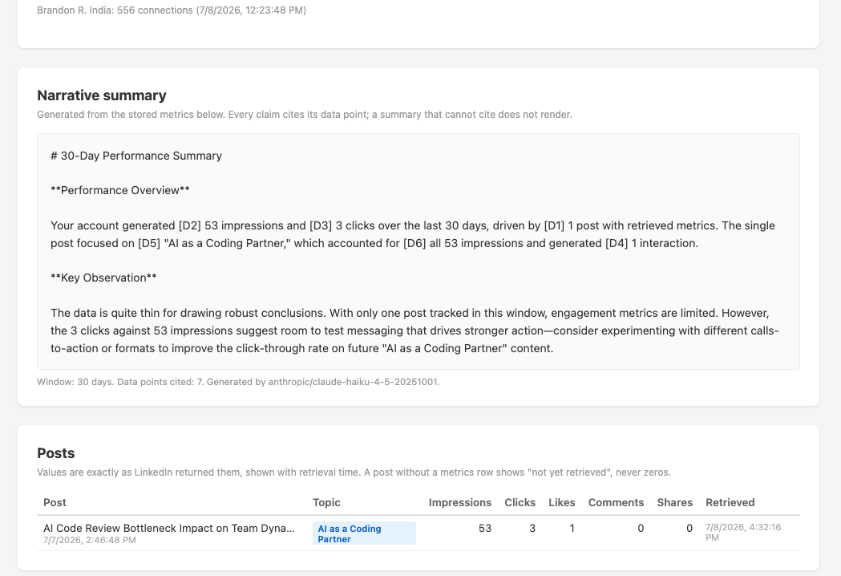

Slide 8
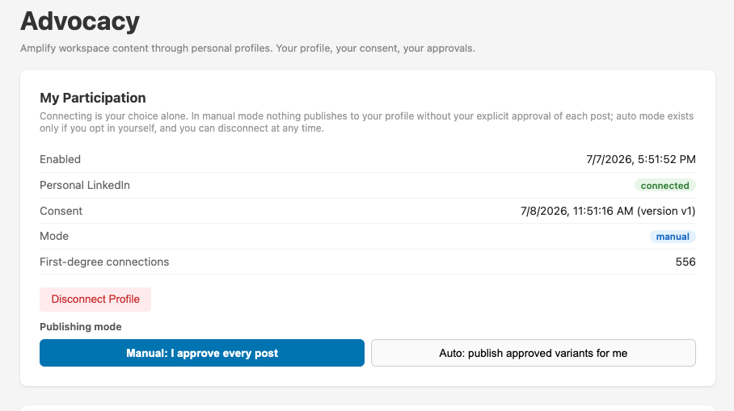
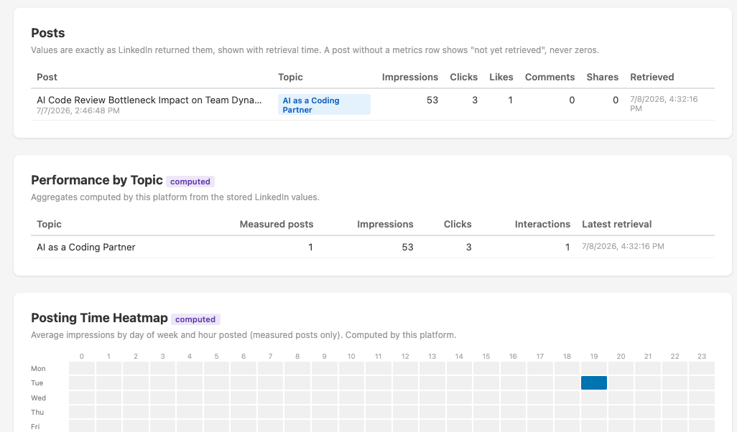

Slide 9
PHASE 3 / ORGANIC-TO-PAID BRIDGE
IN DEVELOPMENT
Put budget behind what already works
When an organic post outperforms, promoting it should be one click, not a rebuild in Campaign Manager.
Boost suggestions
One-click sponsored
A prompt when a post clears your threshold.
Promote a strong post without leaving the app.
AI ad copy variants
One unified report
Ad angles from the same research pipeline.
Organic and paid, side by side.
On the roadmap. The value: promote what is already proven, instead of guessing.
Market Intelligence
6

Slide 10


PHASE 4 / CLOSED-LOOP OPTIMIZATION
IN DEVELOPMENT
A platform that gets smarter every cycle
This is the moat. Performance data feeds the next cycle, so the platform improves on its own instead of standing still.
Smarter topic weighting
Angle rotation tuning
Results inform which topics come next.
Favor the angles that prove out.
Audience alignment
Automated cadence
Match your content to who you reach.
Frequency tunes to each account.
In development. The building blocks (topic weighting, quality scoring, and cadence controls) already ship today.
Market Intelligence
7

Slide 11



ALSO SHIPPED IN 2.2.19
Four more upgrades behind the loop
Publish as your brand
Always-on delivery
Publish as your personal profile or a company page you administer, switched live in the app.
Your LinkedIn connection refreshes itself, so scheduled posts stop failing overnight.
Choose your AI engine
More control over posts
Pick your provider and model, Claude, GPT, or Grok, and bring your own key.
Reschedule, edit anytime, or write a post from scratch with no AI in the loop.
Market Intelligence
8

Slide 12




BUILT-IN TRUST AND SAFETY
Confidence, by design
Consent-first advocacy
Honest analytics
Members opt in, approve each post, and can disconnect anytime. Credentials are encrypted and isolated.
Real numbers only. No invented zeros, and AI summaries must cite your own data.
Stronger content defenses
Owner-only controls
Improved detection of hidden instructions buried in outside news and feeds.
Sensitive settings are enforced on the server, not just hidden in the interface.
Market Intelligence
9

Slide 13

THE LOOP, CLOSING
Research, generate, publish, measure,
learn, and improve.
Available now
Coming next
Organization Analytics and Employee Advocacy, live in 2.2.19.
The Organic-to-Paid Bridge and Closed-Loop Optimization.
Market Intelligence
Built for people who have something to say.
Market Intelligence
10

