Slide 1
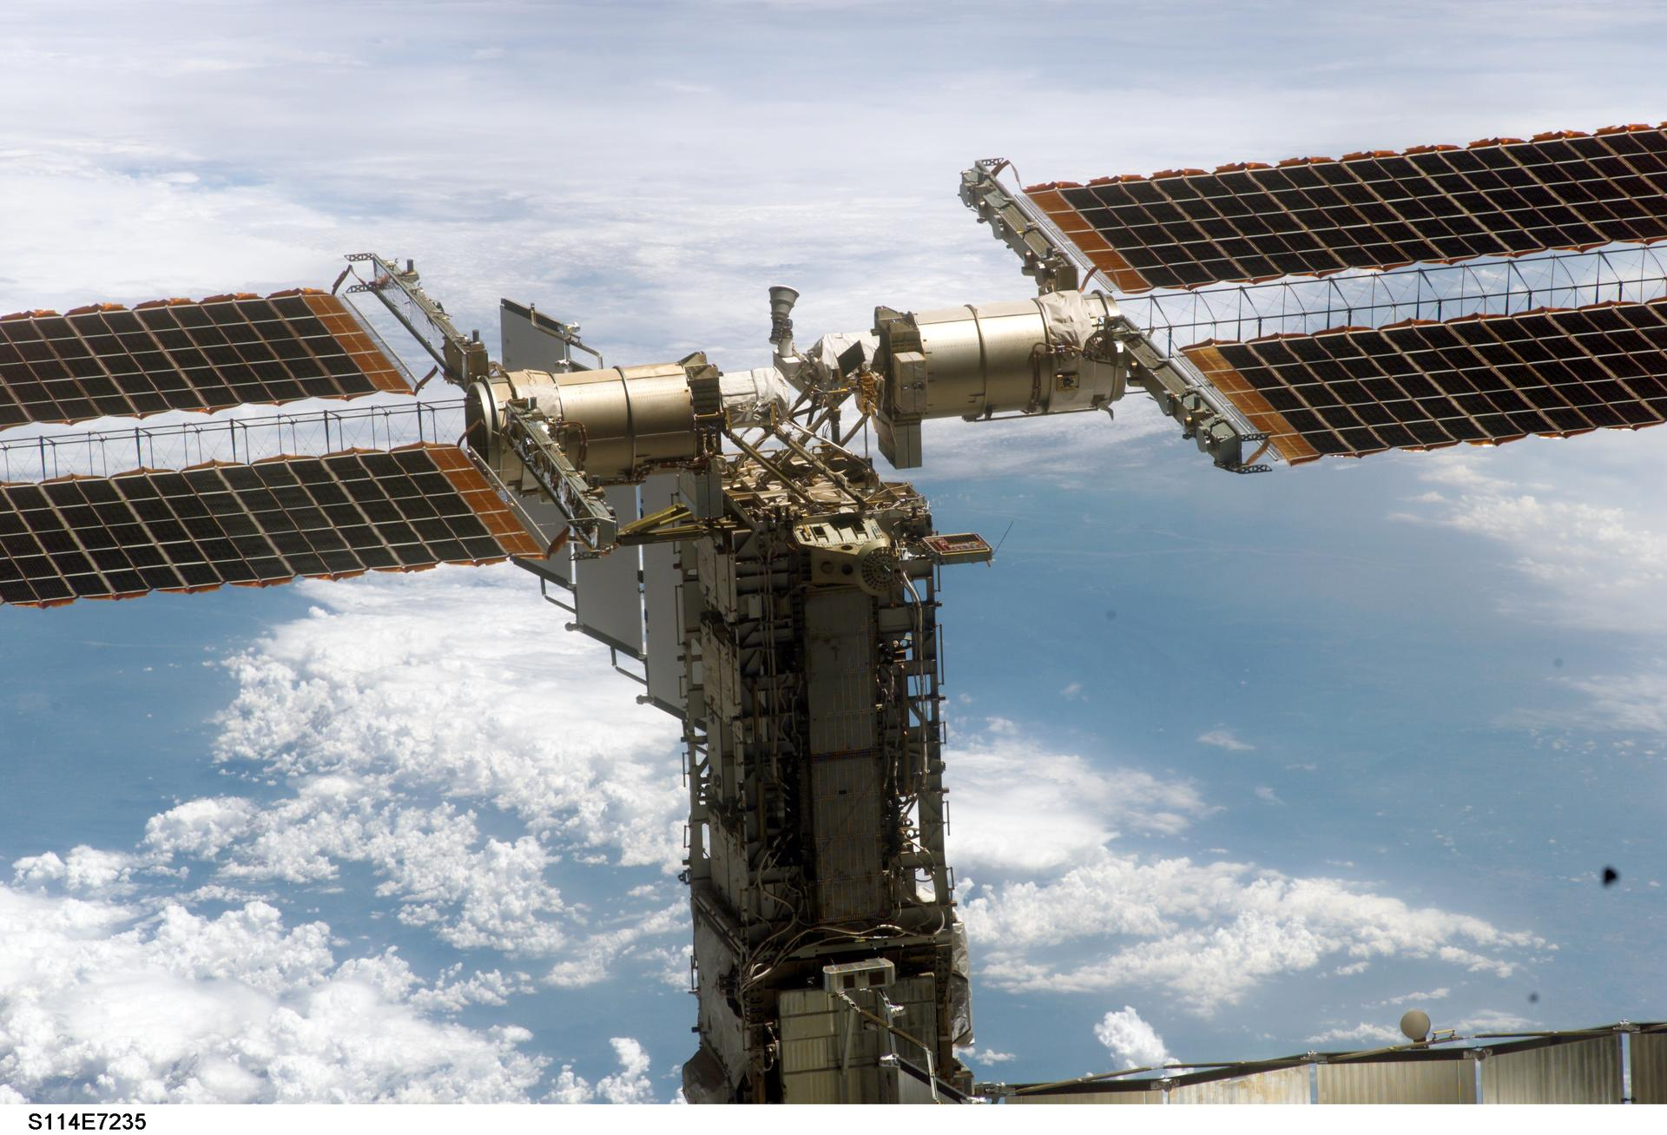
SPCE 5065 · Current-Event Presentation
Cold Welding in the Vacuum Environment
When spacecraft parts fuse themselves together
Image: NASA
Jordan Clayton | SPCE 5065 | July 2026
Notes:
Hi, I'm Jordan Clayton. My current-events topic is the vacuum environment, and I want to look at it through one specific and slightly strange effect: cold welding, where spacecraft parts can fuse themselves together in orbit with no heat at all.

Slide 2
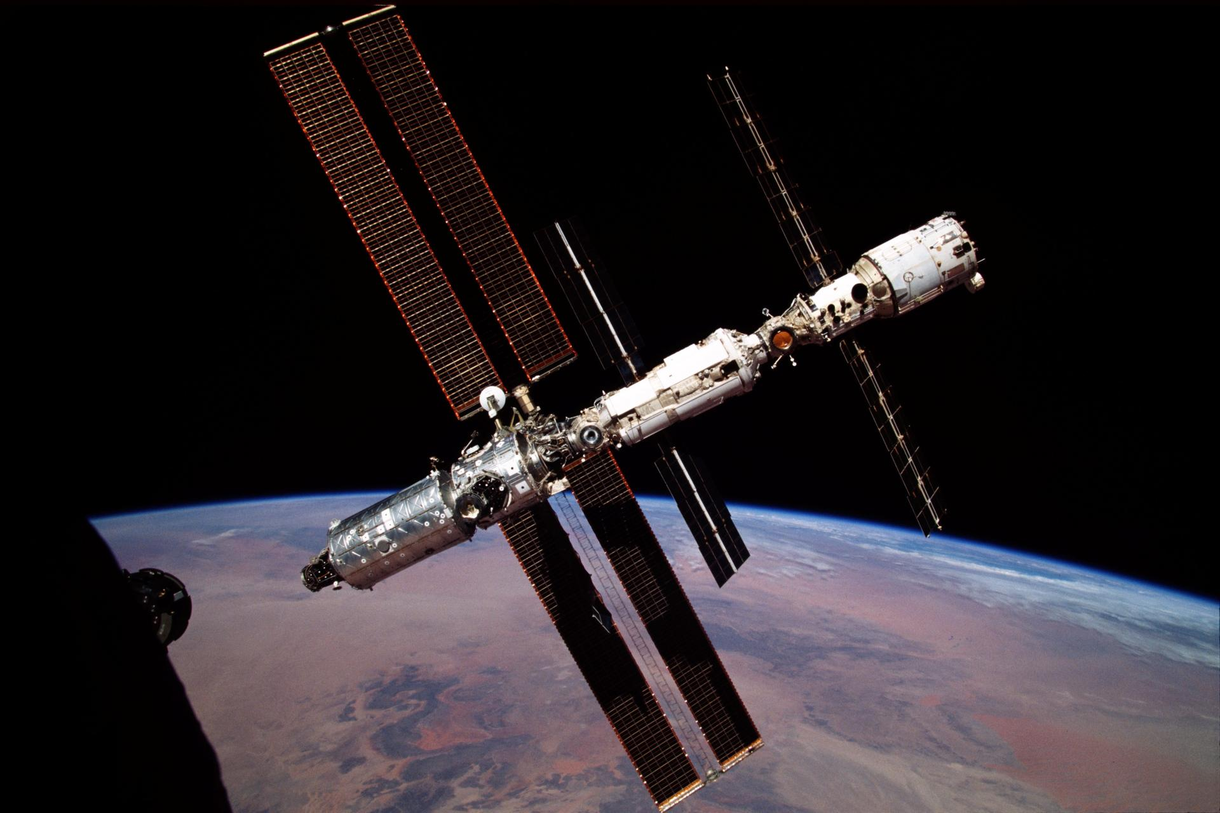
A weld with no heat, 400 km up
In November 2024 an experiment called ASTROBEAT reached the ISS to test cold welding as a way to repair debris damage to a spacecraft hull [1][2]
It runs on a phenomenon engineers usually spend careers trying to prevent
That same physics once jammed a NASA spacecraft's antenna shut
The question for today: how do two metal parts weld together in orbit with no heat and no welder?
Image: NASA
2 / 11
Notes:
Here is the hook. In November 2024, an experiment called ASTROBEAT went up to the International Space Station. Its goal is to use cold welding on purpose, as a way to patch holes punched in a hull by debris. What is interesting is that cold welding is normally a failure mode, something designers fight to avoid, and the same physics once jammed a famous NASA antenna shut. So the question I want to answer is simple: how can two metal parts weld together in orbit, with no heat and no welder?

Slide 3
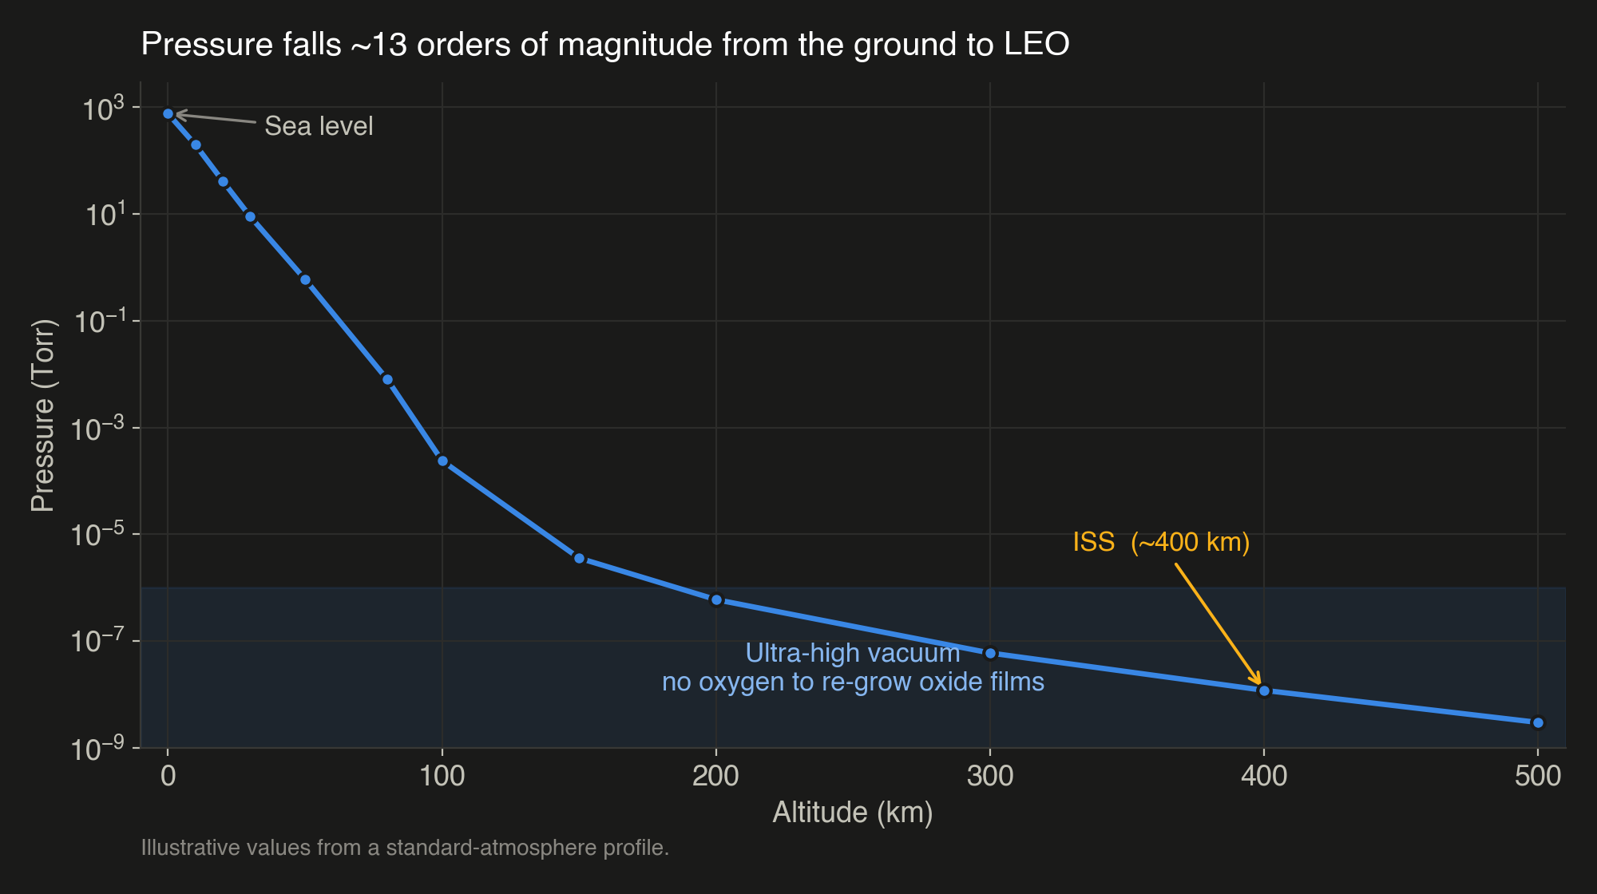
Space is not just empty
Pressure falls about 13 orders of magnitude from sea level to low Earth orbit
At ISS altitude it is around 1e-8 Torr, harder than most vacuum chambers on the ground
The key consequence: almost no oxygen to re-grow the oxide films that normally protect metal surfaces
3 / 11
Notes:
First, what the vacuum environment actually is. Pressure drops about thirteen orders of magnitude from the ground to low Earth orbit. At the Space Station's altitude it is around ten to the minus eight Torr, which is a harder vacuum than most chambers we can build on the ground. The consequence that matters for us is this: there is essentially no oxygen up there to re-grow the oxide films that normally protect a metal surface.

Slide 4
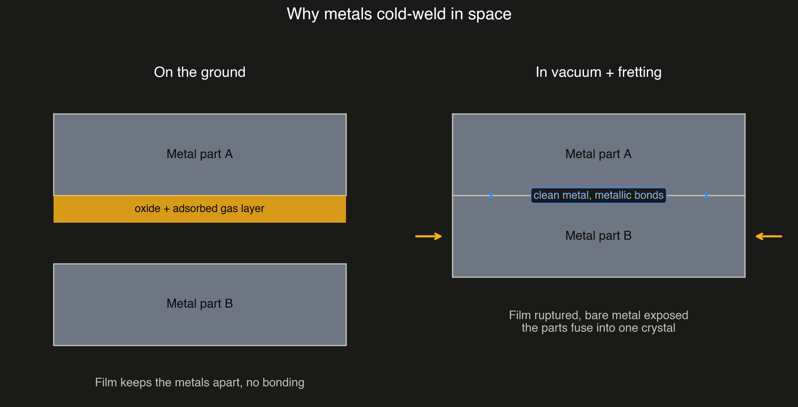
Why clean metal is sticky
On Earth every metal instantly grows an oxide layer plus adsorbed gas; those films keep parts from bonding
From our surface-interaction lectures: a truly clean surface has a high sticking coefficient and bonds readily
In vacuum, once that film is scrubbed off it does not come back
Bare metal on bare metal forms real metallic bonds; the atoms cannot tell which part they came from [3]
4 / 11
Notes:
So why is clean metal sticky? On Earth, every metal instantly grows an oxide layer plus a film of adsorbed gas, and those films are what keep two parts from bonding when they touch. This ties straight back to our surface-interaction lectures: a truly clean surface has a high sticking coefficient and wants to bond. In vacuum, once that protective film is scrubbed away, it does not grow back. Now you have bare metal touching bare metal, and the atoms form real metallic bonds across the joint. The two parts effectively become one crystal, because the atoms cannot tell which original piece they belong to. No heat, no melting.

Slide 5
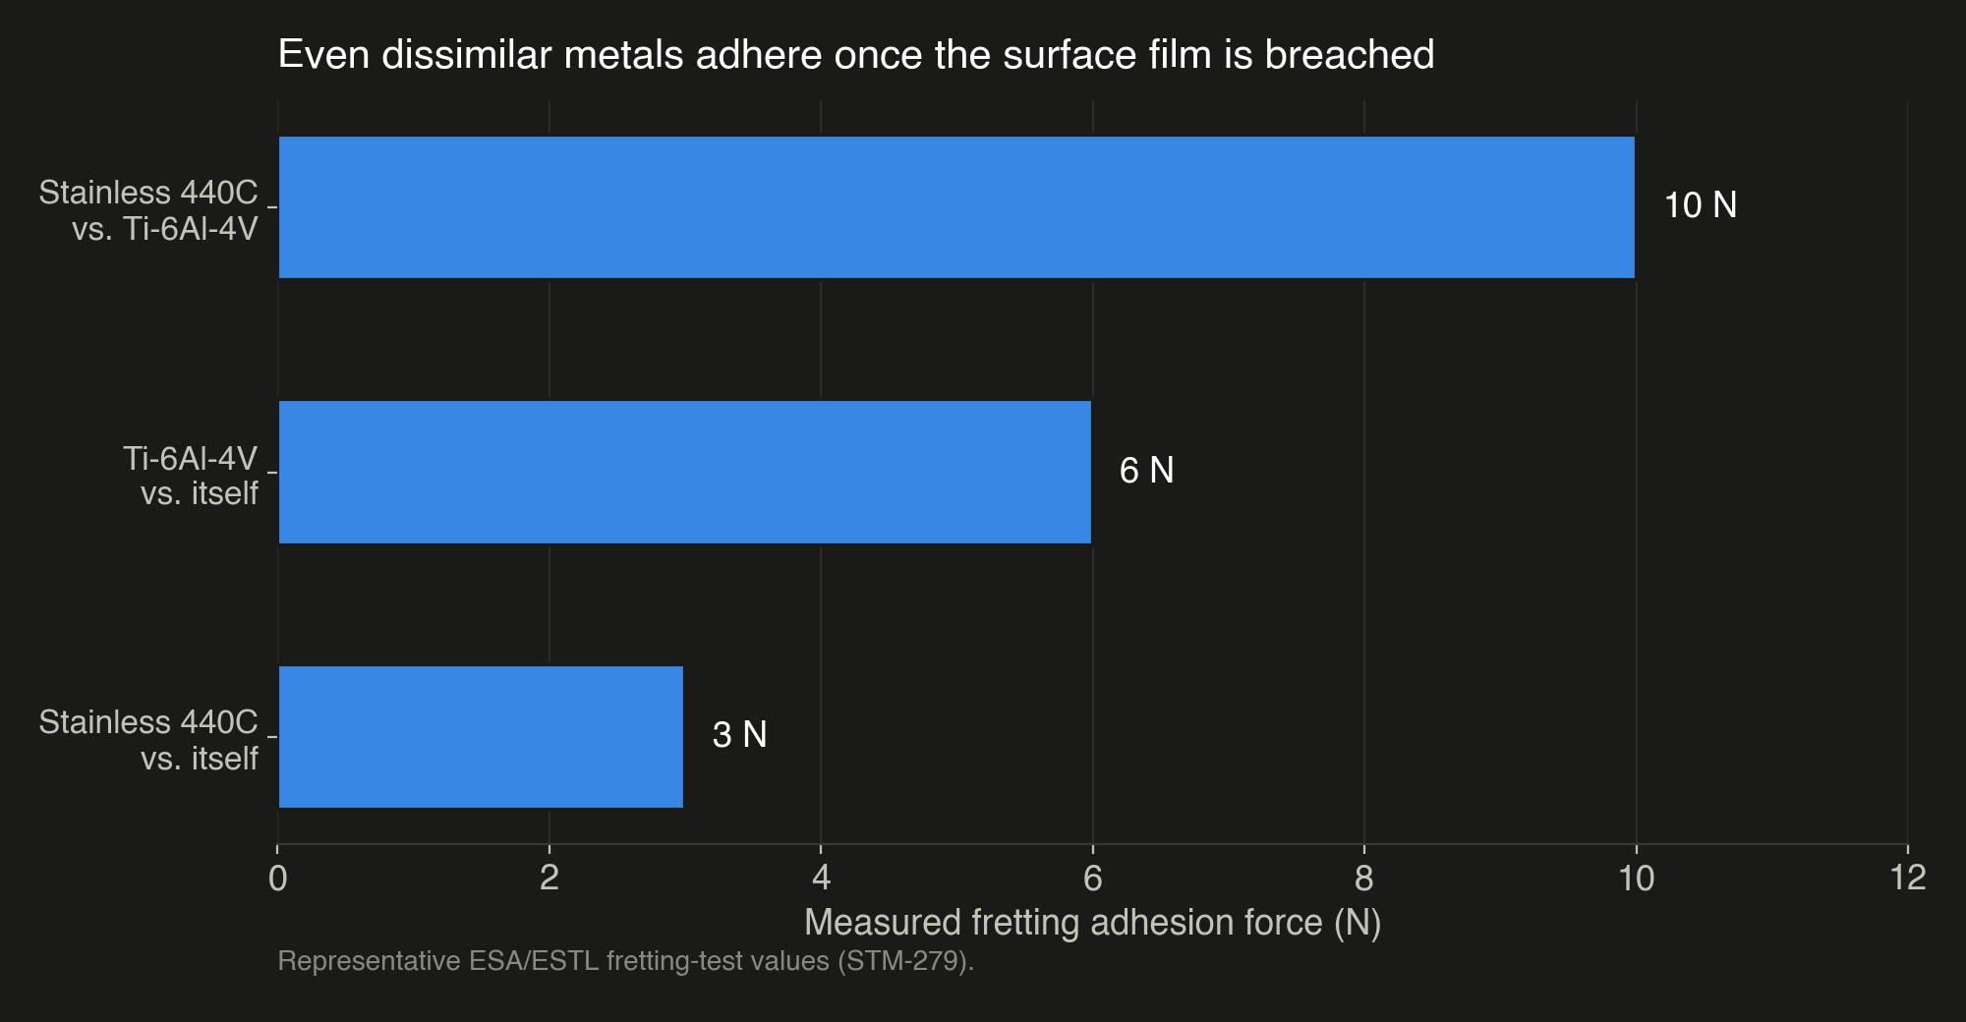
Static contact is not the danger. Motion is.
Flat parts just resting together rarely weld; real surfaces are rough and the oxide usually survives
The real driver is fretting: tiny vibration during launch, plus impact, which scrub the film off and press fresh metal together [4]
Worst pairs: soft metals like aluminum and copper, and any metal against an identical metal
Even dissimilar metals adhere once the surface film is breached [5]
5 / 11
Notes:
Here is the nuance that separates hype from engineering. Pure static contact, two flat parts just resting together, rarely welds, because real surfaces are rough and the oxide usually survives. The real danger is fretting: tiny oscillating motion, like launch vibration, and impact. That motion scrubs the film off and presses fresh metal together, which is essentially a friction weld. The worst material pairs are soft metals like aluminum and copper, and any metal against an identical metal. But as this ESA test data shows, even dissimilar metals adhere with real force once the film is breached.

Slide 6
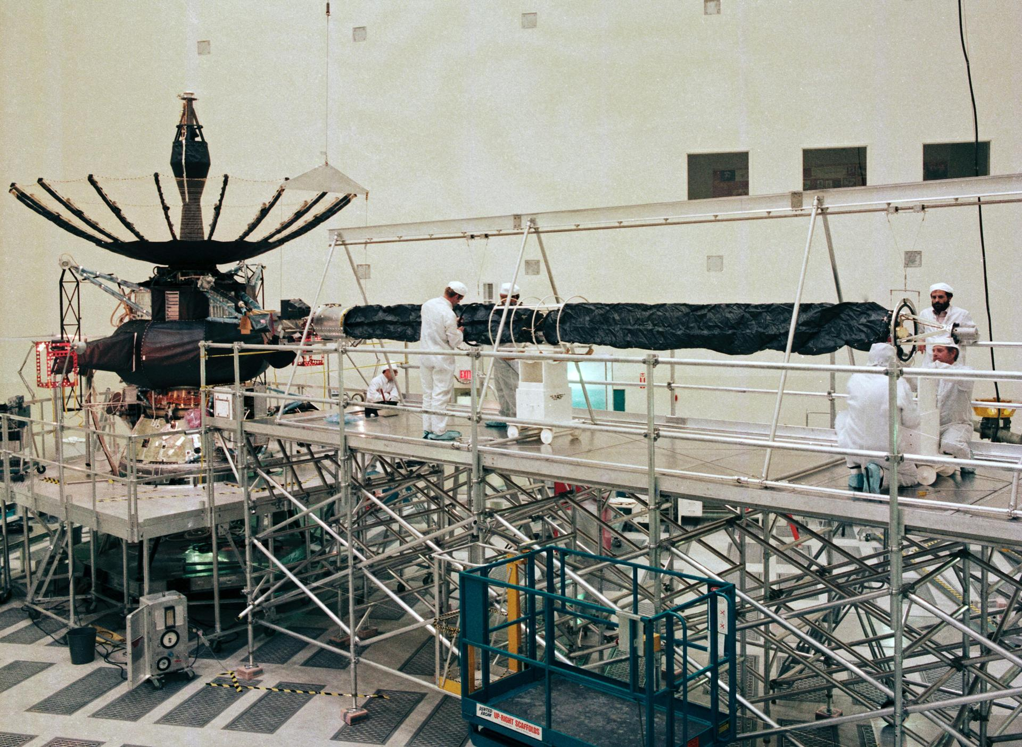
Case 1: Galileo's antenna, told honestly
1991: Galileo's umbrella high-gain antenna stalled with 3 of 18 ribs stuck [6]
Root cause was loss of the dry MoS2 lubricant, worn away by vibration over cross-country truck transport, plus pin-and-socket friction
The antenna never received a thermal-vacuum test before launch
Bare-metal cold welding was a contributor once the lubricant was gone, not a spontaneous static weld [7]
Image: NASA/JPL (Galileo; furled high-gain antenna at top)
6 / 11
Notes:
Case one is the classic story, and I want to tell it honestly, because it is often oversimplified. In 1991, Galileo's umbrella-style high-gain antenna tried to open and stalled, with three of its eighteen ribs stuck. NASA's investigation found the main cause was loss of the dry molybdenum-disulfide lubricant on the rib pins, worn away by vibration during several cross-country truck trips, combined with friction in the pin-and-socket joints. It also never got a thermal-vacuum test before launch. Cold welding of the now-bare metal was a contributor once the lubricant was gone, but it was not a spontaneous static weld. Lubricant loss and fretting came first.

Slide 7
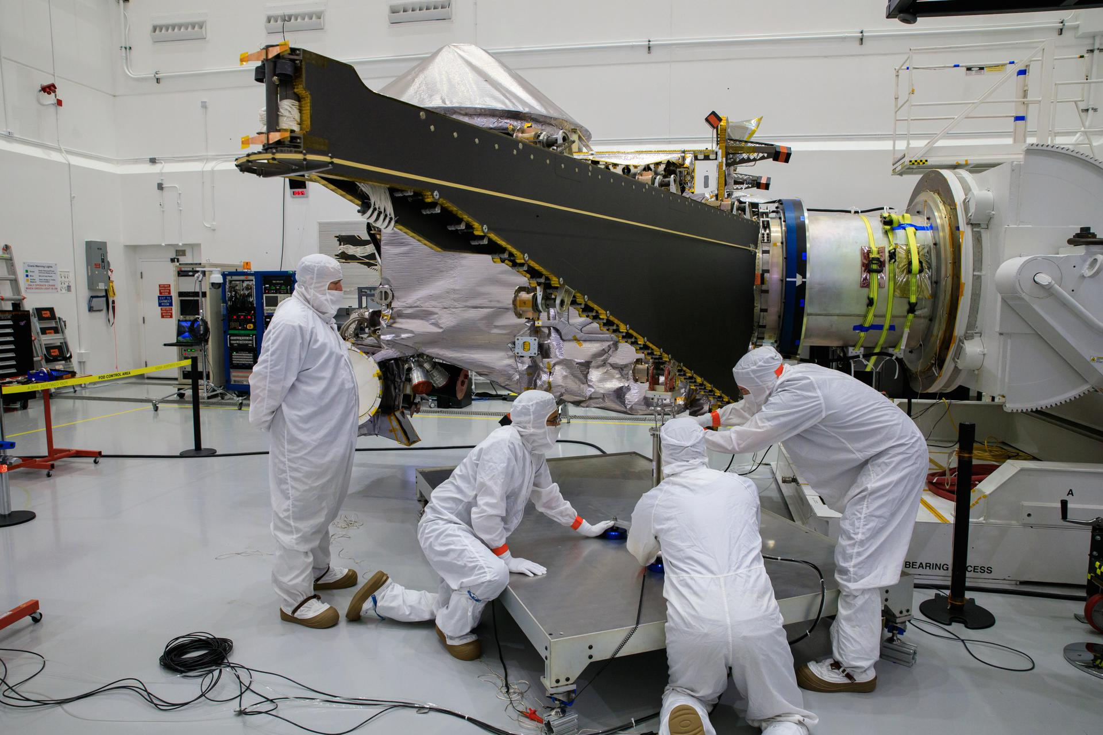
Real, but often over-blamed
Confirmed and current: ESA testing shows repeated bending of wire harnesses in vacuum can cold-weld individual strands, stiffening or even breaking them [7]
The counter-example: NASA's Lucy solar array stuck about 92 percent open in 2021
Widely blamed online on vacuum sticking, but NASA traced it to a deployment lanyard that lost tension [8]
Lesson: cold welding is real, but diagnosis matters; not every stuck deployable is a weld
Image: NASA/KSC (Lucy spacecraft and its solar array)
7 / 11
Notes:
Cold welding is real, but it is also one of the most over-cited facts on the internet, so let me show both sides. On the confirmed and current side, recent ESA testing shows that repeatedly bending a wire harness in vacuum can cold-weld the individual strands together, stiffening the harness or even breaking wires. On the over-blamed side, NASA's Lucy mission had a solar array stick about ninety-two percent open in 2021. A lot of people online blamed vacuum sticking, but NASA actually traced it to a deployment lanyard that lost tension. The lesson is that cold welding is real, but careful diagnosis matters. Not every stuck deployable is a weld.

Slide 8
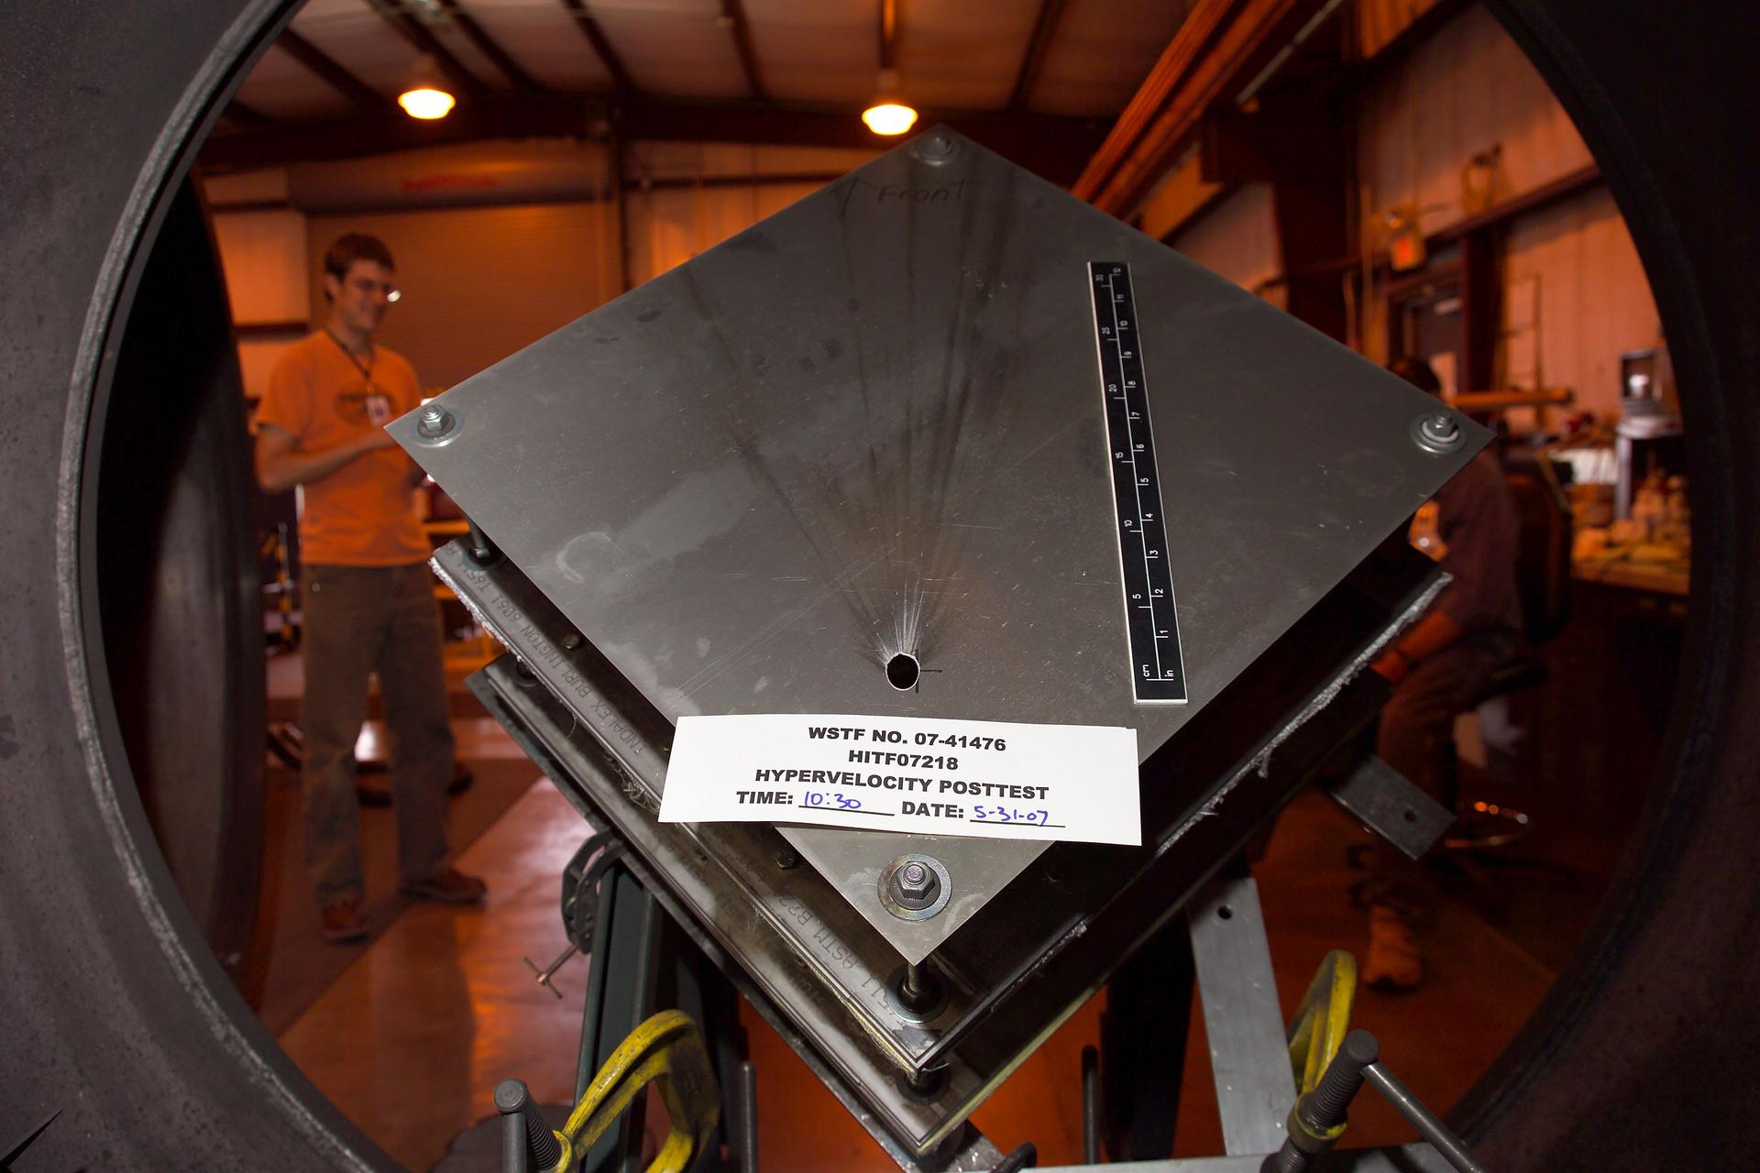
Turning the failure mode into a tool
ASTROBEAT flips the problem: use cold welding on purpose to patch hull damage from hypervelocity debris [1]
A technology-readiness-level 6 demonstrator, run on the ISS by a team led out of Malta
The same adhesion that threatens deployables becomes an in-space repair method
Why now: growing mega-constellations and debris make on-orbit repair increasingly worth the effort
Image: NASA/WSTF (hypervelocity impact test; the damage ASTROBEAT aims to repair)
8 / 11
Notes:
Which brings us back to ASTROBEAT. It flips the whole problem around: instead of preventing cold welding, it uses it on purpose to patch hull damage from hypervelocity debris impacts. It is a fairly mature demonstrator, technology-readiness-level six, run on the Space Station by a team led out of Malta. The same adhesion that threatens hinges and antennas becomes a repair method. And the timing makes sense: with mega-constellations and a growing debris population, being able to repair a spacecraft in orbit is worth more than ever.

Slide 9
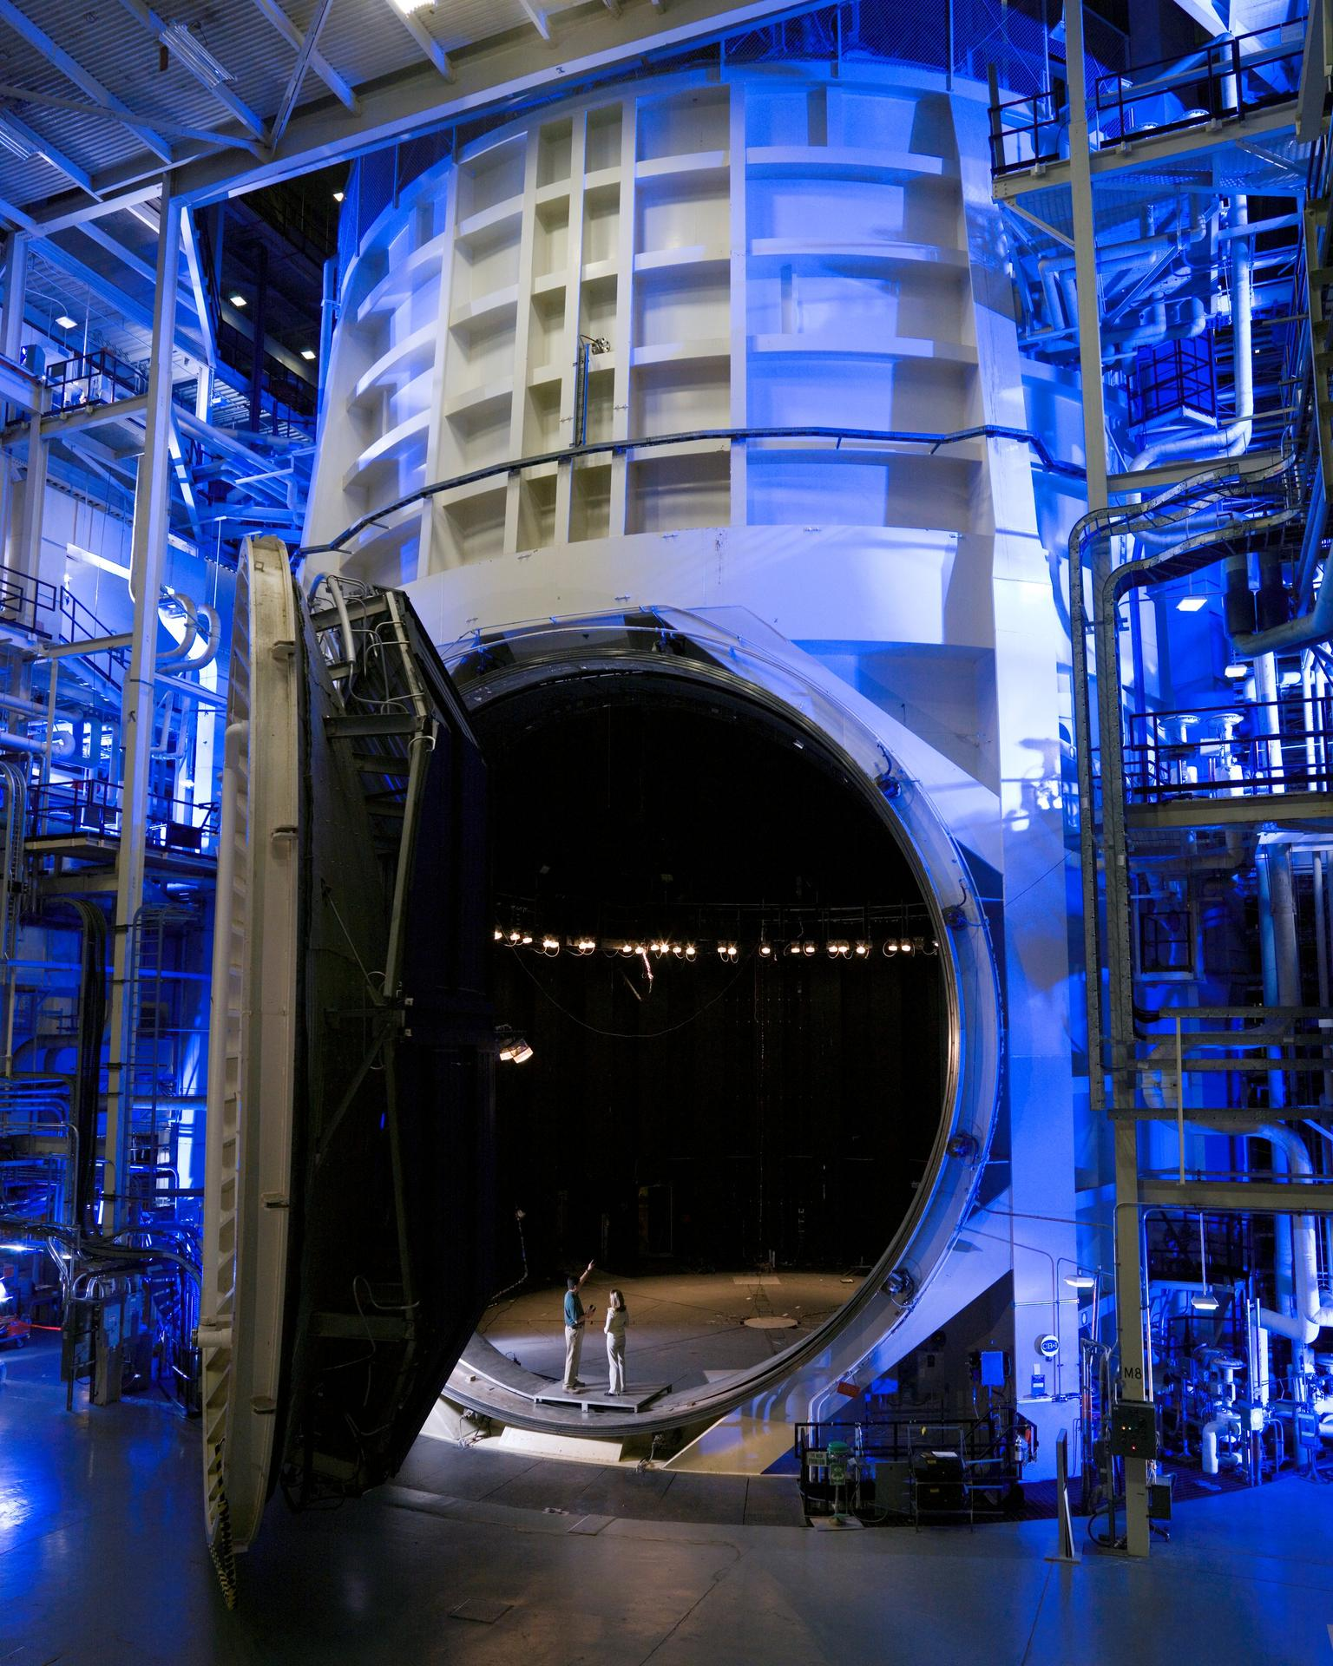
How designers fight cold welding
Material choice: avoid soft, identical metal pairs in separable contacts; pair hard against soft
Coatings and dry lubricants like MoS2 help, but ESA found they are not a guarantee; adhesion returned after about 20 fretting cycles [9]
Limit fretting with preload and stiff hold-downs, and add redundant actuators
Protect the lubricant during ground handling, and qualify deployment in a thermal-vacuum chamber
Image: NASA (thermal-vacuum Chamber A, Johnson Space Center)
9 / 11
Notes:
So how do designers actually fight this? Four levers. First, material choice: avoid soft, identical metal pairs in any contact that has to separate later, and pair a hard material against a soft one. Second, coatings and dry lubricants like molybdenum disulfide help, but ESA testing found they are not a guarantee. Adhesion came back after only about twenty fretting cycles. Third, limit fretting itself with preload and stiff hold-downs, and add redundant actuators so one stuck joint is not fatal. And fourth, protect the lubricant during ground handling, which is exactly where Galileo failed, and qualify the deployment in a thermal-vacuum chamber before flight.

Slide 10
Takeaways
The vacuum environment is active by absence: no oxide re-growth means bare metal bonds
Fretting and impact, not static contact, drive real cold-welding failures
The effect is real but frequently over-cited; the Lucy case shows why diagnosis matters
Engineers are now using it deliberately, as ASTROBEAT is testing on the ISS right now
10 / 11
Notes:
To wrap up, four takeaways. The vacuum environment is dangerous by absence: with no oxide to re-grow, bare metal bonds. Fretting and impact, not static contact, are what actually drive cold-welding failures. The effect is real but frequently over-cited, and the Lucy case shows why you have to diagnose carefully. And finally, engineers are now turning it into a tool, which is exactly what ASTROBEAT is testing on the Space Station right now. Thank you.

Slide 11
References
[1] ISS National Laboratory, "ISS National Lab-Sponsored Research to Test Cold Welding for Spacecraft Repairs," ISS National Laboratory, Nov. 2024, https://issnationallab.org/press-releases/spacex-crs31-mcast-astrobeat-welding/ [retrieved 21 July 2026].
[2] Malta College of Arts, Science and Technology, "ASTROBEAT," MCAST, 2024, https://mcast.edu.mt/astrobeat/ [retrieved 21 July 2026].
[3] Merstallinger, A., "Cold Welding: An Underestimated Problem in Space Engineering," Aerospace and Advanced Composites GmbH, 23 Oct. 2023, https://www.aac-research.at/cold-welding-an-underestimated-problem-in-space-engineering/ [retrieved 21 July 2026].
[4] Merstallinger, A., Sales, M., Semerad, E., and Dunn, B. D., "Assessment of Cold Welding between Separable Contact Surfaces due to Impact and Fretting under Vacuum," STM-279, European Space Agency, ESTEC, Noordwijk, The Netherlands, 2009.
[5] Merstallinger, A., et al., "Cold Welding in Hold-Down Points of Space Mechanisms Due to Fretting When Omitting Grease," Lubricants, Vol. 9, No. 8, 2021, Art. 72. doi:10.3390/lubricants9080072.
[6] "Galileo High Gain Antenna (HGA) Deployment Failure," Lesson No. 0492, NASA Lessons Learned Information System, https://llis.nasa.gov/lesson/492 [retrieved 21 July 2026].
[7] Holzbauer, R., Merstallinger, A., Gaillard, L., and Bamsey, N., "Cold Welding under Space and Launch Conditions," Proceedings of the 47th Aerospace Mechanisms Symposium (ESMATS 2024), Paper 519, 2024, https://www.esmats.eu/amspapers/pastpapers/pdfs/2024/holzbauer.pdf [retrieved 21 July 2026].
[8] "NASA Suspends Efforts to Fully Deploy Lucy Solar Array," SpaceNews, 20 Dec. 2022, https://spacenews.com/nasa-suspends-efforts-to-fully-deploy-lucy-solar-array/ [retrieved 21 July 2026].
[9] "Temperature-Dependent Friction, Wear, and Life of MoS2 Dry-Film Lubricants for Space Mechanisms: A Comprehensive Review," Lubricants, 2025, https://pmc.ncbi.nlm.nih.gov/articles/PMC12316733/ [retrieved 21 July 2026].
11 / 11

