Slide 1


Slide 2
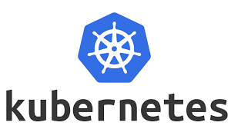
Management of Containerized Application

Slide 3

Management of Containerized Application
Distributed even streaming platform

Slide 4

Management of Containerized Application
S3-Compliance Object Storage
Distributed even streaming platform

Slide 5
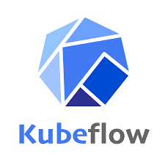
Management of Containerized Application
S3-Compliance Object Storage
Distributed even streaming platform
The Machine Learning Toolkit for Kubernetes
Kubeflow Pipeline, Jupyter,
KATib (AutoML)

Slide 6

Management of Containerized Application
S3-Compliance Object Storage
Distributed even streaming platform
The Machine Learning Toolkit for Kubernetes
Open Source Feature Store for Production ML
Kubeflow Pipeline, Jupyter,
KATib (AutoML)

Slide 7
Management of Containerized Application
S3-Compliance Object Storage
Distributed even streaming platform
The Machine Learning Toolkit for Kubernetes
Open Source Feature Store for Production ML
Kubeflow Pipeline, Jupyter,
KATib (AutoML)

Slide 8
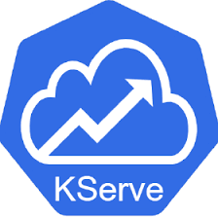
Management of Containerized Application
S3-Compliance Object Storage
Distributed even streaming platform
The Machine Learning Toolkit for Kubernetes
Open Source Feature Store for Production ML
Kubeflow Pipeline, Jupyter,
KATib (AutoML)
serving machine learning (ML) models

Slide 9
Management of Containerized Application
S3-Compliance Object Storage
Distributed even streaming platform
The Machine Learning Toolkit for Kubernetes
Open Source Feature Store for Production ML
Kubeflow Pipeline, Jupyter,
KATib (AutoML)
MLOps
serving machine learning (ML) models

