Slide 2
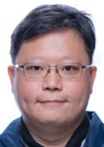
Author: Chow Ming Kit (Atauro)
Images creator: MidJourney (AI generated images)
Transcripts creator: OpenAI ChatGPT
Speech creator: Amazon Polly (AI text to Speech)

