Slide 2
Table of contents
Topic
Introduction section
Data section
Methodology section
Result section
Discussion section
Conclusion section

Slide 3
INTRODUCTION
Problem background:
Abuja is the capital city of Nigeria located in the centre of the country within the Federal Capital Territory (FCT). It is a planned city and was built mainly in the 1980s, replacing the country's most populous city of Lagos as the capital on 12 December 1991. Abuja's geography is defined by Aso Rock, a 400-metre (1,300 ft) monolith left by water erosion. The Presidential Complex, National Assembly, Supreme Court and much of the city extend to the south of the rock. Zuma Rock, a 792-metre (2,598 ft) monolith, lies just north of the city on the expressway to Kaduna.

Slide 4
Data
Data requirements:
To find a solution to the questions and build a recommender model, we need data and lots of data. Data can answer question which are unimaginable and non-answerable by humans because humans do not have the tendency to analyze such large dataset and produce analytics to find a solutions.
Collecting geographical coordinates is not difficult but after googling for more than 2 days, it was not available on open source data websites such as Wikipedia, Nigeria gov website, census report websites etc. So I decided to use Google maps API to fetch latitude and longitude but google API has limited number of calls that I could make with my free account. So it would take around 15 - 20 days to fetch location of all the neighborhoods in Abuja.

Slide 5
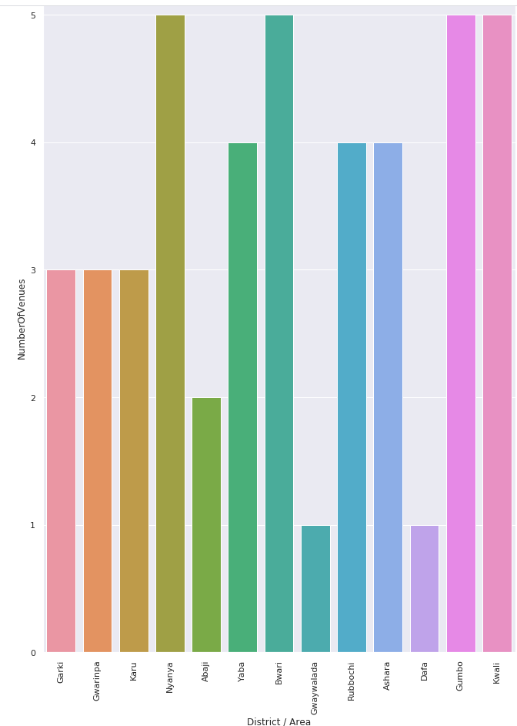
Methodology
Exploratory analysis:
Scrapping the data from different sources and then combining it to form a single-ton dataset is a difficult task. To do so, we need to explore the current state of dataset and then list up all the features needed to be fetched.
Exploring the dataset is important because it gives you initial insights and may help you to get partial idea of the answers that you are looking to find out from the data.
While exploring the dataset, I found out that that Nyanya, Bwari, Gumbo and Kwali had the most number of venues while Gwagwalada and Dafa had the least.

Slide 6
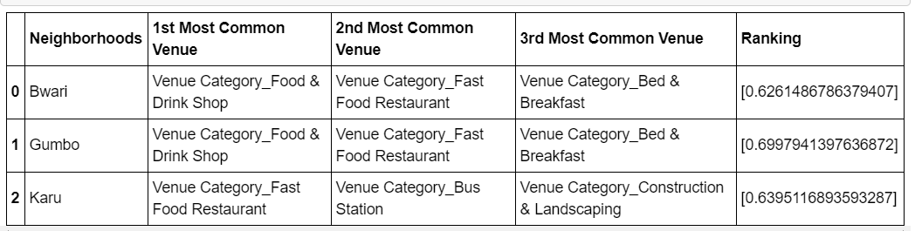
Result
The result of the recommender system is that it produces a list of top restaurants and the most common venue item that the user can enjoy. During the runtime of the model, a simulation was done by taking ‘Nyanya’ as the neighborhood and then processed through our model so that it could recommend neighborhoods with similar characters as that of ‘Nyanya’.
The following image shows the result:

Slide 7
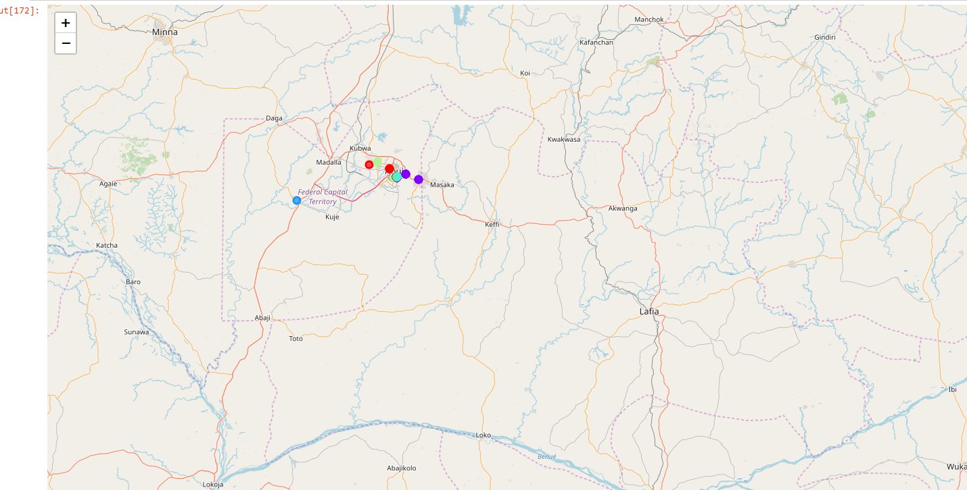
Since there was a nonlinear relationship between income and population, it can be concluded that we must always perform inferential approach to find relationship among different set of features. Also during clustering, similar neighborhoods must be dumped into the right cluster.
The following graph shows the clusters:

Slide 8
conclusion
The recommender system is a system that considers factors such as population, income and makes use of Foursquare API to determine nearby venues. It is a powerful data driven model whose efficiency may decrease with more data but accuracy will increase. It will help users to finish their hunger by providing the best recommendation to fulfil all their needs.

