Slide 1
Dev-Ops

Slide 2
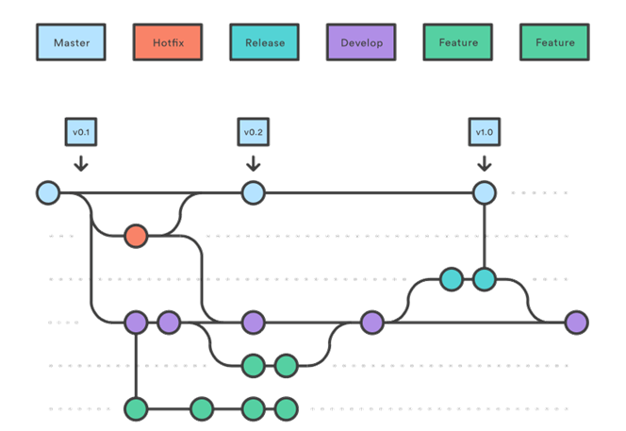
Git Flow

Slide 3
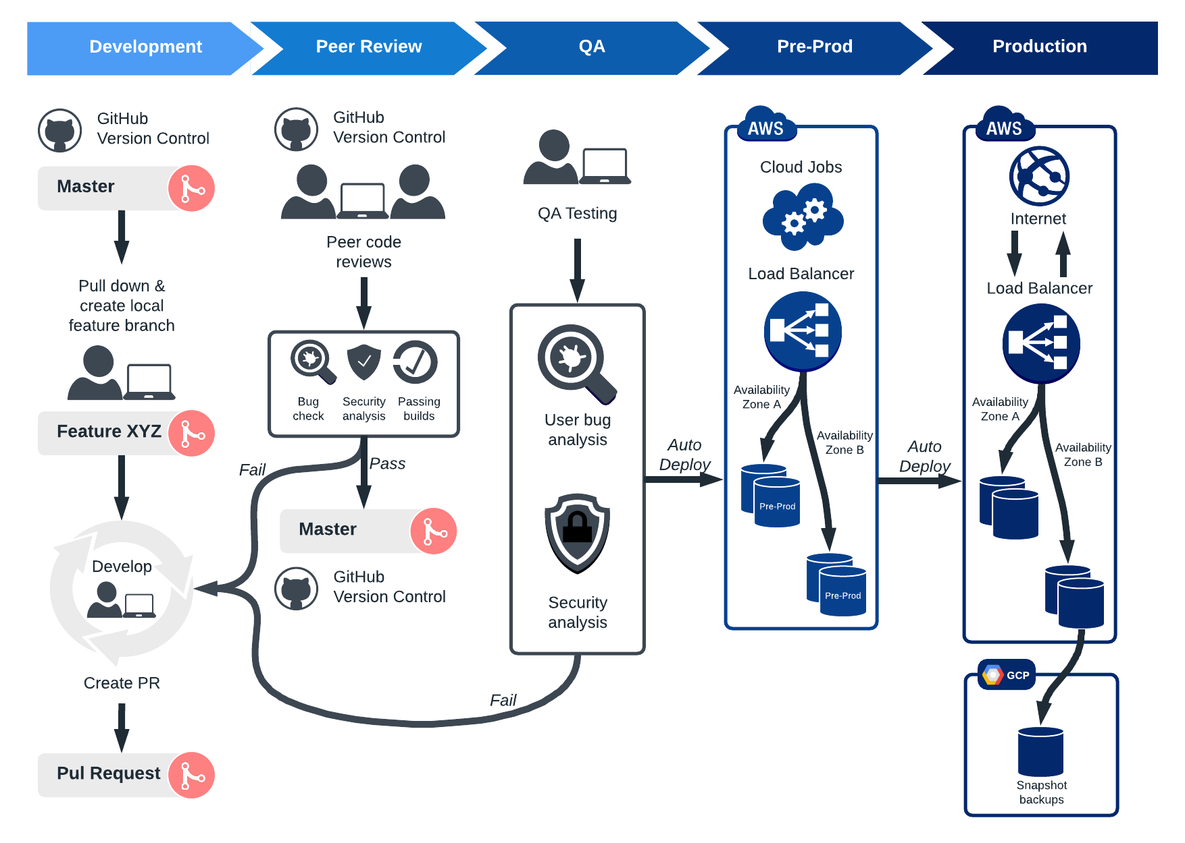
CI/CD

Slide 4
Build Pipelines
Dockers
Pipelines
Bitbucket Pipeline
Git pipeline
Azure pipeline
Unit Testing
E2E Testing

Slide 5
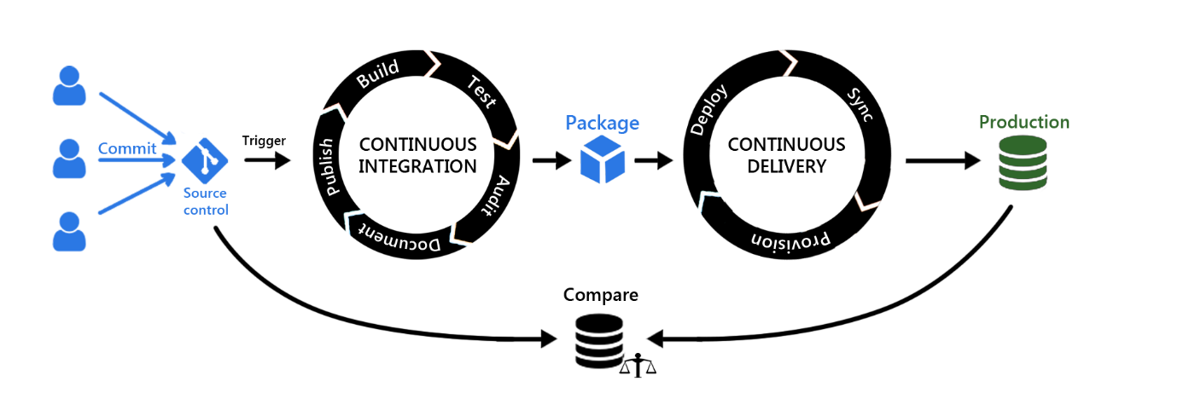
CI/CD

